Slide 1
Ace Course 101:
Metacognition is the Key!

Slide 2
What is Metacognition?
How can it help me?

Slide 3
Some questions we will address today:
How is studying for a college course different from a high school course? Is it easier/harder/equivalent? What makes it so?
What are your current learning strategies (how do you learn/study)?
Would like to improve your current grade in this course? What would you do differently in order to achieve this goal?
Would you be interested in becoming a more efficient learner by studying smarter, not necessarily harder?

Slide 4
The Story of Students
Who Dramatically Improved
Student 1 Final Grade:
Student 2
Student 3
Student 4

Slide 5
Step 1: Analysis
What’s the difference, if any, between studying and learning?
What are your current:
study habits?
learning strategies?

Slide 6
Which mode have you been in?
Study mode
2. Learn mode
Why is it important that we consider this?

Slide 7
Why?
For which task would you work harder?
Make an A on the test
2. Teach the material

Slide 8
Strategy 1:
To Ace this course (and everything else!):
Stay in learn mode, not study mode
Study as if you have to teach the material, not just make an A on the test

Slide 9
Why is this important?
Because this Course is harder than a HS Course
What makes it different?
The course moves a lot faster
The material is conceptually more challenging and cumulative
The problems and questions are more involved
The tests are less straightforward and require you to apply several concepts at one time

Slide 10

Are you able to decipher the word above?

Slide 11

How about now?

Slide 12

How about now?

Slide 13


Slide 14
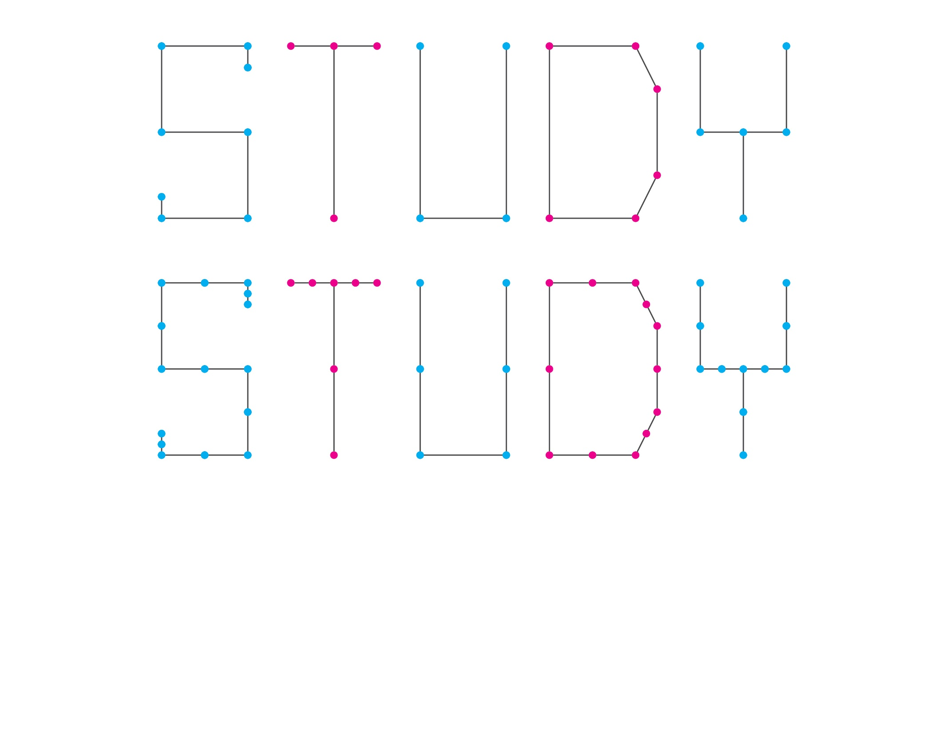
What are the rules used?

Slide 15

Apply the rules established in the previous slide to decipher the word above

Slide 16
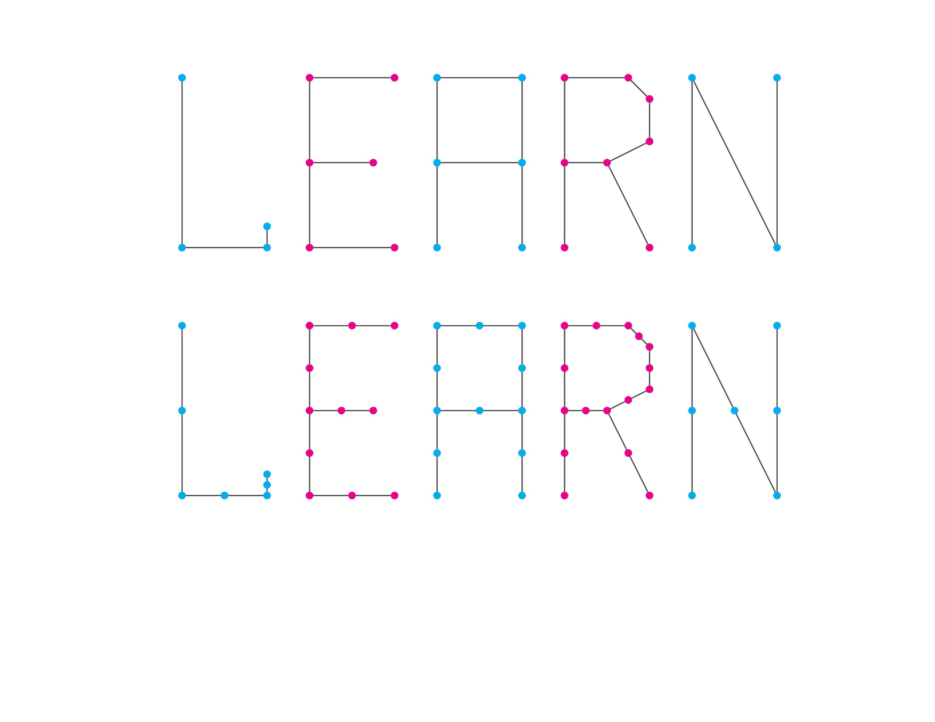

Slide 17
Based on what was learned, could you create your own puzzle for any word?

Slide 18
This pyramid depicts the different levels of thinking we use when learning. Notice how each level builds on the foundation that precedes it. It is required that we learn the lower levels before we can effectively use the skills above.
Bloom’s Taxonomy
Creating
Putting elements together to form a coherent or functional whole; reorganizing elements into a new pattern or structure through generating,
planning, or producing.
Making judgments based on criteria and standards through checking and critiquing.
Evaluating
Breaking material into constituent parts, determining how the parts relate to one another and to an overall structure .
Analyzing
Carrying out or using a procedure through executing, or implementing.
Applying
Constructing meaning from oral, written, and graphic messages through interpreting, exemplifying, classifying, summarizing, inferring, comparing, and explaining.
Understanding
Retrieving, recognizing, and recalling relevant knowledge from
long-term memory.
Remembering
http://www.odu.edu/educ/llschult/blooms_taxonomy.htm

Slide 19
Using Metacognition to Become an Expert Learner

Slide 20
Metacognition
The ability to:
think about thinking
be consciously aware of oneself as a problem solver
monitor and control one’s mental processing (e.g. “Am I understanding this material?”)
accurately judge one’s level of learning

Slide 21
This pyramid depicts the different levels of thinking we use when learning. Notice how each level builds on the foundation that precedes it. It is required that we learn the lower levels before we can effectively use the skills above.
Bloom’s Taxonomy
Creating
Putting elements together to form a coherent or functional whole; reorganizing elements into a new pattern or structure through generating,
planning, or producing.
Making judgments based on criteria and standards through checking and critiquing.
Evaluating
Breaking material into constituent parts, determining how the parts relate to one another and to an overall structure .
Analyzing
Carrying out or using a procedure through executing, or implementing.
Applying
Constructing meaning from oral, written, and graphic messages through interpreting, exemplifying, classifying, summarizing, inferring, comparing, and explaining.
Understanding
Retrieving, recognizing, and recalling relevant knowledge from
long-term memory.
Remembering
http://www.odu.edu/educ/llschult/blooms_taxonomy.htm

Slide 22
At what level of Bloom’s did you have to operate to make A’s, B’s, or C’s in high school?
Remembering
Understanding
Applying
Analyzing
Evaluating
Creating

Slide 23
At what level of Bloom’s do you have to operate to make A’s in college?
Remembering
Understanding
Applying
Analyzing
Evaluating
Creating

Slide 24
How do you move yourself higher on Bloom’s Taxonomy?
Use the Study Cycle!

Slide 25

The Study Cycle
4
Reflect
3
Review
Preview
Preview before class – Skim the chapter, note headings and boldface words, review summaries and chapter objectives, and come up with questions you’d like the lecture to answer for you.
4
Reflect
Attend
Attend class – GO TO CLASS! Answer and ask questions and take meaningful notes.
Review after class – As soon after class as possible, read notes, fill in gaps and note any questions.
Review
Study – Repetition is the key. Ask questions such as ‘why’, ‘how’, and ‘what if’.
Intense Study Sessions* - 3-5 short study sessions per day
Weekend Review – Read notes and material from the week to make connections
Study
Assess your Learning – Periodically perform reality checks
Am I using study methods that are effective?
Do I understand the material enough to teach it to others?
Assess
*Intense Study Sessions
1 | Set a Goal | (1-2 min) | Decide what you want to accomplish in your study session
2 | Study with Focus | (30-50 min) | Interact with material- organize, concept map, summarize, process, re-read, fill-in notes, reflect, etc.
3 | Reward Yourself | (10-15 min) | Take a break– call a friend, play a short game, get a snack
4 | Review | (5 min) | Go over what you just studied
Center for Academic Success
B-31 Coates Hall ▪ 225.578.2872 ▪www.cas.lsu.edu

Slide 26
Effective Metacognitive Strategies
Always solve problems and answer questions without looking at an example or the solution
Memorize everything you’re told to memorize (e.g. new terminology/ vocabulary)
Always ask why, how, and what if questions
Test understanding by giving “mini lectures” on concepts
Spend time on subject every day
Use the Study Cycle with Intense Study Sessions
Attend SI sessions on a regular basis
Aim for 100% mastery, not 90%!

Slide 27
Concept maps facilitate development of higher order thinking skills

Slide 28
Chapter Concept Map
Title of Chapter
Primary Headings
Subheadings
Secondary Subheadings

Slide 29
Compare and Contrast
Concept #1
Concept #2
How are they similar?
How are they different?

Slide 30
Which of the next Two Slides more accurately describes YOUR actions before Test 1?

Slide 31
1. Didn’t spend enough time on the material
2. Started the homework too late
3. Didn’t memorize the information I needed to
4. Did not use the book
5. Assumed I understood information that I had read and re-read, but had not applied

Slide 32
1. Did preview-review for every class
2. Did a little of the homework at a time
3. Used the book and did the suggested problems
4. Made flashcards of the information to be memorized
5. Practiced explaining the information to others

Slide 33
Which group do you think did better?

Slide 34
Get the Most Out of Homework
Start the problems early--the day they are assigned
Do not flip back to see example problems; work them yourself!
Don’t give up too soon (<15 min.)
Don’t spend too much time (>30 min.)

Slide 35
Get the Most from Tutorial Centers, Office Hours, and Study Groups
Try to understand the concept or work the problem by yourself first
Come prepared to ask questions
Explain the material to the tutor or instructor

Slide 36
Peer Advisement:
https://openlab.citytech.cuny.edu/perkinspeeradvisement/
the Atrium Learning Center
https://www.citytech.cuny.edu/alc/

Slide 37

Study Group Starter Kit
CAS Study Group Starter Kit
www.cas.lsu.edu/study-groups

Slide 38
Challenge to Students in Course 101
Metacognition Discussion – Date
Average on Exam 2:
How do I know you CAN do this?
…Because other classes have done it!

Slide 39
In-Class Writing Exercise
What strategy will you use for the next three weeks?

Slide 40
If you don’t try it within the next 48 hours...
… you probably never will.

Slide 41
Final Note
Please visit the websites:
www.citytech.cuny.edu/alc/
and
www.cas.lsu.edu.
There are on-line workshops and information that will teach you even more effective study strategies.

