Slide 1
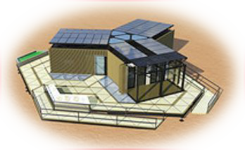
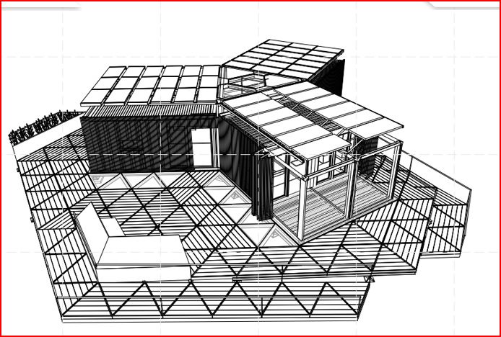
Y-CONTAINER HOUSE
BY CHRISTOPHER JALECO
THE Y- CONTAINER CONTAINS VACUUM INSULATED MATERIALS THAT BLOCK HEAT TRANSFER AND MODERATE TEMPERATURE. WE WILL BE DISCUSSING ABOUT THE FEATURES THAT MADE THIS HOUSE MAINTAIN ITS COMFORT LEVEL FOR TENANTS.

Slide 2

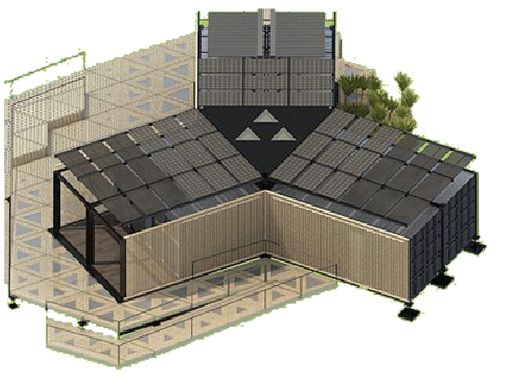
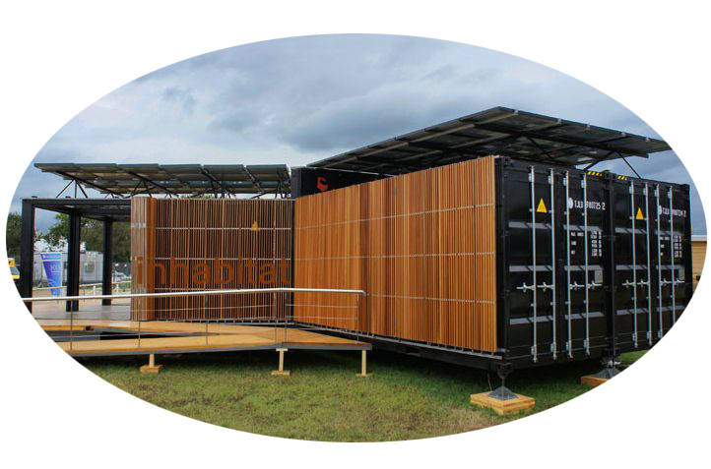
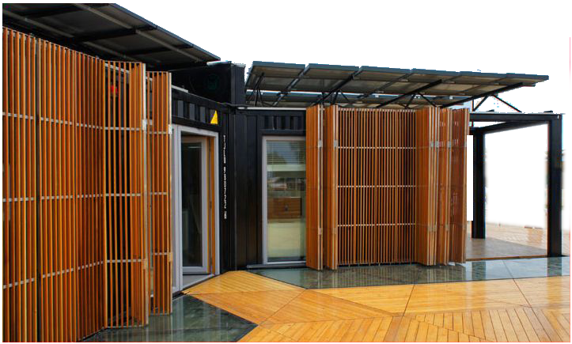
THE EXTERIOR
THE Y CONTAINER IS A TYPE OF HOUSE THAT ALLOWS PEOPLE TO JUST LIVE ANYWHERE SINCE IT HAS ALL THE COMFORT FEATURES OF LIGHTWEIGHT DESIGN, MOBILITY, AND ENERGY EFFICIENCY.
ONE OF ITS FEATURES INCLUDE THE WOODEN SCREENS WHICH IS ADJUSTABLE AT ANYTIME ESPECIALLY AT THE DAYTIME WHICH ALLOWS LIGHT TO PENETRATE INSIDE THE HOUSE. IT CAN BE OPENED TO REVEAL THE INTERIOR FROM THE INSIDE.

Slide 3
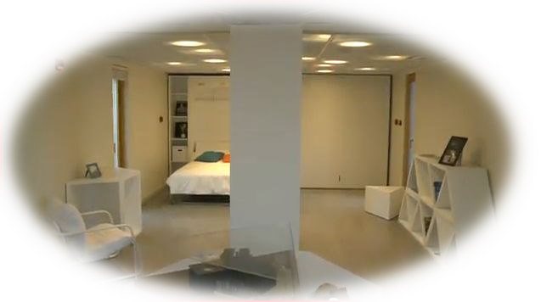
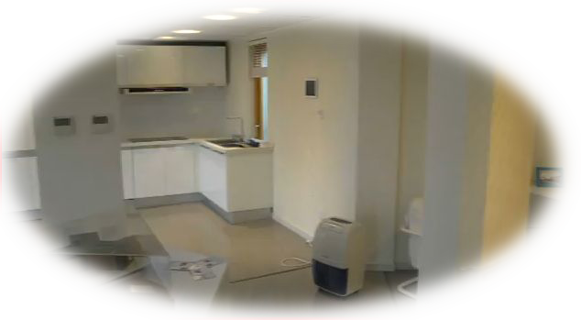


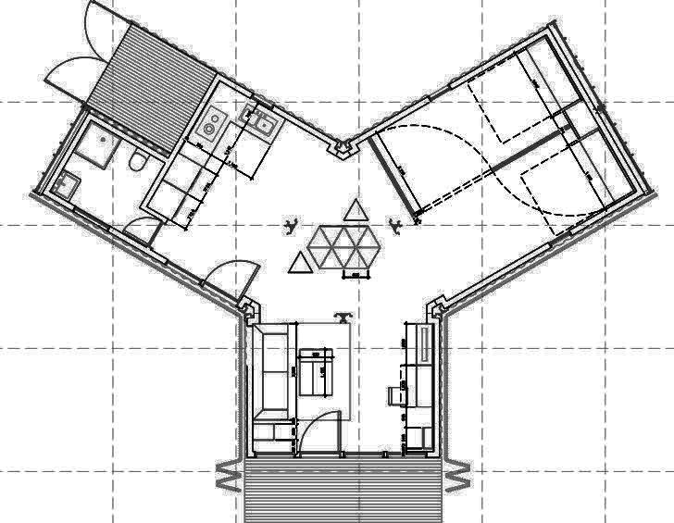
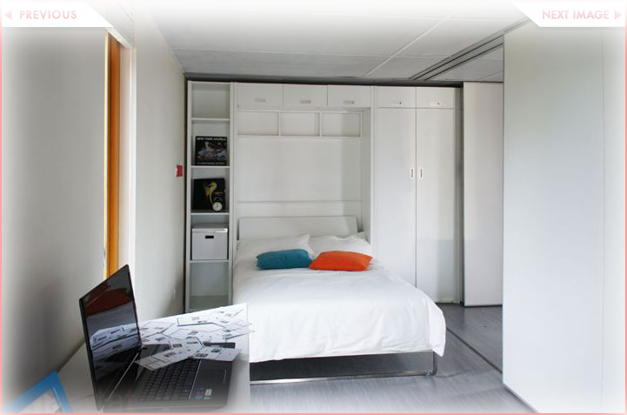

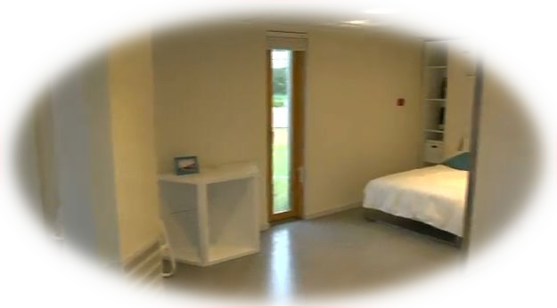
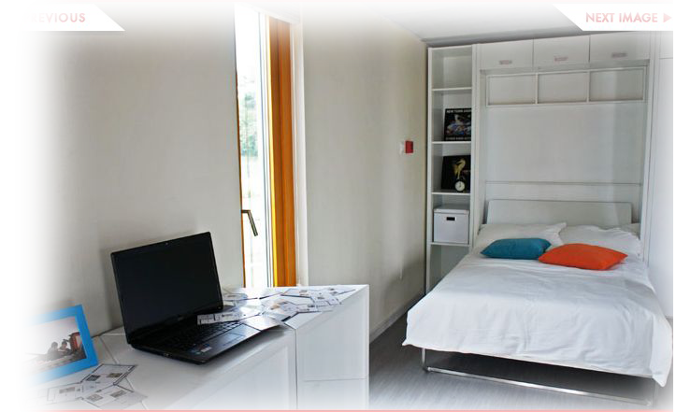
THE INTERIOR

Slide 4
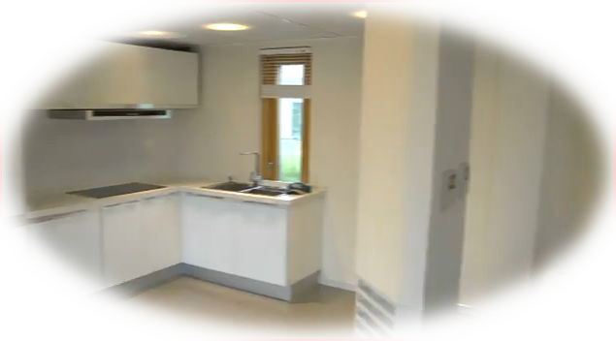
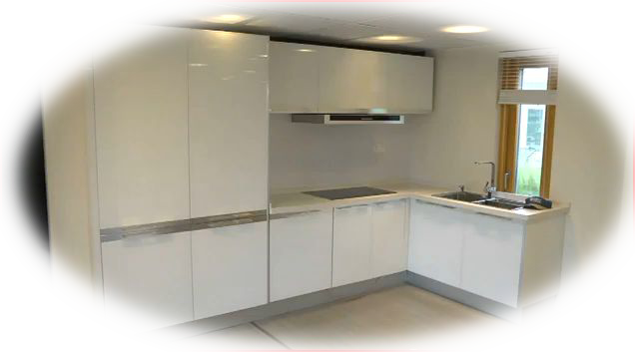
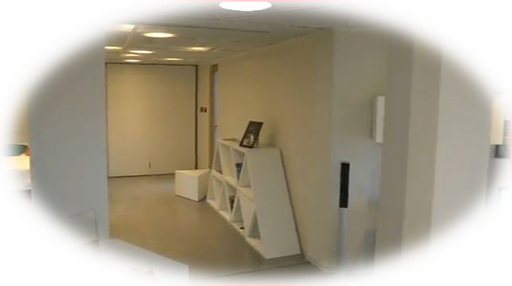
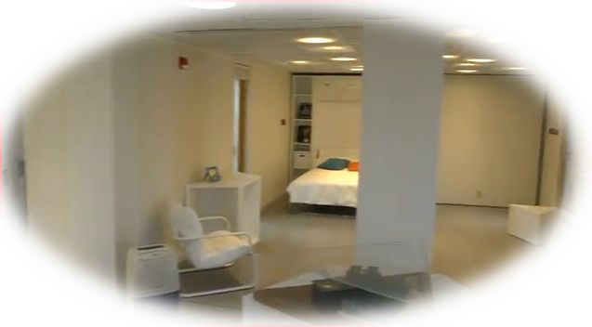
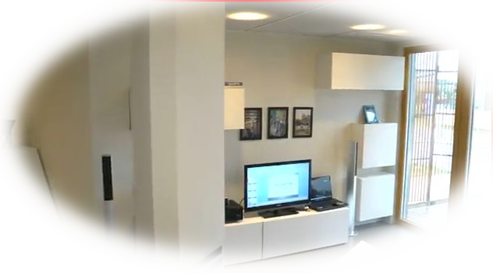
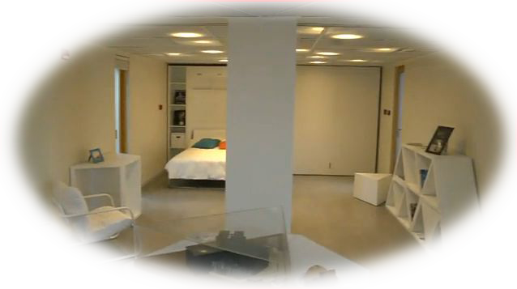
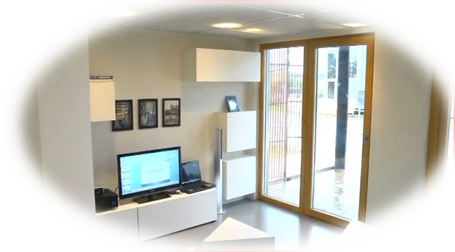

Slide 5
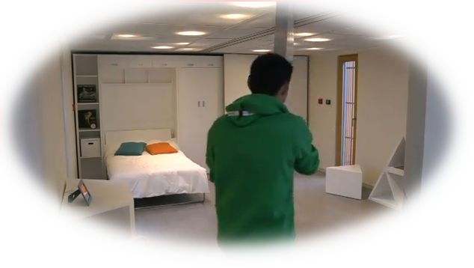
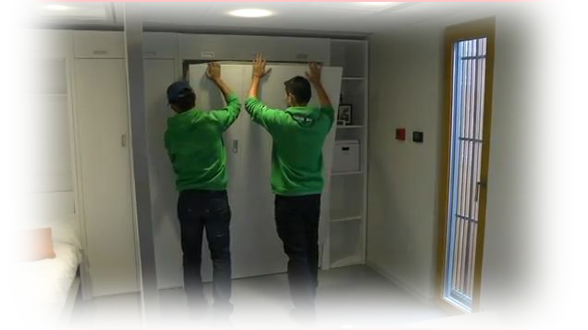
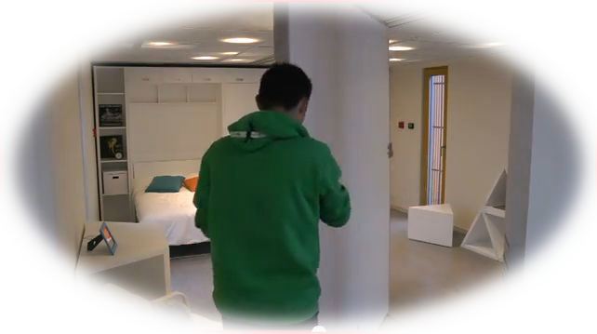
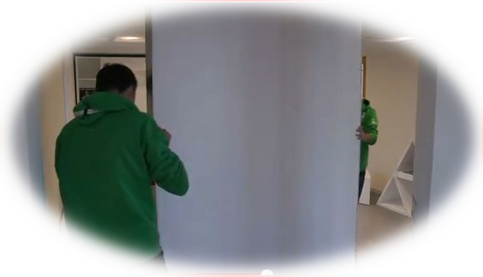
UNIQUE FEATURES
THE Y CONTAINER HAS MOVABLE WALLS THAT ADD A GREAT LEVEL OF FUNCTIONALITY TO THE DESIGN. RESIDENTS CAN SLIDE THE WALLS SO THAT EACH INDIVIUAL CAN HAVE HIS/HER SPACE OF THEIR OWN.
CONVERTIBLE DRAWERS ADD AN ADDITIONAL SPACE FOR FURNITURES .

Slide 6
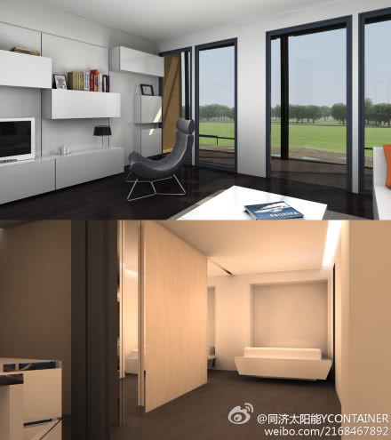
POWERHOUSE
THE FLAT ROOFS IS LINED WITH PHOTOVOLAIC PANELS. IT TRANSFERS THE HEAT COLLECTED FROM THE SUN, THE HEAT FROM THE Y CONTAINER FLOOR, AND THE WATER COLLECTED FROM THE GROUND. ENERGY FROM THE ROOF PANELS IS GAINED FROM THE SUN THUS ANY ENERGY GENERATED FROM THE SUN, THE HOUSE CAN HARNESS ITS POWER TO POWER UP AIR CONDITIONERS TO REGULATE TEMPERATURE AS WELL AS POWERING UP ADJUSTABLE LOUVERS THAT CONTROL THE AMOUNT OF SUNLIGHT ENTERING THE HOUSE. THE HOUSE BENEFIT FROM THE HEAT GAINED FROM THE SUN AND LIGHT ENERGY TO ELECTRICAL INORDER TO MAINTAIN HOMEOSTASIS.

Slide 7
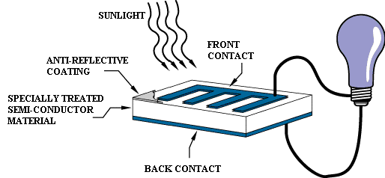
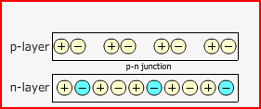

HOW
PHOTOVOLAIC PANELS WORK
THE Y CONTAINER HOUSE HARNESS ITS ENERGY FROM THE SUN LIGHT ENERGY TURNS INTO ELECTRICITY . THIS TYPE OF MATERIAL CAN ABSORB PHOTONS FROM THE SUN AND RELEASE ELECTRON. WHEN THESE ELECTRONS ARE ABSORBED THEY PRODUCE AN ELECTRIC CURRENT THAT TRAVELS TO THE OUTLETS OF THE Y CONTAINER HOUSE. PHOTOVOLAIC CELLS ARE KNOWN AS SOLAR CELLS THAT ARE MADE OF SEMICONDUCTOR MATERIALS SUCH AS SILICON. SOLAR CELLS ARE A FORM OF ELECTRIC FIELD THAT FORMS POSITIVE ON ONE SIDE AND NEGATIVE ON THE OTHER. WHEN ELECTRONS ARE ABSORBED IT FORMS ELECTRICITY.

Slide 8
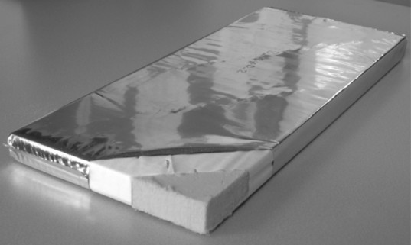
WAYS IT MAINTAINS COMFORT
THE Y CONTAINER HOUSE REGULATES ITS TEMPERATURE IN DIFFERENT WAYS. ONE WAY WOULD BE USING HIGH VALUE INSULATION OF VACUUM PANELS AND USING SPLIT SYSTEM AIR CONDITIONING. BOTH FACTORS HAVE CONTRIBUTED TO THE Y CONTAINERS HOUSE COMFORT ZONE AS WELL AS MAINTAINING THE HIGHEST RATING IN GREEN DESIGN IN THE US DEPARTMENT OF SOLAR DECATHOLON IN 2011. ONE CONTRUBUTION THAT THE Y CONTAINER HOUSE MADE WAS USING AN INSULATION WITH VACUUM INSULATED PANELS THAT WAS R-35 . TWO PANELS ADD UP TO R-70 WAS CAPABLE OF STORING HEAT AND CAN ADAPT TO VARIOUS WEATHER CLIMATES WHILE MAINTAIN COMFORT.

Slide 9
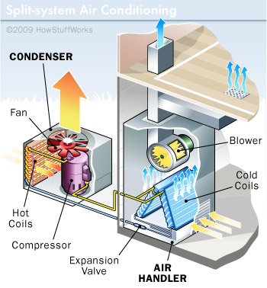
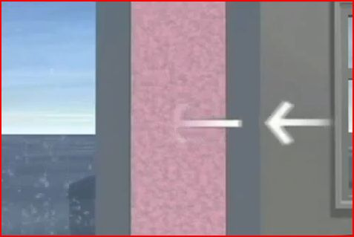
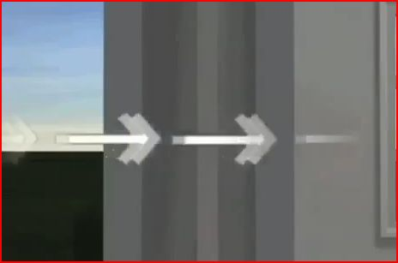
SPLIT SYSTEM AIR CONDITIONING
THE SPLIT SYSTEM AIR CONDITIONER TOOK ITS MAJOR TOLL ON COMFORT SINCE IT ISOLATED BOTH THE WARM MOIST AIR AND THE COLD DRY AIR. IT IS SPLIT WITH THE INDOOR COMPONENT WHICH IS THE EVAPORATOR AND THE EXTERNAL COMPONENT THE COMPRESSOR. THE EVAPORATOR EXTRACTS THE WARM AIR WHILE THE COOLING SYSTEM IN THE COMPRESSOR REMOVE THE HEAT FROM THE GAS AND MOVE IT INDOORS.
THE INSULATION THAT HAS A VALUE OF R-70 REGULATED TEMPERATURE ALL YEAR. WITH A VALUE OF R-70 THE AMOUNT OF HEAT NEEDED IN THE WINTER LAST LONG AND IN THE SUMMER THE COOL AIR STAYS INSIDE WITHOUT ANY OUTSIDE AIR COMING THROUGH.

