Slide 1





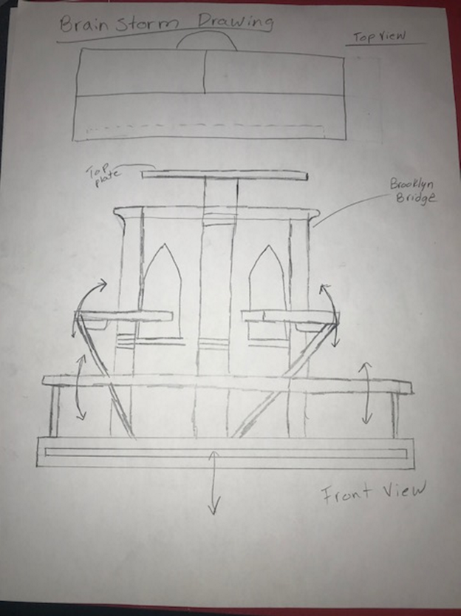
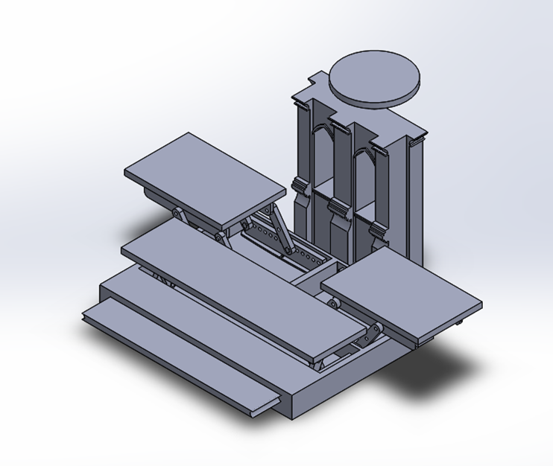
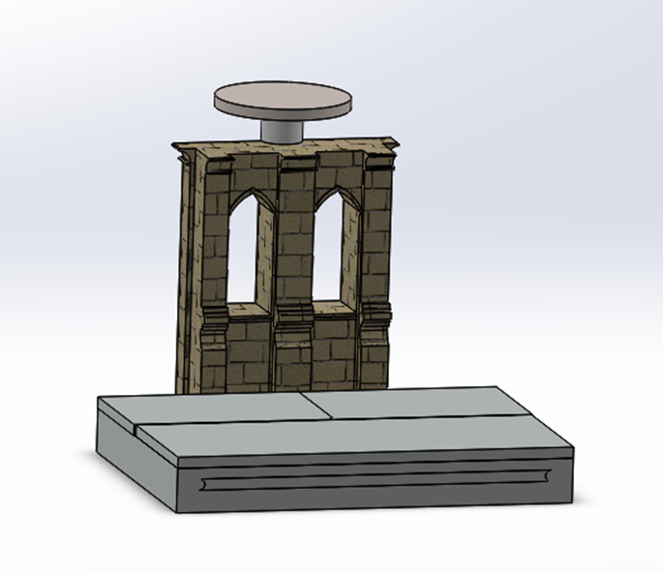
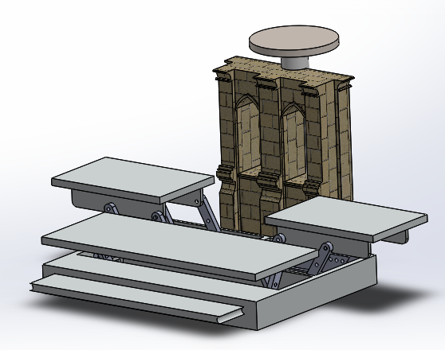
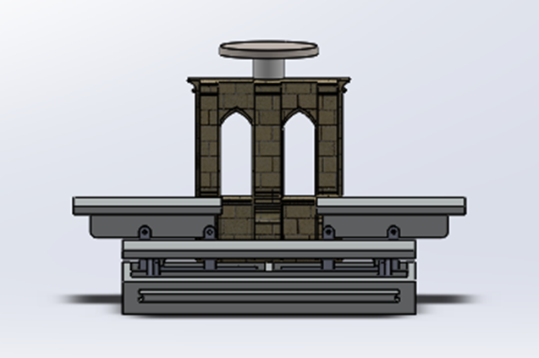
Culinary Design Project
Student: Iran, Baltazar, Advisor: Prof. Masato R. Nakamura,
Department of Mechanical Engineering Technology and Industrial Design Technology
New York City College of Technology (City Tech), City University of New York (CUNY), Brooklyn, NY
Background
The task was to design an alluring table stand that would
add on to the engaging garnishes at the Culinary Competition.
Logistics
    Must be packable, easy to travel.
    Light weight, Easy to set up, appealing
    MUST REPRESENT NYC !!!
Idea
The scenery of the picture on the right was what sparked the idea of having the Brooklyn Bridge as part of the culinary table. It was a way of representing, not just New York in general but Brooklyn as well.
3D Models
Overall Dimension:
    Length : 36 in; Height : 30 in; Width: 32 in
Material would consist mostly of Stainless steal.
Having a total of four stands, with the top platform specifically for the main dish.
Model shows how simple and effortless it would be to set up.

