Slide 1




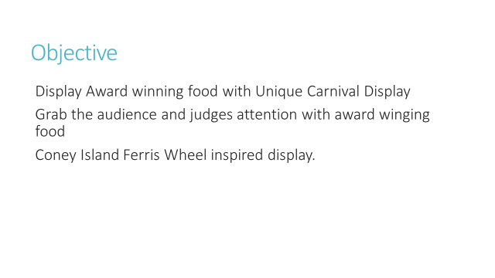
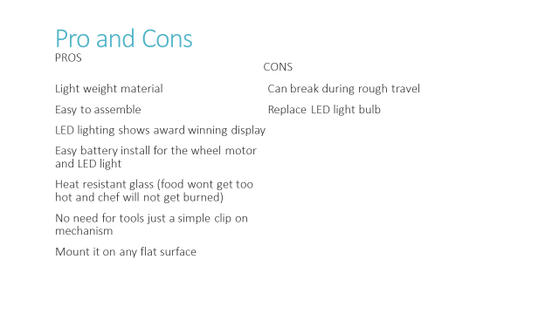
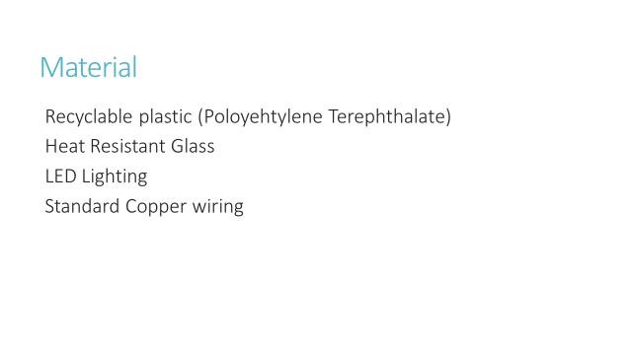
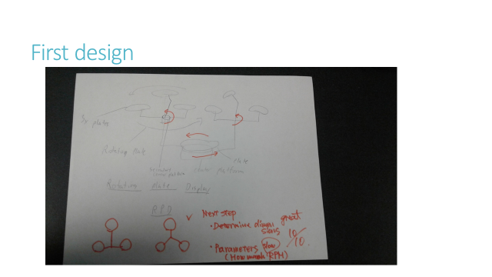
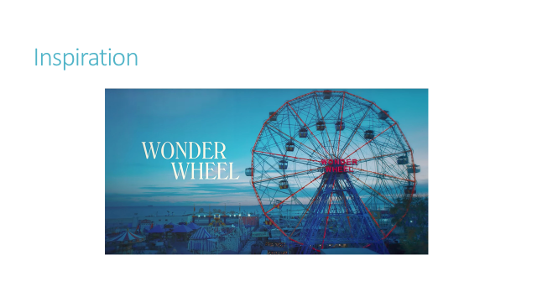
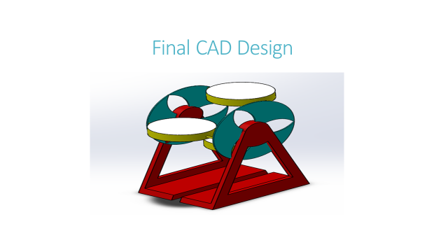
Carnival Food Display
Student: Joshua Veliz, Advisor: Prof. Masato R. Nakamura,
Department of Mechanical Engineering Technology and Industrial Design Technology
New York City College of Technology (City Tech), City University of New York (CUNY), Brooklyn, NY

