Slide 1



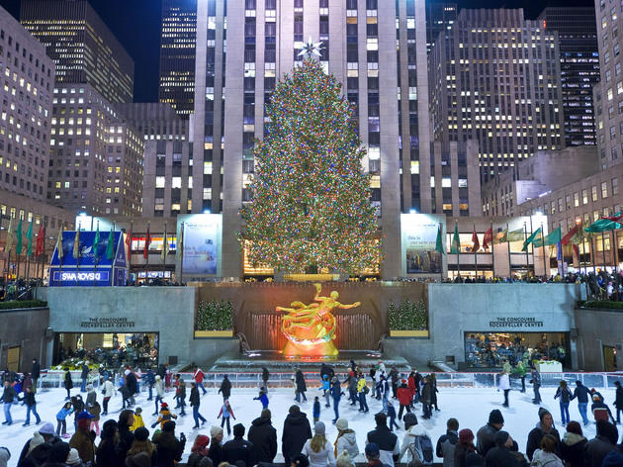

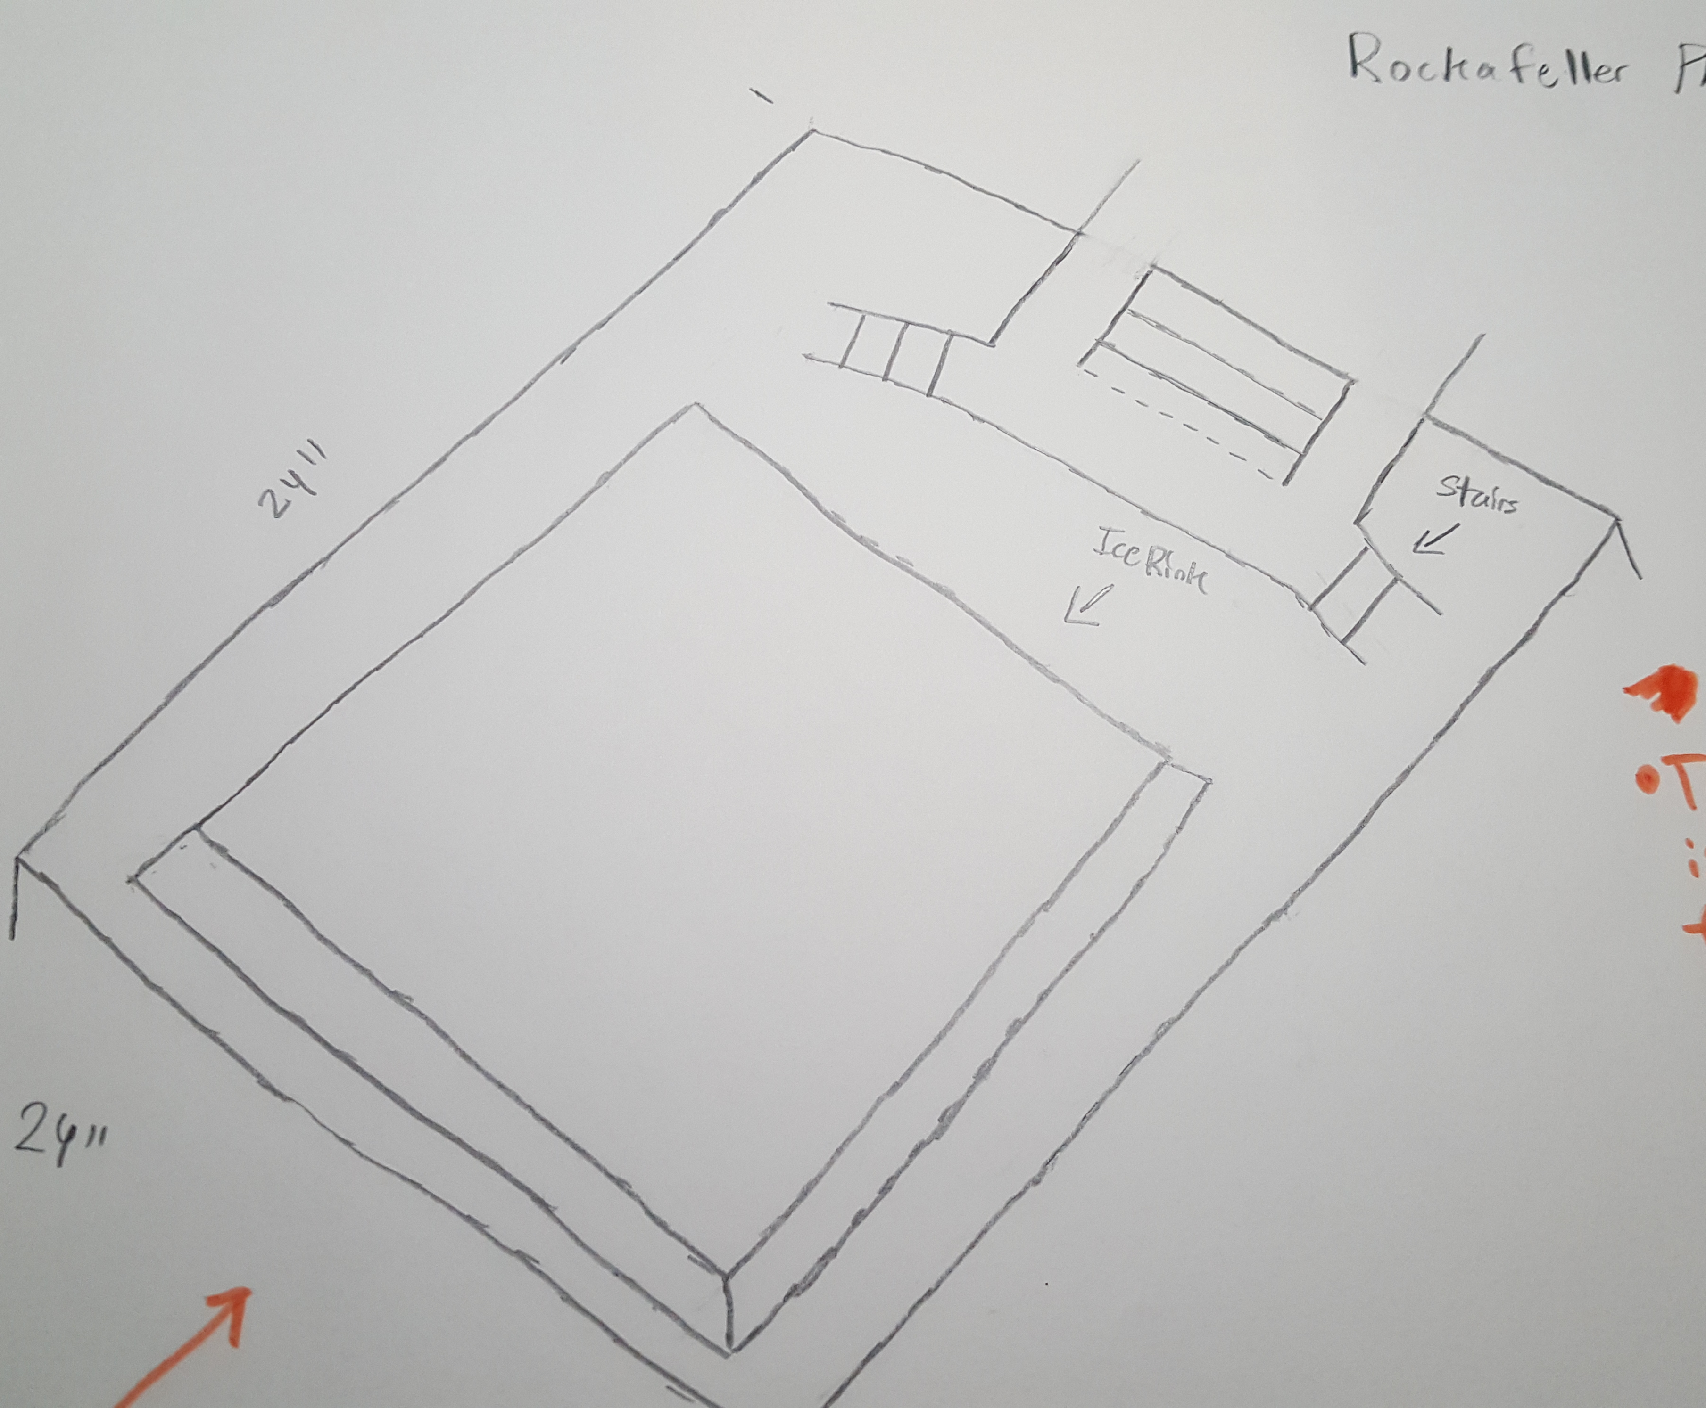
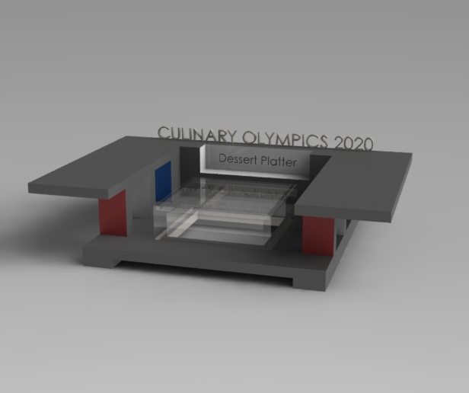
Rockefeller Platter
Student: Paul, Castrilllon, Advisor: Prof. Masato R. Nakamura,
Department of Mechanical Engineering Technology and Industrial Design Technology
New York City College of Technology (City Tech), City University of New York (CUNY), Brooklyn, NY
Introduction
Background
A platter fit for the chef competitions/tournaments.
Platter that supports the dish.
Platter that is durable .
NYC theme.
Related to the Rockefeller center with the skating rink.
Simple design no mechanisms.
Multi Color LED Lights beneath the rink.
2D Sketch
3D Sketch
Simple yet incomplete design.
Dimensions 24 X 24 X 8 (in)
Stairs incorporated in sketch but not in CAD model.
Materials:
Plastic (ABS)
Acrylic (rink)
Lights under rink
Protective Layer
Top Stand for samples
Summary
The platter must be a support item for the main entrees to improve physical appearance. The platter has to be NYC theme people want to know there the entrees originated from. The platter must be durable for travel and hold the weight of the entrees without breaking the platter. Light would help improve the entrees image or can help distinguish the taste of the entrée.

