Slide 1
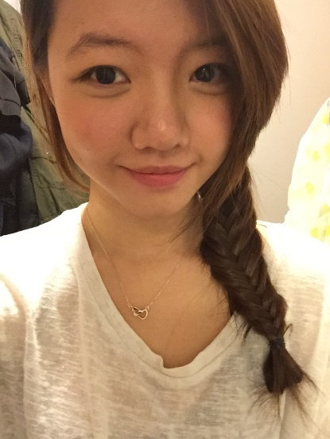
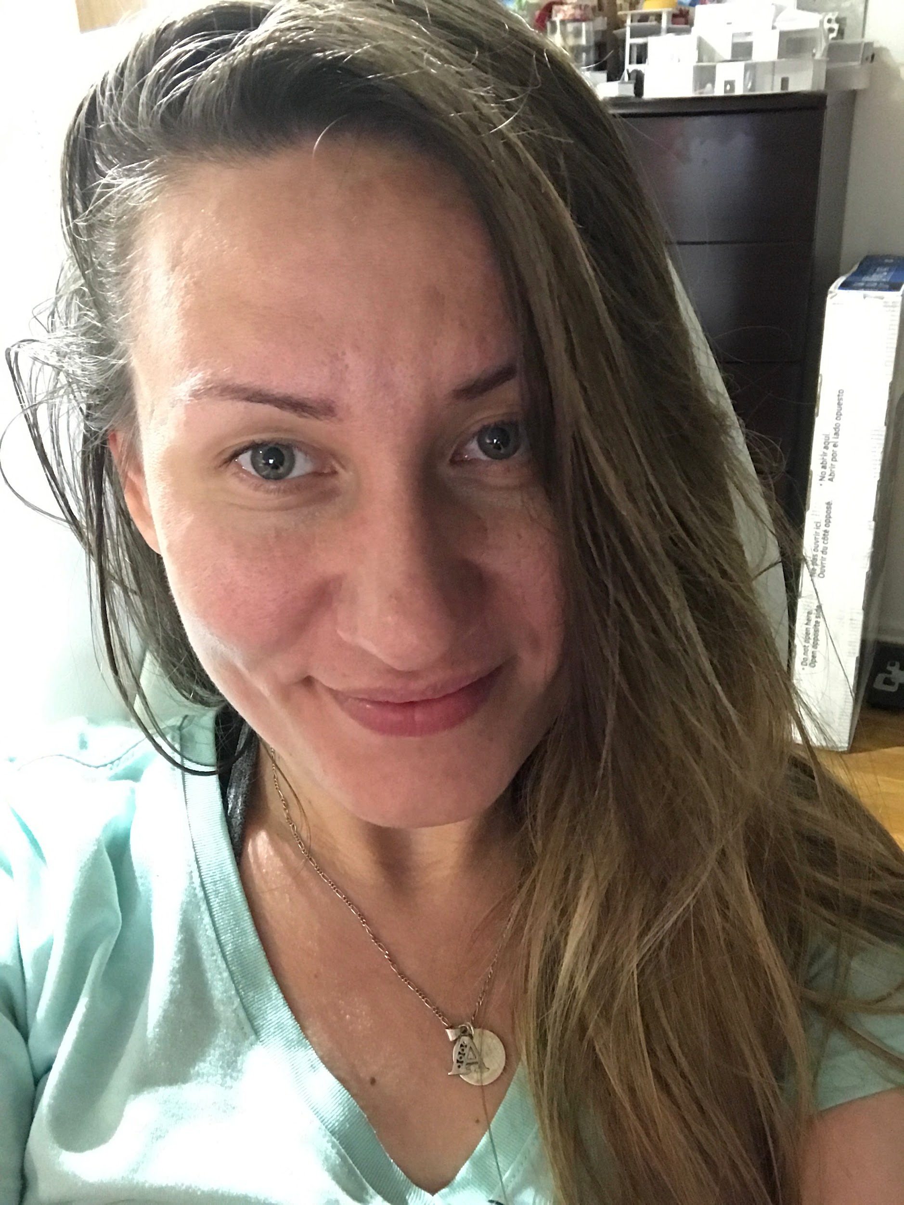
Ying
Albina
My name is Zhuo Ying Tan or you can call me Ying. I’m from China and study Architectural Technology in NYCCT. In the future, I hope I can provide people a safe “shelter” that keep them safe from the outer environment.
My name is Albina. I’m from Russia, and a senior student in NYCCT. I am really interested in a projects that are sustainable and practical. Going to be an engineer.
Building Technology 3
Professor: Justin Sherman

Slide 2
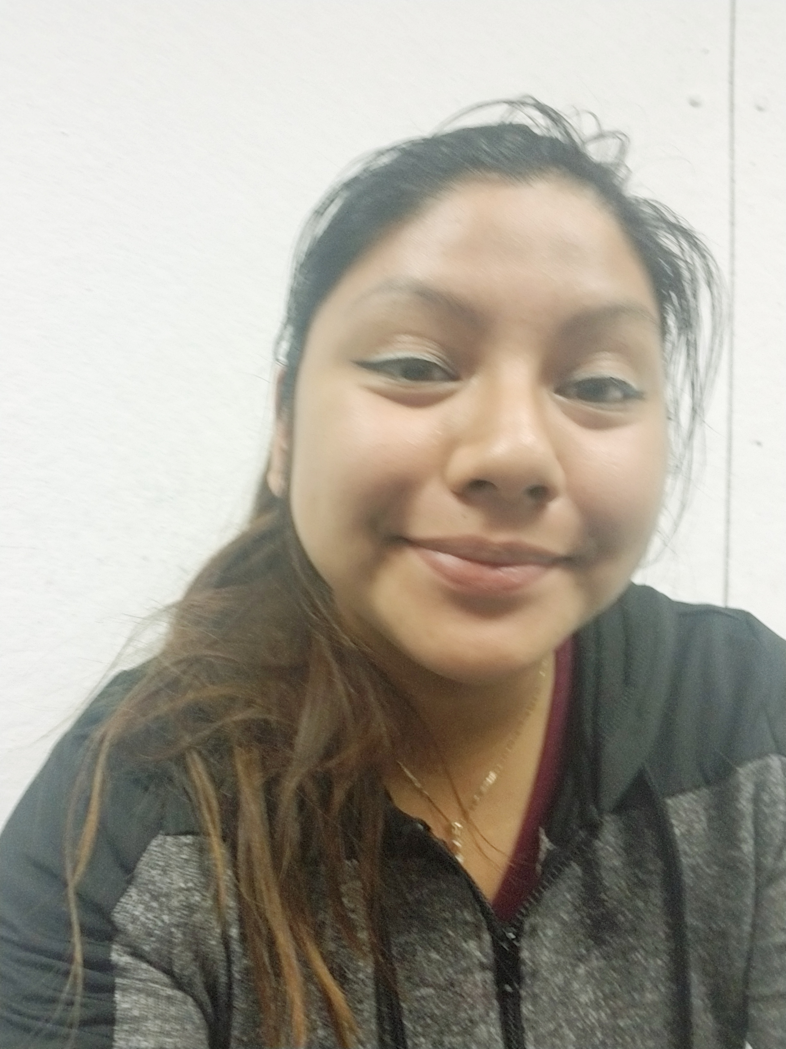

My name is Jessenia Vizhco. I am Ecuadorian and I am a sophomore at NYCCT. I like to play volleyball I enjoy making new projects and showing my ideas.
My name is QiuPing Mei. I came from China and this is my second year in NYCCT. I like to listen to music, I like to create things and models. I might finish my architecture degree first, and might into fashion design.
Building Technology 3
Professor: Justin Sherman

