Slide 1
BRONX LIBRARY CENTER
CASE STUDY PRESENTATION 1
Najah, Nayaab,Eva

Slide 2
Najah Ridgel
I am 18 years old, born and raised in Crown Heights, Brooklyn, New York. I am the youngest of 5, with two older sisters and two older brothers. I'm interested in anime, drawing, rock climbing, being outdoors in nature when it's warm, fanfiction, and almost any book I can get my hands on. I love . I chose to study in Architecture Technology because I always enjoyed drawing and designing and when took civil engineering and architecture classes in my high school, I knew I wanted to do something with this. There we did little projects with bridges and designing my own house. I also enjoyed the drafting aspect as well as drawing the plans and elevations. Nothing feels as wonderful as having ideas, designing, and then seeing it come to life. It is great finally see it come to life in a render or 3D model after all the hard work. So I wish to do that in the future designing buildings, spaces, and structures that people can love and experience as I would.

Slide 3
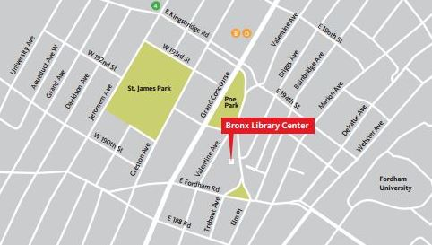
LOCATION: 310 East Kingsbridge Road, Bronx, 10458
YEAR OF COMPLETION: 2006
AREA: 78,000 sq ft
ARCHITECT: Dattner Architect
CLIENT: The New York Public Library

Slide 4
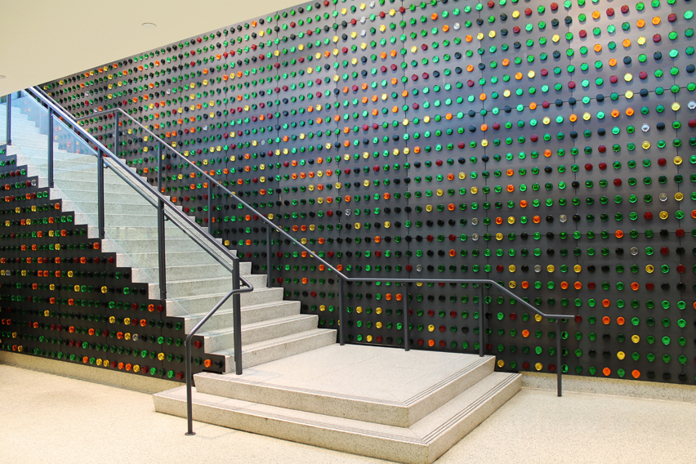
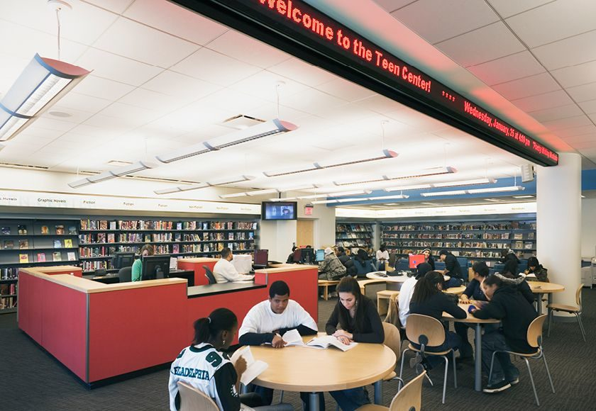
Program/ Layout of Library
Basement floor :
Auditorium that can fit 150 people
Writing center
Technology Training Center
Ground floor (First Floor):
Teen center with teen (ages 13-17) only computer lab
Main circulation desk (get library cards, checkout and check in items)

Slide 5
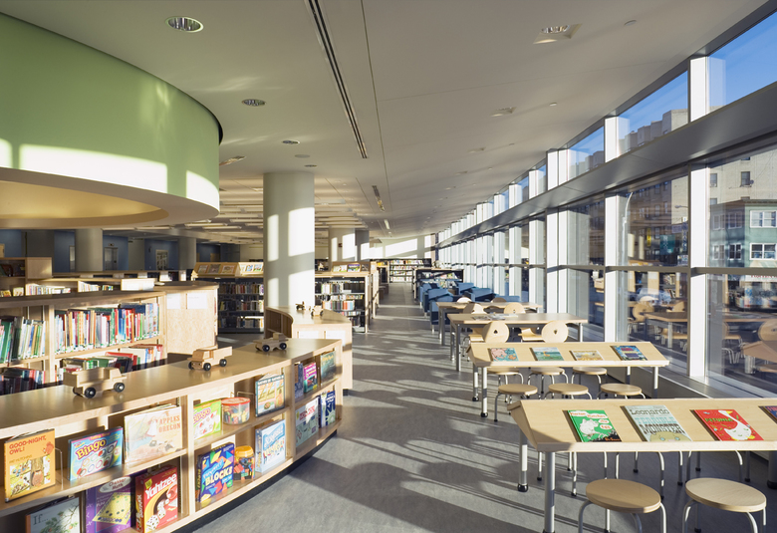
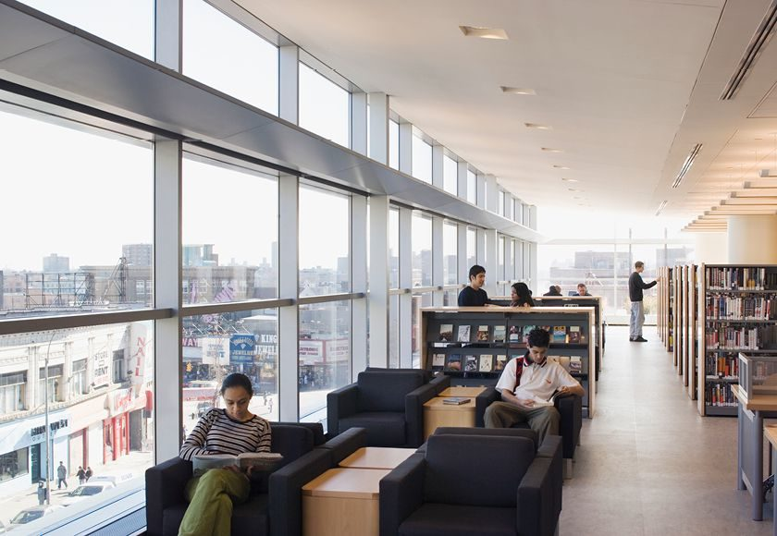
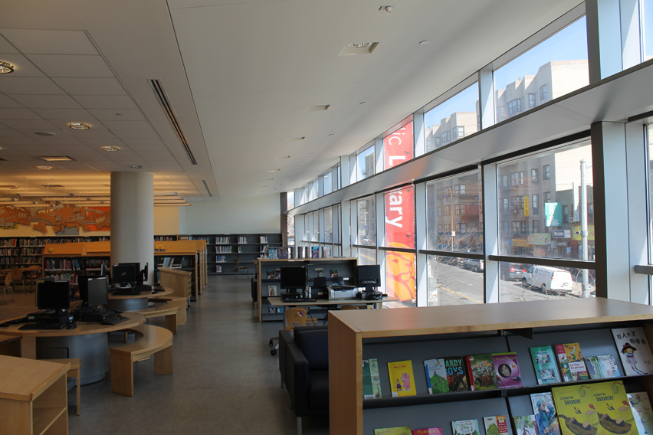
Program/ Layout of Library
Second floor:
Children's floor
Third floor:
Adult’s floor with adult (18+) only computer lab

Slide 6
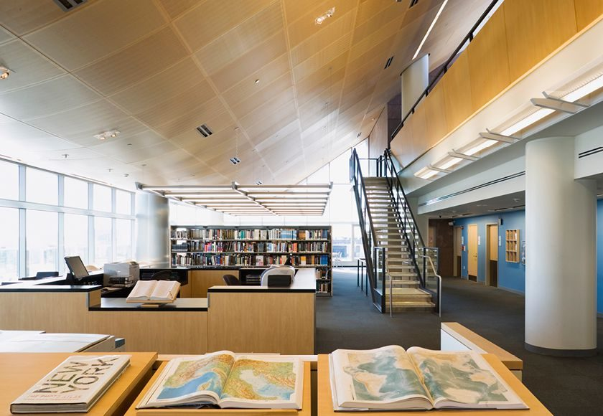
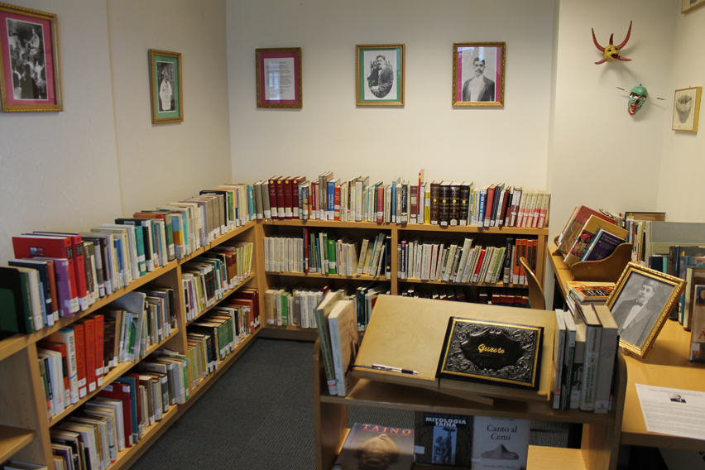
Program/ Layout of Library
Fourth floor:
Research Department with reference collection
48 internet accessible computers
Latino and Puerto Rican Cultural Collection
Fifth floor :
Career Services Center (NYC Programs)
Conference Room

Slide 7
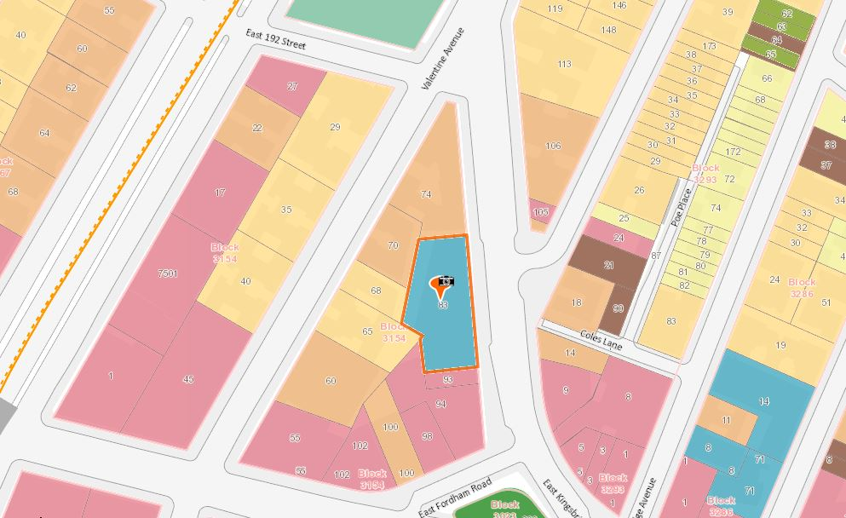
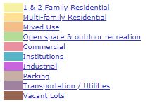
Land Use
Block: 83
Institutions- Public Library

Slide 8
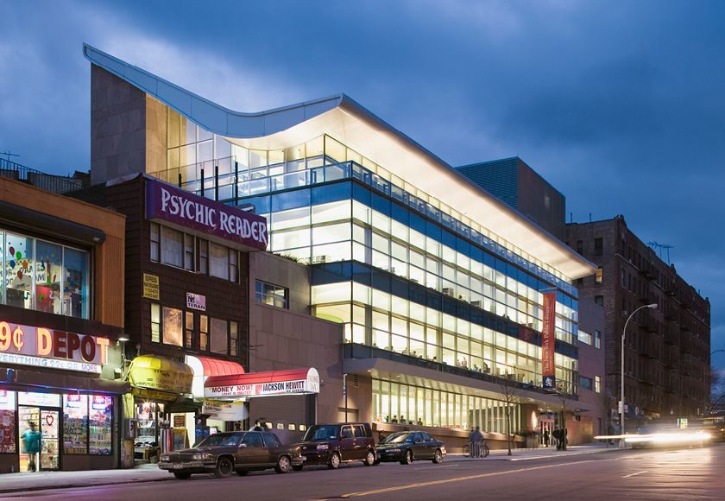
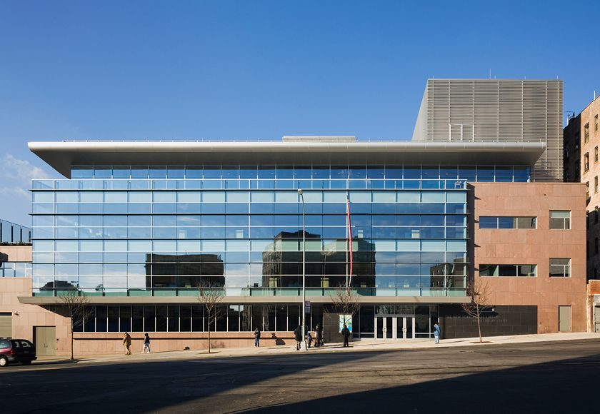
Architecture
The building is steel-framed and uses diverse materials in its construction that contrast with each other. The building is intended to be inviting on the interior and bold on the exterior.
The library has 6 levels
Exterior of the library:
  A multi-story glazed glass curtain wall (which stretches four stories and cantilevers out from the main body of the library to dominate the front façade).
  Red granite panel are the rest of the façade and also extend into the interior of the library on the fourth floor towards the terrace.
  The signature swooping roof is clad in aluminum paneling on the exterior and maple veneer on the interior.

Slide 9
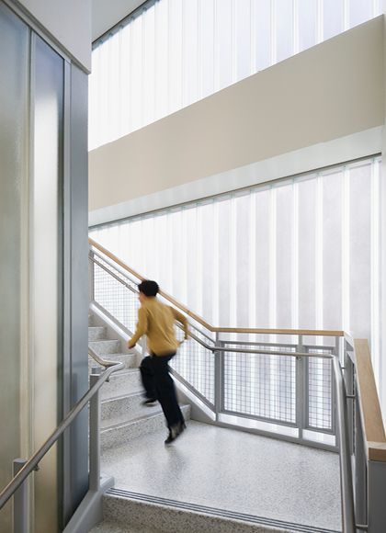
Architecture
The main stair at the back of the library has a frosted channel glass wall, steel handrails, and linoleum flooring. The main stair wraps around the elevator and is framed by the glass wall to provide daylight.
The Bronx Library Center is LEED Silver-certified and is the first "green" library in New York City; it includes many sustainable architecture features.
About 40% of materials used in the construction of the library were manufactured locally (within 500 miles of the site).
The library itself is composed of roughly 20% recycled material.
In addition to using environmentally safe materials, the use of water-cooled chillers has lessen the gravity of chemical release into the atmosphere.
The mechanical HVAC systems help provide building energy use of 20 percent less than code requires.
The glazed curtain wall is composed of glass with a low U-value for better insulating properties on the interior of the building. At times there may be too much daylight along the perimeter reading areas along the wall, so there are mechanized nylon mesh shades to soften the light and light shelves that bounce some of the strongest light off of the surface and push it deeper into the spaces.
Photocell sensors on the ceilings react to daylight levels and automatically change electric lighting intensities accordingly to save energy used.
Overall, 75% of the interior spaces meet LEED criteria for the ratio of daylight to illuminated light.

