Slide 1
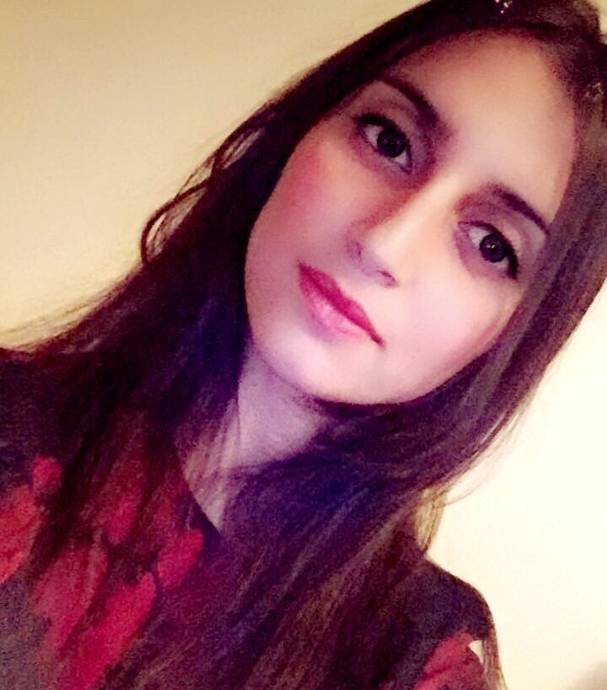


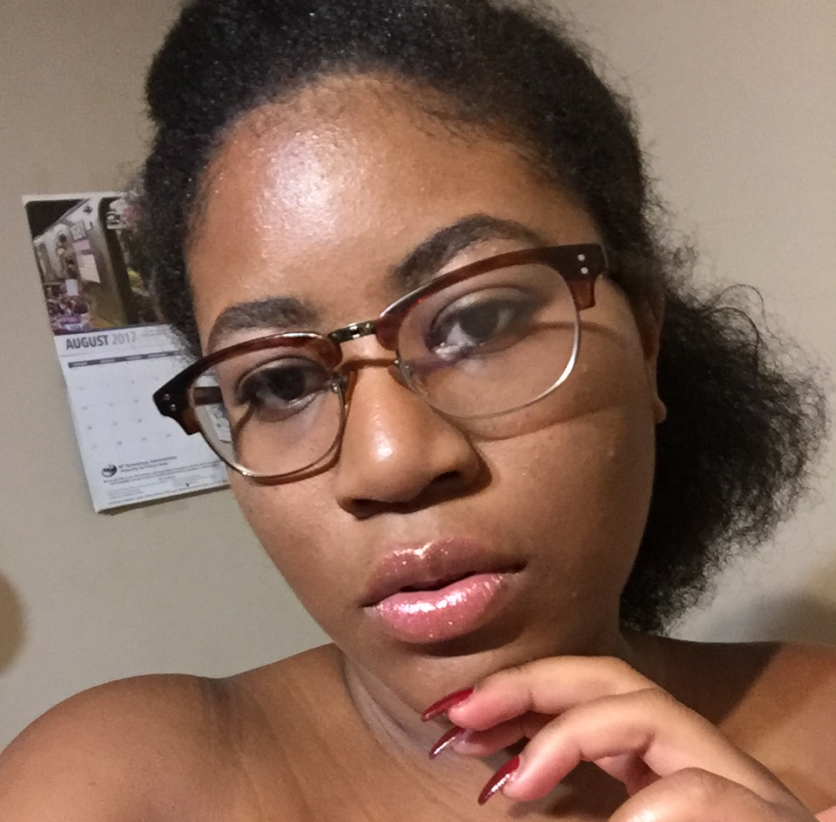
Carolin
What programs you work best at? - The programs I work the best are Rhino, Indesign, and Autocad.
What is your goal as architect? - I want to get my license and work on the city and do some crazy and fantastic building in NYC.
What is your favorite style of architect? - My favorite style of architect is modern because I feel that this has more geometric shapes and has unique style.
Arianna
What is your goal in Architecture? - My goal as is to design my own field, and be the best architect I can be.
Who is your favorite Architect? - One of My favorite Architects is Zaha Hadid, she is an inspiration even after her death. She was the first woman to receive the Pritzker Architecture Prize and the only one to be awarded the Royal Gold Medal.
What is your biggest struggle as an architect student? - My biggest struggle was learning the programs and understand the language used by architects. .
Jovanny
Why do you like architecture?
I like architecture because it is where art meets the real world, and also where building do more than just become a habitable volume.
What do you hope to achieve from architecture? - I hope to be able to find an alternative to public housing, meaning to be able to create a form of housing that is affordable and can hold a vast amount of people.
What else to you do besides school? - I currently work for a non-profit, who helps day labors look for secure jobs that meet working standards.
Janel
When did you first get into architecture? - I started architecture in high school, we had to design our dream house using popsicle stick, and then eventually, we started using revit and autoCAD.
When you are not in school, what is your favorite thing to do? - I love to draw, write stories and listen to music.
What you struggle with the most? - I struggle with time management, and completing more than one goal at a time.

