Slide 1
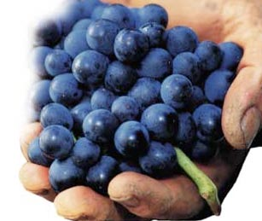

Prof. Karen Goodlad, CSW
Wine & Beverage Management
HMGT 2402
Fall 2017
Viticulture & Vinification

Slide 2
Overview
Attendance
Questions about OpenLab
Lecture Topic
  Vinification

Slide 3
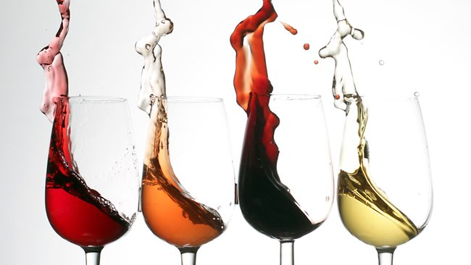
What Factors Affect the Taste of Wine?
Photo Credit: http://coloradowineexperience.com/calling-all-amateur-winemakers/

Slide 4
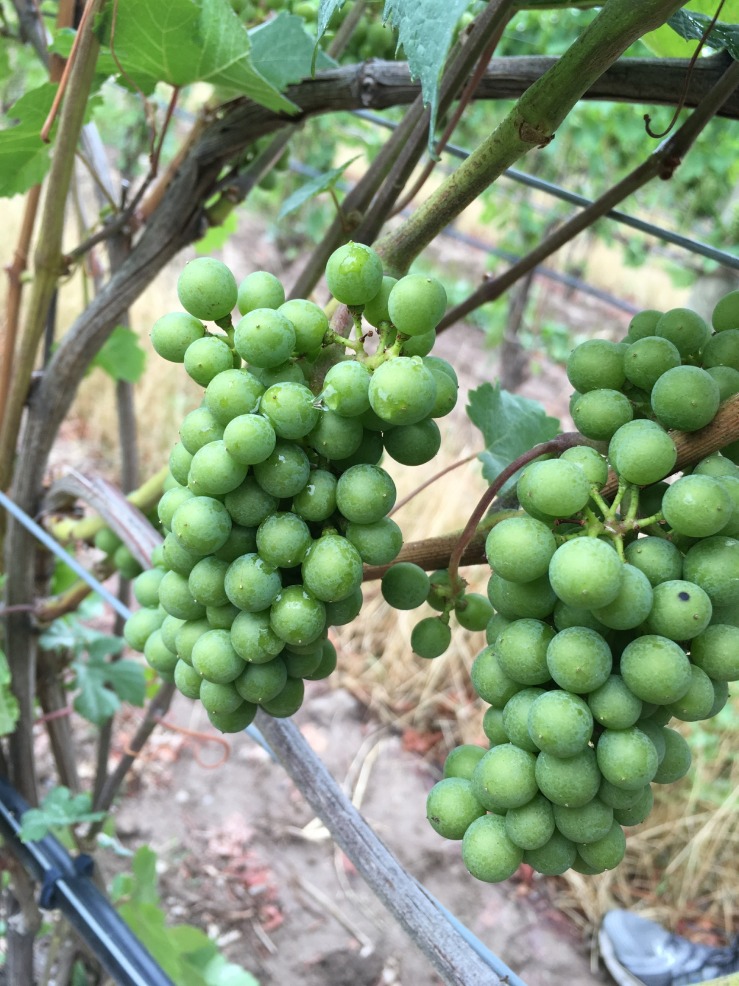
What questions do you have about viticulture?

Slide 5
The Climate & The Weather
Continental vs. Maritime
Average temperature over a year
Likeliness of Fog During a Season
Average % of Sunlight
Actual Temperature
Actual Rain Fall
Actual Fog/Cloud Cover/Sunlight

Slide 6
Oenology:
The scientific study of wine & winemaking
Vinification: the process of making wine
  Harvest → Sorting
  Fermentation
    Yeast stains, oak vs. stainless steal, arrest fermentation
  Blending
    Mixing of various grape varieties of different lots
  Fining & Filtering
  Aging
    On wood, in bottle, how long

Slide 7
White Wine Production
Grapes
Crush/Destem
Press
White, Pink, Purple, Black
Ferment
Age
Separate from skin
Consider: Chilling, Barrel, Inert Vessel, Lees Stirring
Consider: Chilling, Clarification, Barrel, Inert Vessel
Blend
Optional, Consider: Racking, Barrel, Inert Vessel,
Optional: Grapes, Vintages, Vineyards, Aging environment
Notes:
http://extension.psu.edu/food/enology/wine-production/an-introduction-on-low-temperature-fermentation-in-wine-production
Desirable fermentation temperatures vary for red and white wines. Red wine fermentation temperatures are optimally between 68-86°F (20-30°C), while white wine fermentation temperatures are recommended at or below 59°F (15°C) (Reynolds et al. 2001). Higher temperatures are favorable in red winemaking to enhance extraction of color, phenolics, and tannins from skins (Reynolds et al. 2001). The goal of white wine fermentation temperature control is to preserve compounds that contribute to aroma and flavor (Molina et al. 2007).

Slide 8
Red Wine Production
Grapes
Crush/Destem
Purple, Black
Ferment
Age
Consider: Chilling, Barrel, Inert Vessel
Free Run or Press Wine
Consider: Barrel, Inert Vessel
Blend
Optional: Grapes, Vintages, Vineyards, Aging environment
Notes:
http://extension.psu.edu/food/enology/wine-production/an-introduction-on-low-temperature-fermentation-in-wine-production
Desirable fermentation temperatures vary for red and white wines. Red wine fermentation temperatures are optimally between 68-86°F (20-30°C), while white wine fermentation temperatures are recommended at or below 59°F (15°C) (Reynolds et al. 2001). Higher temperatures are favorable in red winemaking to enhance extraction of color, phenolics, and tannins from skins (Reynolds et al. 2001). The goal of white wine fermentation temperature control is to preserve compounds that contribute to aroma and flavor (Molina et al. 2007).

Slide 9
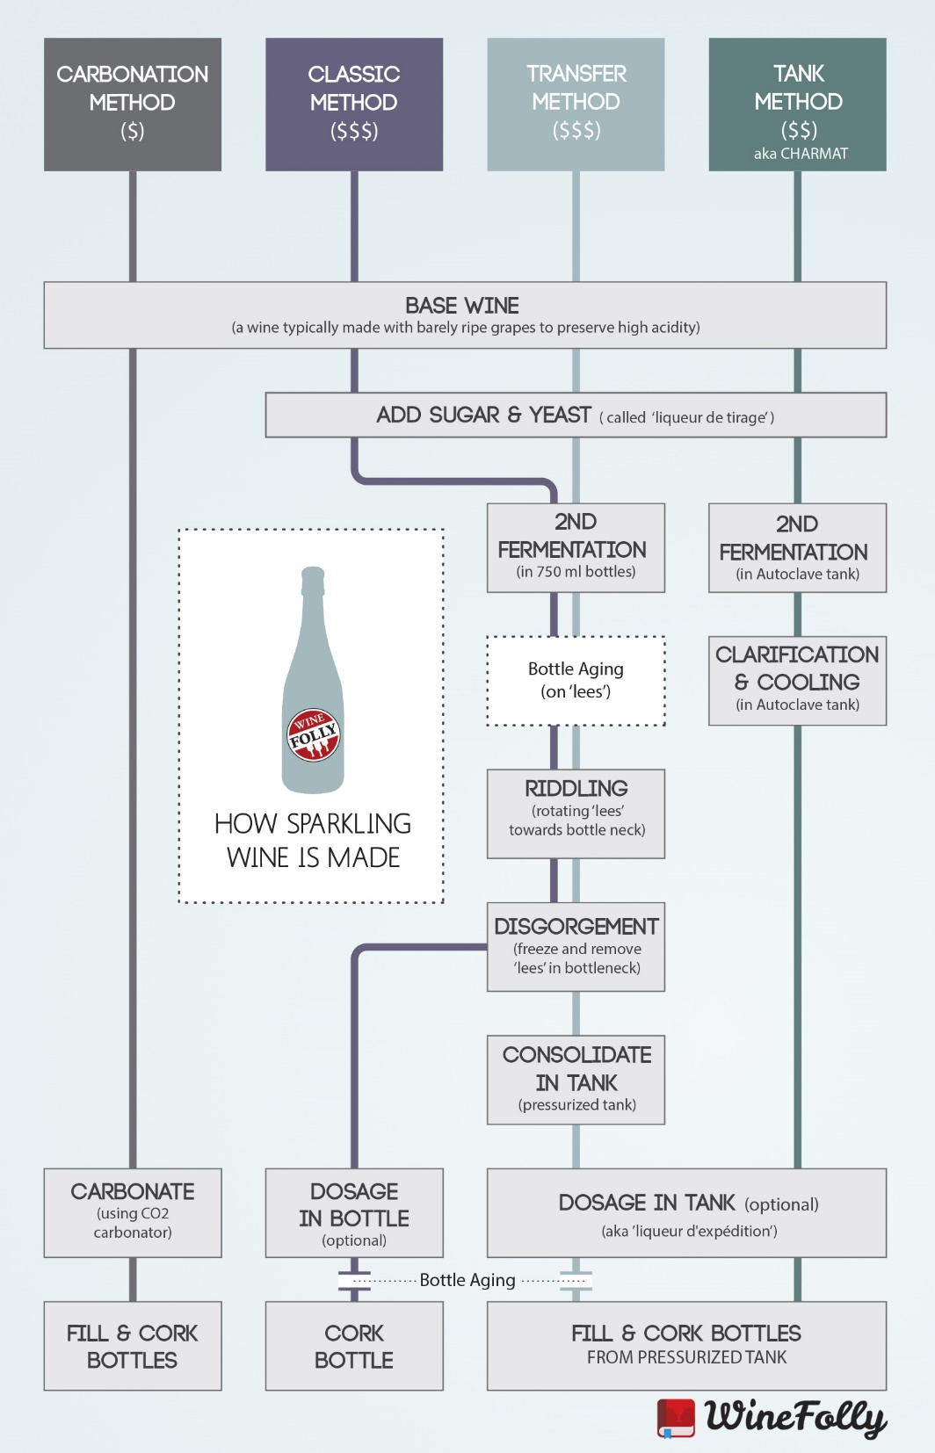
Sparkling Wine Production

Slide 10
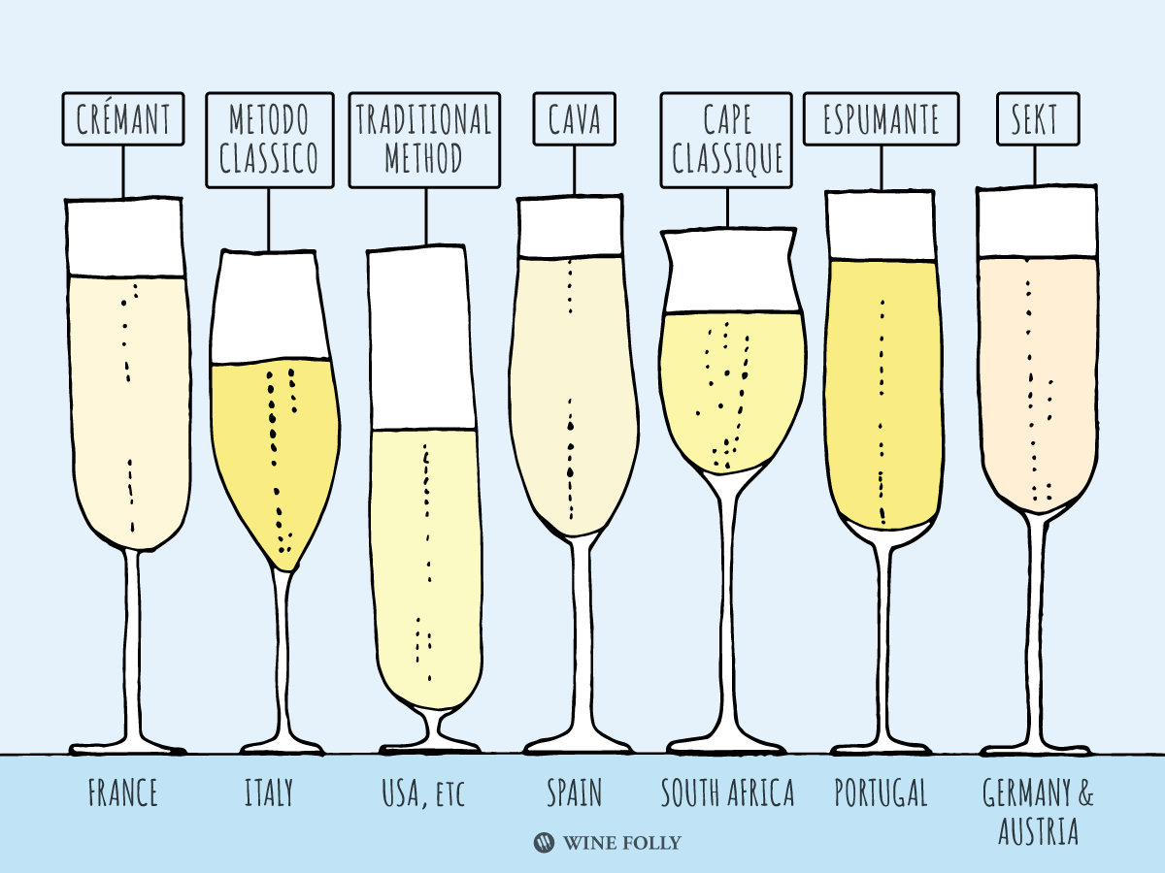

Slide 11
Carbonic Maceration (Whole Berry Fermentation)
Add Whole Clusters of Grapes to a Container
White, Pink, Purple, Black
Ferment
Press
Grapes at bottom are crushed by weight
Filter
Bottle
Notes:
http://extension.psu.edu/food/enology/wine-production/an-introduction-on-low-temperature-fermentation-in-wine-production
Desirable fermentation temperatures vary for red and white wines. Red wine fermentation temperatures are optimally between 68-86°F (20-30°C), while white wine fermentation temperatures are recommended at or below 59°F (15°C) (Reynolds et al. 2001). Higher temperatures are favorable in red winemaking to enhance extraction of color, phenolics, and tannins from skins (Reynolds et al. 2001). The goal of white wine fermentation temperature control is to preserve compounds that contribute to aroma and flavor (Molina et al. 2007).

Slide 12
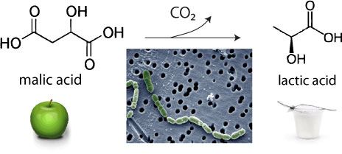
Malolactic Fermentation

Slide 13
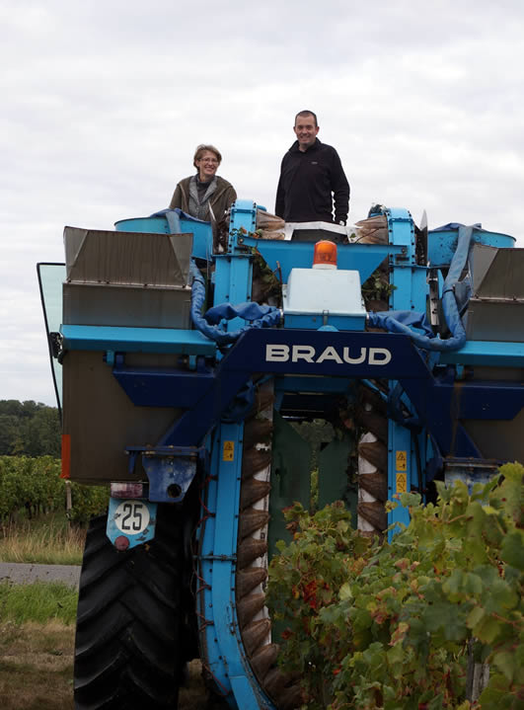
Harvest: Mechanical

Slide 14
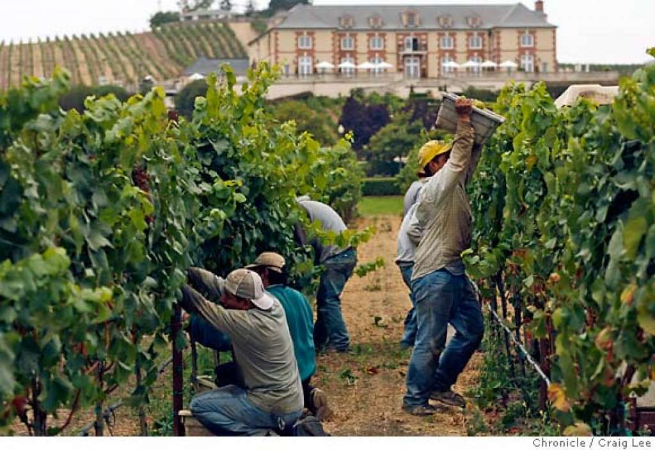
Harvest: Manual

Slide 15
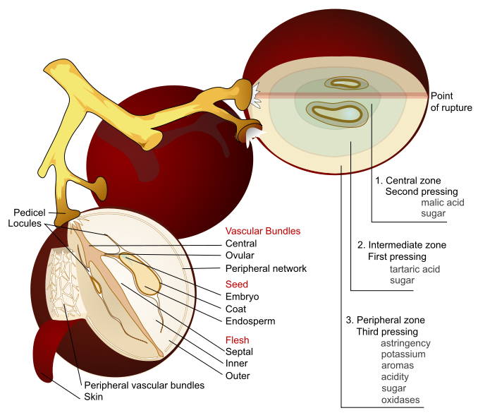
By Mariana Ruiz Villarreal (LadyofHats) - This image was created as part of the Philip Greenspun illustration project., Public Domain, https://commons.wikimedia.org/w/index.php?curid=4546784

Slide 16
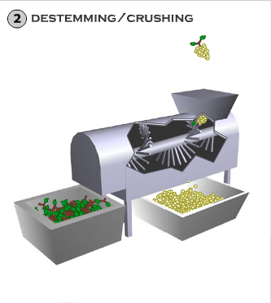

Slide 17
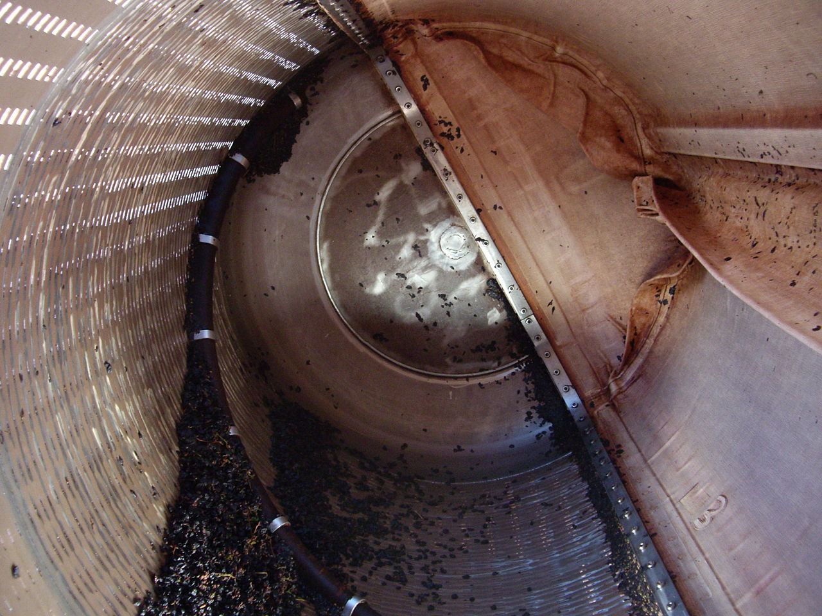
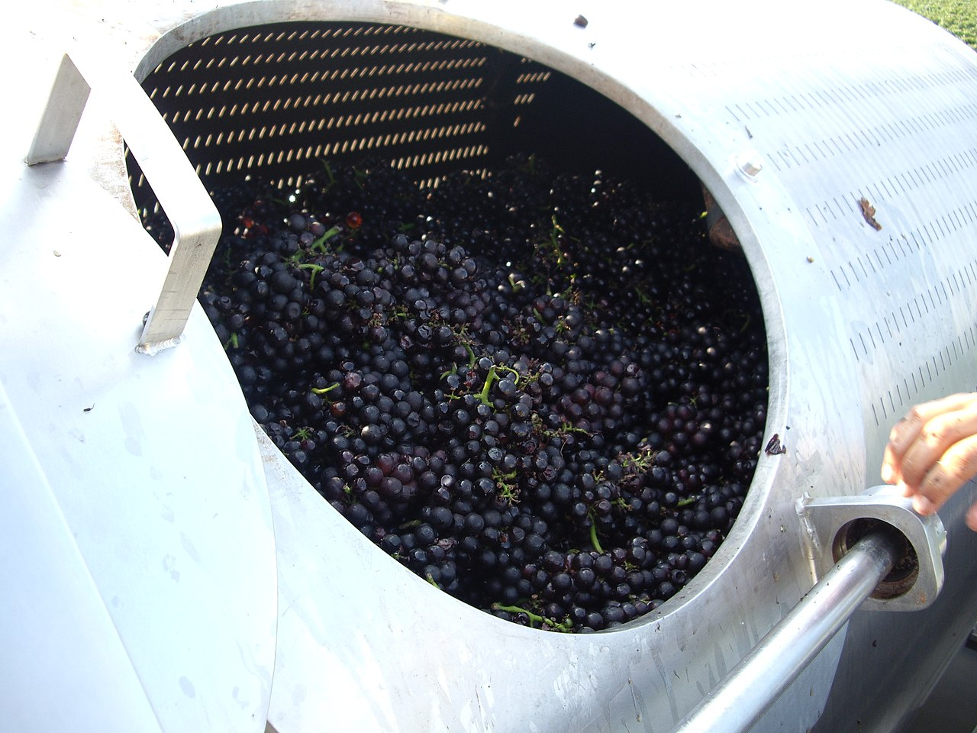
By Robert Pitkin - Flickr: IMGP1328, CC BY-SA 2.0, https://commons.wikimedia.org/w/index.php?curid=19365700

Slide 18
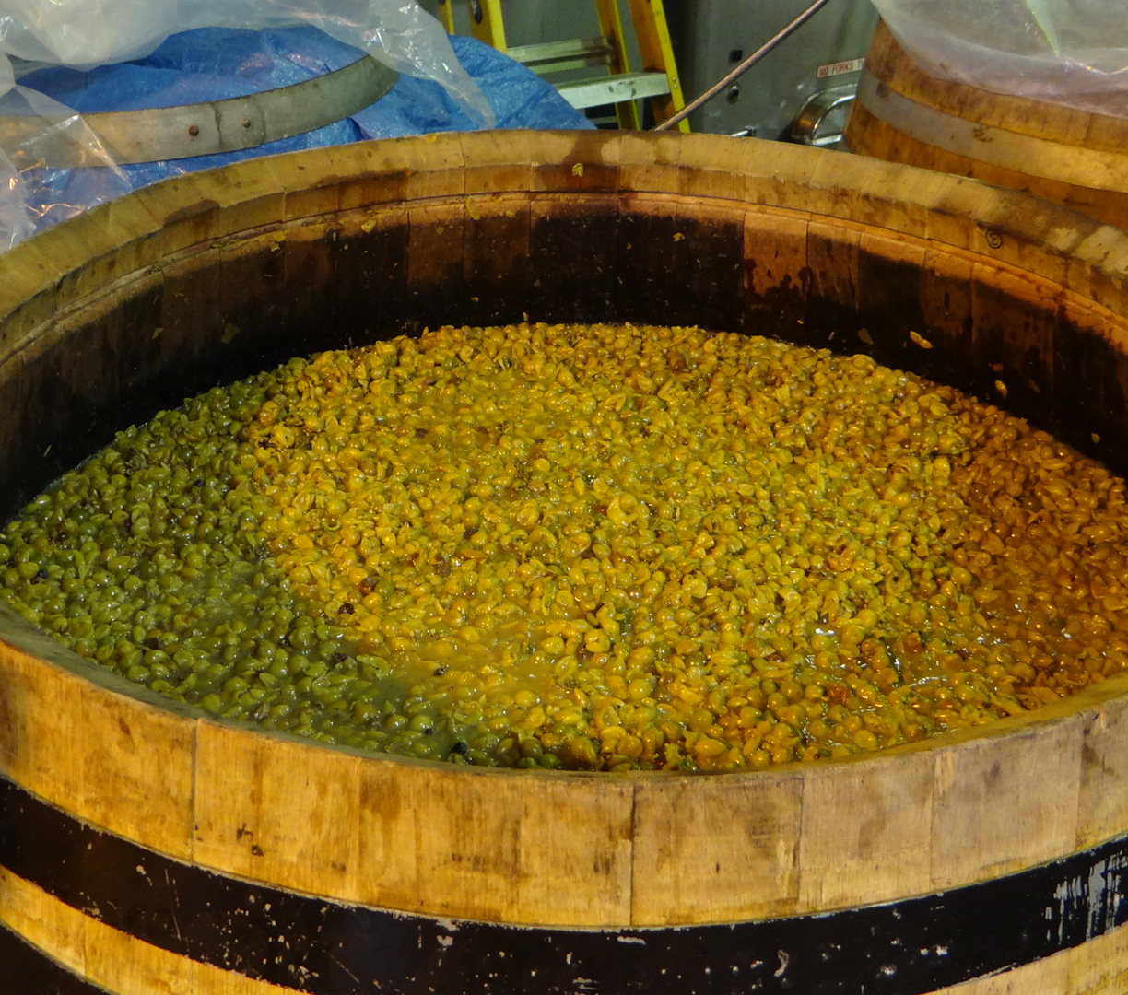
What is the Formula for Fermentation?

Slide 19
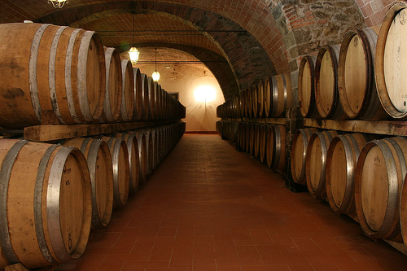
Wine Casks
Notes:
What type of oak, American (more aromatic) (kiln dried) vs. French (more tannic) (air-dried)
Size of oak barrel

Slide 20
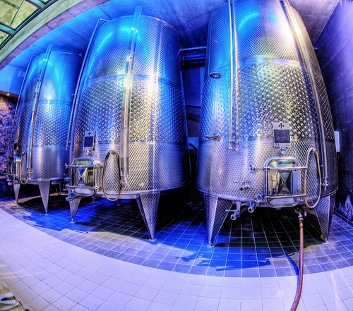
Wine Casks

Slide 21
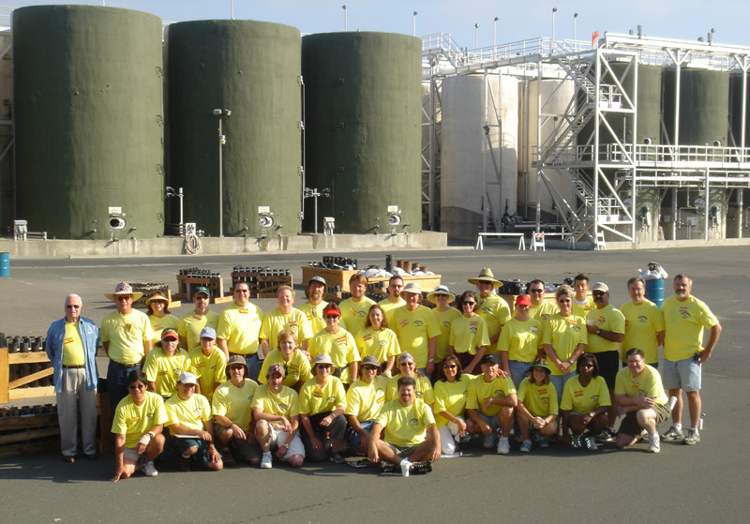
Gallo Wine Production Facility

Slide 22
What Considerations do Enologists Make in Regard to Fermentation?

Slide 23
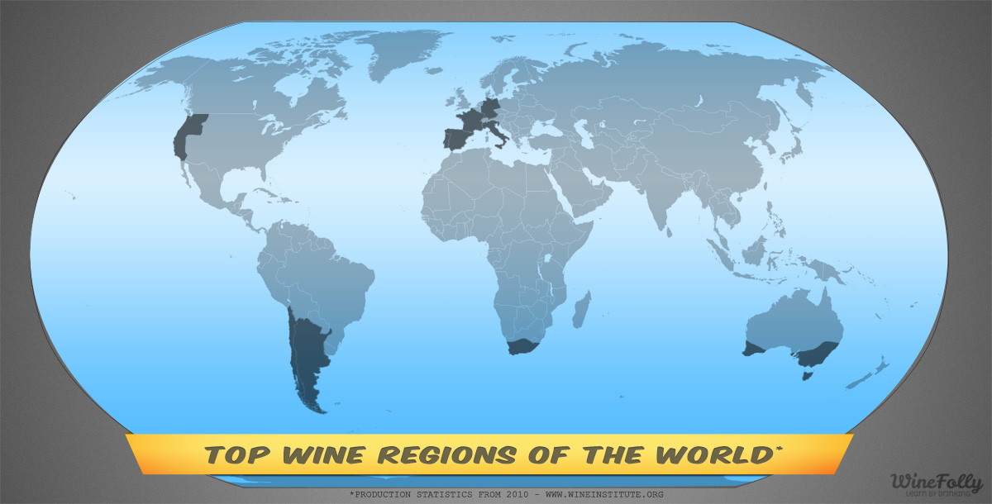
Image credit: http://winefolly.com/update/top-wine-regions-of-the-world/
Notes:
Temperate Zones
(both maritime and continental)
OLD WORLD:
France, Italy, Spain, Germany, Portugal, Switzerland, Austria, Hungary, Greece
NEW WORLD:
US, California, Chile, Argentina, Uruguay, South Africa, Australia, New Zealand

Slide 24
Thinking about the world of wine: Common Regulations & Laws
Appellations
Grape Variety
Minimum Alcohol
Maximum Yield
Methods of Viticulture
Methods of Vinification
Notes:
Appellations: regions: zones: states:

Slide 25

Terms to Know
Viticulture
Oenology (alt. spelling Enology)
Wine Maker, Vitner, Vineyard Manager, Grape Grower
Botrytis Cinerea (Noble Rot)
Must
Chaptalization
Acidification
Brix and Beaume
Carbonic Maceration
Fining and Filtration
Racking
Malolactic Fermentation
Vintage
Phylloxera
Appellation
Yield
Formula for fermentation
Cap, punching down the cap
Barrique
Vitis vinifera/labrusca
Grafting
Root stock/bud wood
Notes:
Botrytis Cinerea: Noble rot, mold growth that punctures the skin, water drains out
Must: the juice and liquidy pulp produced by crushing or pressing grapes before fermentation
Chaptalization: adding cane or beet sugar to wine must before or during fermentation in the effort to increase the sugar and hence alc.
Brix: a way to measure sugar
Carbonic Maceration: uncrushed grapes placed in a closed tank weight crushes grapes, heat from Fermentation creates fermentation in uncrushed grapes, light “juicy” wine
Barrique = 60 Gallons, 9 liters just over 6 cases

Slide 26
Until we meet again
Join the OpenLab and our course site.
Week 3
  EU Regulations, French White Wine
  Quiz, Viticulture and Vinification
  Read: Chapter 8, 9, 21

