Slide 1


Introduction to Food & Beverage Management
Culinary Math:
Fractions & Decimals

Slide 2


Slide 4
Convert units to fractions
1 pound = 16 ounces
how do you express 3 ounces as a fraction of a pound?

Slide 5
Units seen as Fractions
Express smaller units as a fraction of a larger unit
1 teaspoon = ____ tablespoon
1 ounce = ____ pound
1 cup = ____ gallon
1 pint = _____ quart

Slide 6
Units seen as Fractions
Express smaller units as a fraction of a larger unit
1 teaspoon = 1/3 tablespoon
1 ounce = 1/16 pound
1 cup = 1/16 gallon
1 pint = 1/2 quart

Slide 7
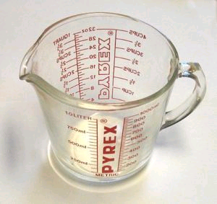
Units seen as Fractions
Express smaller units as a fraction of a larger unit
2 tsp = ____ tbsp
6 oz = ____ lb
8 c = ____ gal
1 1/2 pt = _____ qt

Slide 8
Units seen as Fractions
Express smaller units as a fraction of a larger unit
2 teaspoons = 2/3 tablespoon
6 ounces = 6/16 or 3/8 pound
8 cups = 8/16 or 1/2 gallon
1 1/2 pint = 3/4 quart

Slide 9
Subtracting Fractions with Different Denominators Exercise
what is ½ cup − 2 tablespoons in
a) tablespoons
b) fl. ounces
c) cups

Slide 10
Subtracting Fractions with Different Denominators Exercise
what is ½ cup − 2 tablespoons in
a) tablespoons: 8 - 2 = 6
b) fl. ounces: 4 – 1 = 3
c) cups ½ - ⅛ = ⁴/₈ - ⅛ = ³/₈

Slide 11
Exercise: Fractions to Decimals
2 ¾ pounds = ____ ounces
What is 2 ¾ of a pound as a decimal?

Slide 12
Exercise: Fractions to Decimals
2 ¾ pounds = ____ ounces
What is 2 ¾ of a pound as a decimal?
3 ÷ 4 = .75

Slide 13
Exercise: Convert to a Decimal 1
¹/₃ = _____
²⁷/₂ =_____
⁵/₈ = _____
¹¹/₃ = _____
8 ¼ = _____
⁹/₁₆ = _____

Slide 14
Exercise: Decimals to Fractions
2.875 pounds = 2 pounds____ ounces
What is .875 pounds as a fraction?
CAN YOU MEASURE IT?

Slide 15
Exercise: Decimals to Fractions
2.875 pounds = 2 pounds____ ounces
What is .875 pounds as a fraction?
1 pound = 16 ounces
.875 × 16 = 14
∴ answer is 2 pounds 14 ounces

Slide 16
Exercise: Fractions to Decimals
2 ¾ pounds = ____ ounces
So to solve the above problem multiply 16 (the number of oz. in a lb.) by 2.75
2.75 ×16 = 44

Slide 17
Working with
Decimals & Fractions
What does that mean in a kitchen?
How do you weight out 2.75 lbs or 2 ¾ lbs?
• Most kitchen scales measure in full oz. and full pounds; therefore we must convert ¾ or .75 lbs to oz.
• To do this multiply .75 by 16 (the number of ounces in a lb)

Slide 18
Working with
Decimals & Fractions
.75 x 16 = 12
Therefore the answer is 12 oz.

Slide 19
Exercise: Working with
Decimals & Fractions
Do the following using a calculator:
¾ lb + ½ lb + ¼ lb + ¾ lb

Slide 20
Exercise: Working with
Decimals & Fractions
Do the following using a calculator:
¾ lb + ½ lb + ¼ lb + ¾ lb
.75 lb + .50 lb + .25 lb + .75 lb

Slide 21
Exercise: Working with
Decimals & Fractions
Do the following using a calculator:
¾ lb + ½ lb + ¼ lb + ¾ lb
.75 lb + .50 lb + .25 lb + .75 lb =
2.25 lbs.

Slide 22
Exercise: Convert to a Decimal 2
2 qt. =_____ gal.
2 tsp. = _____ tbsp.
10 tbsp. = ___cups
67 oz. = _____ lb.
4 c. 8 fl. oz. = ___ c.
10 lb. 2 oz. = ___ lb.
3 c. 2 tbsp. = ___ c.
2 qt. 1/3 c. = ____c.

Slide 23
Working with
Decimals & Fractions
The same holds true when subtracting, multiplying and dividing fractions with a calculator.
So first you need to convert fraction into decimal and then perform the function.

Slide 24
Exercise: Working with
Decimals & Fractions
How do we weigh this out on a scale?
2.25 lbs.

Slide 25
Exercise: Working with
Decimals & Fractions
How do we weigh this out on a scale?
2.25 lbs.
We know we can do 2 lbs; but we need to represent .25 of a lb in ounces.

Slide 26
Exercise: Working with
Decimals & Fractions
We know we can do 2 lbs; but we need to represent .25 of a lb in ounces.
To do this multiply .25 by 16 (the number of oz in a lb)
.25 x 16 = 4 oz

Slide 27
Exercise: Working with
Decimals & Fractions
How do we weigh this out on a scale?
2.25 lbs.
2 lbs. 4 oz.

Slide 28
Exercise: measure the following with the equipment you have
32 tbsp. = _____
74 tsp. = _____
3.36 c. =_____
0.6 gal. =_____
0.72 qt. =_____
3.88 lb.= _____

Slide 29
Working with
Decimals & Fractions
¾ = .75
½ = .50
¼ = .25
but
⅔ ≅ .67

Slide 30
Working with
Decimals & Fractions
A recipe calls for 2/3 cup flour.
You need to make 25 times the recipes.
25 × ⅔ = ⁵⁰⁄₃ = 16 ⅔ cups
but if you first convert to decimal
25 × .67 = 16.75 = 16 ¾ cups

Slide 31
Percent Conversion
to convert a fraction to a percentage divide numerator by denominator and multiply by 100
a
b
=
? %
a ÷ b × 100
=
x %
3
4
=
? %
3 ÷ 4 × 100
=
75 %

Slide 32
Percent Conversion
to convert a decimal to a percentage
move decimal point 2 spaces to the right (or vice versa to convert % to decimal)
1.25 = 125%
66.7% = .667%

Slide 33
Recipe Conversion Factor
A factor that is used to convert each recipe ingredient quantity so that the new recipe yields the new desired amount.

Slide 34
Recipe Conversion Factor
Determining the Conversion Factor
    N - New
    O - Original
= Conversion Factor

Slide 35
Recipe Conversion Factor
If a recipe makes 10 portions and you only need 5 portions; you simply use ½ of each ingredient
    N – New 5
    O – Original 10
=
=
.50 or ½

Slide 36
Recipe Conversion Factor
Using the conversion factor of .50; you would multiply each ingredient by .50 (which is the same as using one half of the original ingredients).

Slide 37
Recipe conversion.
The following is a partial recipe list for Caesar salad that serves 16.
Romaine Lettuce 4 heads each
Parmesan cheese 6 ounces
Olive oil 1 pint
Vinegar ½ cup
Croutons 8 cups
How much of each ingredient serves 8?

Slide 38
How much of each ingredient serves 6?
New_ 8_
Original 16
Romaine Lettuce 2 heads each
Parmesan cheese 3 ounces
Olive oil ½ pt = 1 cup
Vinegar ¼ cup
Croutons 4 cups
=
= .5 conversion factor

Slide 39
Exercise: Conversion Factor
The following is a partial list of ingredients for a bruschetta recipe that serves 6 people:
2 lb. ripe tomatoes
4 tbsp. shredded basil
1 cup olive oil
3 oz. garlic, minced
Convert this recipe to serve 10 people

Slide 40
Exercise: Conversion Factor
    N (New) 10
    O (Old) 6
=
≅
1.67

Slide 41
Exercise: Conversion Factor
Using 1.67 as your conversion factor; solve this problem
2 lb. ripe tomatoes
4 tbsp. shredded basil
1 cup olive oil
3 oz. garlic, minced

Slide 42
Exercise: Conversion Factor
tomatoes
2 lb. X 1.67 = 3.34 lb ≅ 3 lb. 5 oz
basil
4 tbsp. X 1.67= 6.68 tbsp ≅ 6 tbsp. 2 tsp.
olive oil
1 c. X 1.67 = 1.67 c ≅ 1 c. 5.25 fl. oz. ≅ 1 2/3 c.
garlic
3 oz. garlic, minced X 1.67 = 5 oz.

Slide 43
Exercise: Conversion Factor
The following recipe for sour cream mashed potatoes yields 7 (4 oz) servings.
Russet potato 10 ea.
Sour cream 3 cups
Butter 1 cups
Salt ½ tbs.
How much of each ingredient is required to make 5 (4 oz) servings ?

Slide 44
Exercise: Conversion Factor
What is the conversion factor?
    N (New) 5
    O (Old) 7
= ?

Slide 45
Exercise: Conversion Factor
What is the conversion factor?
    N (New) 5
    O (Old) 7
    Now multiple each ingredient by the conversion factor
= .71

Slide 46
By the Ounce
The following recipe for sour cream mashed potatoes yields 7 (4 oz) servings or 28 oz.
Russet potato 10 ea.
Sour cream 3 cups
Butter 1 cups
Salt ½ tbsp
How much of each ingredient is required to make 5 (4 oz) servings or 20 oz. ?

Slide 47
Exercise: Conversion Factor
What is the conversion factor?
    N (New) 20
    O (Old) 28
= ??

Slide 48
Exercise: Conversion Factor
What is the conversion factor?
    N (New) 20
    O (Old) 28
= .71

Slide 49
Exercise: Conversion Factor
Russet potato 7.1 each ≅ 7 each
Sour cream 2.13 cups ≅ 2 c. 1 fl. oz.
Butter .71 cups ≅ 5.75 fl. oz.
Salt .36 tbsp ≅ 1 tsp.

Slide 50
Exercise: Conversion Factor
Volume to weight
A recipe for White Bean Soup calls for ¼ cup of beans, the recipe yields (2) servings.
How much does ¼ cup of beans weigh?
What quantity of beans (in pounds) will you need for 120 servings?

Slide 51
Conversion Factor
Rounding up/Rounding down
• After trimming, a twenty pound box of string beans will yield 17 pounds (this is referred to the yield percent).
• How many 3-ounce portions can you get out of it?
17 × 16 ÷ 3 = 90.67
• Should you round up or down?

Slide 52
Conversion Factor
Rounding up/Rounding down
• A recipe calls for 3 large onions. You will be increasing the yield by a factor of 4.5
• How many onions do you need to buy?
3 × 4.5 = 13.5
• Should you round up or down?

Slide 53
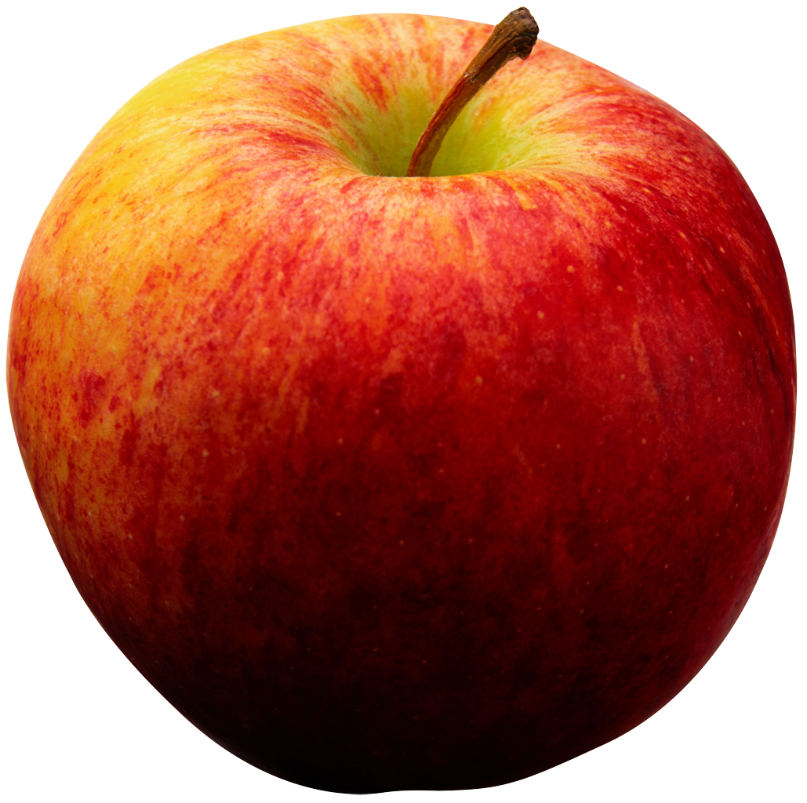
Rounding Up Vs Rounding Down
An apple pie calls for 2 pounds of apples
Each apple is 6 ounces
How many apples do you need to buy?
Each portion of pie costs you $1.263
Do you round up or down?

Slide 54
Introduction to Costing
• AP cost: as purchased cost

Slide 55
Introduction to Costing
• if a pound of Parmesan costs you $12 dollars a pound and you use ½ ounce per portion, what is your cost per portion?

Slide 56
Introduction to Costing
• ½ ounce = 1/32 lb = .03125 lb
.0315 X $12 = $0.375 /portion

Slide 57
Introduction to Costing
If a recipe for lasagna uses 3 ounces Parmesan and serves 8 people what is the cost of Parmesan per portion?

Slide 58
Introduction to Costing
3 oz = 3/16 lb = .1875 lb
.1875 × $12 = $2.25/recipe
2.25 ÷ 8 = $0.28125/portion

