Slide 1
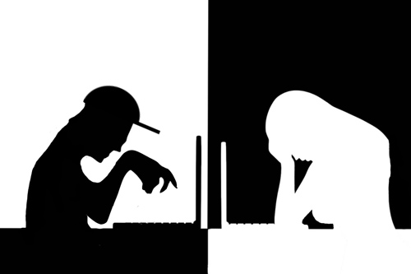
How Do We Prevent Cyberbulling?

Slide 2
Introduction
In 21st century, many technological advances have been evolved such as Internet. Many children and teenagers use social media and electronic devices to harass others. According to the U.S. Department of Health and Human Services, about 1 in 10 boys and 1 in 5 girls are cyber bullied. Many parents may not know that their kids may be going through this and the kids suffer in silent scared to let anybody else know.

Slide 3

Bullying
Bullying is a distinct form of peer aggression involving negative actions that are intentional, repetitive, and involve an imbalance of power between victim and perpetrator (Thomas, et al.).

Slide 4
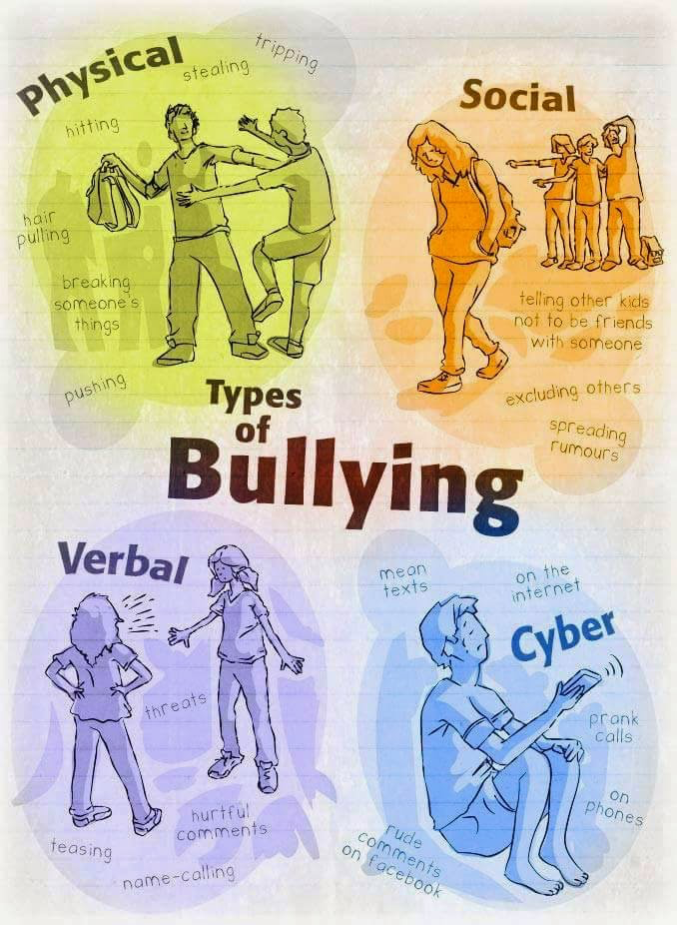

Slide 5
Signs Of Bullying
Emotional
Changes in sleep patterns
Changes in eating patterns
Mood swings
Feeling ill constantly in the mornings
Becoming more aggressive

Slide 6
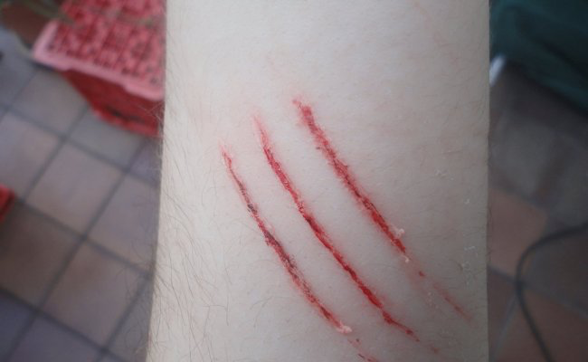
Signs Of Bullying
Physical
Bruises, cuts, scratches and coming home with missing or damaging belongings or clothes.

Slide 7
Signs Of Bullying
Academic
When the kid no longer wants to go to school.
When they are frighten every time they walk to school or changes their route to school.
He/she doesn’t want to take public transportation to go to school.
Low grades
Excluding friendships and team work.

Slide 8
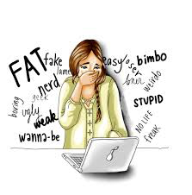
Cyberbulling
Cyberbullying is an aggressive, intentional and repetitive act that is carried out by a group or individual by using electronic forms of contact over time against a victim who cannot easily defend themselves (Thomas, et al.)

Slide 9
Cyberbullying Tactics
The most important thing to understand, is how children are Cyberbullied. This is for easy recognition and access to act against. Some forms of cyberbullying are forms of harassment that cross the line into criminal activity. The decision in some states to prosecute the bullies for criminal harassment.

Slide 10
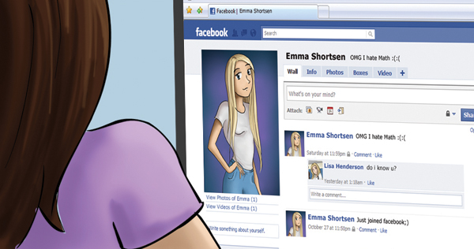
Examples
False identity profile
Posting comments about someone online
Nude photo sharing
Posting mean or hateful names, comments, or content about any race, religion and ethnicity.

Slide 11
Solutions and Resources
http://www.cyberbullying.us/
Dr. Hinduja and Dr. Patchin, two of the leading re- searchers in the field of cyberbullying, have created a comprehensive Web site with information for educators, parents, and teens. Of particular interest to adults may be the “Research” page, and teens may find the “Videos” and “Share Your Story” pages intriguing.
http://www.cyberbullying.org/
Created by Bill Belsey, a renowned speaker in Canada and creator of bullying.org, this site provides an overview of cyberbullying, examples, resources, and facilitates an online discussion and support groups

Slide 12
Solutions and Resources
http://www.bullyingresources.org/main/adult/index Adult.asp?Area=cyberbullying
The U.S. Department of Health and Human Services produced this site, which provides research-based questions and answers regarding various issues related to cyberbullying.

Slide 13
Bibliography
“Cyberbullying Tactics.” StopBullying.gov, 18 Sept. 2017, www.stopbullying.gov/cyberbullying/cyberbullying-tactics/index.html.
Hathcote, Andrea R. and Kathleen A. Hogan. “Resource Guide on Cyberbullying.” Preventing School Failure, vol. 55, no. 2, Feb. 2011, pp. 102-104. EBSCOhost, doi:10.1080/1045988X.2011.539464.
“Signs Of Bullying | National Centre Against Bullying.” NCAB, Digital Agency, 2017, www.ncab.org.au/bullying-advice/bullying-for-parents/signs-of-bullying/.
Thomas, Hannah, et al. “Integrating Traditional Bullying and Cyberbullying: Challenges of Definition and Measurement in Adolescents – a Review.” Educational Psychology Review, vol. 27, no. 1, Mar. 2015, pp. 135-152. EBSCOhost, doi:10.1007/s10648-014-9261-7.

