Slide 1
Travel and Tourism
HMGT 1101
Karen Goodlad
Fall 2017

Slide 2
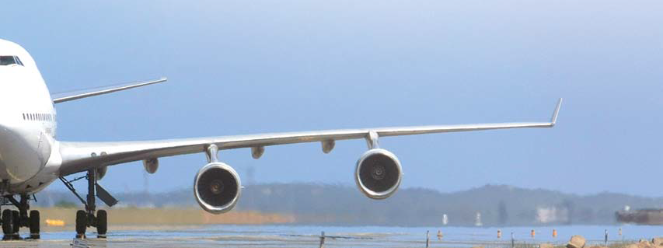
Class Learning Outcomes
Summarize Tourism and the impact of transportation on tourism
Define tourism and describe the important international tourism organizations
Discuss the economic impact of tourism
Summarize the sociocultural impact of Tourism

Slide 3
What makes up the Tourism Industry
Accommodations
Transportation
Dining
Travel Planning
Notes:
https://www.oecd.org/industry/tourism/Tourism2016-Highlights_Web_Final.pdf
8- OECD TOURISM TRENDS AND POLICIES 2016: HIGHLIGHTS
© OECD 2016
The sharing economy is mainly apparent in four
sub
-sectors of tourism:
Accommodation , involving short -term rentals of all or part of private accommodation
. In many countries the sharing economy now accounts for a growing, and in some cases significant,
Share of all visitor accommodation. A small number of platforms dominate the marketplace. Airbnb
has close to 2 million properties in more than 190 countries and is the third most valuable
venture
-capital backed company in the world
, with an estimated worth of USD
25.5
billion
in
June 2015
. Small local or niche based platforms operate alongside the global players.
Transportation
includes car
-sharing, ride
-hailing and bike
-sharing.
Car
-sharing platform Uber
operate
s in
around 400
cities
in 68 countries
and was v
alued at USD
62.5
billion
in
January
2016
. Other major platforms include Blablacar, which is based on a sense of community
rather than a commercial transaction.
Dining
covers activity such as purchasing home
-cooked meals or attending dinners organised
by local residents. Platforms include EatWith, BonAppetour and Feastly.
Travel planning
includes itinerary planning and tours by locals who offer personal and customised experiences. Platforms include Vayable, ToursByLocals and VoomaGo. Within these areas, offers and models have been evolving, catering for both the leisure and business markets and including commercial co-operation with traditional tourism service
provider
s, as well as true
peer
-to-peer exchanges
.

Slide 4
Who are the Promotors of Tourism?
Government
Tourism Boards
Tour Operators
Travel Agencies
Tour Wholesale and consolidators
Destination Management Companies

Slide 5
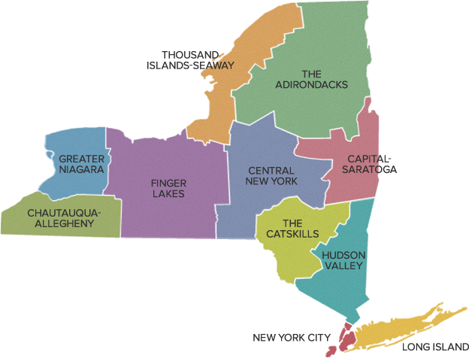
NY State Tourism
I Love NY
New York City & Company
Uncork NY
The Power of Travel

Slide 6
Why do certain groups of people choose certain vacation experiences?

Slide 7
types for travel
Business Travel
Historic Tourism
Ecotourism
Sustainable Tourism
Cultural Tourism
Heritage Tourism

Slide 8
What are the forms of transportation that contribute to tourism?
Air
Road
Rail
Water
Other
Link to Videos about transpiration and sustainable tourism: http://2015.internationaltransportforum.org/sustainable-tourism

Slide 9
What are the needs of travelers to New York City?
effective factors in choosing mode of transportation in tourism
Time limit
Distance
Status
Comfort
Security
Benefit
Price
Geographical position
Competition
Define the traveler
Discuss the traveler’s needs
Identify the forms of transportation used
Notes:
What travelers need to consider
• Time limit
• Distance
• Status
• Comfort
• Security
• Benefit
• Price
• Geographical position
• Competition

Slide 10
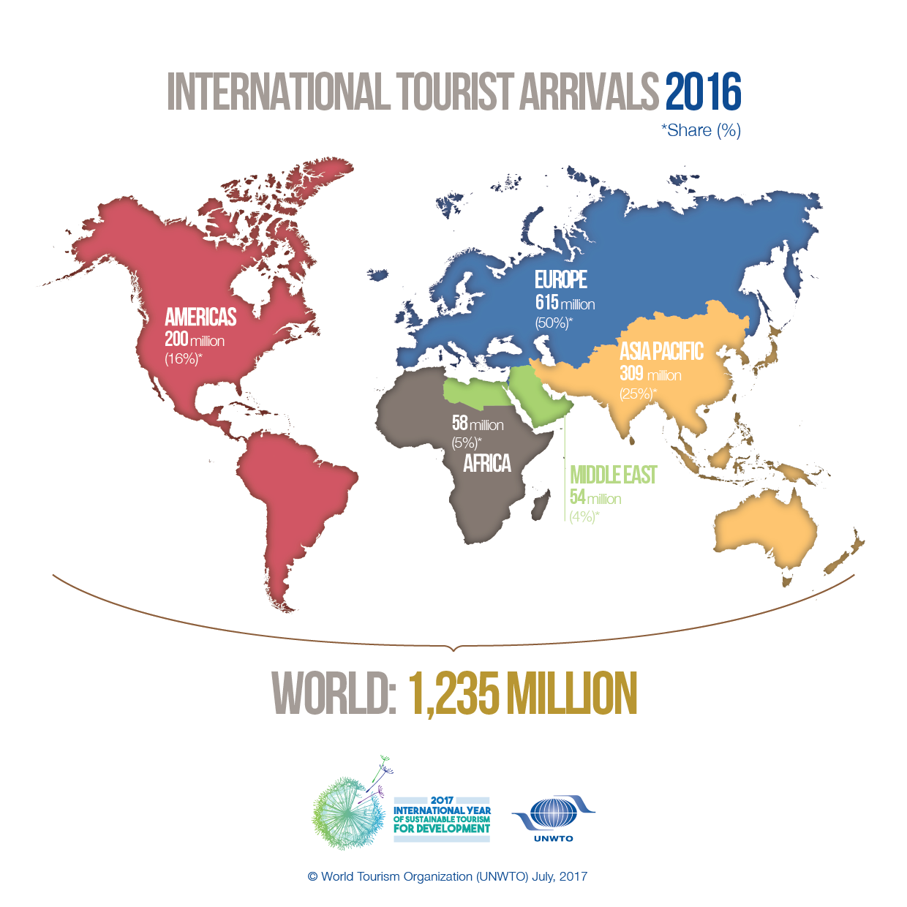

Slide 11
Activity
The Director of Tourism for the New York State Division of Tourism is seeking input from regional tourism managers.
Each group of students represents a region in New York State.
Each group is competing for a grant to foster tourism in their region.
  Identify the type of tourism you will design a package for (define it)
  Identify the needs of travelers in your category
  Include 4 terms from the list provided
  Report out

Slide 12
Next class meeting is at the Brooklyn Bridge Park
Review site visit information on OpenLab

