Slide 1
Perspectives in
Hospitality Management
Prof. Karen Goodlad
Fall 2017
Introduction

Slide 2
Introduction
Prof. Bio
Student Introductions
Syllabus Review
Tour of Department
Lecture
OpenLab

Slide 3

So What is Hospitality?
Notes:
Call on students to provide their own response

Slide 4
“It's how you make your customers feel while using your products that distinguishes you.” Danny Meyer
At The Ritz-Carlton, hospitality is about providing legendary service to our guests, members and residents while embracing the culture that is The Ritz-Carlton.
"Food is our common ground, a universal experience." James Beard

Slide 5
Specific Areas we will Explore
Tourism
Hotels and Lodging
Food and Beverage
  Restaurants, Food Service, Beverage Operations
Accounting
Human Resources
Marketing
Event & Conference Planning
Recreation and Theme Parks

Slide 6
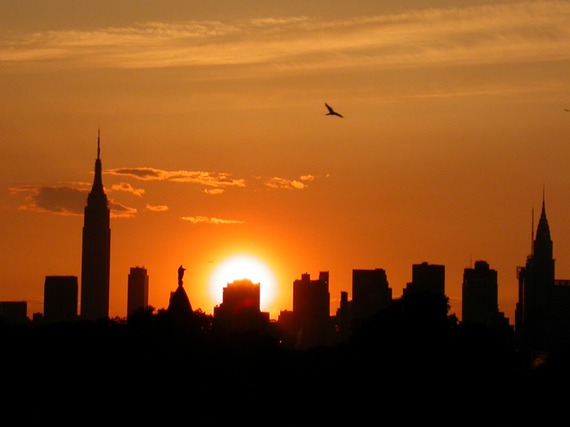
Exploring Your World:
A Moment of Truth
Notes:
Bring in a current event/topic for discussion.

Slide 7
OpenLab
Our electronic classroom
Review and submit assignments
Ask questions
Blog
Find and share club information
Learn about other courses at City Tech
Communicate with classmates and others on OpenLab

Slide 8
OpenLab
Create an OpenLab Account and ePorfolio
  Due Before Class on Tuesday, September 5
Upload Electronic Profile assignment
  Profile Due Before midnight on Monday, September 4
  Comments on Peer Profiles Due Before Class on Tuesday, September 12
  Upon approval from Prof. Goodlad, update personal ePortfolio
Explore site
  Blogging, commenting, assignment submissions, editing, connecting with classmates

Slide 9
Before We Meet Again…
Read NYTimes Travel Section
Read Chapter 1 in Introduction to Hospitality , 7th edition
Complete weekly homework questions
Complete OpenLab Assignment for eProfile
Read Various BIO’s of industry leaders introduced in Introduction to Hospitality , 6th edition
Explore City Tech’s Library Website

