Slide 1
Public Speaking & Information Literacy
Prof. Karen Goodlad
Perspectives in Hospitality Management
Fall 2016

Slide 2
Public Speaking
“There are always three speeches, for every one you actually gave. The one you practiced, the one you gave, and the one you wish you gave.” -Dale Carnegie

Slide 3

Let thy speech be better than silence, or be silent.
-Dionysius Of Halicarnassus

Slide 4

“It usually takes me more than three weeks to prepare a good impromptu speech.”
Link to Professor Davis’ website for information about how to best approach public speaking assignments.
- Mark Twain

Slide 5
What is “Information Literacy”?
Library Research Guide
Evaluating Information Sources
For more information: http://library.citytech.cuny.edu/services/faculty/teaching/instruction.php
has the information been edited, reviewed, verified, fact-checked?
Information that you get from print sources in the library has been evaluated twice:
  By the publisher of the book or periodical
  By the City Tech librarian who selected it for our library
Notes:
What is Information Literacy?
An information literate individual can:
• determine the nature and extent of the information needed
• access relevant information effectively and efficiently
• evaluate information and its sources critically
• use information effectively to accomplish a specific purpose
• understand the economic, legal, and social issues surrounding the use of information and access and use information ethically and legally.
(from the Association of College and Research Libraries Information Literacy Competency Standards)

Slide 6
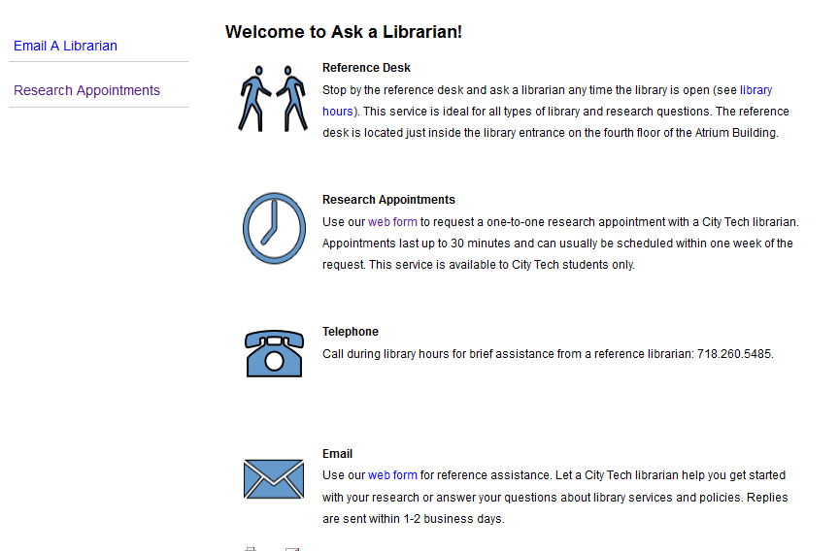
What Does the Ursula C. Schwerin Library Offer Students?
Library services: http://library.citytech.cuny.edu/services/ask/index.php
A visit from our librarian, Prof. Monica Berger

Slide 7
What should you look for when you evaluate information?
Accuracy: Is the information correct? Are the sources (references) cited? Can you verify the information in another source?
Expertise: Who is the author or organization that is responsible for the information? Is the author/organization an expert on the subject? Can you verify his or her credentials?
Objectivity: Is the information biased in any way? Is the author or organization trying to sell you something or convince you of something? Is the information based on fact or opinion?
Currency: Can you find a publication date for this source? If it's a website, when was the website last updated? Does the information seem relevant or is it out of date?

Slide 8
Why use
Books, Journals & Articles
Finding Books on the Library Website
  Are books available on your topic/industry leaner/leading organization?
Finding Articles on the Library Website
  Are articles available on your topic/industry leaner/leading organization?
Hospitality Management Specific Resources

Slide 9
What is Plagiarism
How do I Avoid Plagiarism?
For More Information: http://library.citytech.cuny.edu/instruction/plagiarism/index.php
Plagiarism is representing someone else's ideas, words, images, music, video, etc. as your own, either intentionally or unintentionally, without citing the source of the information.

Slide 10
Tips for avoiding plagiarism
While you are starting your research, taking notes, writing your outline, and beginning your first draft, record all books, articles, websites, and other resources that you consult.
Know which citation style your instructor requires (usually APA or MLA) and know how to use it.
HMGT uses APA
  Ursula C. Schwerin Library: http://library.citytech.cuny.edu/research/subjectGuides/wiki/index.php/Style_Guides_and_Research_Paper_Support#APA_Style
  Purdue OWL: https://owl.english.purdue.edu/owl/resource/560/01/

Slide 11
Some APA Standards for Reference Pages
Oz Clarke, wine writer
  Books
  Articles
  Website

Slide 12
Some APA Standards for Citations
Oz Clarke, wine writer
  Books
    (Clarke, p140, 2008)
    (Clarke, 2008)
  Articles
    (Clarke, p12, 2010)
    (Clarke, 2010)
  Website
    (Clarke, para 4, nd)
    (Clarke, nd)

Slide 13
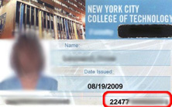
Terms to know…
Source= reference
Citation
How do you know a source is reputable?
Plagiarism
APA

Slide 14
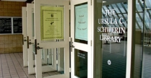
Next week we will meet here and go to the Library during our next class session.

Slide 15

Total Quality Management Approach
What Award Recognizes the leaders in TQM?
What hospitality company has won the award numerous times?

Slide 16
Trends
Globalization
Health, Safety & Security
Diversity & Changing Demographics
Technology
Sustainability
Social Media and Mobil Media
“Preparing for Tomorrow Committee”

