Slide 1
Perspectives in Hospitality Management
Karen Goodlad, CSW
Fall 2016

Slide 2
Class Objectives
Explore Topics in the NY Times Travel Section, “36 Hours In…”
Utilize OpenLab
Review of Profiles
Hospitality, Past, Present and YOUR Future

Slide 3
NY Times
36 Hours in ________
Would you visit? Why?
Components of the article.

Slide 4
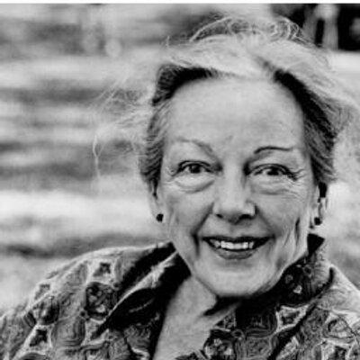
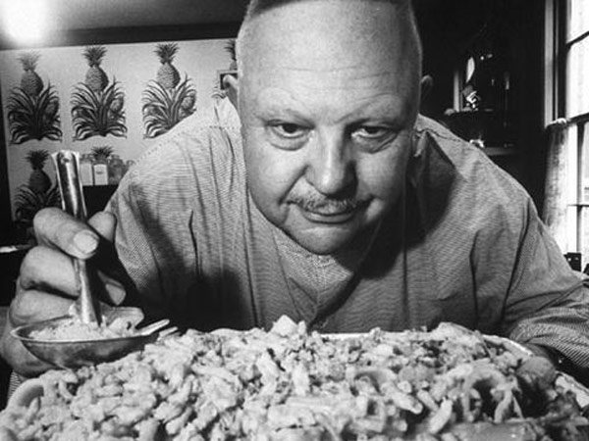
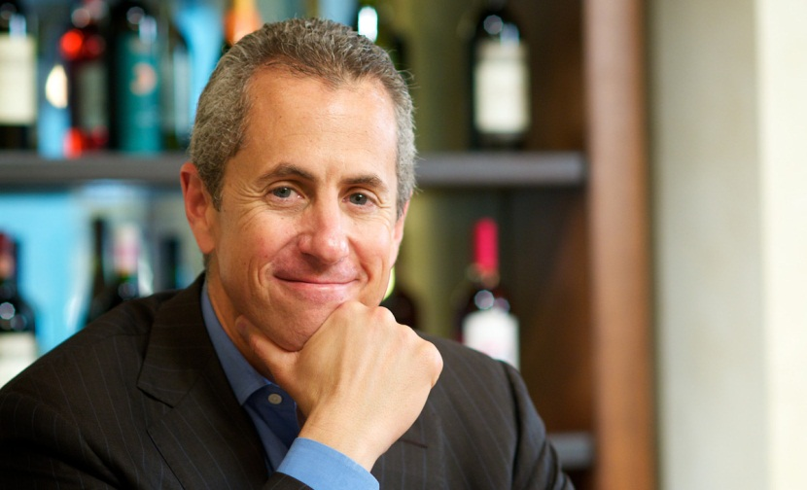
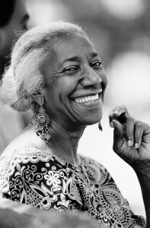
Who did you learn about?
MK Fischer?
James Beard?
Danny Meyer?
Edna Lewis?
Each other?

Slide 5
OpenLab
Reasons to use
How to use
What it means to YOU

Slide 6
History of Hospitality
Identify similarities between Ancient, Greek and Roman and Medieval Times
What changes occurred as trade developed and technology progressed?

Slide 7
History of Hospitality
Identify similarities between Ancient, Greek and Roman and Medieval Times
  Places to gather, places to trade and share, places to exchange ideas
What changes occurred as trade developed and technology progressed?
  Coffee houses, banquets became al a carte meals, use of utensils, kitchen brigade

Slide 8
You in the Hospitality Industry
Lodging
F&B
Travel and Tourism

Slide 9
Regional Manager
General Manager
Host/Bar Back/Back Waiter
Asst. Gen. Manager
Closing/Opening Manager
Bartender/Server

Slide 10
Regional Chef
Chef d’ Cuisine
Saucier
Closing/Opening Manager
Prep Cook
Dish Washer

Slide 11
Industry Profile
Distribution of Assignment

Slide 12
Until We Meet Again
Students 17 years old see me after class
NY Times, Read “36 Hours in …”
Chapter Review Questions, See OL for specific questions
Revise eProfile as directed in messages and, upon approval, post to your individual ePortfolio
Think about your career goals and companies or individuals you wish to work for

