Slide 1
Park & Recreation
Management
Prof. Karen Goodlad
Perspectives of Hospitality Management
Spring 2016

Slide 2




Class Objectives
Identify the scope of the hospitality and tourism industry.
Understand and describe the characteristics of the hospitality and tourism industry from a local, national and global perspective.

Slide 3
Today’s Schedule
Review of NYTimes Travel Section
Review of Concierge Assignment
Parks and Recreation Lecture

Slide 4
Commercial Recreation
Themed Parks
Amusement Parks
Sports Facilities
Recreation Facilities
Historic Places
Museums
Performing Arts

Slide 5
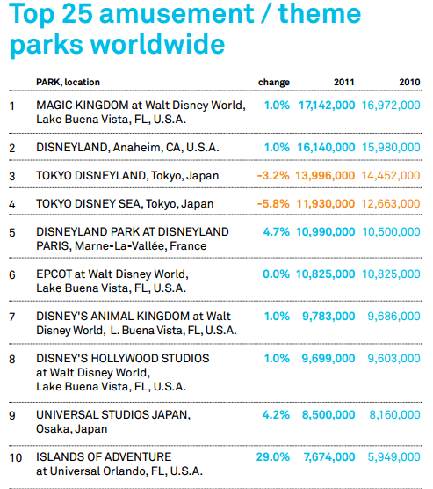
Source: Themed Entertainment Association

Slide 6
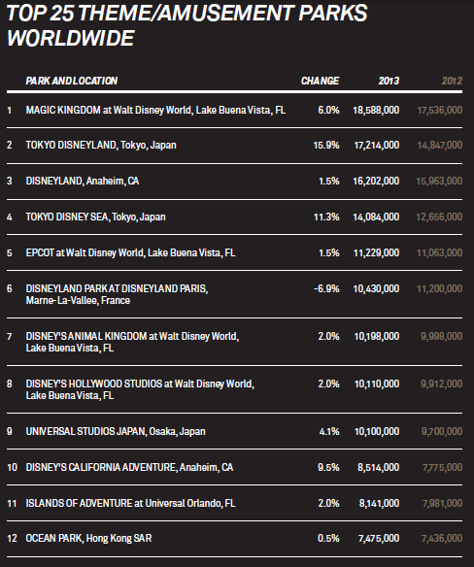
Source:
Theme and Museum Index Report

Slide 7
Major League Baseball, 2012
2012 Attendance |  | Home |  |  |  | Road |  |  | Overall
RK | TEAM |  | TOTAL | AVG | PCT | GMS | AVG | PCT | GMS | AVG | PCT
1 | Philadelphia |  | 3,565,718 | 44,021 | 100.8 | 81 | 31,749 | 72.8 | 162 | 37,885 | 86.9
2 | NY Yankees |  | 3,542,406 | 43,733 | 87.0 | 81 | 34,154 | 82.0 | 162 | 38,943 | 84.7
3 | Texas |  | 3,460,280 | 42,719 | 86.9 | 80 | 28,209 | 66.7 | 161 | 35,509 | 77.6
4 | San Francisco |  | 3,377,371 | 41,695 | 99.5 | 80 | 32,889 | 72.4 | 161 | 37,320 | 85.5
5 | LA Dodgers |  | 3,324,246 | 41,040 | 73.3 | 80 | 32,640 | 74.4 | 161 | 36,866 | 73.8
6 | St. Louis |  | 3,262,109 | 40,272 | 91.6 | 81 | 31,436 | 72.7 | 162 | 35,854 | 82.2
7 | LA Angels |  | 3,061,770 | 37,799 | 83.3 | 81 | 30,831 | 70.2 | 162 | 34,315 | 76.8
8 | Boston |  | 3,043,003 | 37,567 | 101.4 | 81 | 31,038 | 71.8 | 162 | 34,303 | 85.5
9 | Detroit |  | 3,028,033 | 37,383 | 90.6 | 81 | 30,539 | 73.5 | 162 | 33,961 | 82.0
10 | Chicago Cubs |  | 2,882,756 | 35,589 | 86.5 | 81 | 32,485 | 75.2 | 162 | 34,037 | 80.7
Notes:
NYC Ballet, just over 35, 000 people, 2012

Slide 8
2013 Attendance |  | Home |  |  |  | Road |  |  | Overall
RK | TEAM | GMS | TOTAL | AVG | PCT | GMS | AVG | PCT | GMS | AVG | PCT
1 | LA Dodgers | 81 | 3,743,527 | 46,216 | 82.5 | 81 | 35,348 | 79.3 | 162 | 40,782 | 81.1
2 | St. Louis | 81 | 3,369,769 | 41,602 | 94.6 | 80 | 32,374 | 75.9 | 161 | 37,016 | 85.4
3 | San Francisco | 80 | 3,326,796 | 41,584 | 99.2 | 81 | 34,977 | 76.6 | 161 | 38,260 | 87.3
4 | NY Yankees | 81 | 3,279,589 | 40,488 | 80.5 | 80 | 33,632 | 78.8 | 161 | 37,082 | 79.7
5 | Texas | 82 | 3,178,273 | 38,759 | 78.8 | 81 | 28,121 | 66.5 | 163 | 33,473 | 73.2
6 | Detroit | 81 | 3,083,397 | 38,066 | 92.3 | 81 | 28,024 | 67.2 | 162 | 33,045 | 79.7
7 | LA Angels | 81 | 3,019,505 | 37,277 | 82.1 | 81 | 27,588 | 64.2 | 162 | 32,432 | 73.4
8 | Philadelphia | 81 | 3,012,403 | 37,190 | 85.2 | 81 | 30,463 | 70.1 | 162 | 33,826 | 77.7
9 | Boston | 81 | 2,833,333 | 34,979 | 94.4 | 81 | 33,045 | 74.8 | 162 | 34,012 | 83.7
10 | Colorado | 81 | 2,793,828 | 34,491 | 68.3 | 81 | 32,669 | 72.5 | 162 | 33,580 | 70.3
Notes:
2013 season

Slide 9
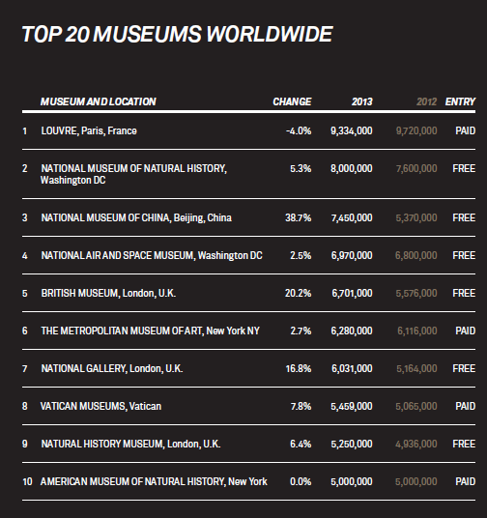
Source:
Theme and Museum Index Report

Slide 10
National Parks System
What is a National Park?
  Pursuit of happiness
What value does a National Park bring to a community?
  Jobs
  Influx of money from out side of the community
  Preserves natural resources, historic places, unique features
  Education
  Public recreation
Identify National Parks of interest to you
Controversy in our National Parks
  NPR: Yellowstone National Park

Slide 11
Nation Parks in NYC
African Burial Grounds
Castle Clinton
Ellis Island
Gateway National Recreation Center
General Grant National Memorial
Governor's Island
Home of FDR
Lower East Side Tenement Museum

Slide 12
Working in National Parks
Park Guide: http://www.nps.gov/personnel/seasonal.htm#parkguide
Internships with the Delaware North Company http://www.delawarenorth.com/careers-internships.aspx

Slide 13
Examples of Parks & Recreation
Career Opportunities In NYC
New York City Department of Parks & Recreation
Central Park Conservancy
Bronx Zoo
New York Botanical Gardens
Brooklyn Botanical Gardens
Yankee Stadium & Citi Field
  F&B Department
  Luxury Suites
  Concession Management
  Ticketing Department
  Sales

Slide 14
What Would You Do?
Stake Holders
  Parks Department Recreation Manager
  Parks Department Facilities Manager
  Local restaurateur
  Community Board Member
  Private Donor
Who will use the park?
What facilities should be included? http://www.nycgovparks.org/facilities
What services/activities should be offered?
What is your “big draw”? Why will people visit your park?
Brian Lehrer, WNYC, 10/10/14 35-parks-130-million
Brian Lehrer, WNYC, 2012 Financing the Parks

Slide 15
