Slide 1
Project: Automatic ID Scanner
Alias: “ Go green, $ave time”
By Derek Ametam & William Wong

Slide 2
Main Objective for this Project
To Create a system for student to swipe their student ID when they enter the class .
To Use the constructed Technology to save precious time.
Making the world a better and convenient place to live.
Make the Professors job more easier than taking Attendance before class.
Saving some trees and going green to save our planet.

Slide 3
Application
The ID Scanner can be used in many places and for different reasons. In this project, its been used as a class register.
The students swipes their ID’s in the Id Scanner, to verify their present to school on that day.
Python records, process and output the data on a spreadsheet.
The Spreadsheet represents the student coming to school or not and if they were late or not.

Slide 4
Project Schedule
10/18/2012 – 10/24/2012 Begin Testing of USB Shield and Arduino Uno Board
10/25/2012 – 10/31/2012 Test USB Magnetic Stripe Reader (If device arrives by then)
11/01/2012 – 11/14/2012 Develop a functional prototype and code
11/15/2012 – 11/21/2012 Test prototype and code
11/15/2012 – 12/13/2012
11/22/2012 – 11/29/2012 Work on Presentation Slides
11/22/2012 – 12/15/2012
12/06/2012 Presentation Day
12/20/2012

Slide 5
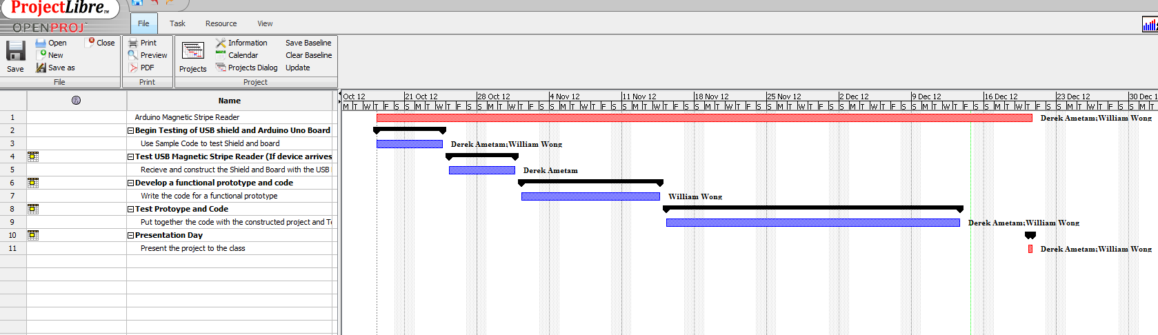
Schematic of the projects Schedule

Slide 6
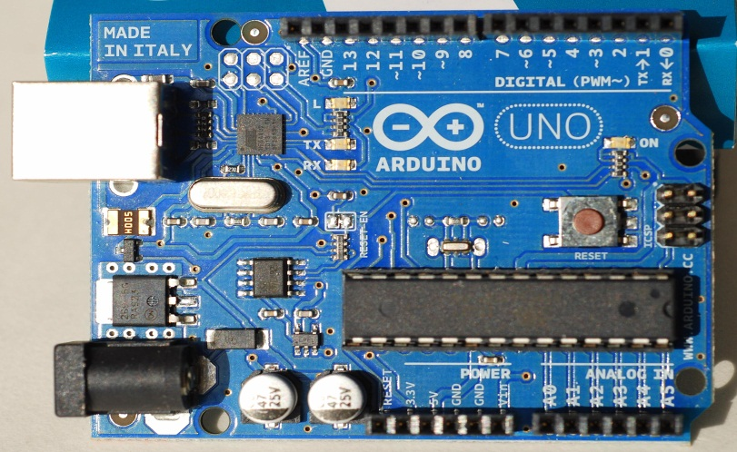
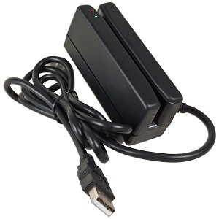
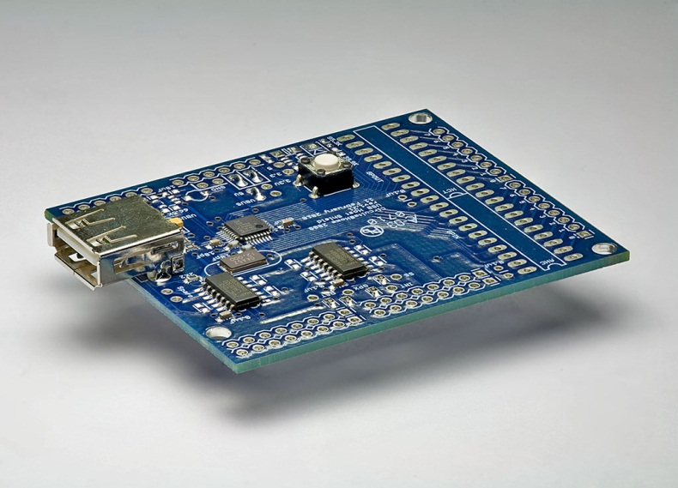

Equipment (Hardware)
Arduino Uno $29.99
Magnetic Stripe Reader $58.00
USB Shield for Arduino $30.00
Laptop

Slide 7
Equipment (Software)
Microsoft Excel 2007 or higher
Data Nitro Add-in for Excel
Python 2.7

Slide 8
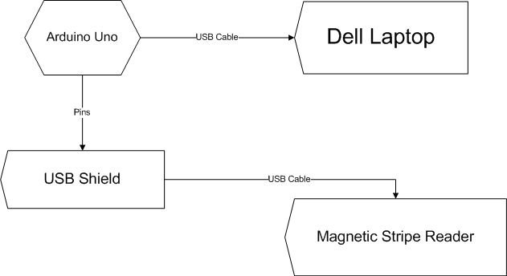
Physical Construction

Slide 9
How It Works
Student Scans Card
Python Code checks to see if name is already on roster
If name is on roster set to either 1 or 0.5
If name is not on roster, add name to the end of roster
If student not present to scan set to 0
Writes to Excel

