Slide 1
Understanding Beer
Prof. K. Goodlad
Spring 2017

Slide 3
What Ingredients are used to make beer?
____
____
____
____

Slide 4
What contribution does each ingredient make?
Water
Barley
Hops
Yeast

Slide 5
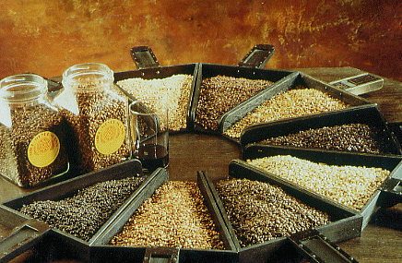
Ingredients: Barley
Barley gives beer color, flavor & is a source of sugar.
Most of the sugar will ultimately be converted into alcohol.
Garrett Oliver on Beer (Video)

Slide 6
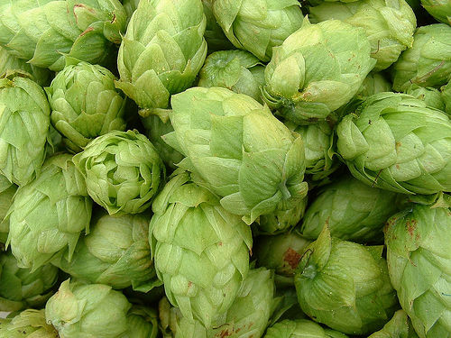
Ingredients: Hops
Hops are a flower that lends natural preservatives to beer along with bitterness & a range of flavors & aromas.

Slide 7
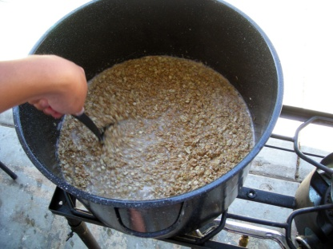
Making Beer
Making Beer with Garret Oliver of the Brooklyn Brewery (Video)
Wort
Hot, Sweet Liquid & Hops Combination Prior to Fermentation
Seperated in a Lauder Tun
Malting Barley
Barley that is allowed to germinate (starch turns to sugars)
Dried and roasted in a kiln in temps ranging from 122˚f-220˚f
Mash
Water + malted barley
Use a Lauter tun to separate grains (draft) and liquid (wort)
Boiled in a kettle
Notes:
Malting Barley: http://www.rpi.edu/dept/chem-eng/Biotech-Environ/beer/malt/barley1.htm This is accomplished industrially by increasing the water content of the seed to 40-45% by soaking it for a period close to 40 hours. The seed is then drained and held at a constant temperature (60 F) for close to 5 days until it starts to sprout. The barley is slowly dried in a kiln at temperatures gradually rising to 122 F for lighter malts and 220 F for darker malts. This kiln drying takes about 30 hours.
The next step to prepare the malted barley for brewing is termed "mashing." It is a process of grinding the malted barley into granular sized pieces. This ground malt is mixed with water in order to dissolve the starch, sugar and enzymes within the malted barley. The temperature of the "mash" is then raised to 150-160 F,

Slide 8
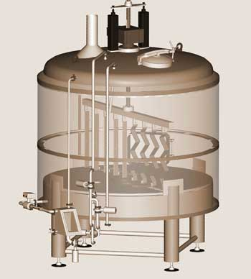
Lauter Tun
To convert mash into wort

Slide 9
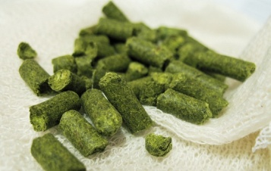
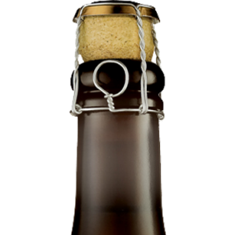
Making Beer (Cont.)
Fermentation
Bottling
Fine and filter (most beers)
Carbonation added
Alternate Style: Bottle Conditioning
Yeast removed, can be aged
Moved from kettle to fermentation tank
Hops
Added for Bitterness + Aroma
Takes 7-10 days
Bottled after boiling, fermentation takes place in the bottle
Garrett Oliver on Fermentation (video)
Garrett Oliver on Local 1 (video)

Slide 10
Mondern Marvels clips 1-5
History, marketing and production: http://www.youtube.com/watch?v=_DbPUtXtudE&feature=BFa&list=PL7FAA63C233DD4A12
All About Hops: http://www.youtube.com/watch?v=NWk6cBHDEcI&feature=BFa&list=PL7FAA63C233DD4A12
Taste and Yeast, Mass production vs. craft http://www.youtube.com/watch?v=7Nhw6OctrNY&feature=BFa&list=PL7FAA63C233DD4A12
Selling beer: http://www.youtube.com/watch?v=vk6SxA8eDyg&feature=BFa&list=PL7FAA63C233DD4A12
Beer Service: http://www.youtube.com/watch?v=v_N_c6G5Aww&feature=BFa&list=PL7FAA63C233DD4A12

Slide 11
Types of Beer
Ale | Lager
Top Fermenting | Bottom Fermenting
Porters | Pilsner (dominate in US)
Stouts | Bock
Wheat Beers | Double Bock

Slide 12
Serving Temperatures
Why are some beers chilled more than others?
45 °F
Light style beers (pale lagers);
46 °F
wheat beers;
48 °F
for all dark lagers, altbier
55 °F
British ale, stout
59 °F
dark ales
Notes:
Wikipedia:
Beer writer Michael Jackson proposed a five-level scale for serving temperatures: well chilled (7 °C/45 °F) for "light" beers (pale lagers); chilled (8 °C/46 °F) for Berliner Weisse and other wheat beers; lightly chilled (9 °C/48 °F) for all dark lagers, altbier and German wheat beers; cellar temperature (13 °C/55 °F) for regular British ale, stout and most Belgian specialities; and room temperature (15.5 °C/59.9 °F) for strong dark ales (especially trappist beer) and barley wine.[

Slide 13
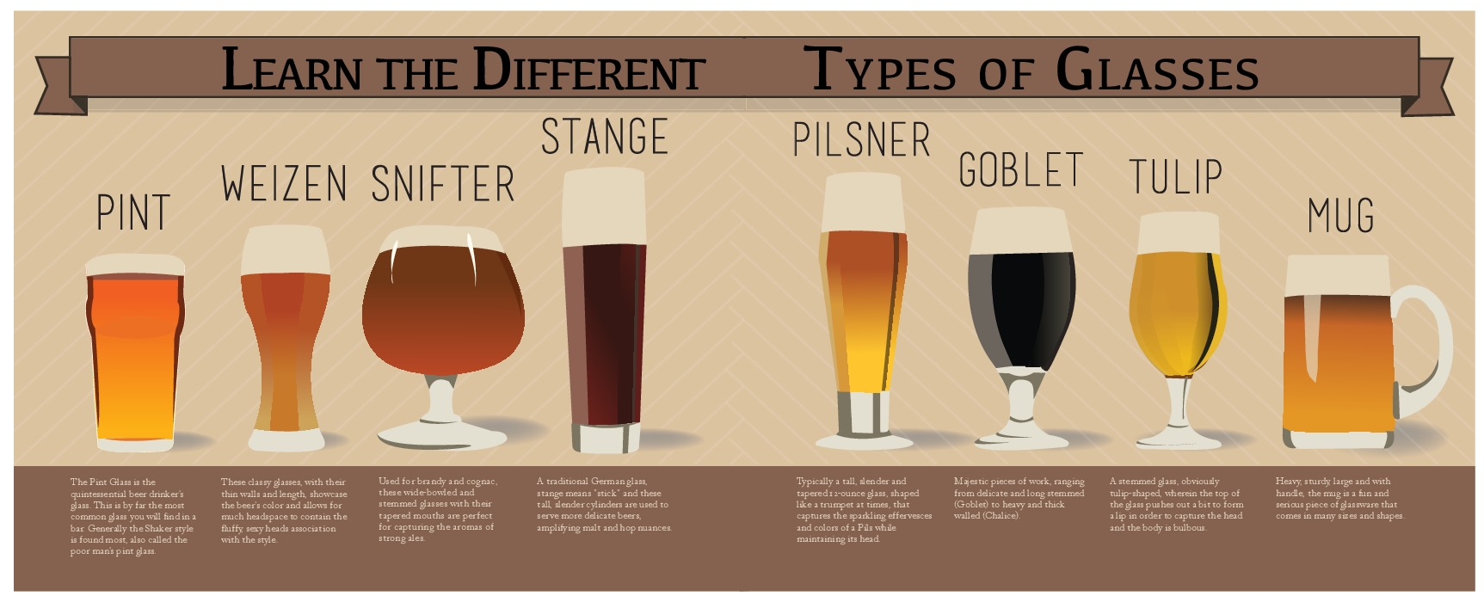
Source : https://www.finedininglovers.com/blog/food-drinks/different-beer-glasses/

Slide 14
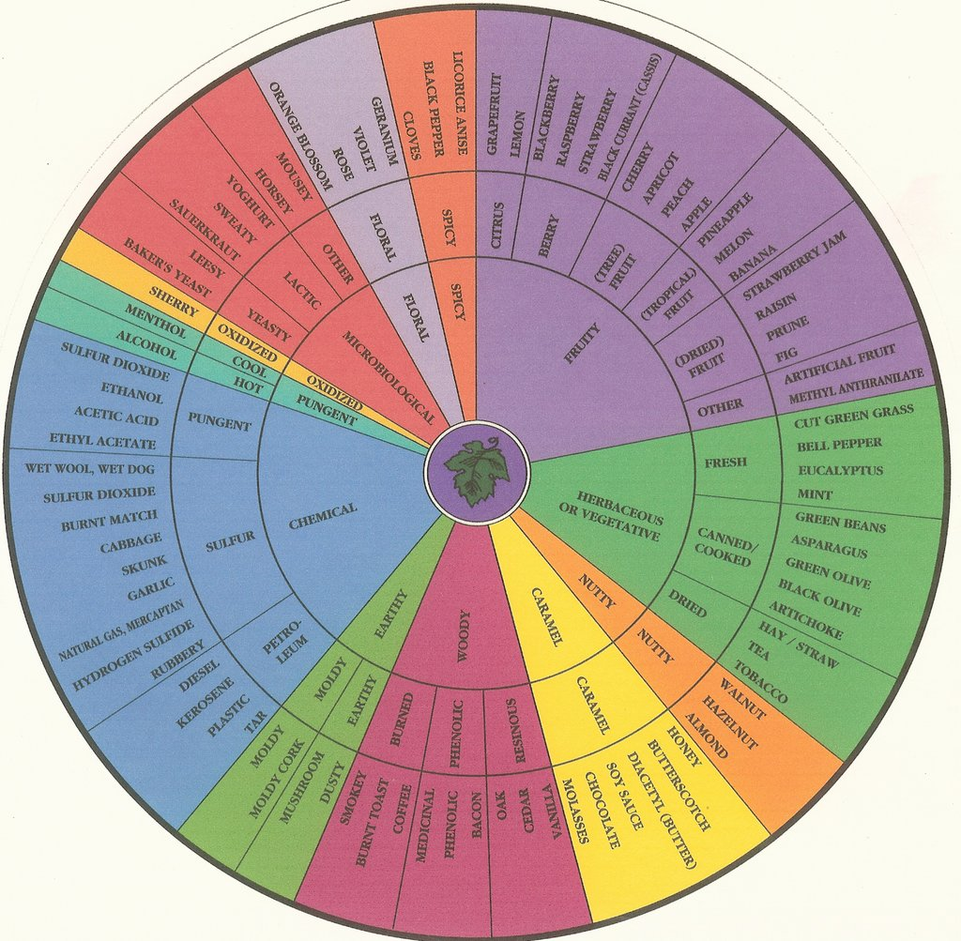
Tasting

Slide 15
Tasting
Brooklyn Lager
Brooklyn Summer Ale
East India Pale Ale

Slide 16
Recommended Reading
“Beer School” By Steve Hindy & Tom Potter
“The Best of American Beer and Food” By Lucy Saunders

