Slide 1
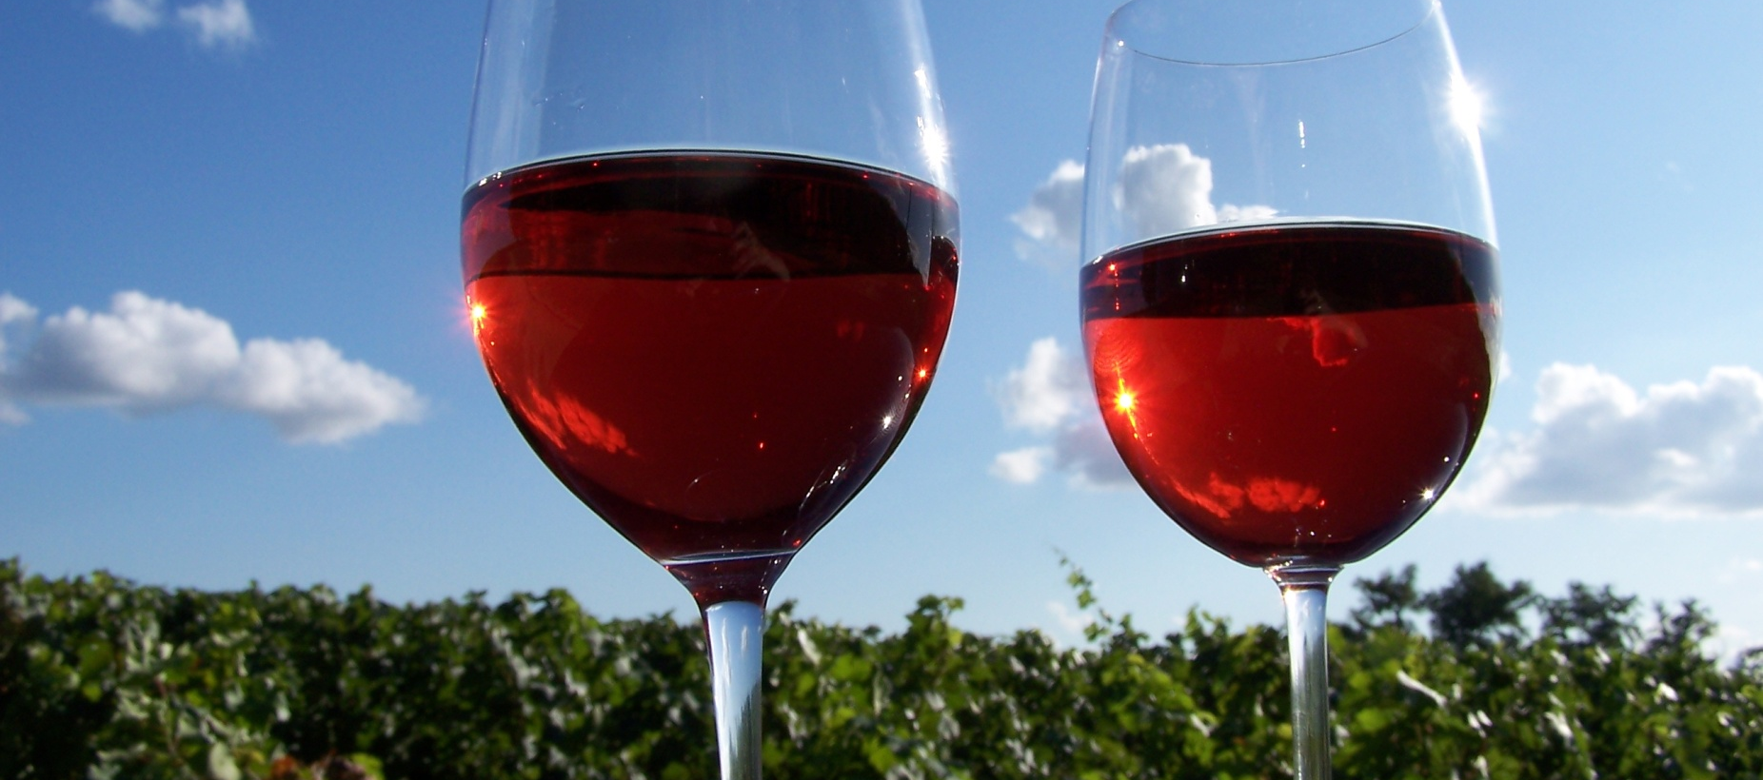
Red wine of France
Karen Goodlad department of hospitality management
Spring 2017

Slide 2
Objectives
  Discuss the laws of French wine regions
  Match appellations with the regions where they are located and their principal grapes and wine styles
  Discuss wine making methods used to make red wine in various regions of France
  Explain the factors that affect the taste of red wines of France

Slide 3
European Union Wine Regulations
Protected Designation of Origin (PDO)
  Produced from grapes grown in the specific territory (100%), listed the name on the label
  Names are registered and delimited boundaries are assigned
  Defined Viticulture practices: Max. yields, permitted grape varieties…
  Defined Vinification practices
  Defined wine characteristics
  Can be identified by the traditional terms of the country
  Typically do not include grape variety on label
Protected Geographical Indication (PGI)
  85% of grapes come from a registered geographical region
  Viticulture and Vinification are defined but less strict than PDO
  Grapes listed on the label will be listed in descending order.
  May list grape variety on label
Wine/Table Wine:
Least strict, No geographical indication, vintage, grape on label

Slide 4
What do the wine laws tell us?
Grape
Winemaking Techniques
Cultivated and Harvested

Slide 5
French Regulation AOP/AOC = PDO
Under AOP regulations, France´s winegrowing areas are divided into:
Regions
Districts
Villages, towns, or communes
Individual vineyards or crus ("growths").

Slide 6
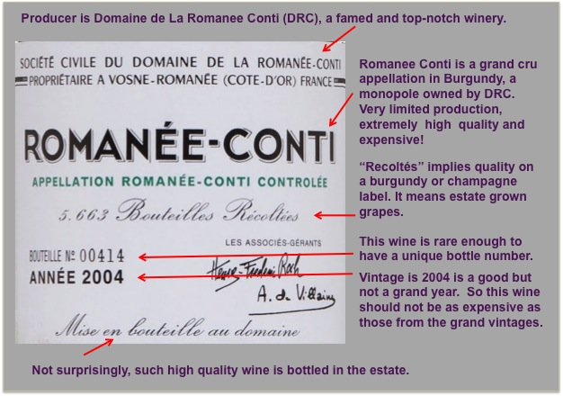

Slide 7
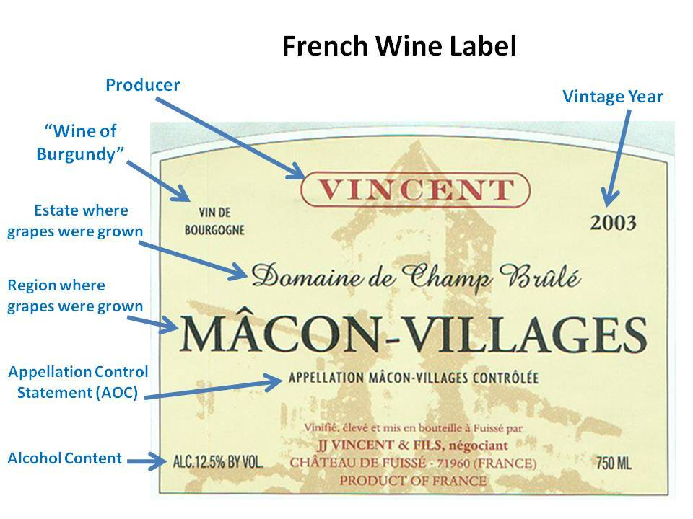

Slide 8
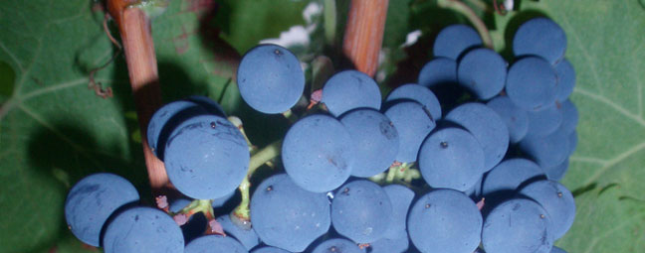
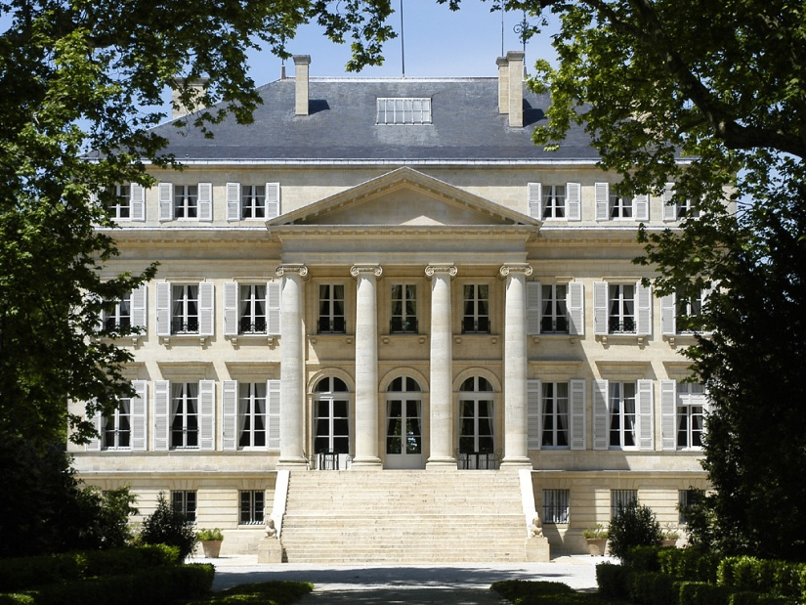
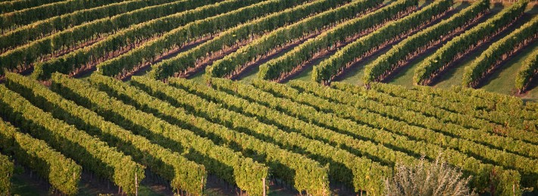
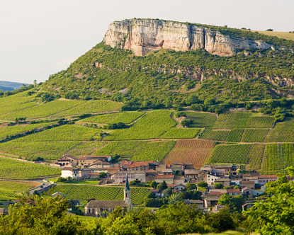
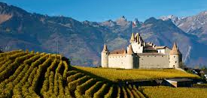
Red Wine Regions of France
Loire Valley
Bordeaux
Sud France
Burgundy
The Rhone Valley

Slide 9
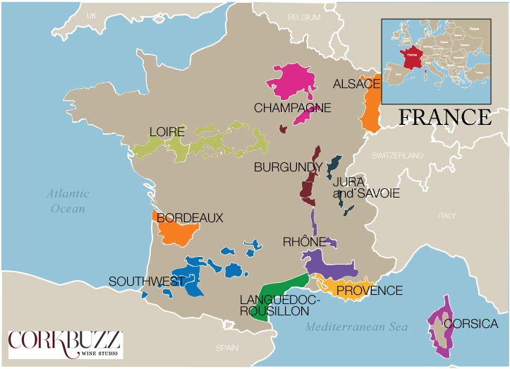
What is Terroir?

Slide 10
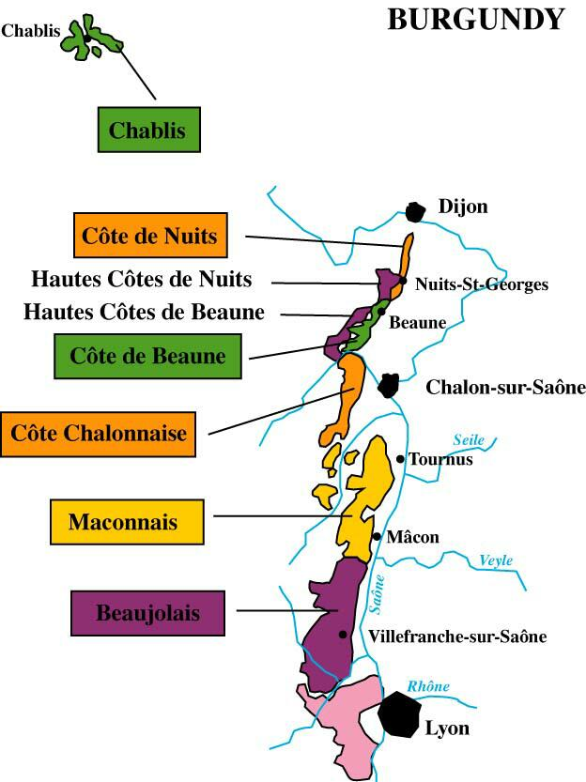
Burgundy

Slide 11
Burgundy, Cru System, established 1861
30 vineyards, all in Côte d’Or
Near hill tops
All reds come from Côte de Nuits
~1% of wine, age 20-30 years
Grands Crus
Premiers Crus
Regional
Village AOC
Mid range of hills
Label includes vineyard name as well as village name
More complex, more intense
~10% of all Burgundy Wine
Along low slopes & hill tops
All wine sourced from village
Lower yields, higher alc.
53 villages, 23% of all Burgundy Wine
General large areas, 65% of all wine from Burgundy

Slide 12
Burgundy
Red Wine Regions
Cote d’Or (Regional and Village and Cru)
    Climate Varies: Continental cold winters, warm summers. Changes with hills, Saone River, and course of weather
Cote de Nuit
  Soil: varied some chalk, limestone, marl (clay), gravel and sand
Cote de Beaune (White and Red)
  Soil: Limestone and Clay
Guild Somm Video: https://www.guildsomm.com/learn/videos/m/videos/16280
Notes:
50 Burgundy
30 village
17 Premier Cru
3 Grand Cru (mostly cote d’Nuit)

Slide 13
Beaujolais
Red Wine Region
Grape Variety: Gamay
Nouveau, Beaujolais, Village, Cru (10)
Soil: granite
Topography: hilly up to 3,300
Climate:
Vinification: Carbonic Maceration (not Cru)

Slide 14
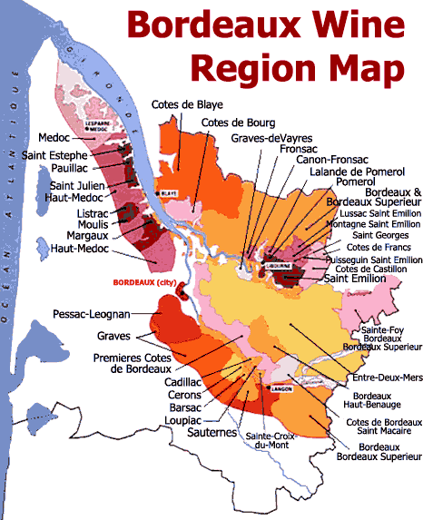
Bordeaux
Important water ways:
Atlantic Ocean
Gironde Estuary
Dordogne River and Garonne River
A Valuable Interactive Resource: http://www.bordeaux.com/us/Our-Terroir/The-Medoc

Slide 15
Bordeaux
Red Grape Varieties:
Cabernet Sauvignon, Merlot, Cabernet Franc, Petit Verdot, Malbec
  Climate: Maritime
  Soil: Gravel & Limestone (Left Bank)
Clay (Right Bank)
Viticulture: Depends on Appellation
Vinification: Depends on Appellation
Cru System: Depends on Appellation
Bordeaux
Video: https://www.guildsomm.com/learn/videos/m/videos/16292
Notes:
The Left Bank. The soil on the left bank of the Garonne and Gironde Rivers is primarily gravel, and the predominant red grape varietal is Cabernet Sauvignon. The wineries in the left bank generally produce full, elegant, and very tannic red wines that may require years to soften and develop.
Entre-Deux-Mers. This area is better known for its white wines than for its reds. But in recent years, it has become a principal source of light-bodied red wines that are made from Merlot and Cabernet Sauvignon and sold as Appellation Bordeaux Contrôlée.
The Right Bank. In the area on the right bank of the Dordogne River the soil is primarily clay. On the right bank, the wineries rely more heavily on the early-ripening Merlot grape. They generally produce softer, scented red wines.

Slide 16
Bordeaux
Important to know about Bordeaux
Premiers Cru of Medoc (Classification of 1855)
Appellations of Bordeaux
Medoc, Grave, St. Emilion, Fronsac, Pomerol
Appellations of the Medoc
  Saint Estephe, Pauillac, Saint Julian, Moulis, Listrac, Margaux
Saint Emilion Grand Cru vs. Grand Cru Classe

Slide 17
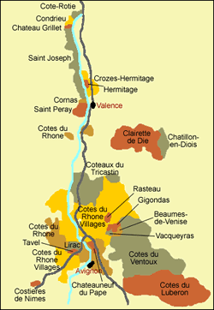
The Rhone Valley

Slide 18
The Rhone Valley
Northern Rhone Valley
Southern Rhone Valley
Location
Grape variety
Climate
Soil
Viticulture
Vinification
Location
Grape variety
Climate
Soil
Viticulture
Vinification

