Slide 1
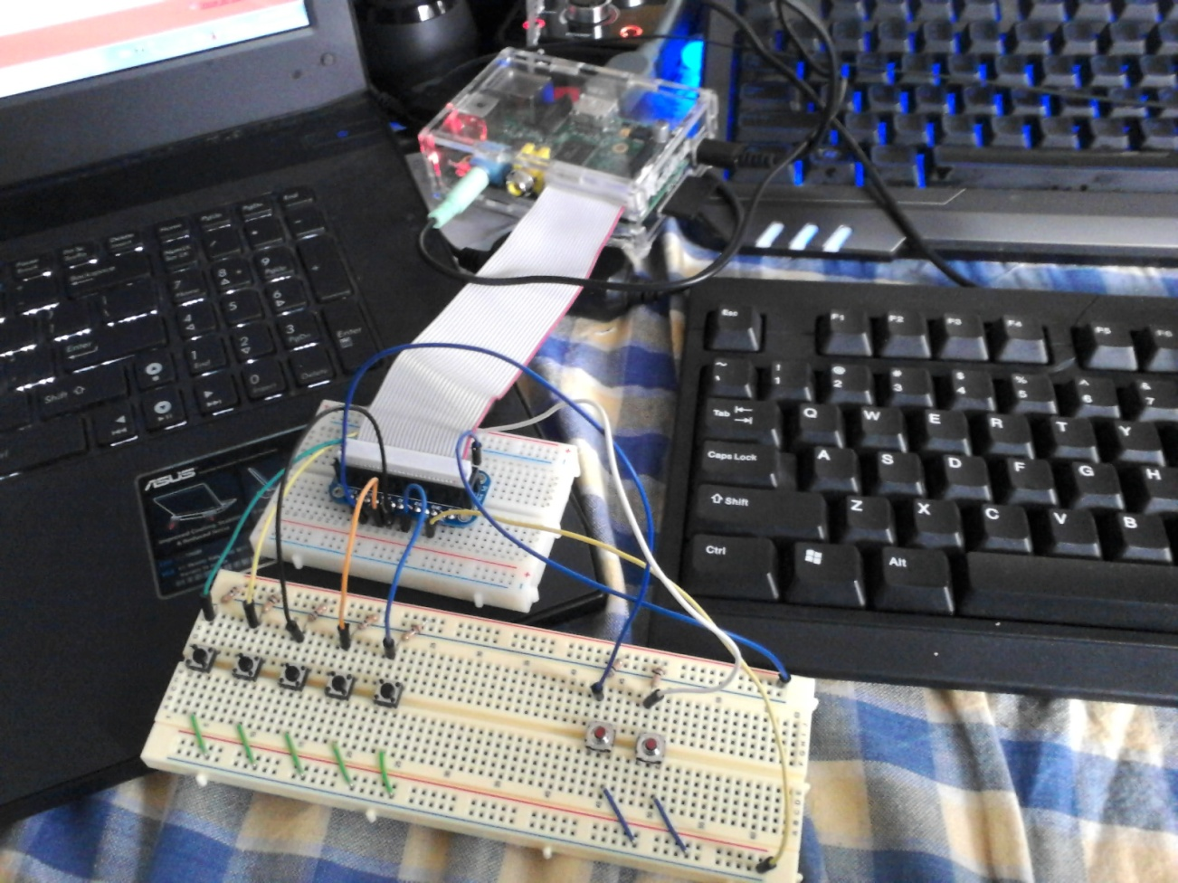
Pushbutton Music Player Using Raspberry Pi
By: Paul Baek

Slide 2
Materials
Breadboard
7 push buttons
7 10k ohm resistors
Raspberry Pi Budget pack from Adafruit.com
Budget pack includes the following:
GPIO Kit, Wires, 4 GB SD card, Raspberry Pi enclosure, Raspberry Pi power supply, small breadboard.
Raspberry Pi

Slide 3
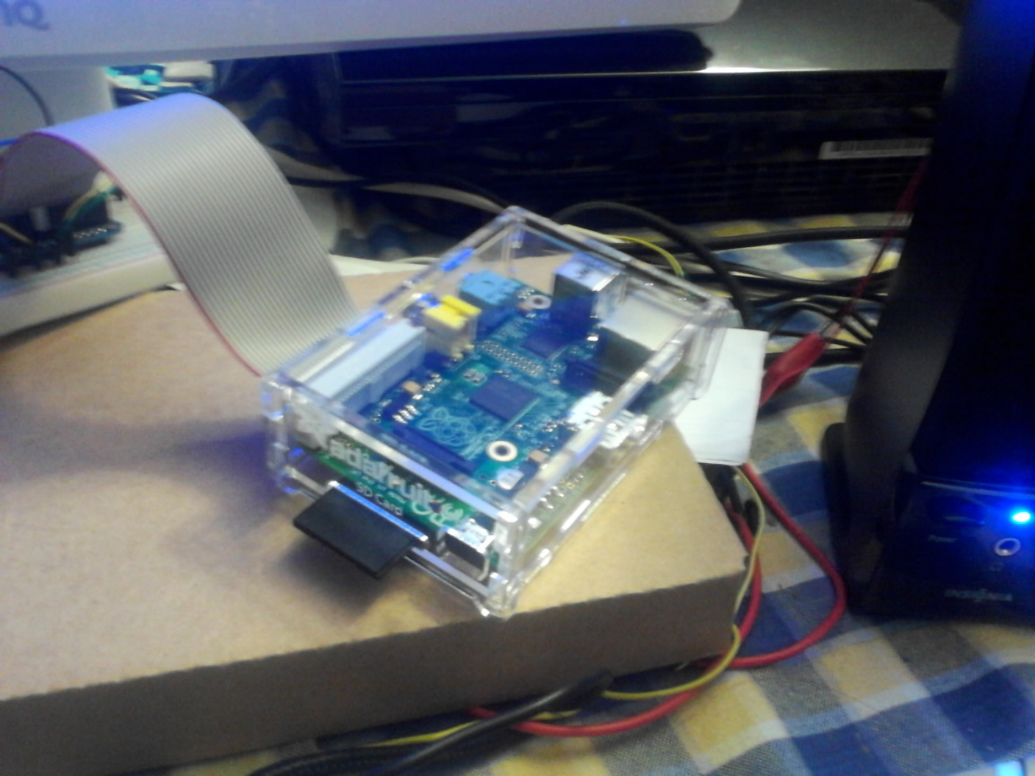
Raspberry Pi

Slide 4
What is it?
The Raspberry Pi is a Linux based computer that is about the size of a credit card. It can be used for computing, however, it is best used for personal projects and/or used as an embedded device.
The ability to connect to and program it’s GPIO pins allow the user to connect sensors, buttons, switches, etc. to the Raspberry Pi.

Slide 5
Objectives
To make something practical that I can also use at home.
I wanted to create a music player that doesn’t run on my PC so I can reduce processing power used.
Make it controllable with push buttons.

Slide 6
Wiring the Breadboard

Slide 7
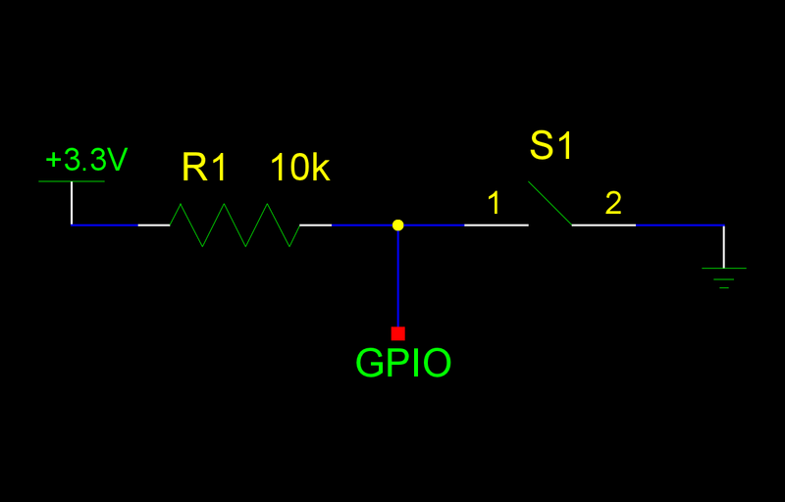
Button Schematic

Slide 8
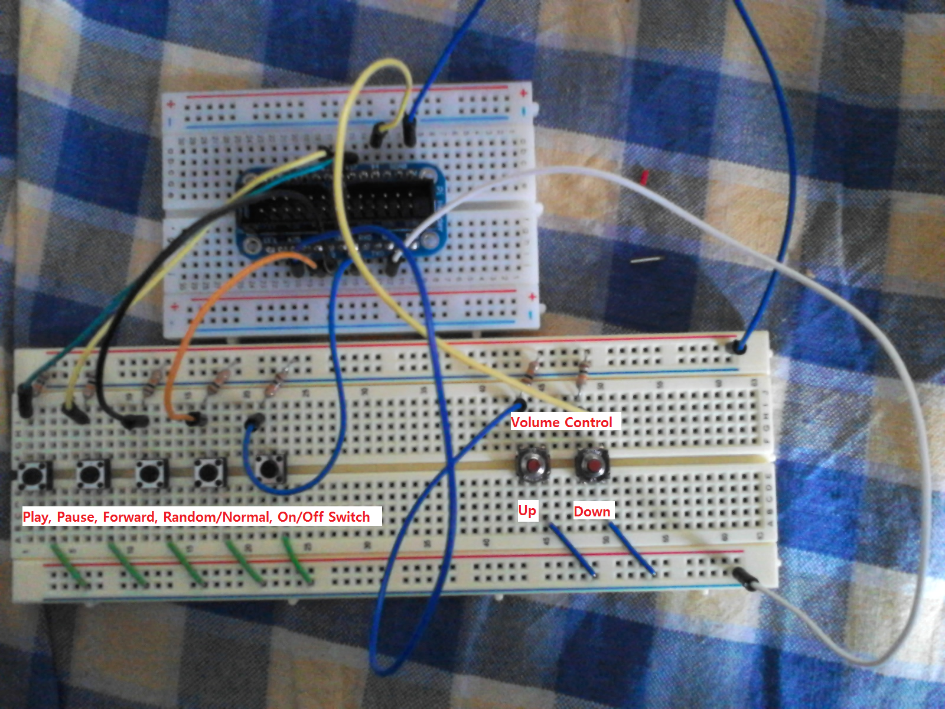
Wiring / Button Layout

Slide 9
Python Code
Key points

Slide 10
Key Press Function
MPG321 uses the Control+C key press to skip forward to the next song. To bind this to a push button, I had to create a special function and variable.

Slide 11
Contol C function
Control_c_sequence = ‘ ‘ ‘keydown Control_L
key c
keyup Control_L
‘ ‘ ‘
Def keypress(sequence):
p=Popen([‘xte’], stdin=PIPE)
p.communicate(input=sequence)
return 0;

Slide 12
Signal interrupt
An issue I came across when using the control c input was that it’s the program shutdown button for python. I had to find a way to block the shutdown signal, so I created a function to do just that.

Slide 13
SIGINT function
Def sigint_handler(signum, frame):
pass
The following line of code had to be inserted after the keypress sequence:
signal.signal(signal.SIGINT, sigint_handler)

Slide 14
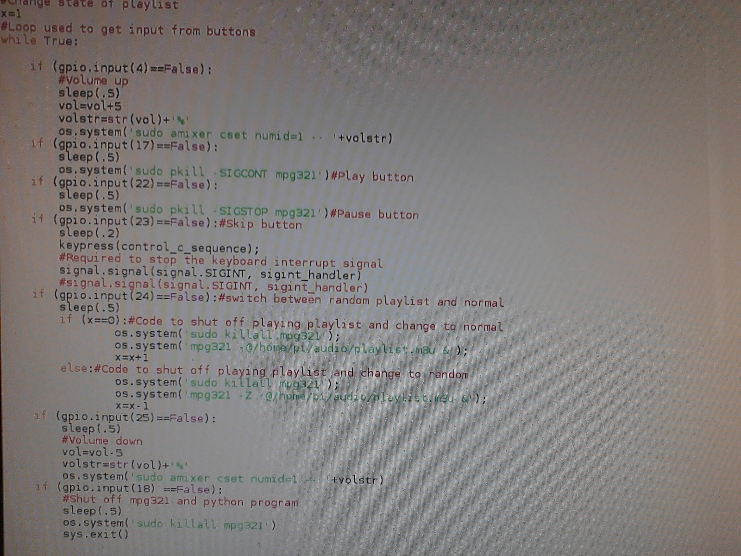
Reading the GPIO input

Slide 15
Put it all together and you get….

Slide 16
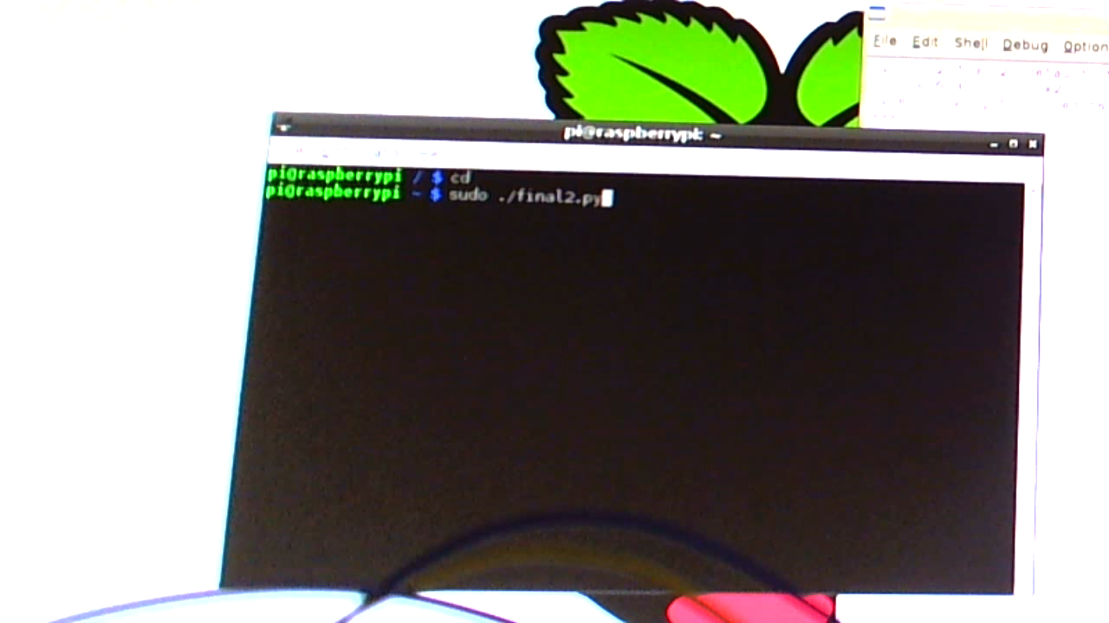
Music Player Demo

