Slide 1
MIDI Controller
By: Ronal Inga
Jeyner Cespedes

Slide 2
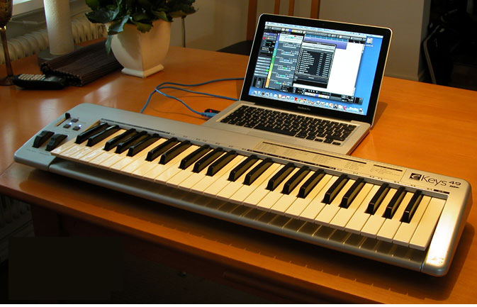
What is MIDI
Musical Instrument Digital Interface is a computer language that allows communication with other devices
Carries instructions of music describing what notes are being play, length, velocity, tempo, etc.
Can be programmed to save instruments information in 16 different tracks.

Slide 3
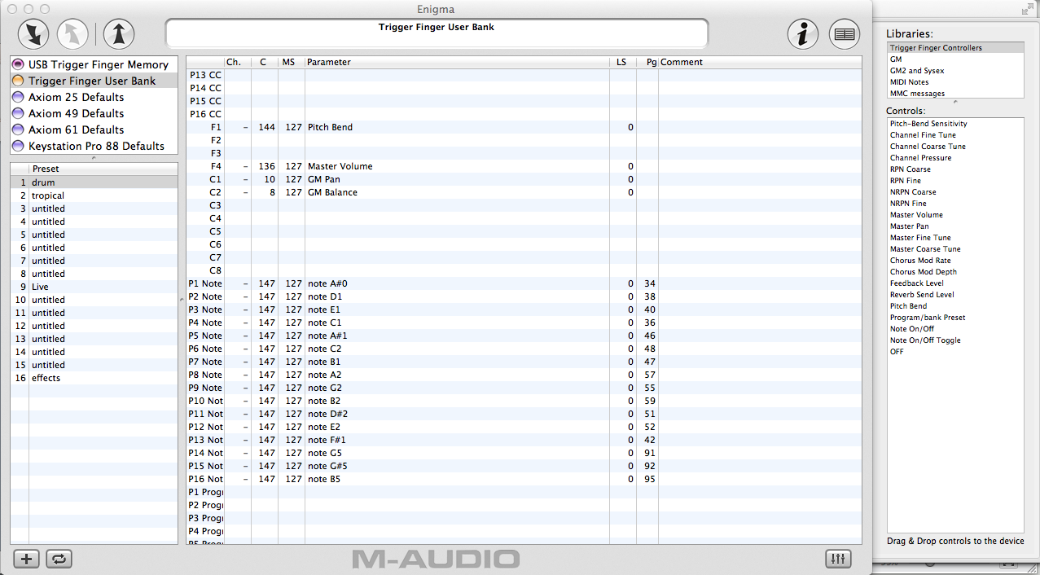

Slide 4
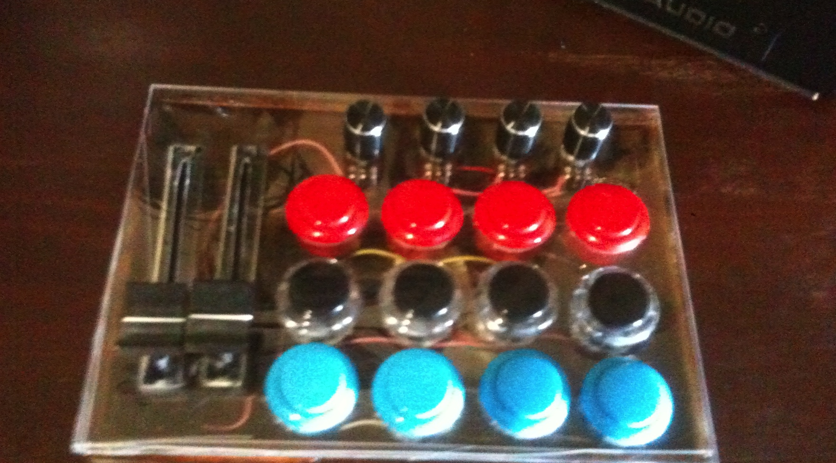
What is a MIDI controller?
A MIDI controller can send and receive MIDI messages from your PC, allowing direct control of your software. Not only that, but the controls can generally be mapped to anything your like. So what might be a volume fader for one person can be an effect filter for another

Slide 5
Components/Prices
Arduino UNO Microcontroller
12 x Sanwa 24mm arcade buttons $26.28
4 x 10k linear potentiometer $4.88
4 x Pot knobs $3.80
2 x 10k linear sliding potentiometer $7.54
2 x Slider knobs $2.04
1 x 4.7 kΩ resistor $0.10
50 x wires/jumpers $5.00
1 x Wood enclosure $5.00
1 x plastic sheet $3.00

Slide 6
Tools/Programs
Soldering iron & Solder
Wire stripper
Needle Nose pliers
Drill bits: 24mm spade, 11mm, 7mm countersinking bit
Time & patience

Slide 7
Programs
Arduino IDE
Audio MIDI setup/IAC driver (MAC)
Serial MIDI converter
Traktor Pro

Slide 8
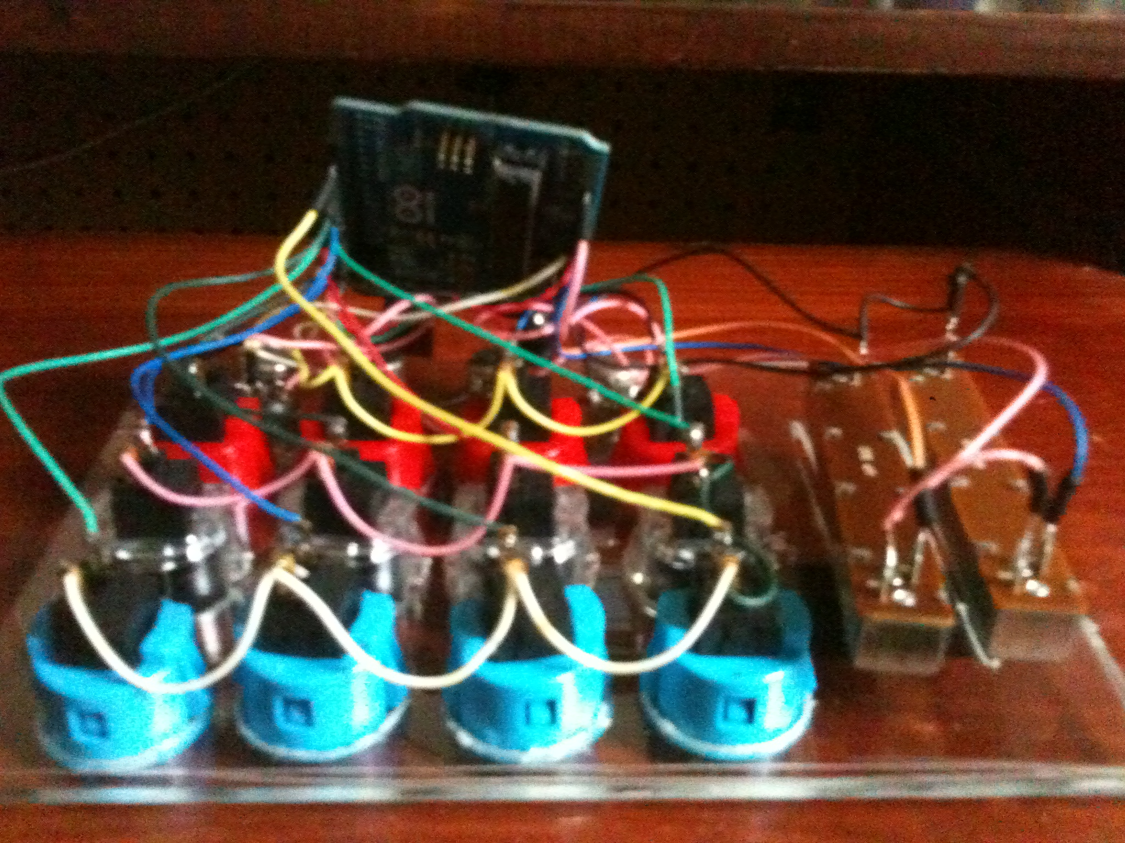
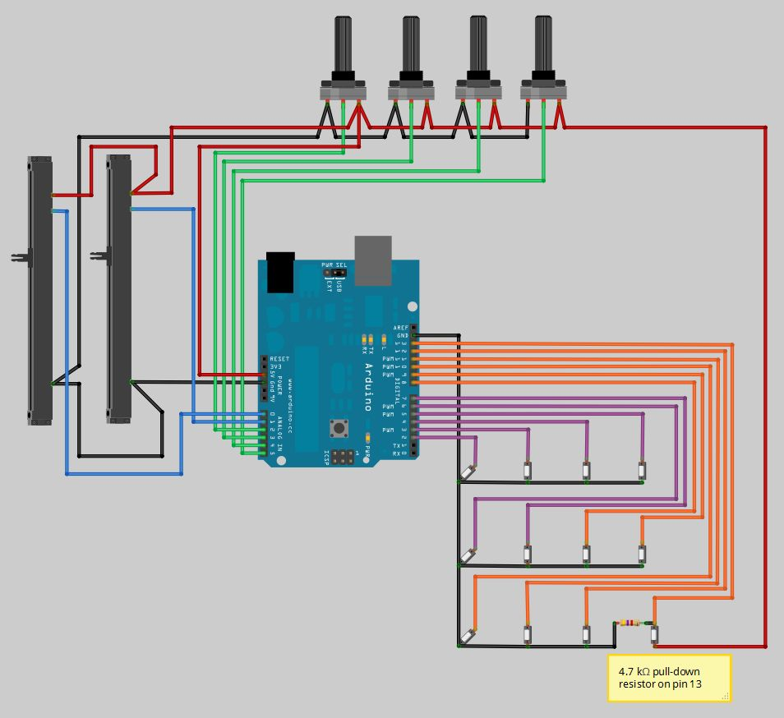
Assembling

Slide 10
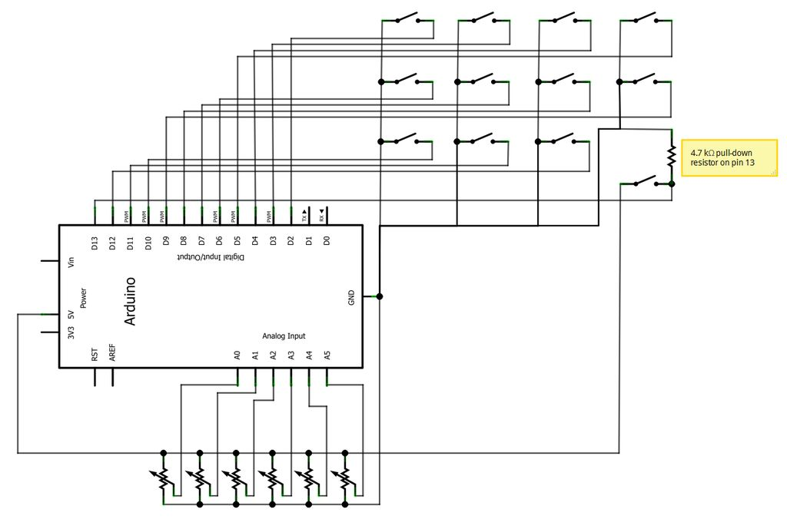

Slide 11
Programming
Upload the file code to the Arduino Uno board using Arduino IDE.
Using the IAC driver add two new ports:
Input from Audio software
Output to Audio Software
These ports will communicate from the device to the Traktor.
Download Serial to MIDI converter software from
www.spikenzielabs.com
Run the software to select the Arduino’s serial port, sound rate, input and output port.
This program will convert the signal from Arduino into MIDI.

Slide 12
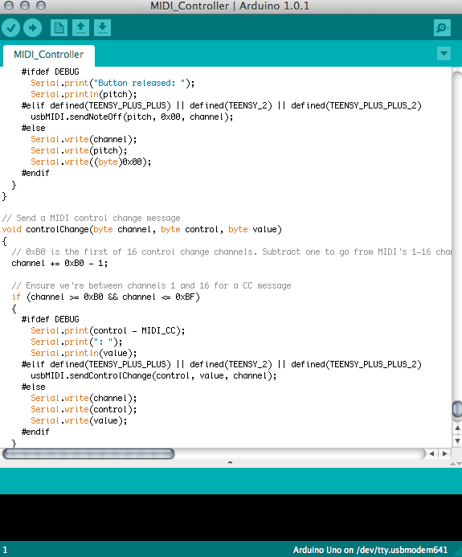
Arduino Code

Slide 13
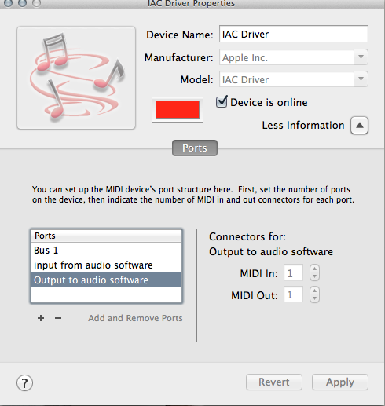
IAC Driver

Slide 14
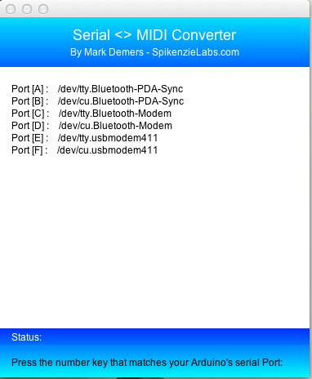
Serial to MIDI converter

Slide 15
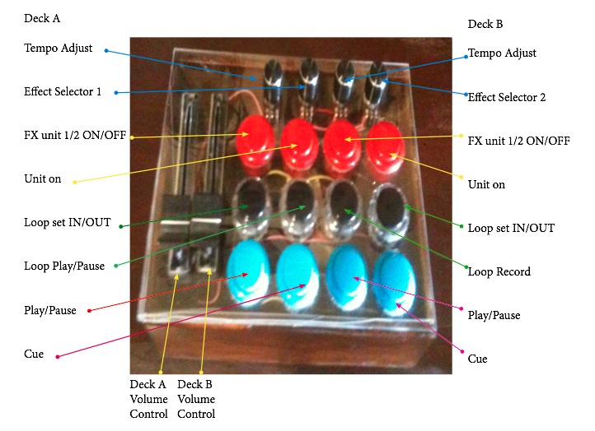
Mapping

Slide 16
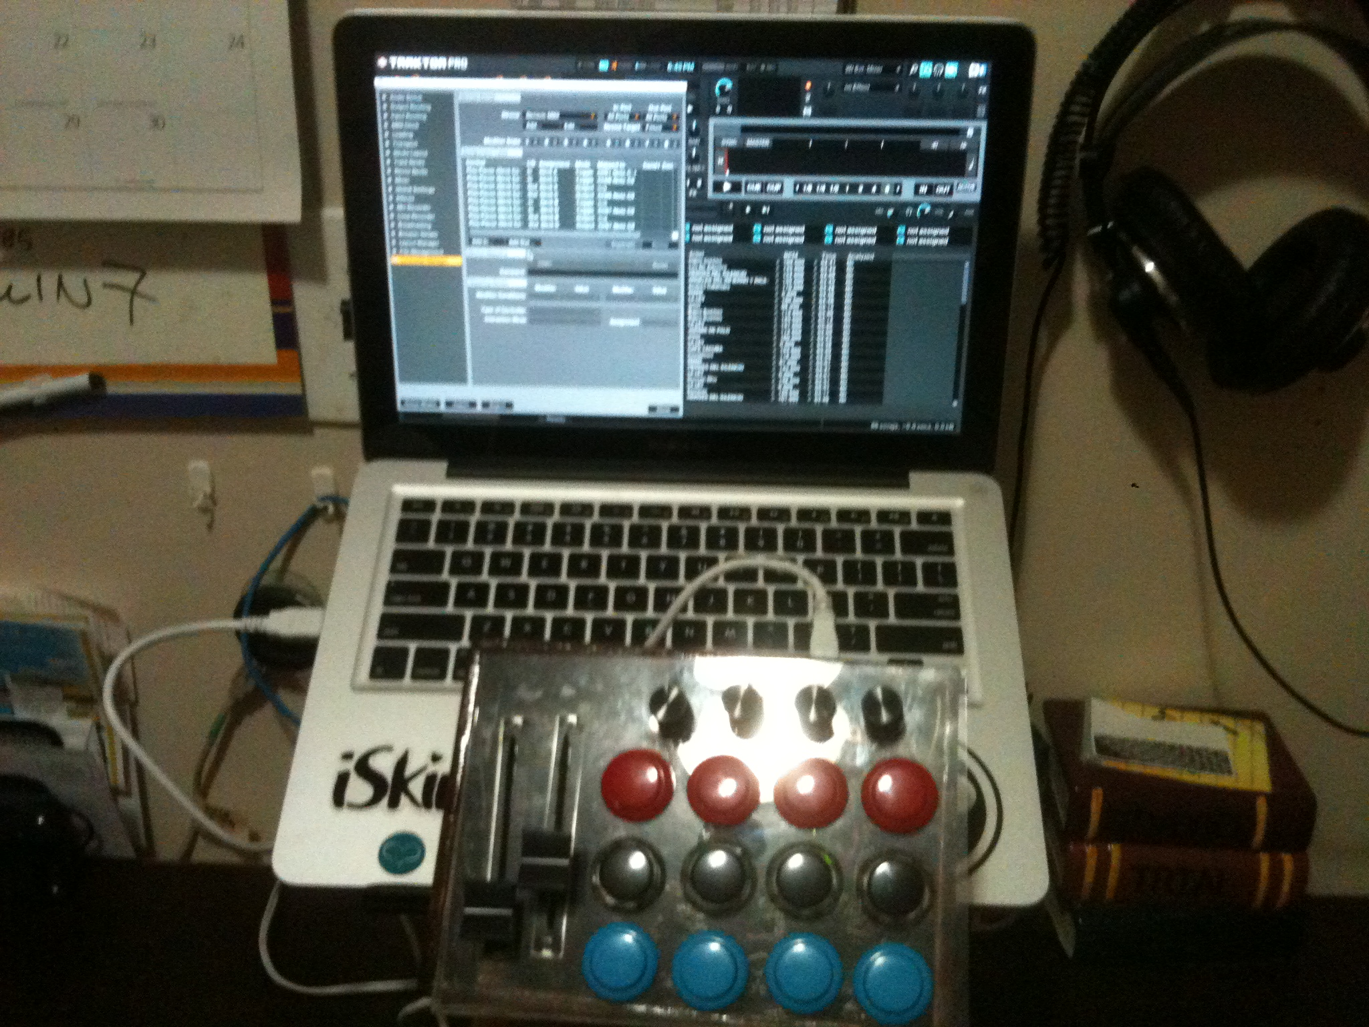

Slide 17
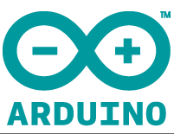
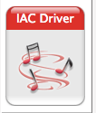

How they communicate?

