Slide 1
ORGANIZATIONAL CHARTS
Illustrate the relationships in groups
Show reporting structure
Name titles, define roles
Show limits, boundaries

Slide 3
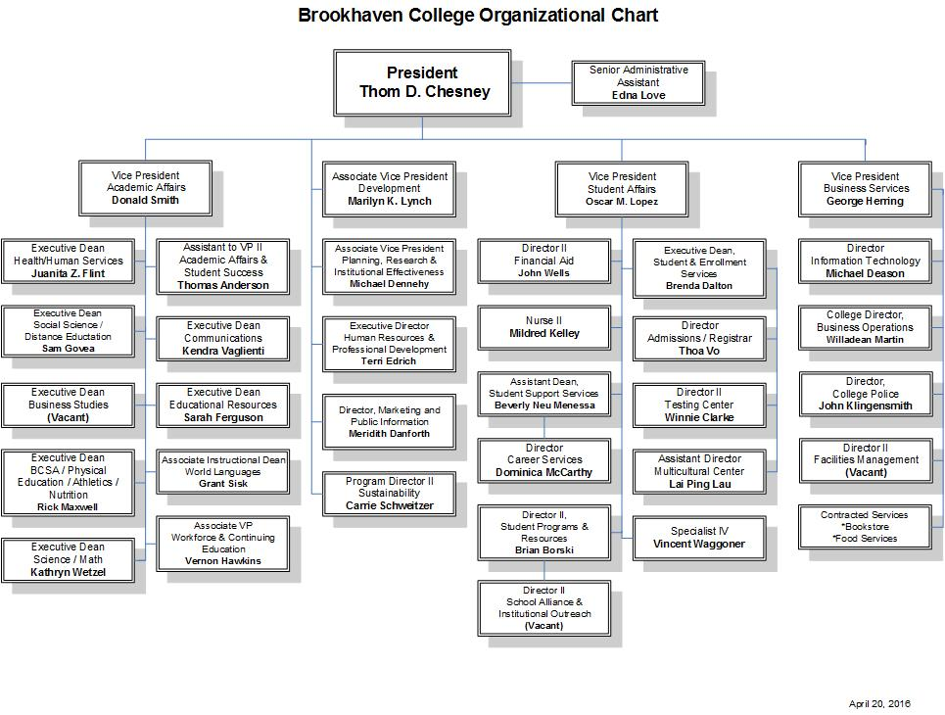

Slide 4
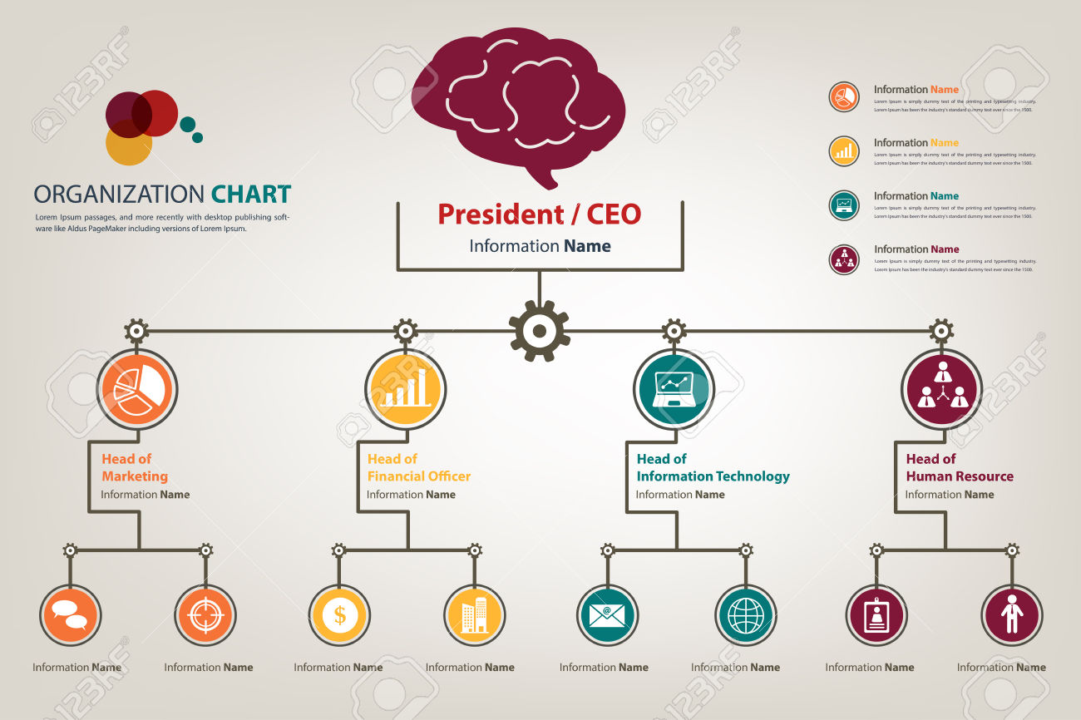

Slide 5
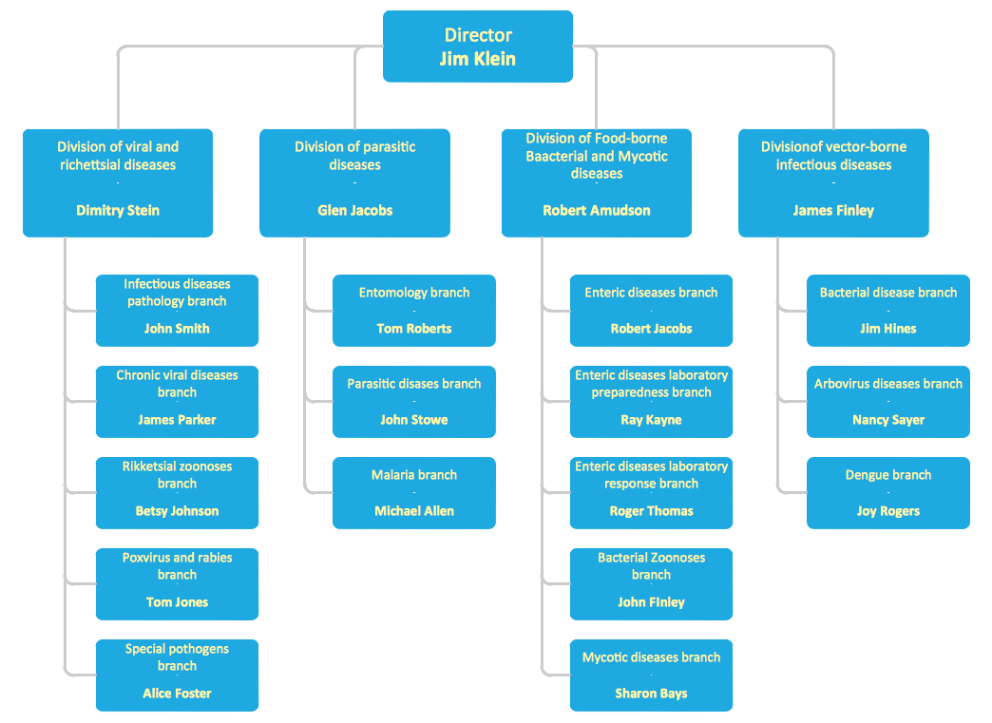

Slide 6


Slide 7
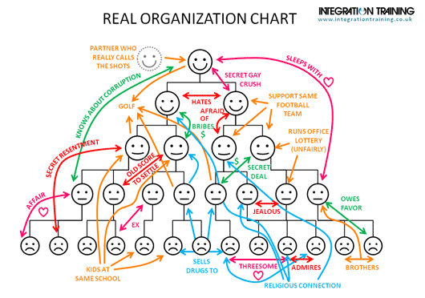

Slide 8
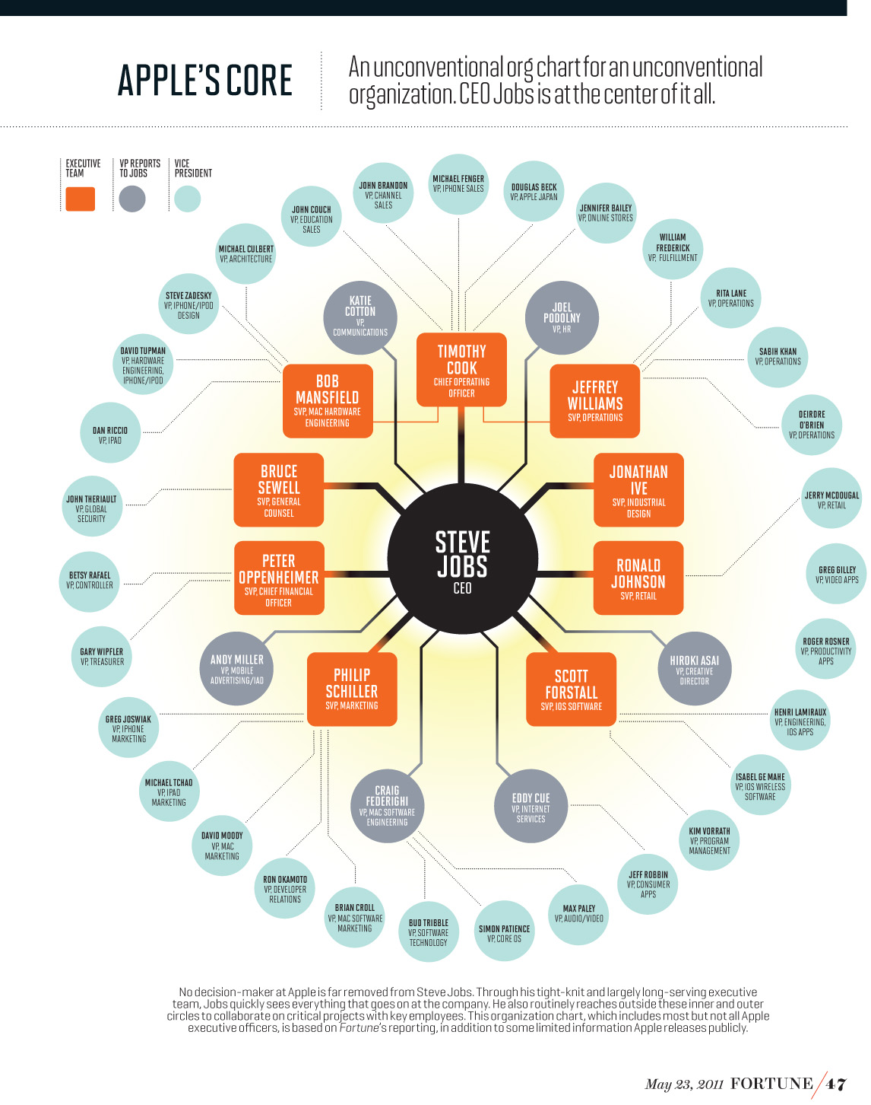

Slide 9
