Slide 1

Elevating Your Print from Good to Great

Slide 2
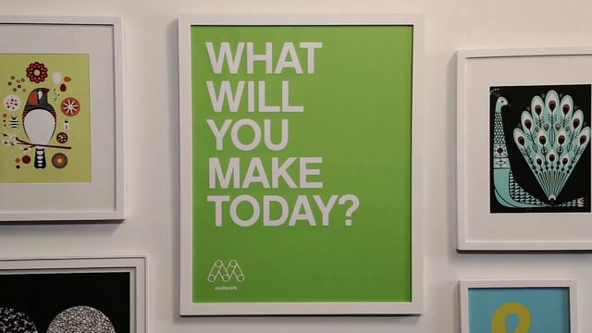
https://vimeo.com/67919457

Slide 3
Why Print?
Print is vital and relevant in the Digital age
  Growing
  From inform to inform + inspire/motivate/connect
  Not either/or but both/and
  A differentiated component in a multi channel world
How to inspire/motivate/connect with print
  CAWP inspires no one
  Our papers are uniquely suited to print’s new role
Notes:
Competition for our audience’s attention
Need something with staying power
Slow people down, activate their senses

Slide 4
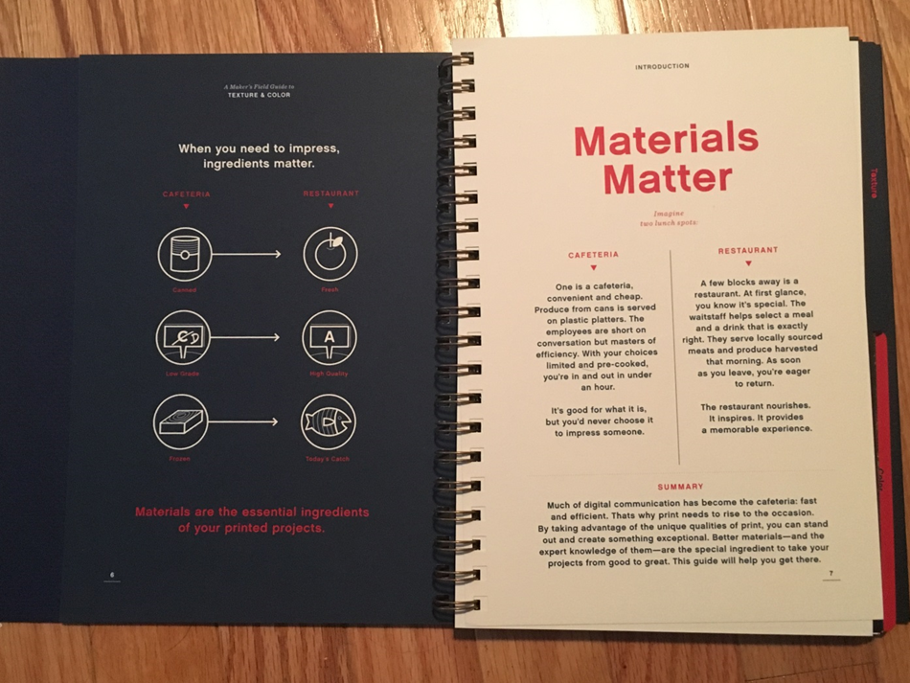
Consider for a moment…
Notes:
If we are going to print, we should do it well.
Pg 7

Slide 5
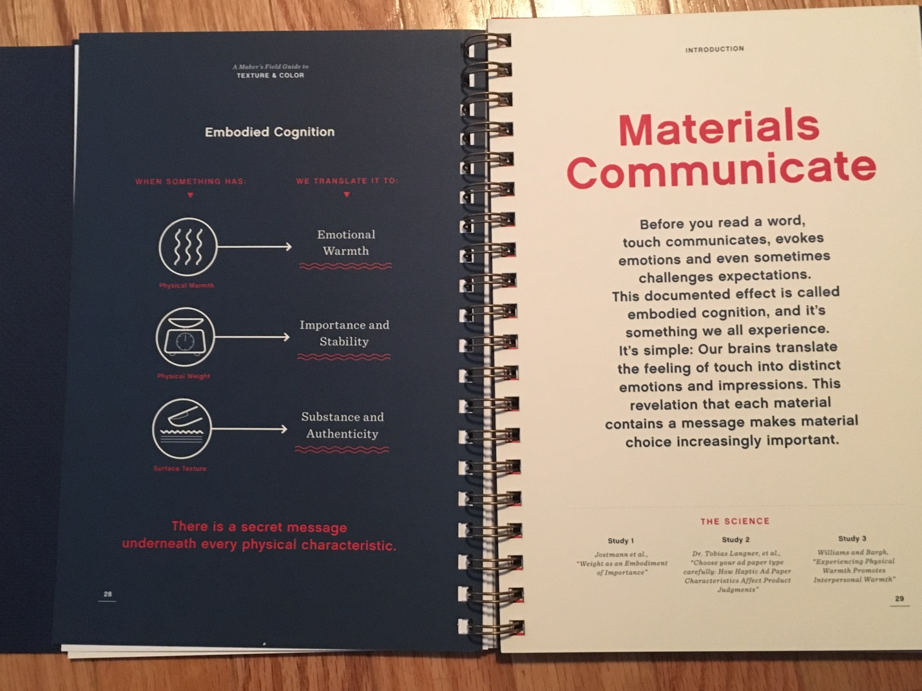
Notes:
Business card
Emobodied cognition
If materials are communicating, we need them to communicate the right thing.
Materials should be considered at the time of design, the same time font is being considered, bc they communicate just as much as words.
You should be well versed in paper to make sure you get the end result you’re looking for.

Slide 6
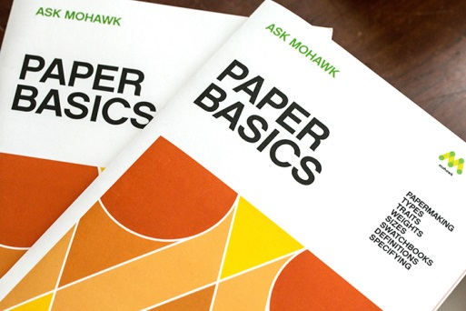
The Basics

Slide 7
Types of Paper – pgs. 5-11
Coated $
Offset and Opaque $-$$
Text and Cover $$-$$$
Writing $$$
Specialty $$$-$$$$

Slide 8
Paper Traits – pgs. 14-15
Formation
Opacity
Brightness/Color
Finish/Smoothness
  Coated – Gloss, Dull/Silk/Satin, Matte
  Uncoated – wide variety
Side-to-side Consistency
Printability
Environmental Qualities
Paper Permanence
Weight
Notes:
Formation related to quality – best in higher end papers
Opacity – lots of text? Heavy ink coverage?
Brightness
Finish – Coated - Makers, next slide
Side to side consistency – Planning artwork layout, ex. Textured/embossed papers
Printability – related to all of the above factors, assocaited with price
Environmental qualities – FSC, Recycled, Windpower, Carbon neutral; consider the project (i.e. sustainability report)
Paper permanence – archival qualities, cotton

Slide 9
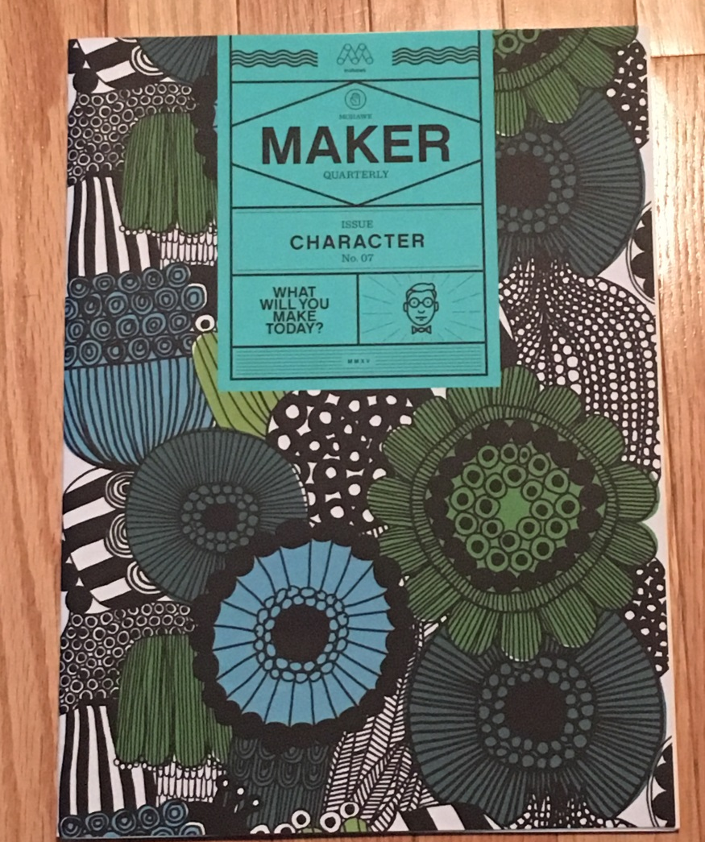
Texture

Slide 10
Paper Weight – pgs. 16-17
Caliper
M Weight
Basis Weight
  Writing
  Text
  Cover
GSM
Notes:
Once you’ve decided general paper type, we need to consider weight

Slide 11
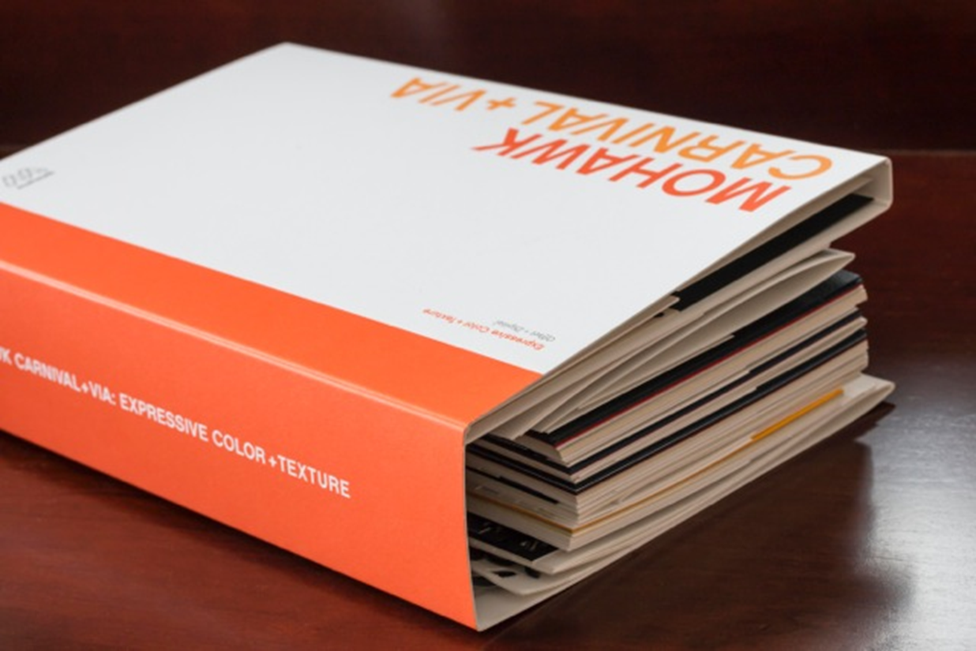
THE TACTILE EXPERIENCE
Paper Specification
Using Swatchbooks
Notes:
All swatchbooks are different, but they all include similar info.
Key specification info – color/brightness, finish, basis weights, opacity, recycled content/enviro info, sample pieces
Explain our swatchbook
Consider print process – offset, digital, foil stamping, embossing, engraving, letterpress

Slide 12

Don’t forget the envelope!
Notes:
Guide to envelope styles, sizes, enclosure sizes on pgs 16-19
Samples in back pocket along with checklist
Envelopes are so important to getting mail opened – the most expensive direct mail piece is the one that doesn’t get opened!
Dish Network example

Slide 13


Choose the paper which will adequately tell your story… Use a paper which will tell a story of cheapness ~ if that is your story… But if your story is one of quality, do not overlook the subtle force of suggestion in the choice of a paper to match it.
STRATHMORE
Mittineague, Massachusetts
Notes:
Paper knowledge is key to accomplishing the goals you set forth as you design and produce print work. The more you know, the better decsions you can make…and the more you can convince those who don’t know print but keep pushing back on the budget why your recommendations should be taken seriously.

Slide 14
Reference tools
Field Guide - https://www.mohawkconnects.com/referral/newsletter?type=promotions&items=76-702621602
Maker Quarterly - https://www.mohawkconnects.com/marketing-page/cultureofcraft
Product info – www.mohawkconnects.com
Inspiration – www.feltandwire.com

