Slide 1
Tourism
Chapter 9
Prof. Karen Goodlad
Fall 2016, Thursday

Slide 2
Student Learning Outcomes
Discuss scope of the hospitality and tourism industry
Gather information from observation in regard to the hospitality industry from a local, national and global perspective
Understand and discuss the roles and responsibilities of key executives and department heads in the hospitality industry

Slide 3
Overview of Lecture
Discussion of NY Times “36 Hours in…”
Review of Industry Leader/ Personal Essay
Tourism: A World Wide Powerhouse of Economic Stimulation
  What is the total number of American jobs supported by travel?
    14.4 million
  How many international visitors create one American job in tourism?
    33

Slide 4
Tourism
World Tourism Organization:
  A specialized agency of the United Nations
  The leading international organization in the field
  What does the WTO do?
    Development of sustainable tourism.
    Development of universally accessible tourism.
    Continuation of economic development.
    Development of a global code of ethics for tourism.
What does tourism mean to you?

Slide 5
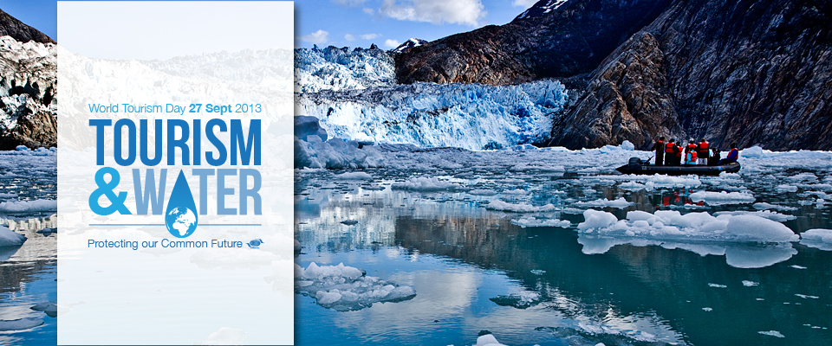

Slide 6
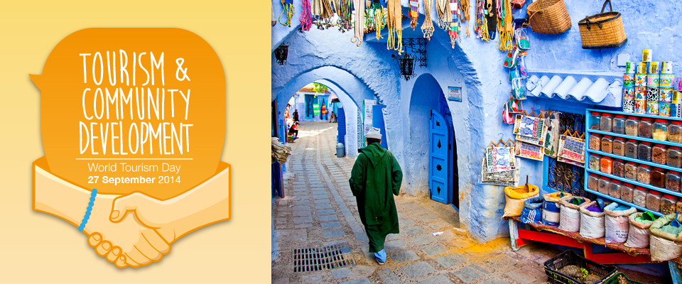
Notes:
World Tourism Day (WTD), celebrated every year on 27 September, is a global observance to highlight tourism’s social, cultural, political and economic value.
WTD 2014 is being held under the theme Tourism and Community Development - focusing on the ability of tourism to empower people and provide them with skills to achieve change in their local communities.
Leading up to the official WTD celebrations in Guadalajara, Mexico, we want to hear from YOU. Let us know how you will be celebrating, send us your best photos on this year’s theme for the WTD Facebook album and join the #WTD2014 conversation on Twitter to share your thoughts and experiences with the global tourism community.
Throughout the campaign we will add a lot of interesting content related to tourism and community development. Stay updated on upcoming WTD news, keep checking back and make sure to follow UNWTO on Facebook and Twitter!

Slide 7
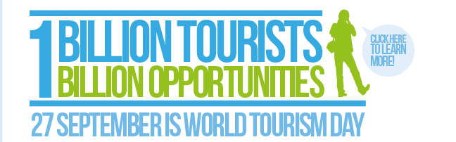
Notes:
This year´s World Tourism Day highlights the global potential of tourism for socio-economic development. With more than one billion international tourists now traveling the world each year, tourism has become a powerful and transformative force that is making a genuine difference in the lives of millions of people.
The potential of tourism for sustainable development is considerable. As one of the world’s leading employment sectors, tourism provides important livelihood opportunities, helping to alleviate poverty and drive inclusive development.
As tourism revolves around encounters between different peoples, the sector can foster multicultural understanding and raise awareness on the need to preserve cultural and natural heritage.
As the world prepares to adopt a new sustainable development agenda, tourism should be recognized for its ability to create jobs, promote local culture and products and champion the conservation and sustainable use of marine and terrestrial habitats.
Let us work together to maximize the immense potential of tourism to drive inclusive economic growth, protect the environment and promote sustainable development and a life of dignity for all.

Slide 8
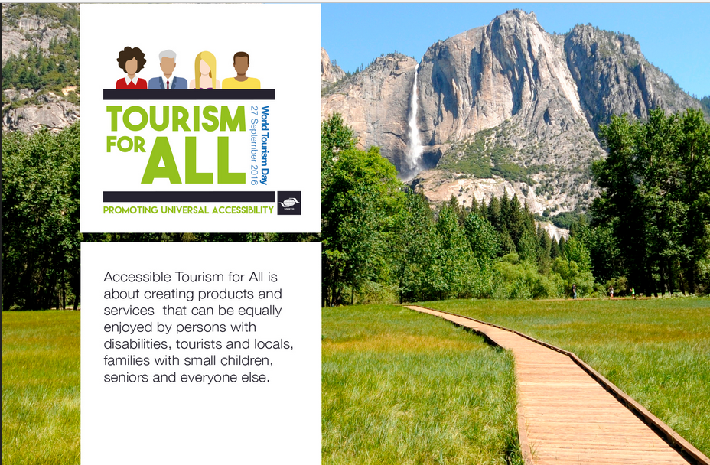

Slide 9
Why Does International Tourism Matter?

Slide 10
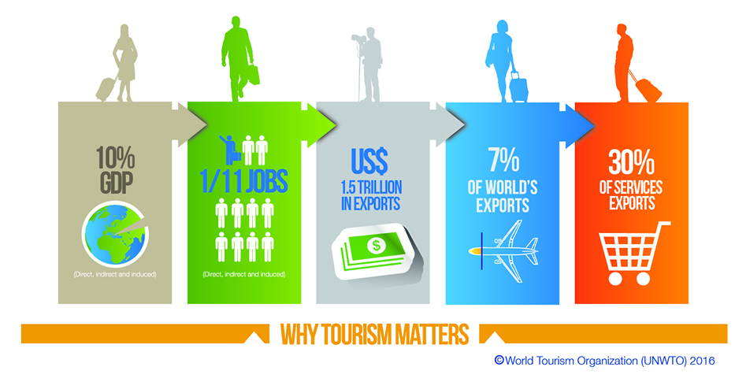
Why Does International Tourism Matter?

Slide 11
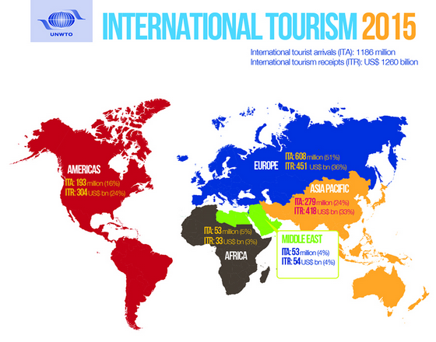
Source: http://cf.cdn.unwto.org/sites/all/files/infographic_2016_july_clari-01_0.jpg

Slide 12
Benefits of Tourism
Provides governments with substantial tax revenues
Offers the greatest global employment prospects due to:
  The opening of borders.
  An increase in disposable income=vacations.
  Reasonably-priced airfares.
  An increase in the number of people with time and money.
  More people with the urge to travel.

Slide 13
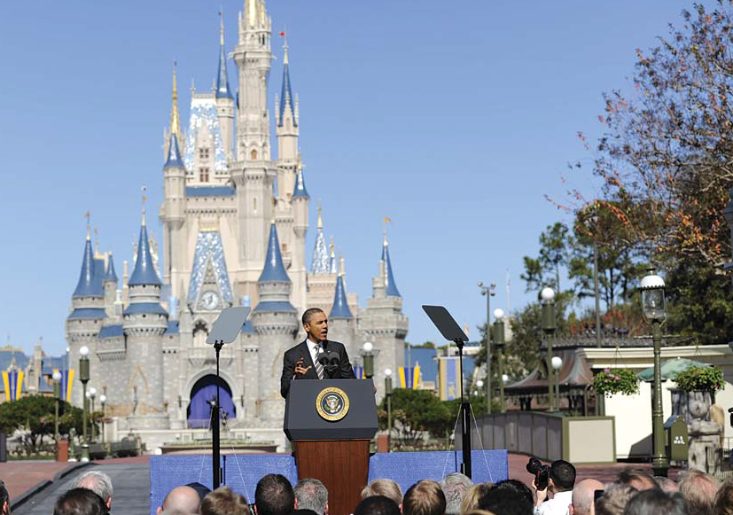
“Tourism is the number one service that we export. Number one. And that means jobs.”
— President Barack Obama,
January 19, 2012
Source: Travel Means Jobs, U.S. Travel Association

Slide 14
Tourism In the United States
The travel and tourism industry has the following characteristics:
  24/7 economic driver
  Accounts for 10.2% of the GDP = Gross Domestic Product (2011)
  Employs 259 million people (8.8% of the global workforce, 2011)
  $93.9 billion in spending in the U.S. in 2009, up from $73.2
  Leading producer of tax revenues
  4.6% annual forecasted growth until 2015

Slide 15
How We Travel
Source: UNWTO
Rail, 2% of international travel
Car, “road”, 40% of international travel
Bus
Airplane, 52% of international travel
Cruise Ships, 6% of international travel

Slide 16
Traveling by Train
One of the main factors that led to railroads in the U.S. was the need to move goods and people from one region of the country to another
Cars and buses caused a decline in rail travel
To encourage passenger service,
  Congress passed the Rail Passenger Service Act in 1970 (amended in 2001) known as AMTRAK

Slide 17
High Speed Rail Travel
Defines as trains up to 155-186MPH
Acela Express from Boston to DC only one in the US
Many Proposed in US, no others created
HSRT is popular in China and other Asian Countries and in Europe
Notes:
How is high-speed rail different from nation to nation?
As stated above, China and the EU have trains that can exceed 300 kph (186 mph), which means, in China, trains can zip between Beijing and Wuhan in about five hours. The regular train route takes twice as long, and you'd be lucky to finish the journey in a car in 13 hours.
In Japan, the Shinkansen bullet trains typically travel at between 270 kph (169 mph) and 320 kph (199 mph), while Korea Train Express cars can travel up to 305 kph (190 mph).
In March, Korea's HEMU-430X hit a speed of 421.4 kph (261.8 mph) in a test run, making Korea the fourth country -- behind France, China and Japan -- to develop a train capable of topping 420 kph (261 mph).
Spain has high-speed trains, known as AVEs, that move at speeds up to 310 kph (193 mph), according to Railway Gazette, but the train involved in this week's wreck was not an AVE. It had a max speed of 250 kph (155 mph).

Slide 18
Traveling by Car
Largest segment of ground transportation
Creates accessibility to remote locations
~5,000 rental companies in the U.S.:
  75% of car rentals take place at airports
  The top rental car company agencies in the United States are Hertz, Avis, and Budget
  Rentals available from discount ticketer’s
Challenges to traveling by car
  Gas price increases
  Distance to destination
  Rental Car Consolidation in 2012

Slide 19
Traveling by Bus
Convenient and economic mode of travel
Allows travelers to relax & enjoy the ride
Types of bus service:
  Local, charter, tour, commuter, airport, urban, and rapid transit
  The largest and most recognized is the Gray Line

Slide 20
Air Travel Source: http://www.transtats.bts.gov/
Airline Activity : National Summary (U.S. Flights)
 | 2013 * | 2014 * | Change
Enplaned Passengers (million) | 643 | 651 | 1.2%
Departures (000) | 8,766 | 8,591 | -2.0%
Freight/Mail (million lbs) | 19,631 | 20,121 | 2.5%
Load Factor (%) | 83.6 | 84.1 | 0.5 points
Airlines with scheduled service | 98 | 96 | -2.0%
* 12 months ending June of each year
Notes:
As a business traveler what do these numbers mean?
Do you believe the price of a ticket went up or down?

Slide 21
Air Travel
Airline alliances will allow airlines access to each other’s “feeder markets” and to resources that will enable them to flourish in what will ultimately be a worldwide deregulation
  A feeder market is a market that provides the source—in this case, passengers for the particular destination

Slide 22
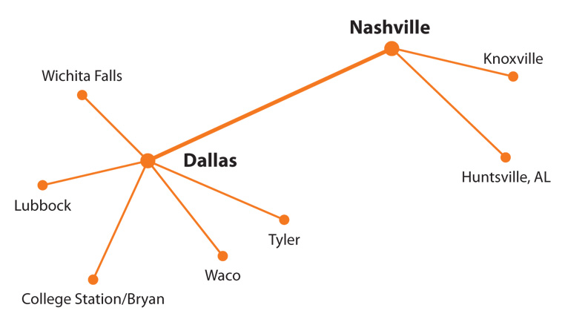
Hub-and-Spoke System; Figure 2-2

Slide 23
Hub-and-Spoke System
Enables passengers to travel from one smaller city to another smaller city via a hub or even two hubs
The hub-and-spoke system has two main benefits:
  service more cities at a lower cost
  maximize passenger loads from small cities, thereby saving fuel

Slide 24
Airline Profit and Loss
Fixed costs do not change:
  Lease of airplanes, the maintenance of airline-owned or leased terminals, interest on borrowed money, insurance, and pensions
Variable costs rise and fall:
  Wages and salaries, advertising and promotion, fuel costs, passenger food and drink, and landing fees
  The biggest single cost for airline operation is labor—which is typically 30–45% of total operating costs
A key statistic in analyzing profitability is the load factor—percent of seats filled on all flights, including planes being flown empty to be in position for the next day’s schedule

Slide 25
Cruise Ships
The cruise market has increased dramatically in recent years
About 9.0 million Americans cruise each year
Rates vary from about $95–$850 per person per day

Slide 26
Cruise Market
Mass market: Consists of people with incomes in the $35,000–$74,000 range; average cost per person is $95–$195 per day
Middle market: Consists of people with incomes in the $75,000–$99,000 range; average cost per person is $175–$350 per day
Luxury market: Consists of people with incomes higher than $100,000; average cost per person is more than $400 per day

Slide 27
Cruise Ships
Most cruise ships sail under foreign flags because they were built abroad for the following reasons:
  U.S. labor costs for ships, officers, and crew—in addition to maritime unions—are too high to compete in the world market
  U.S. ships are not permitted to operate casino-type gambling
  Many foreign shipyards are government subsidized to keep workers employed, thereby lowering construction costs

Slide 28
Promoters of Tourism
National Tourism Organization (NTO)
Travel Industry of America (TIA)
State tourism offices
Convention & Visitors Bureaus (CVBs)
Pacific Area Travel Association (PATA)
Tour operators
Travel agencies
Travel corporations
Travel and tour wholesalers
National Office of Tourism
Destination management companies

Slide 29
NYState Tourism
I Love NY
New York City & Company
Uncork NY
The Power of Travel

Slide 30
Social and Cultural Impact of Tourism
World tourism organizations recognize that tourism is a means of enhancing international understanding, peace, prosperity, and universal respect for and observance of human rights and fundamental freedom for all
Provided the number of tourists is manageable and they respect the host community’s sociocultural norms and values, tourism provides an opportunity for social interactions

Slide 31
Ecotourism:
“Tourism with a Conscience”
Sustainable Tourism: A Broad Obligation on Society
Implement and participation in ecotourism activities should follow the following principles:
  Minimize impact
  Build environmental & cultural awareness & respect
  Provide positive experiences for both visitors & hosts
  Provide direct financial benefits for conservation
  Provide financial benefits & empowerment for local people
  Raise sensitivity to host countries’ political, environmental, & social climate
  Support international human rights & labor agreements
  Ensure viable, long-term economic operations.

Slide 32
Cultural, Heritage, Nature, and Volunteer Tourism
Culture and heritage are “our legacies from the past, what we live with today, and what we pass on to future generations. Our cultures and natural heritages are irreplaceable sources of life and inspiration.”
Cultural tourism: Motivated by interest in cultural events
Heritage tourism: Motivated by historic preservation
Nature tourism: Motivated by nature
Culinary tourism: Culinary adventures are at least a contributing motivation
Volunteer tourism: Motivations include opportunity to travel safely and cheaply and to experience different cultures

Slide 33
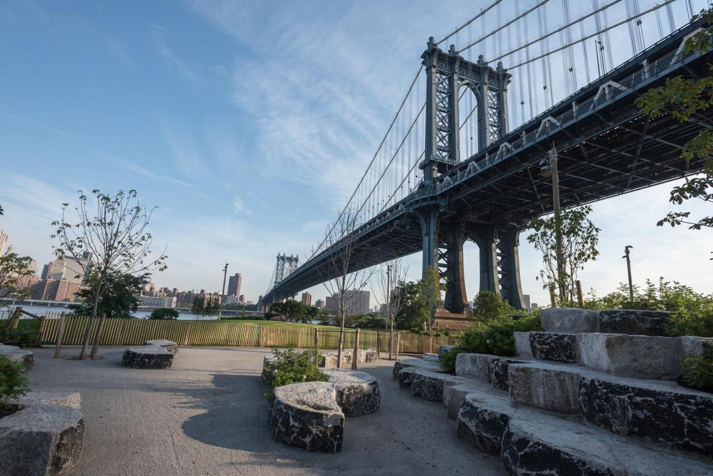
Tourism Terms
Link to Terms from The World Tourism Organization
Photo Credit: Julienne Schaer for Brooklyn Bridge Park.

Slide 34
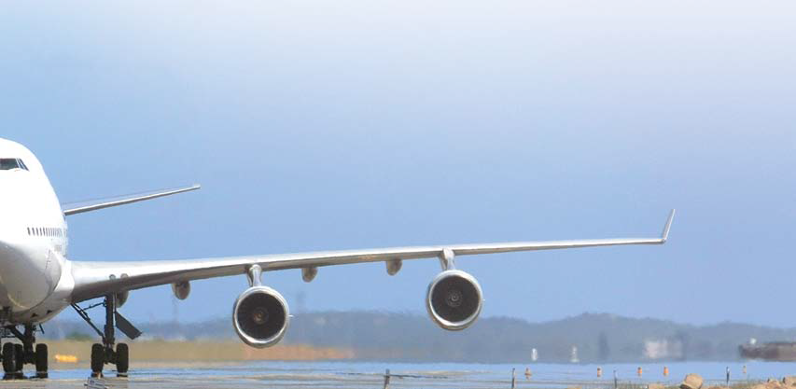
Activity
Why do certain groups of people choose certain vacation experiences?
You are a travel provider. Your top client just learned about the initiatives of the World Travel Organization and asked you to design a month long vacation for her. Working in groups…
  Identify your client’s needs
  Design a luxury vacation based on category of tourism
  Include 4 terms from the list provided
  Money is not a concern...
  Report out

Slide 35
Resources used for this Lecture
US Association of Travel
  Fast Forward: http://www.ustravel.org/sites/default/files/page/2012/08/e-Fast_Forward.pdf
  Travel Means Jobs: http://www.ustravel.org/sites/default/files/page/2012/08/e-Travel_Means_Jobs-2012.pdf
UN World Tourism Organization
  http://www2.unwto.org/en
  Key Trends http://dtxtq4w60xqpw.cloudfront.net/sites/all/files/pdf/unwto_highlights13_en_hr_0.pdf

Slide 36
Travel Jobs by the Numbers
1 in 8: American jobs (private sector) supported by travel
1.1 million: American jobs directly supported by travel exports
#6: where travel ranks in terms of total U.S. employment
48: number of states where travel is a top ten employer (2010)
29%: pace that travel jobs have been created — faster than the rest of the economy (March 2010–July 2012)
1 in 7: ratio of projected growth of travel jobs (3.3 million) to total U.S. job growth by 2020
44 of 50: number of states where small businesses in travel employ a higher percentage of workers than the private sector (2007)

Slide 37
Until We Meet Again…
Hand in three facts you researched about the Brooklyn Water Front based on your type of tourism
Read the NY Times “36 Hours in…” article
Field Trip to Pier 1, Brooklyn Bridge Park
  Next to the Brooklyn Ice Cream Factory
  Meet at 2:40pm
  Rain or Shine (well almost… if the weather report is poor check OpenLab on Thrusday at 10am for possible changes to the meeting place/time)
  No jeans, no sneakers, business casual
  Bring a camera if possible

