Slide 1


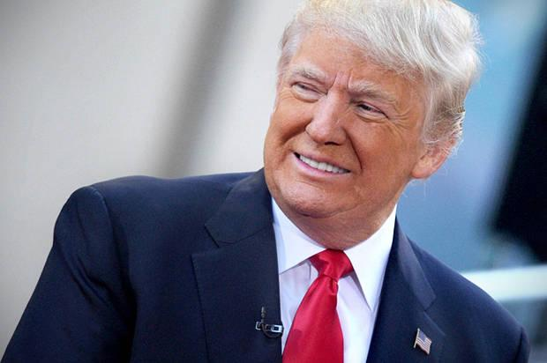
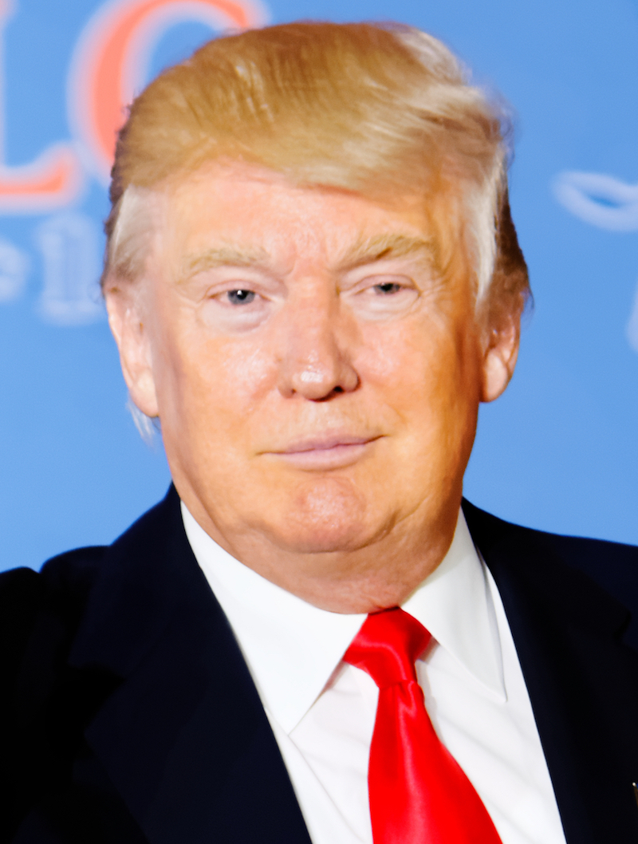
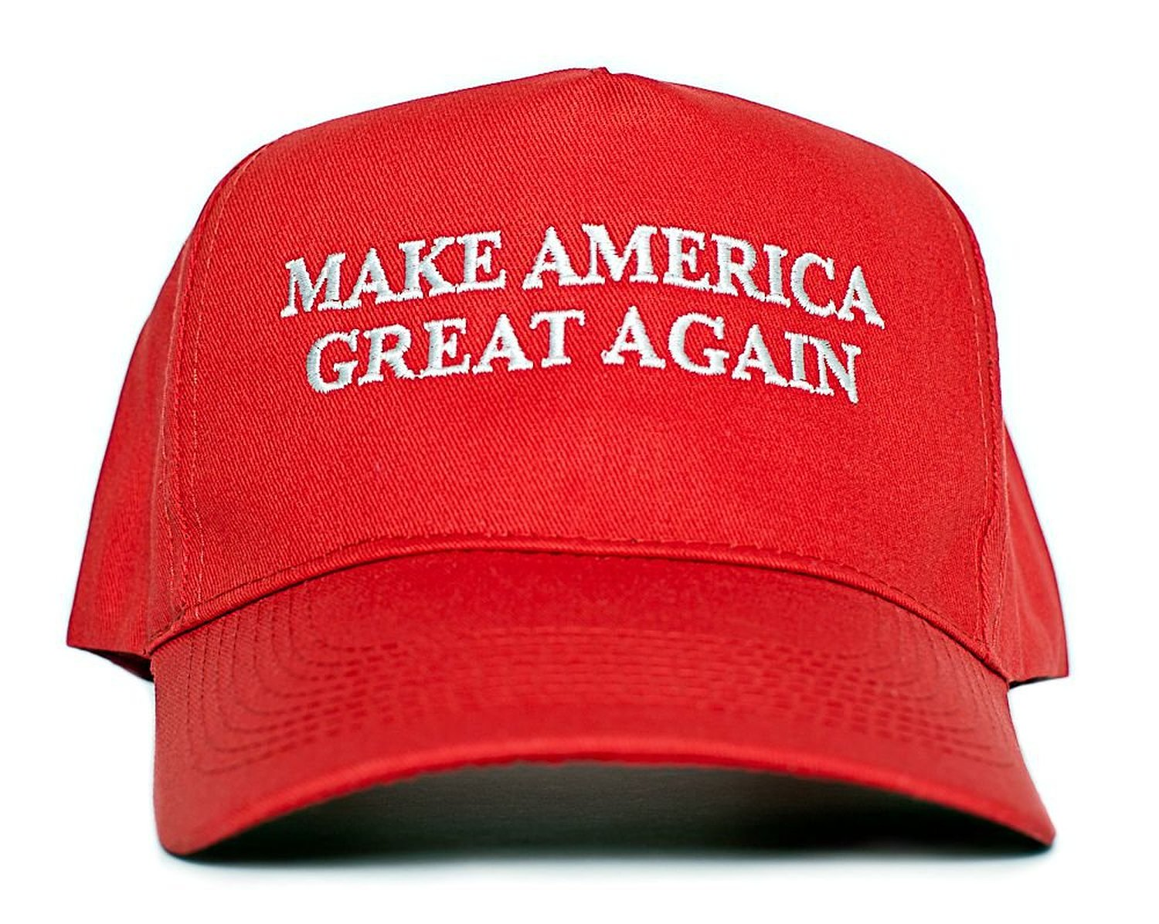
Donald Trump
In 2016 Donald Trump despite many non believers won the presidential election against Hillary Clinton with a historic campaign motto “Make america Great Again”becoming the 45th president of the united states. By catering to many of the forgotten people of middle america MR.Trump ran on the basis of bringing jobs back to america and running the country like a business to promote a revival in the american economy.

Slide 2

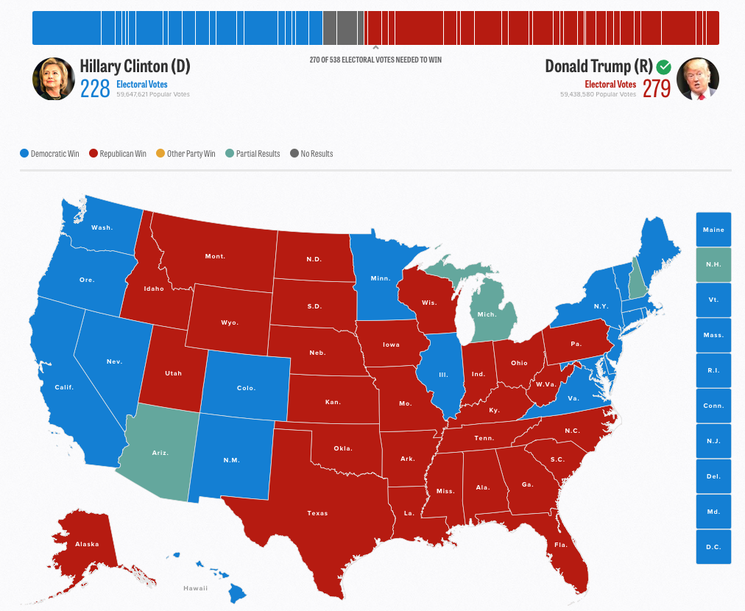
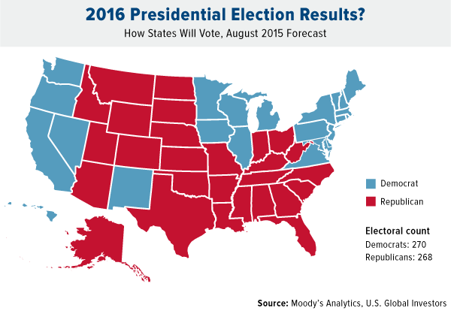
The People
Although democratic candidate Hillary Clinton was Favored by many to win the election when it came election day Americans ultimately voted for trump and so did the electoral college although the popular votes between Trump andClinton were neck and neck.

Slide 3
THE 2016 PRESIDENTIAL ELECTION HAS LEFT A MARK ON THE WAY PRESIDENTS WILL BE CHOSEN FOREVER.

Slide 4

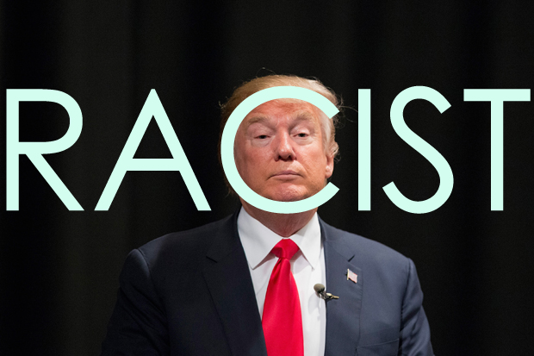
One of the major riffs many americans have with Donald Trump are the racist statement against African Americans, Mexican Americans and other groups of immigrants living in america. Although many believe this would deter him in his quest to be the president he maneuvered around his ludicrous statements to achieve what only 44 other me have and that is become the president of the united state.

