Slide 1
Vera Wang
My inspiration for design

Slide 2
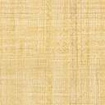
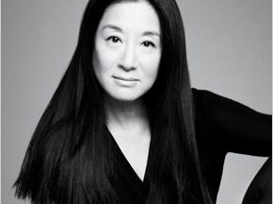
Vera Wang
Vera Ellen Wang was born and raised in New York City, and is of Chinese descent. Her parents were born in China, and came to the United States in the mid-1940s. Her mother, Florence Wu, worked as a translator for the United Nations, while her father, Cheng Ching Wang, owned a medicine company.

Slide 3
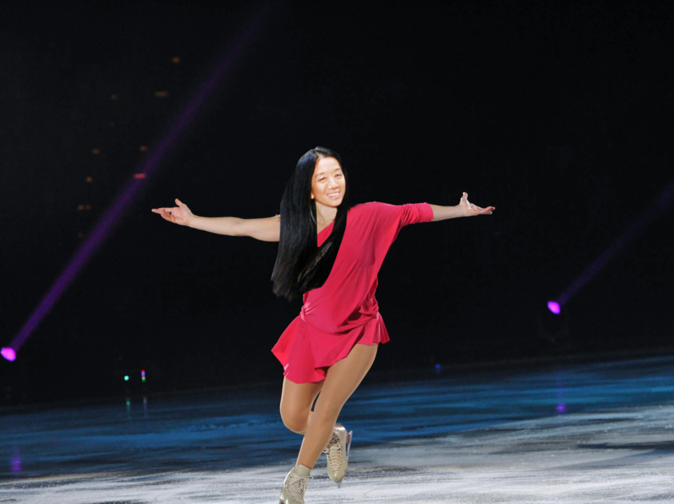
Wang was hired to be an editor at Vogue immediately upon graduation from Sarah Lawrence, making her the youngest editor at that magazine. She stayed at Vogue for 17 years, leaving in 1987 to join Ralph Lauren, who she worked for 2 years. At 40, she resigned and became an independent bridal wear designer.

Slide 4
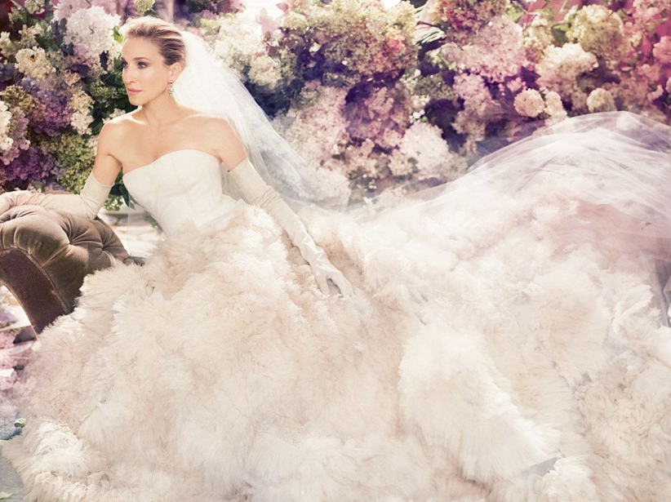
Wang has made wedding gowns for many well-known public figures, such as Chelsea Clinton,^{[6]} Karenna Gore,^{[7]} Ivanka Trump,^{[6]} Campbell Brown,^{[8]} Alicia Keys,^{[6]} Mariah Carey,^{[6]} Victoria Beckham,^{[6]} Avril Lavigne,^{[6]} Hilary Duff,^{[6]} Khloe Kardashian,^{[9]} and Kim Kardashian.^{[10]}Wang's evening wear has also been worn by Michelle Obama.^{[11][12]}

Slide 5
Vera Wang
How did Vera Wang inspire me to become a designer ?
She didn't’t start designing dresses until her 40’s
She changed her whole life by following a passion when her dream ended.
She tells me not give up on your goals and dreams no matter how late in your life. There's always time for improvement.
Notes:
Her dresses are top designer wedding gowns she went from being a professional figure skater who's dreams to represent America in the Olympics shattered and turned a negative into a postive.

Slide 6
Vera Wang
I hope to one day to follow in her footsteps in designing my own brand of clothing. No matter how far in life I am I hope to have her passion and patients.

Slide 7
Vera Wang
I hope to one day run my own clothing line and a business of my own and who know maybe I will be the next Vera Wang who will design beautiful clothing for celebrities

Slide 8
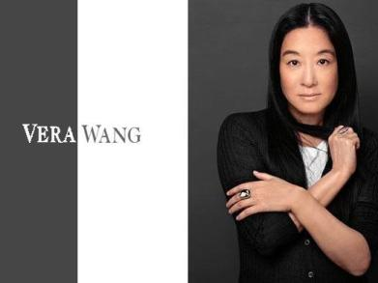
Vera Wang
I chose Vera Wang as my a person who motivated me to become a designer because she not only makes beautiful clothing and couture dresses she made her name to become fashion legend and that is what she is and I hope to walk in her shoes one day and obtain a portion of her success.

Slide 9
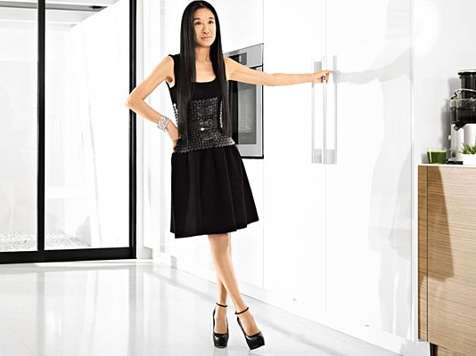
Vera Wang
Vera is and inspiration to designers everywhere. She gives hope and teaches us when one thing in life doesn’t plan out the way you want don’t dwell on the past move on to anther dream because we all have more than one.

Slide 10
www.wikipedia.com
www.timesmagazine/com
www.vogue.com

