Slide 1
Sound for Picture
Introduction to Film Sound & Location Sound

Slide 2
Professions in Film Sound
Film Sound has more jobs available than you might imagine (especially in big-budget Hollywood films)
Production - Sound work during filming show
Post-Production - Sound work done after principal photography has been completed

Slide 3
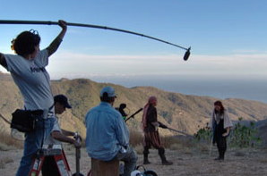
Production
Boom Operator
  Responsible for achieving best recorded sound
  Works closely with Sound Mixer
  Operates long boom arm with microphone attached

Slide 4
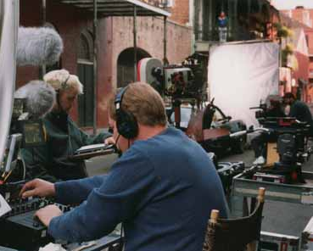
Production
Production Sound Mixer
  AKA Sound Recordist, or simply Sound Mixer
  Operate portable recorder and monitors all inputs to ensure highest quality captured
  Records in sync with camera

Slide 5
Location Sound
Preparation
  Read Script
    Understanding the filming locations, scenery, surroundings, AND story will help better determine the audio needs of the show
  Spec proper equipment
    Bring necessary gear for type of shoot
    Shotgun mic (with all necessary accoutrements)
    Lavalier
    Field Recorder

Slide 6
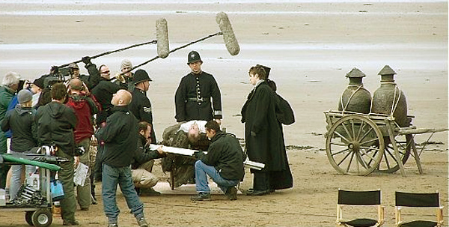
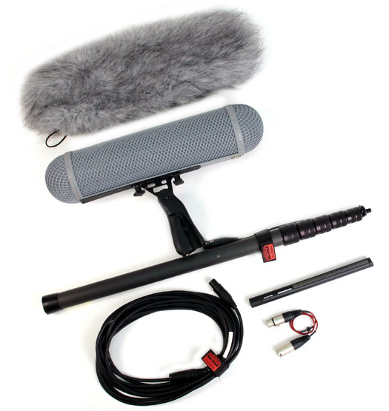
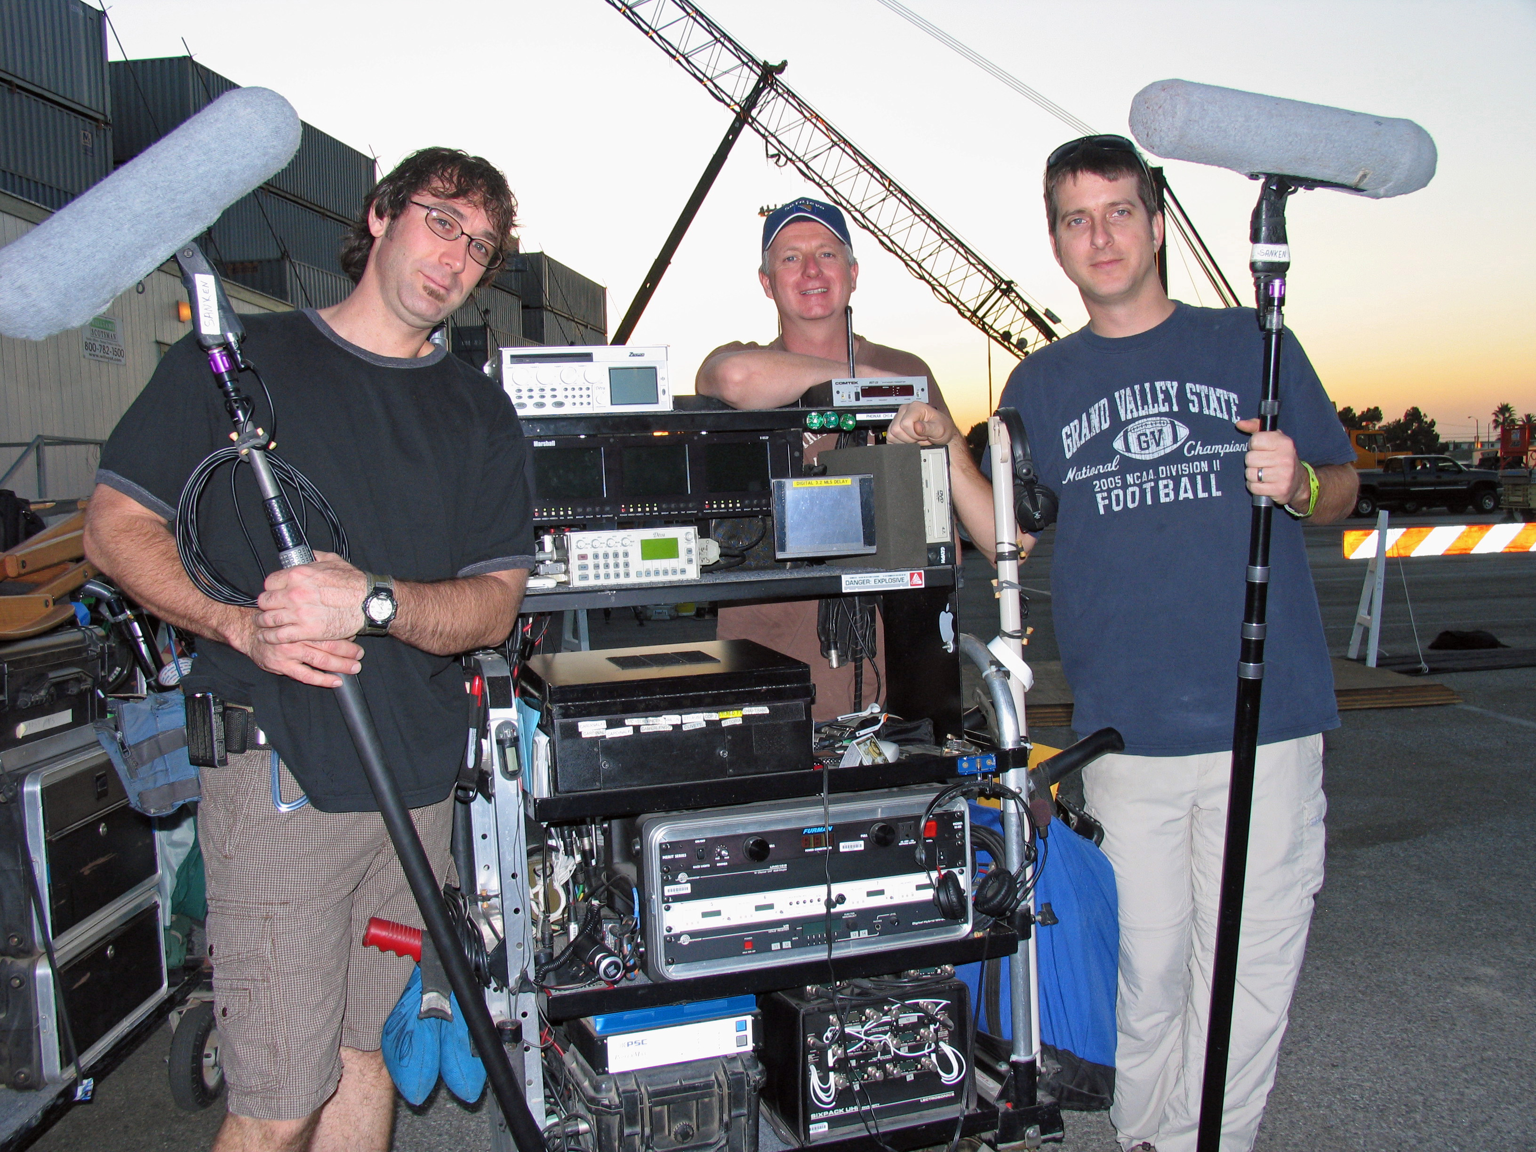
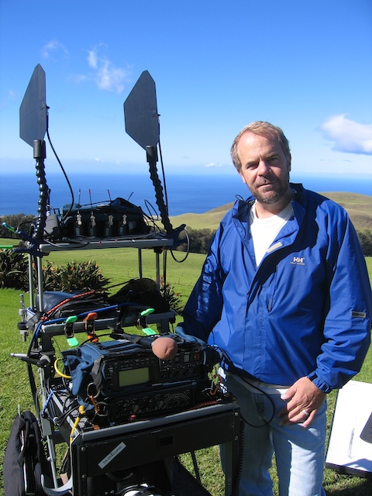

Slide 7
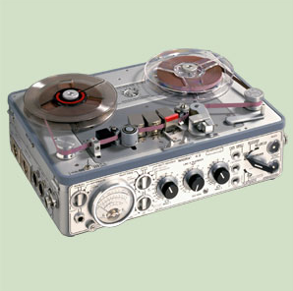
Location Sound
Common Recording Media Through the Ages
  Nagra
    2-Channel 1/4” tape recorder with time-code
  DAT
    Digital Audio Tape - 2 channel digital w/timecode
  Mini-Disc
  HD Recorders
    With timecode and metadata

Slide 8
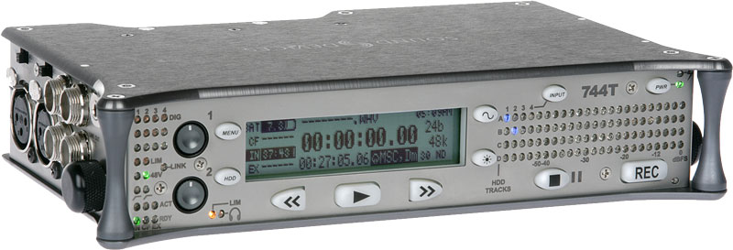
Location Sound
Sound Devices 744T
  4-channel recording w/ timecode
  Metadata - Data about Data
  Records polyphonic BWF (Broadcast Wav.)
    1 name for interleaved files
    Or multi-monophonic (multi-mono)

Slide 9
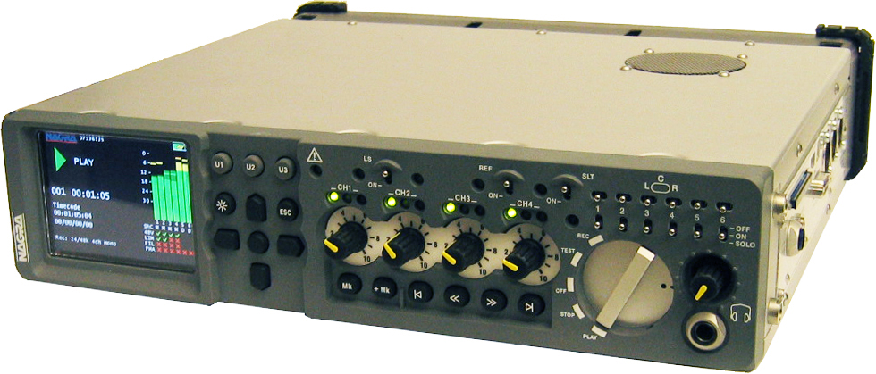
Location Sound
Nagra VI
  8 channels (4 Mic + 2 Line + 2 Mix)
  24 bit, 96 kHz AD / DA
  SMPTE / EBU Time Code
  Internal 2.5” Hard drive disk and removable Compact Flash
  Post-production compatible
      (BWF files)(iXML compatible)

Slide 10
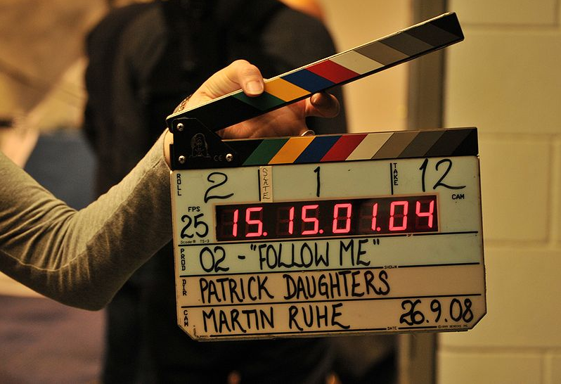
Slate
Visual and Audio cue for syncing sound and picture

Slide 11
A Day in the Life
Successful recordings are not made by accident
  Much planning and preparation are required for accurate and adequate capture of sound

Slide 12
A Day in the Life
Arrival
  Be sure to arrive early
  Scope the location for potential problems in sound capture
    Noise issues
    Sets vs location
      Power requirements
      weather
    Potential interference issues
      Cell phones and radio control equipment

Slide 13
A Day in the Life
Blocking session
  Name of the game is Don’t Be Seen
  Blocking is the marking of where every event happens
    How/where people should stand or move during the shot
      Directors, actors, camera crew, lighting, sound
  You want to end up NOT being part of the visual shot
      No boom in frame, etc.

Slide 14
A Day in the Life
Documentation
  Invaluable to keep neat, legible, accurate records of takes, actors, lines, etc. for later reference
  Production sound is often sorted through at a later date, by other people
    Proper documentation helps save time, money and effort

Slide 15
A Day in the Life
Room tone
  Generic, blank recording of environment
  Used for blending multiple takes
    Filling in where other production audio must be removed

Slide 16
A Day in the Life
Wild takes
  Any sound meant to be added to picture, but not actually recorded in sync with picture
  Useful for edits, storyboard changes, exposition

Slide 17
Post-Production
Supervising Sound Editor
  Oversees entire Post-Production Sound process
  Works closely with director and Sound Designer to coordinate editing and mixing
  Make final decisions on sound editing
  Can be more than one Supervisor (depending on scope of show)
  On smaller shows, oftentimes will be re-recording sound mixer as well

Slide 18
Post-Production
Dialogue Editor
  Assesses original production dialogue
  Edits audio to keep acceptable sound
  Arranges ADR sessions to replace to replace unacceptable dialogue
  Builds background tones (“room tone,” “backgrounds,” or “BG’s”)
  Fits resulting dialogue track to sync with picture

Slide 19
Post-Production
ADR Recordist
  ADR: Automated Dialogue Replacement, Additional Dialogue Recording, or Looping
  Based on Dialogue Editor’s (et al) decisions and prepped sessions, records ADR lines with “talent”
  Ensures highest quality sound, while attempting to maintain the ever-important continuity of audio quality throughout

Slide 20
Post-Production
ADR Editor
  Edits replaced dialogue to fit sync
  Depends on scope of show; Dialogue Editor is, more often than not, ADR editor on smaller projects

Slide 21
Post-Production
Foley Recordist
  Foley: Named for process developed by Jack Foley
    Live recording of synchronized sound FX
    Recorded according to a pre-prepped session created by Sound Effects Editor
      Footsteps, clothing “rustle,” fighting “hits”, object movements (ups, downs, etc.)
      Sound FX should blend perfectly and appear to be part of original filming process (continuity with source audio)
      “Fills in” small, subtle, often-masked sounds

Slide 22
Post-Production
Foley Artist
  Physically creates (performs) sound effects using an array of props, sync to picture
  Has a “library” of props they will travel with, supplementing the items the studio may have at their disposal
      Footsteps, Clothing Rustle, Items “Up” or “Down,” Physicality (Fight Impacts, Eating, Drinking), et al

Slide 23
Post-Production
Foley Editor
  Cuts together the recorded Foley effects into the scene/reel/show
  Checking/adjusting sync as necessary
  Oftentimes, in smaller productions, FX Editor integrates Foley into the show

Slide 24
Post-Production
Sound Effects Editor
  Also known as SFX or FX Editor
  “Cuts” in sound effects from pre-existing sound libraries
    Gun fights, explosions, bird and wildlife sounds
    Ambient noise - boats creaking, cars driving by
  Determines necessary Foley and prepares the session for Foley record

Slide 25
Post-Production
Sound Designer
  Creates specialized sound FX
    Masterfully manipulates sound
    Used in film, theater, game development, animation
    Sometimes parallels Supervising Sound Editor
    Separate Foley sounds can be recorded for use by Sound Designer
      Light Saber, Laser Gun, Space Ship, Dinosaur Roar, Monsters, Flesh Tearing… all designed elements

Slide 26
Post-Production
Music Editor
  Places all music cues for show according to Music Cue Sheet (created by Producer/Director, Music Supervisor)
    Source and score
      Source: pre-existing music (typically licensed songs)
      Score: composed pieces (created work-for-hire)
  On smaller productions, often a job completed by Assistant Sound Editor (or intern)

Slide 27
Post-Production
Composer
  Work For Hire
  Composes “cues” to enhance emotional significance of a scene/moment/image
  Takes direction from Producer/Director in order to fully realize the grander scope or vision of the show

Slide 28
Post-Production
Music Supervisor
  Works with Director/Producer on song/cue choices
  Makes creative decisions with music placement
  Obtains all licenses and rights for Source
  Creates music cue sheet

Slide 29
Post-Production
Assistant Sound Editor
  Supports all engineers (from Supervisor to Foley recordist) in any necessary task
    Session prep/consolidation/migration, pickup record of lines/Foley, cutting, layoffs, deliverables
    Usually needs to be able to hold it together under pressure as well as exhibit a high level of client relations (clients are producers, directors, and talent, among others)

Slide 30
Post-Production
Re-recording Mix Engineers
  Balances all aspects of sound for film
    Dialogue, ADR, FX, Sound Design elements, Foley, Music (score and source)
  Is the final say in the sound department
      Along with Director/Producer team, will make final calls on all questionable effect moments, dialogue/ADR choices, and mix placement in a surround environment

Slide 31
Post-Production
Multiple System Mixes
  On large-budget features, it is not uncommon to have the show mixed by separate Re-recording Mix Engineers “simultaneously.”
  Although the mix systems are run separately (synced with word clock, black burst, or machine control) the mixers are waiting their turn to make adjustments

Slide 32
It’s Not Just for Movies, Anymore
Features – Documentaries, Narratives
      Sometimes referred to as “show”
Television
Video Games (quickly growing industry)
Advertizing/Marketing
Streaming Media

