Slide 1

Rockett racers Toy time
By: Stephen Ricketts

Slide 2

Summary:
It's a toy box, it's a Rocker and comes with one toy. This awesome toy is targeting kids,(5 to 10 years).
It will be made of Plastic and has a small engine.

Slide 3
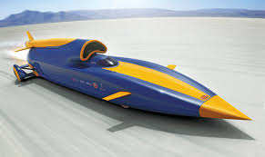
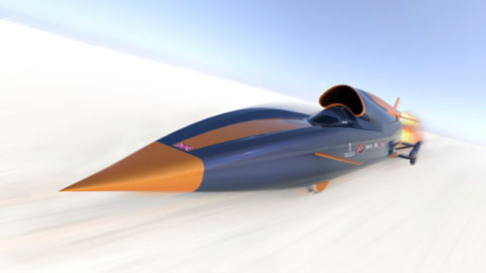
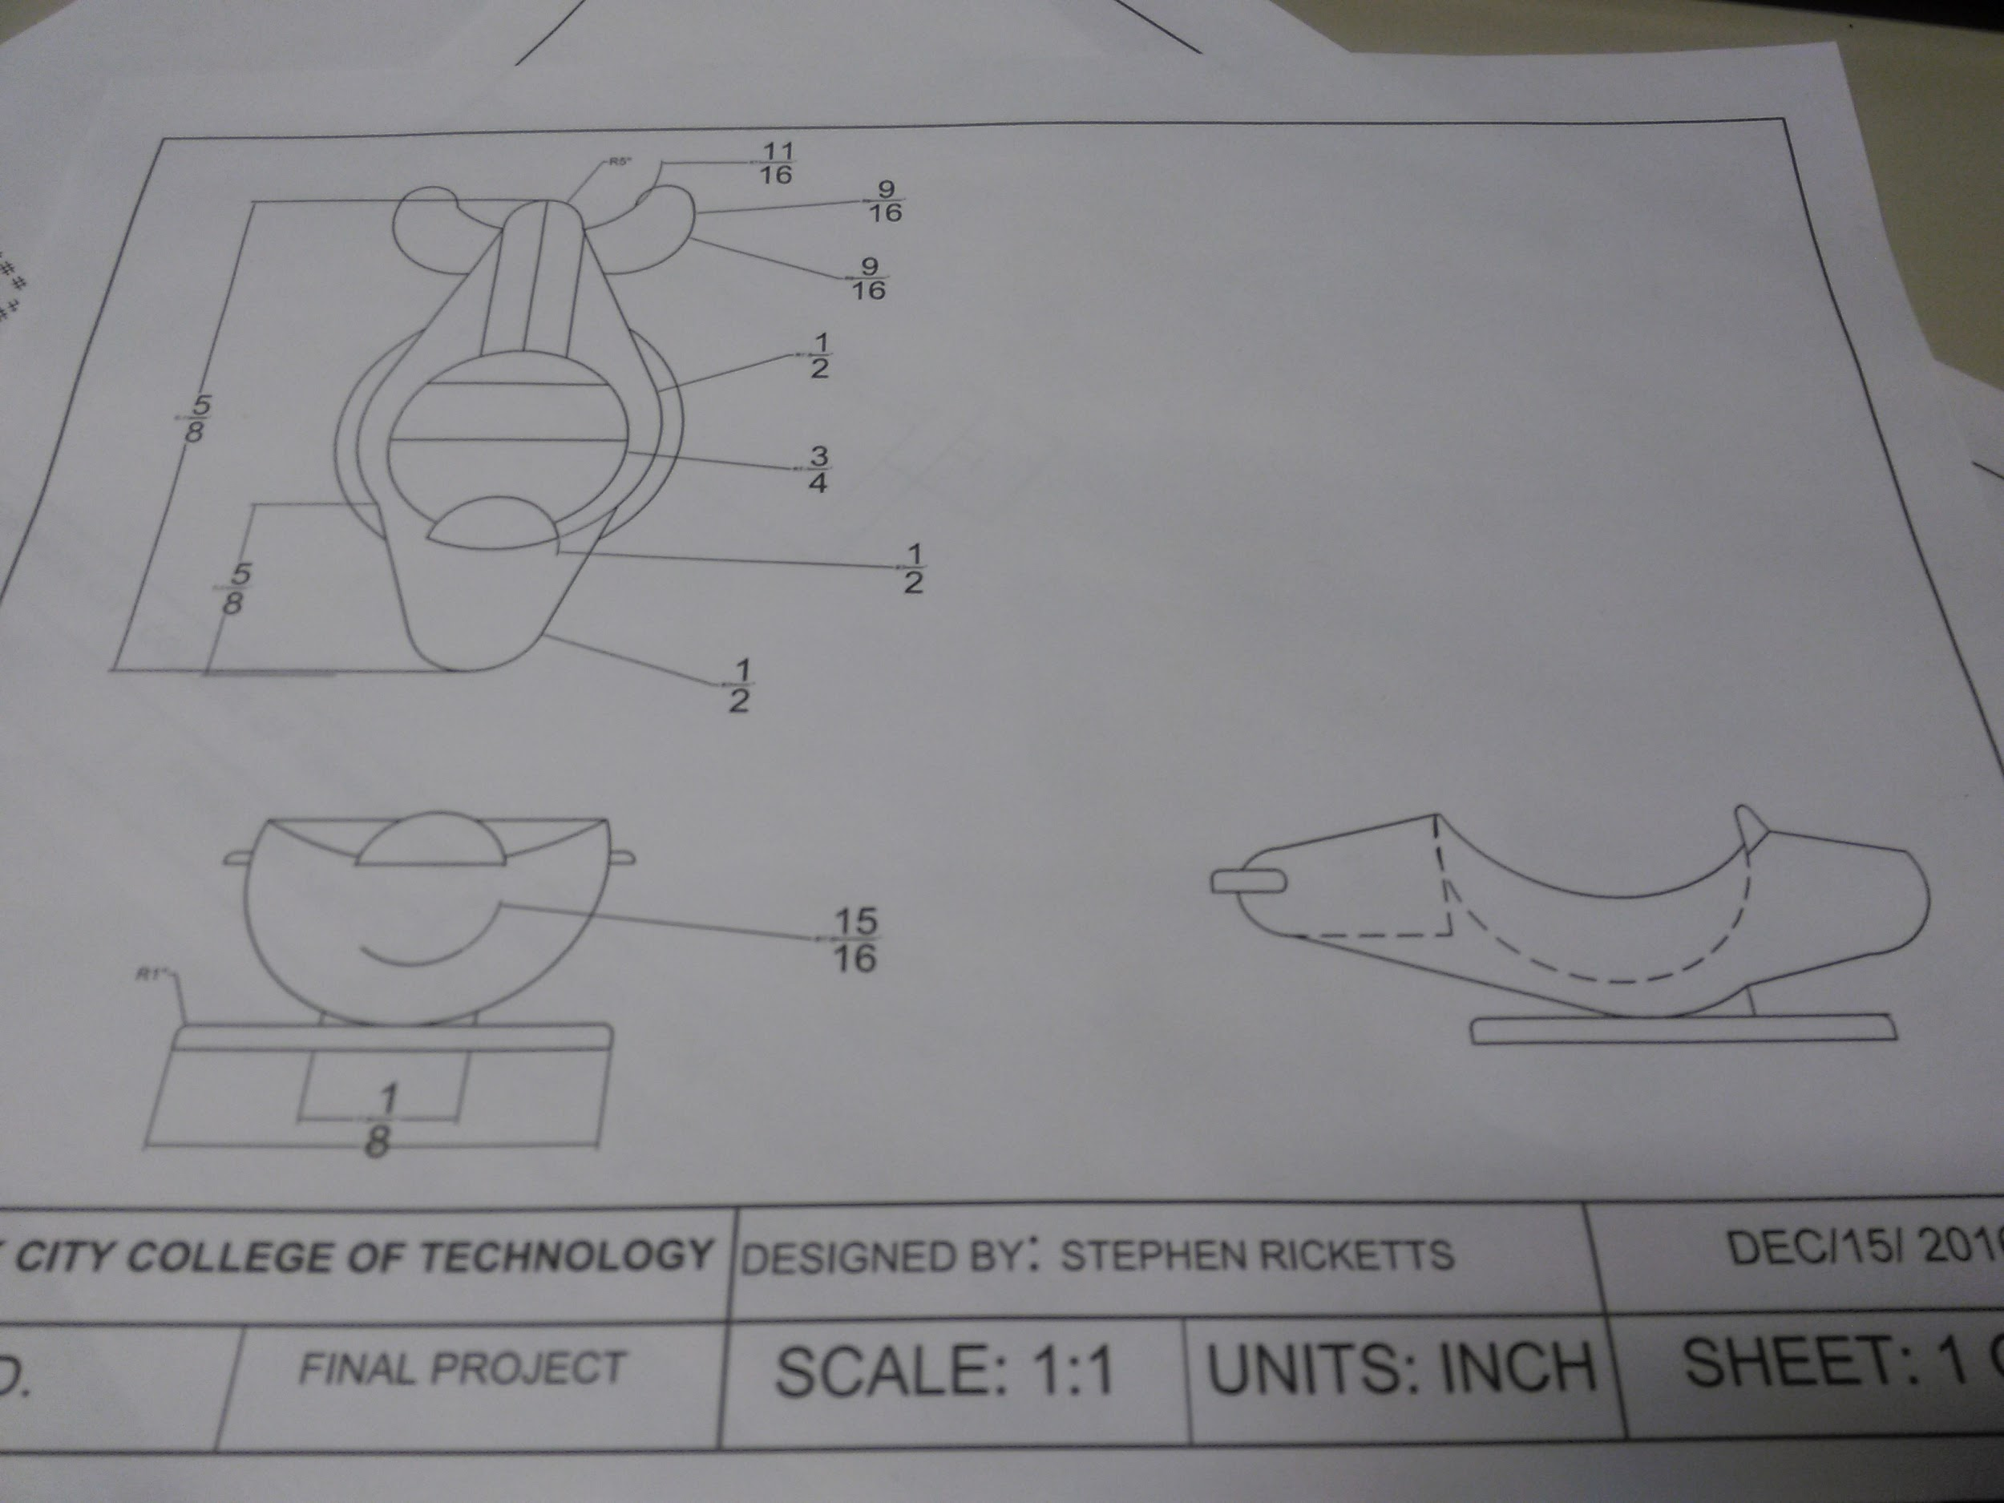


Slide 4
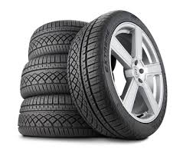
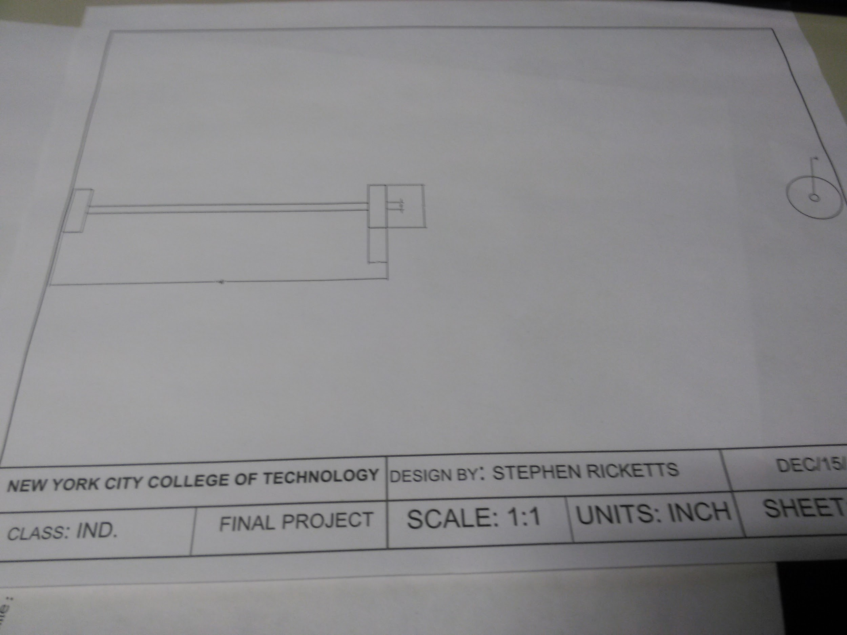

Slide 5
