Slide 1
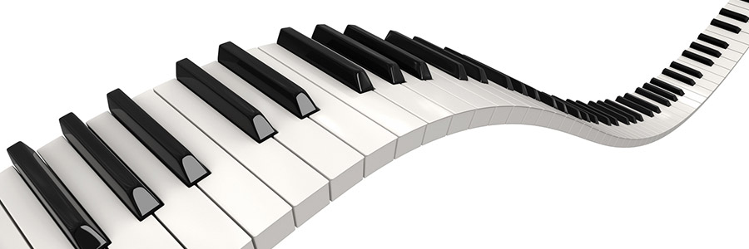
TOY DESIGNING
A B C

Slide 2
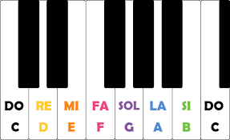
THE IDEA
As a music lover I like when kids play with useful toy so I wanted to design a toy that is educational.

Slide 3
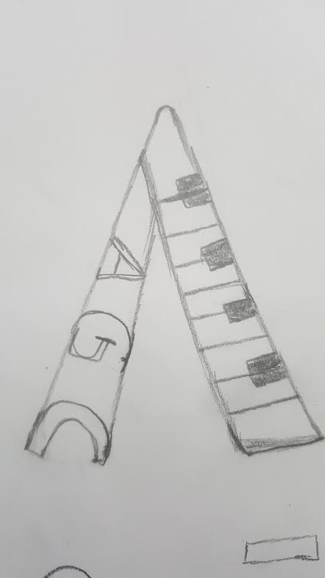
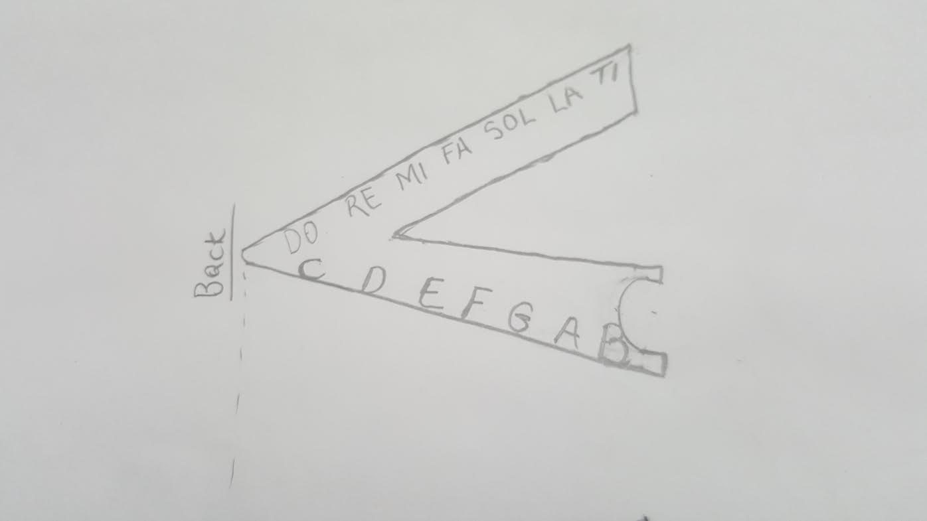
A G C La SOL Do

Slide 4
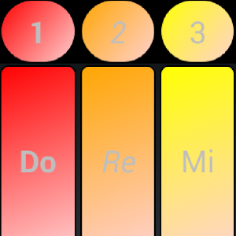
THE FUNCTION
The piano tiles are set just like the regular piano table. But when press the key the note will light up on the piano.
FOR AGE GROUP 3 AND UP.

Slide 5
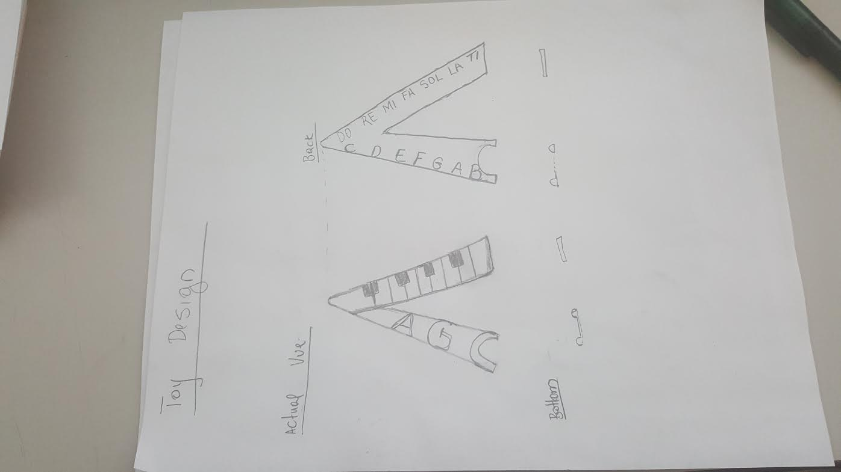
HAND SKETCH

Slide 6
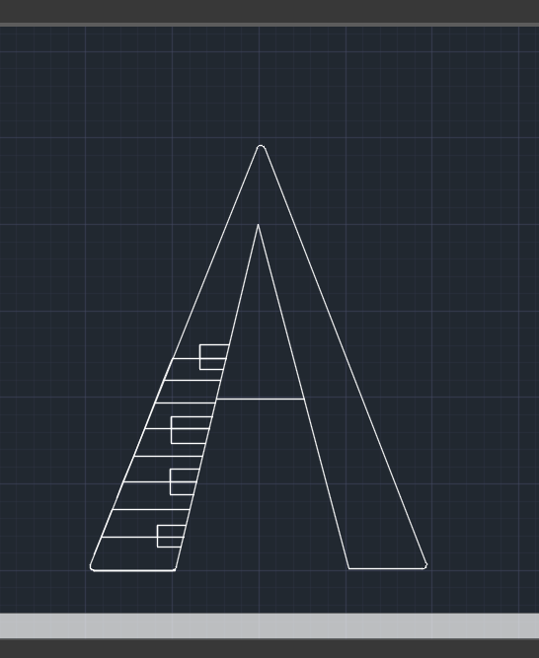
CAD DRAWING

Slide 7
CONCLUSION
It is fun to play but it is very beneficial when kids learn while playing.
A great toy idea for the music lovers

Slide 8
MERCI A TOUS
IND 2313
FINAL PROJECT
PROF. M. NAKAMURA
ROSE-CLAIRE EMMANUELLE PYRAM

