Slide 1
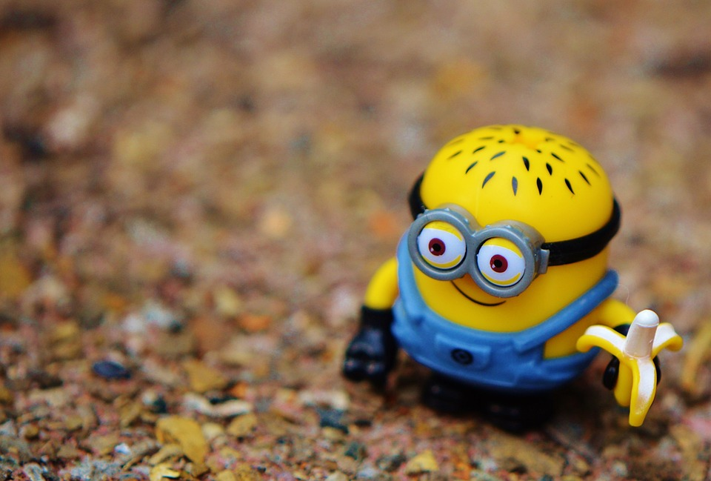
Toy Design Project!!
By Duan Knibbs
IND

Slide 2
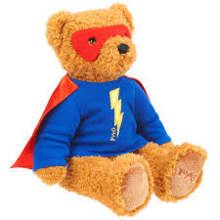
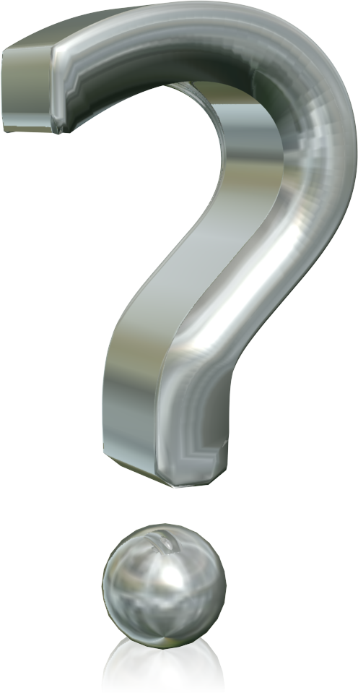
What to think about....
A toy that’s relevant and isn’t to complicated is what I imagined to be ideal. Stuffed Animals is what I had that came in mind.
I wanted the toy to also help people in some way or shape so i thought of how it can may help children but complicate it just enough to require it to have a mechanical function but still be fun.
... A bear that Saves lives ....

Slide 3
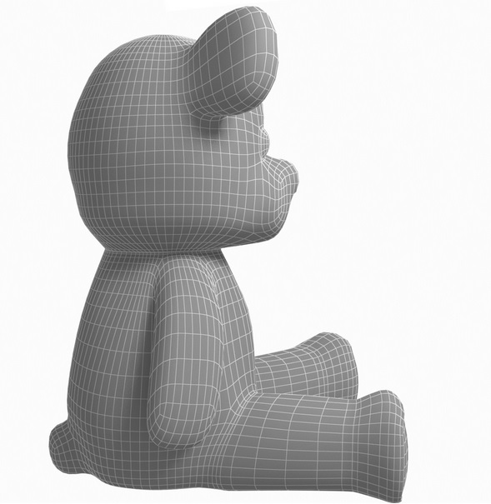
INTRODUCING THE BEAR NECESSITY !!
The Teddy Bear that saves your life...
Each Bear will be equipped with gas masks lined in the inner skull of each Bear.
Other First aid supplies will be in the bear: Wrap, various pills with
basic instructions, bear will also be lined with a blanket and a tracker.
Essentially the bear will be a first Aid-Kit and toy.
Flash light in eye balls.
There will also be a filtered water pouch in the stomach.
Comes a device similar to Life alert that can detect smoke and get help!

Slide 4
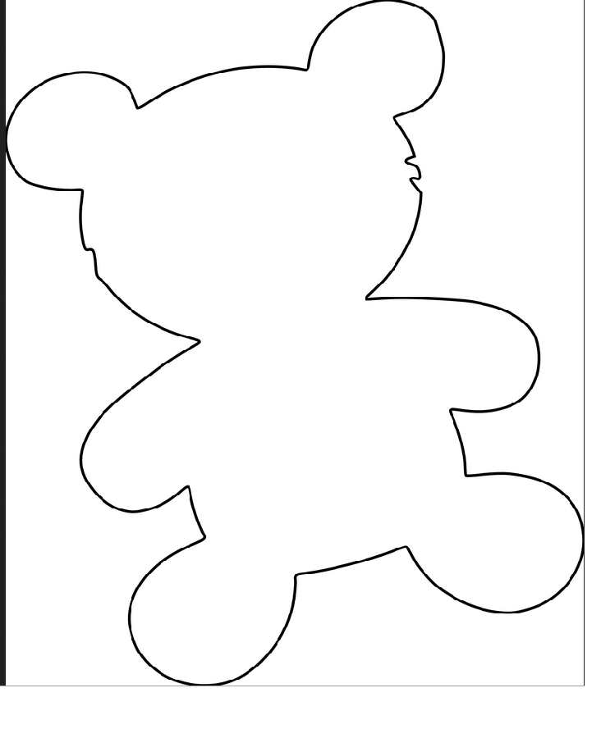
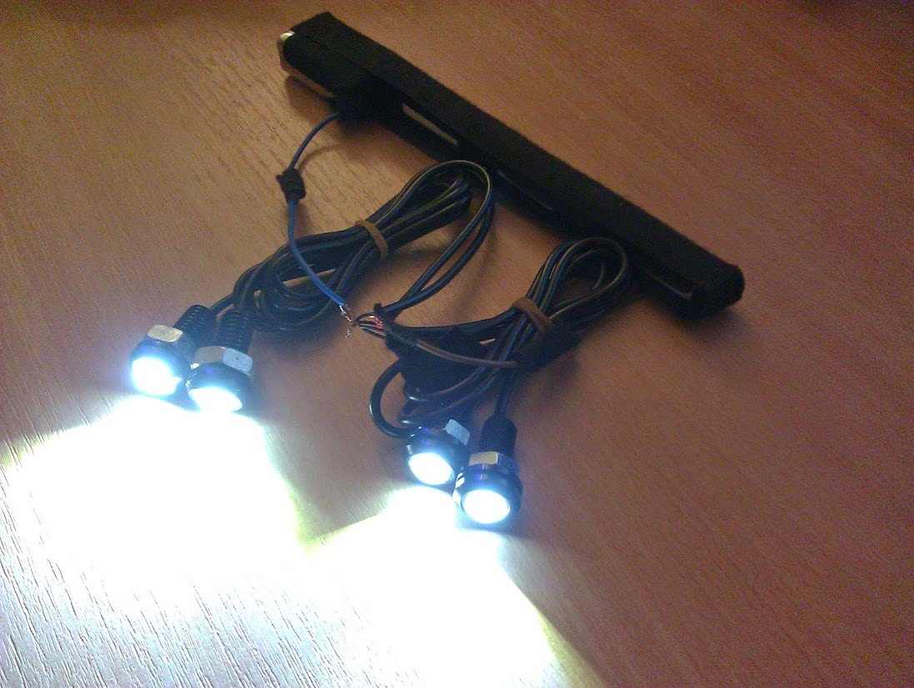
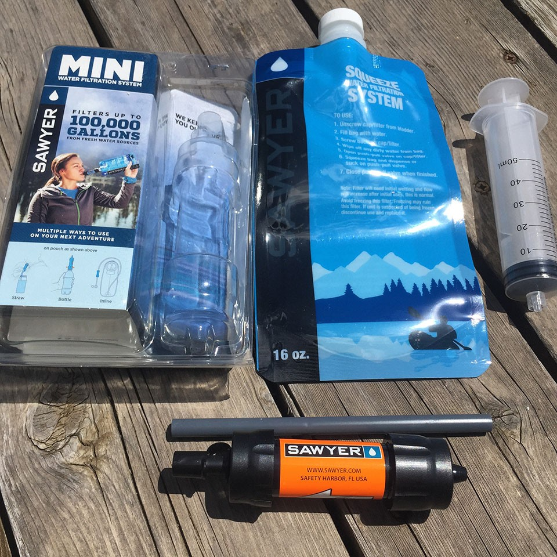
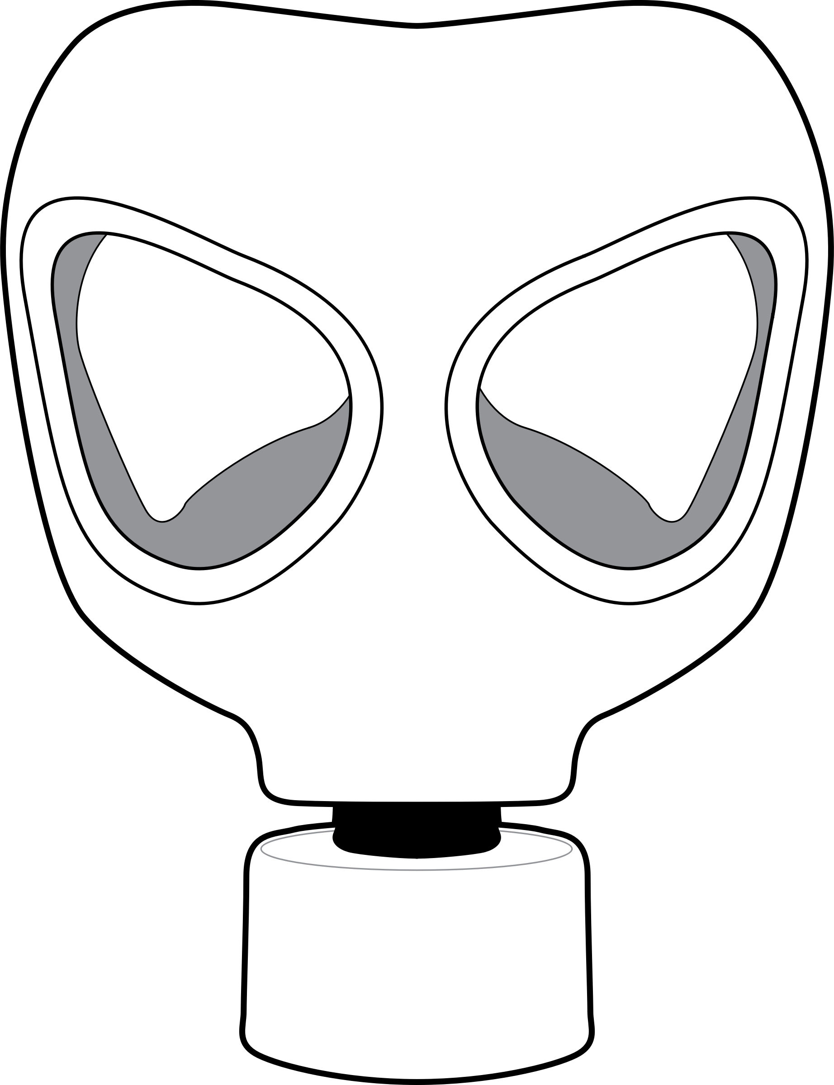
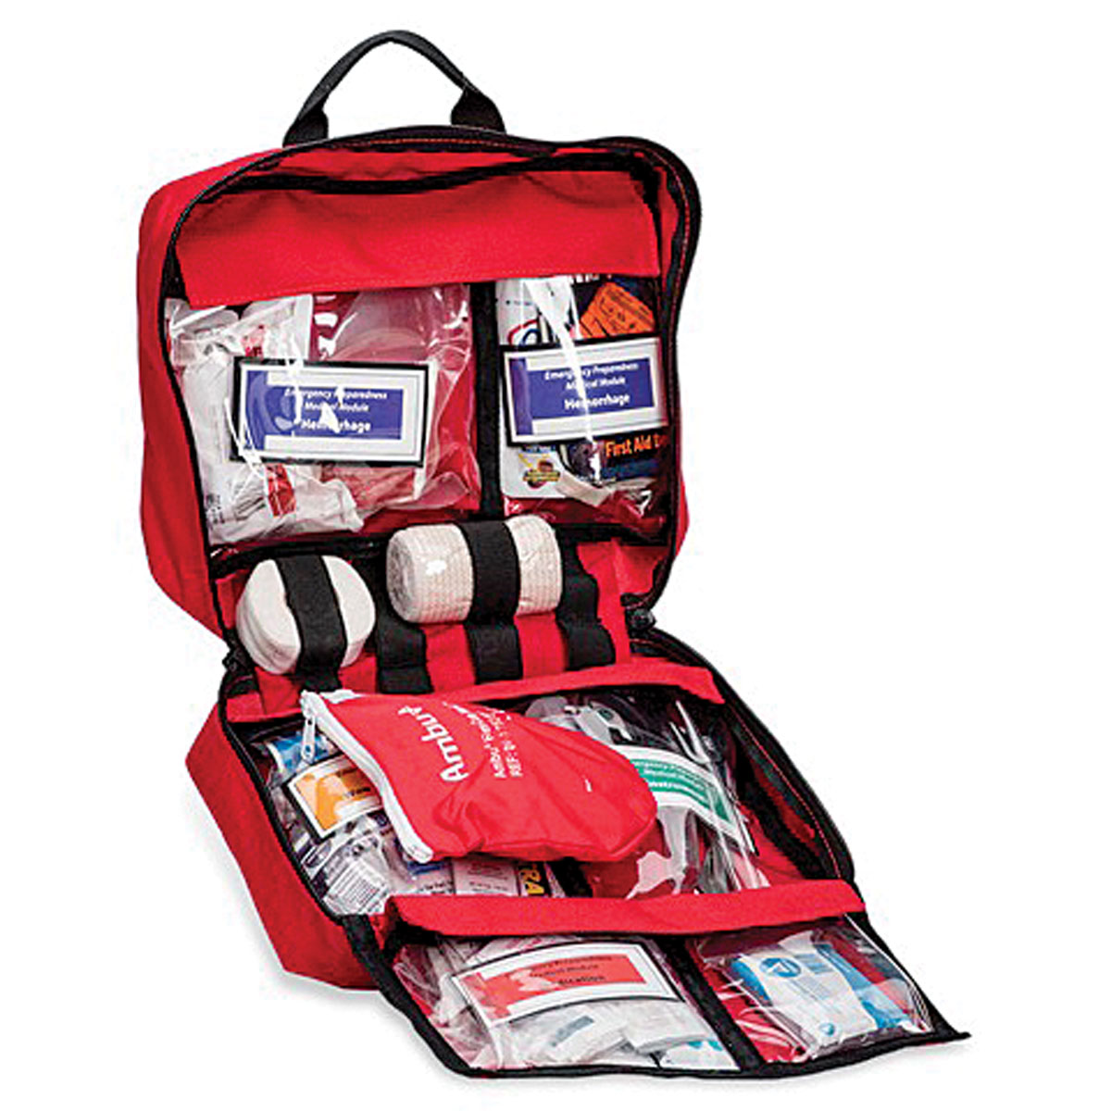

Slide 5
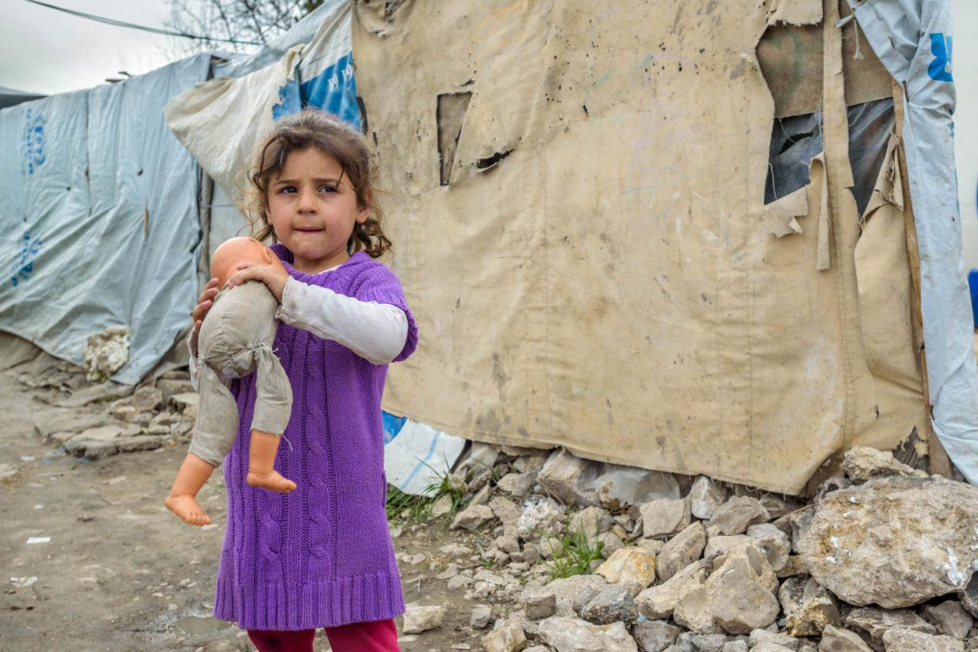

Slide 6
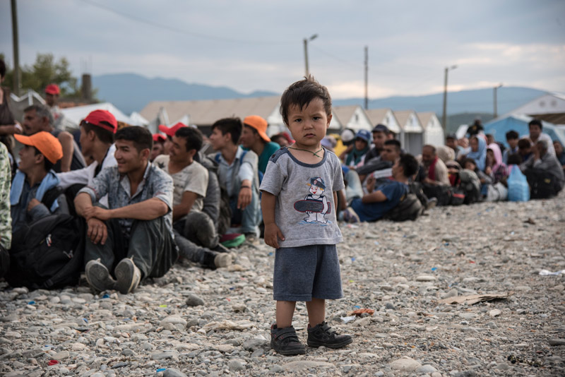
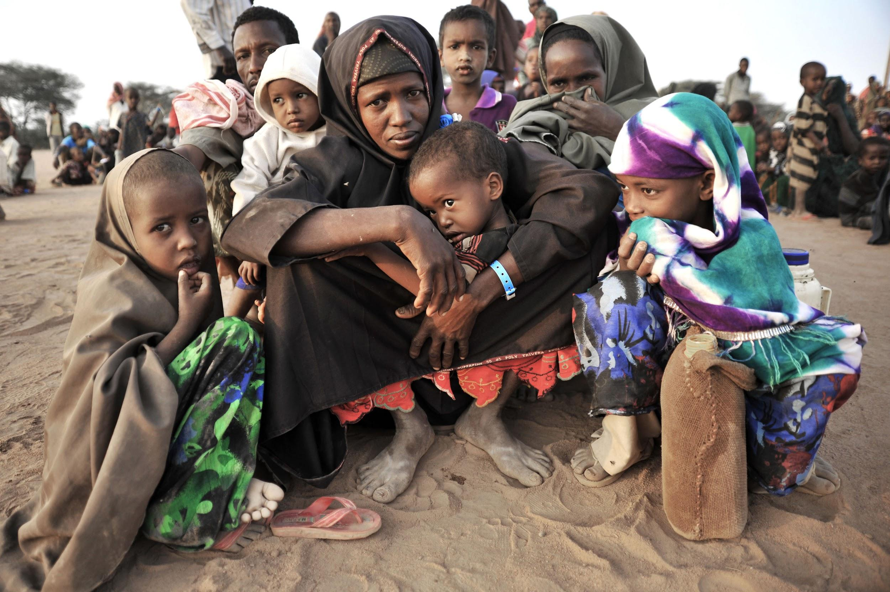

Slide 7
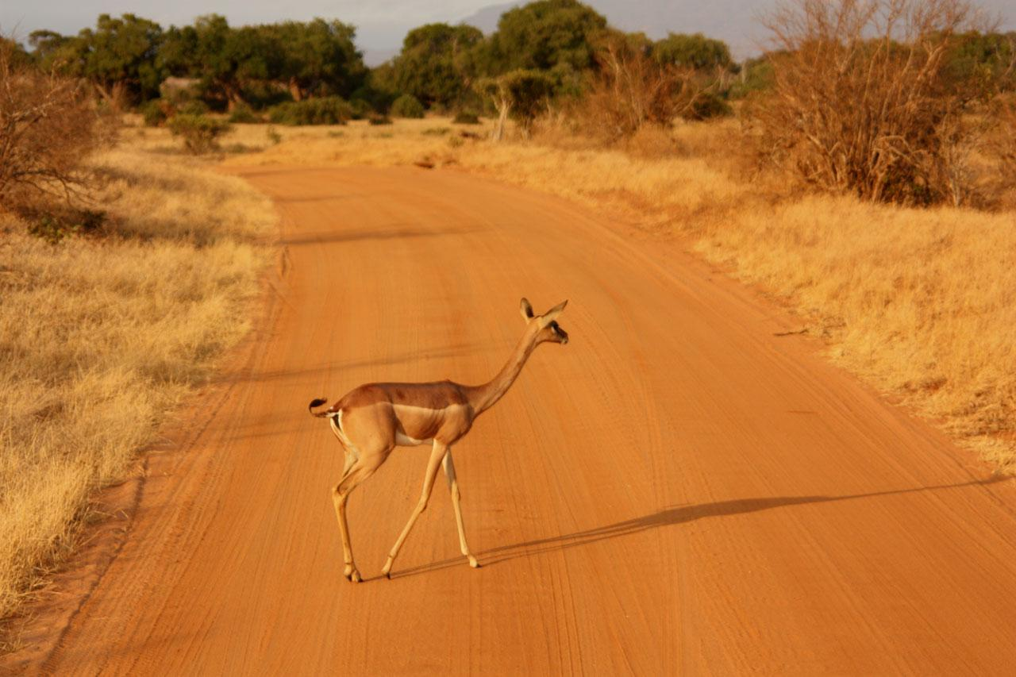
Who needs Saving?
Children of War.
Since Civil war broke out in 2011 in syria, roughly 3 million children have been affected leaving them homeless and on the dangerous streets of chemical warfare, air strikes, constant firearm activity and worse.. The design is inspired by whats currently happening today in Syria and other countries with child refugees.
Each family would be supplied ( or child ) with a Bare Necessity Kit
But not just syrian kids. Kids all over third world countries will be Getting access.

Slide 8
