Slide 1
6 in 1 puzzle
Xiao.Lin
IND2313
12/15/16

Slide 2
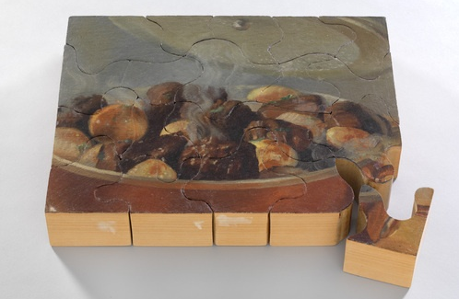
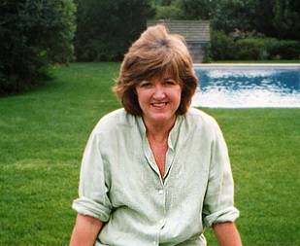
Inspiration
Puzzle in 1965-1966
By Vija Celmins

Slide 3
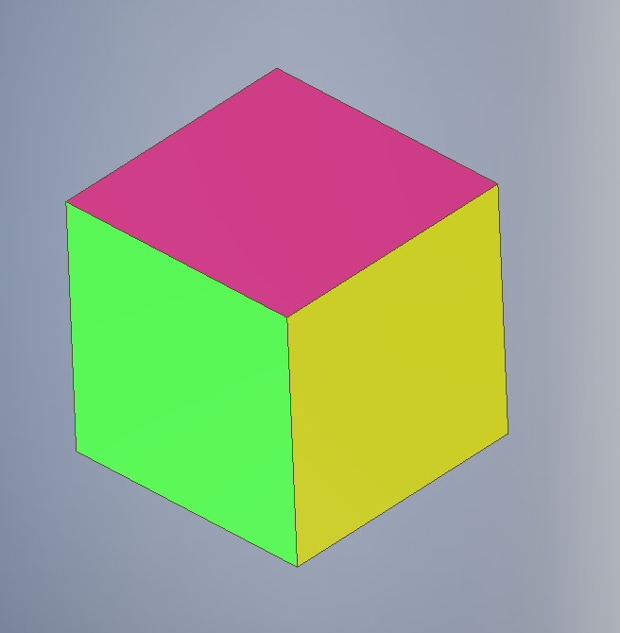

Piece of my puzzle
each color represents to different image of the puzzle

Slide 4
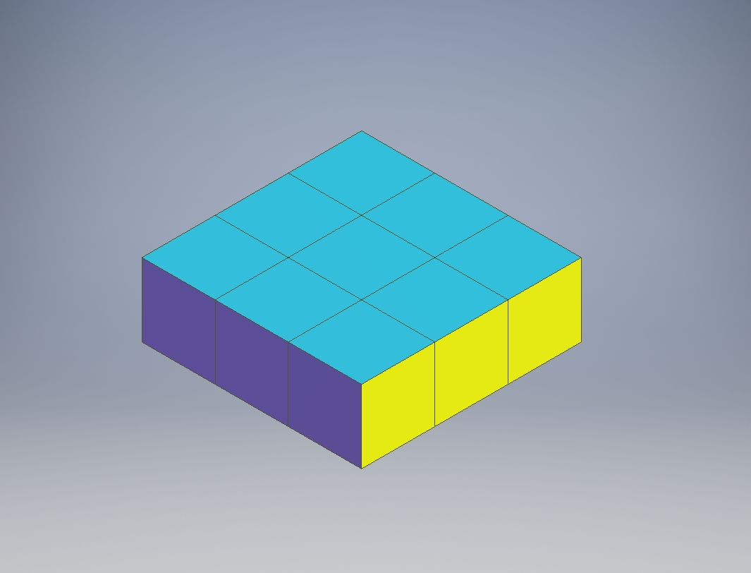
Puzzle finished
There is 3*3 piece puzle
we can also have
4*4, 5*5, 6*6……

Slide 5
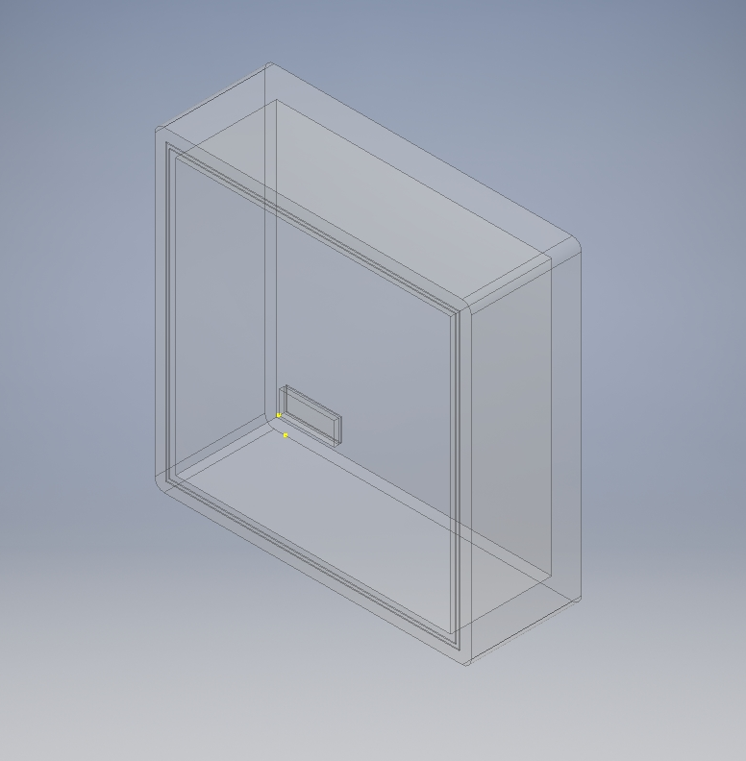
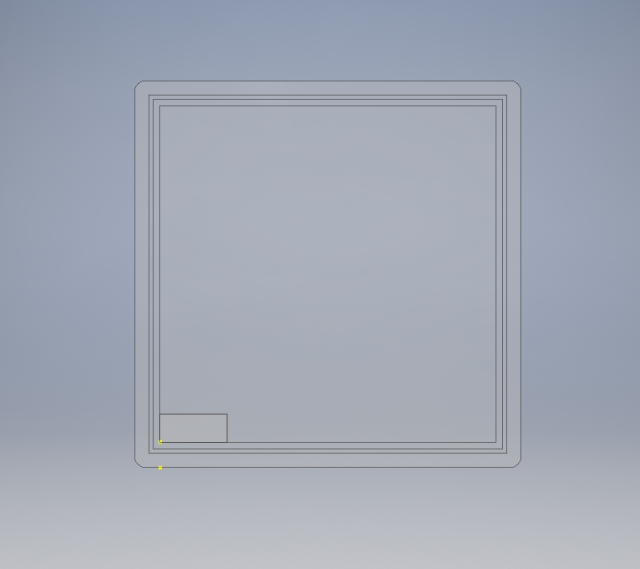
Puzzle box
LED light strips
Button batteries

Slide 6
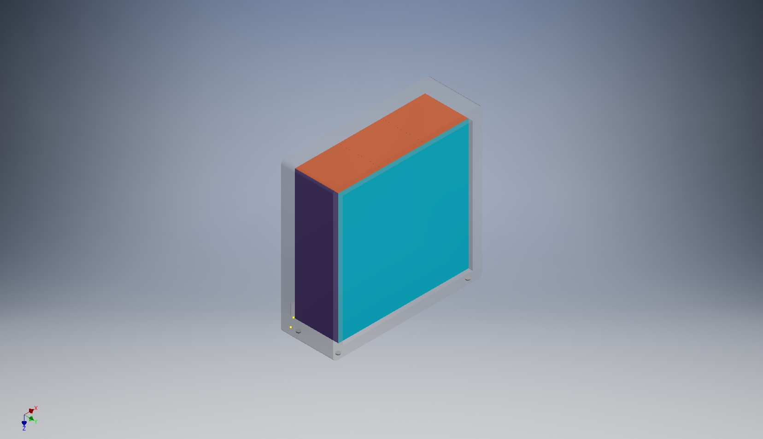

PUZZLE IN THE BOX
It can light up your night!

Slide 7


