Slide 1
SWISHY ROBOFISH
By: Kwame Pilay

Slide 2
WHAT IT IS
This toy is a cross between a water arcade and a fish race.
Ideally age target is 2-8 years old.
The purpose of the game is to push each button to see which fish reaches the finish line first.
When there is no pressure being ejected from the buttons the fish will simply flow back to the starting point.

Slide 3
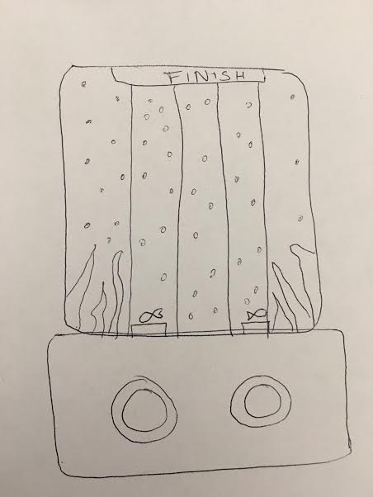
HANDRAWING

Slide 4
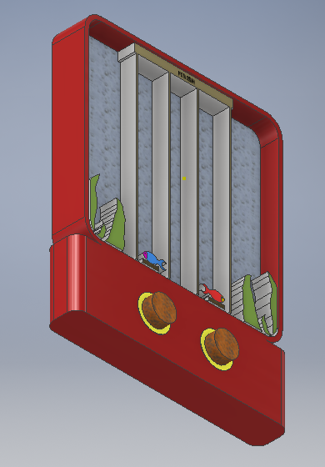
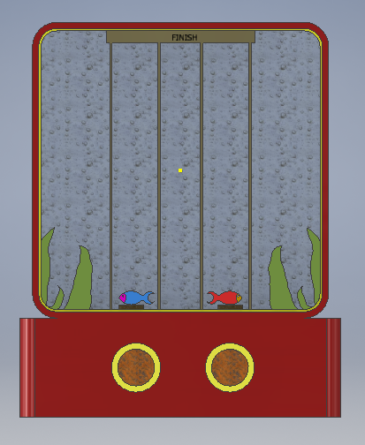
3-D MODEL

