Slide 1
Sea Flow
Created by: Ryan Fleming

Slide 2
Bath time difficult?
Child will not stop moving around?
Hard to get children into the bath?
Bath time not fun for both of you?

Slide 3
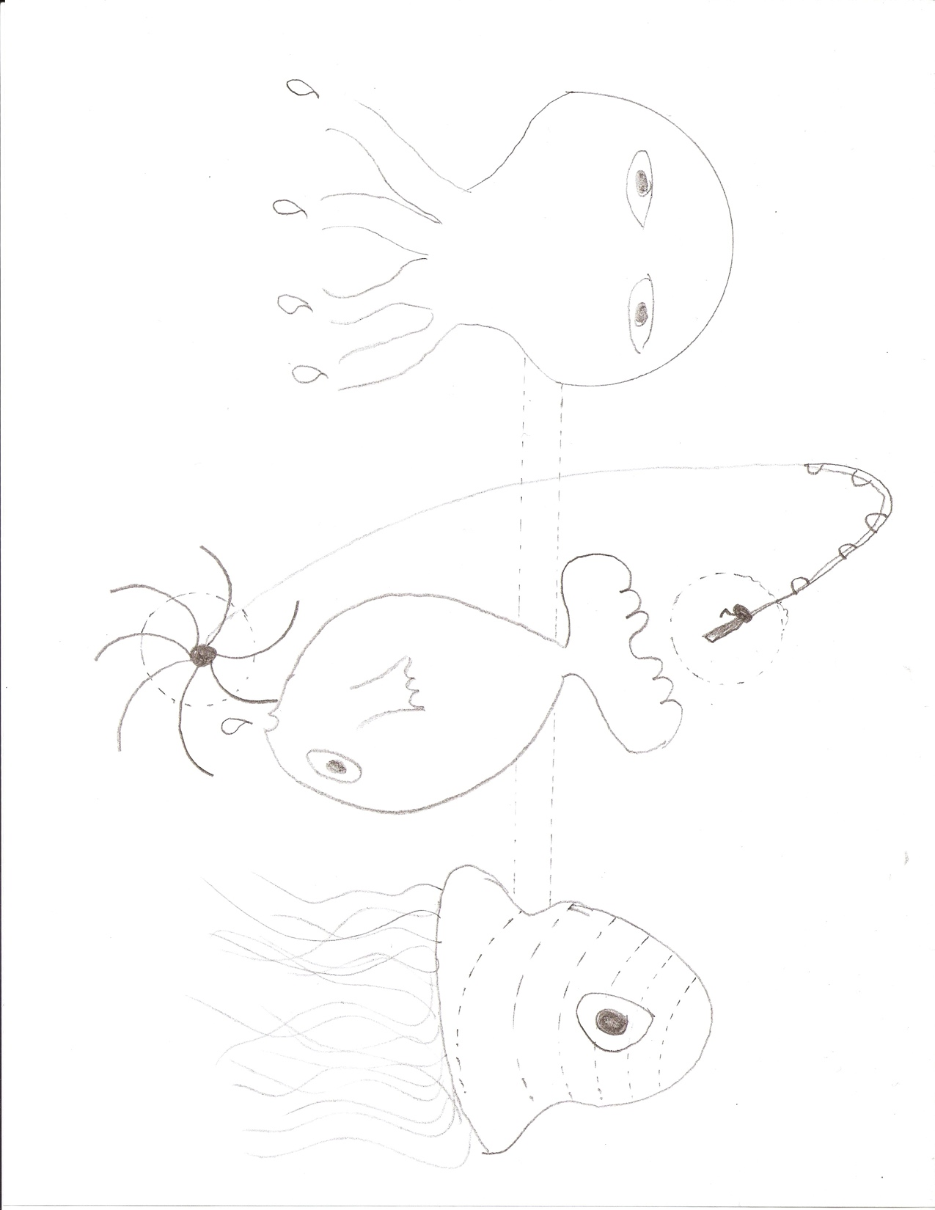
Now introducing
“Sea Flow”

Slide 4
Easily Suction Cup to any bath tub or wall!
Keeps your children occupied while you bathe them!
Is very interesting to them!
Will make bath time more fun and a lot easier for parents!

Slide 5

Purple Octopus
Pour water in through his head and watch the water come out of his tentacles!
Purple Tint in order to see through

Slide 6

“Nemo” Fish
Pour water in through the top and watch the water come out of his mouth spin the “hook” that is trying to catch him
“Nemo” Color so children can relate him to the movie

Slide 7

Clear JellyFish
Pour water in through the top and watch the grooves in the hard plastic “swirl” the water and come out of its tentacles
Clear jellyfish because most jelly fish are clear and you can see inside of them

Slide 8
A Childhood of Fun bath times!
“Sea Flow”

