Slide 1
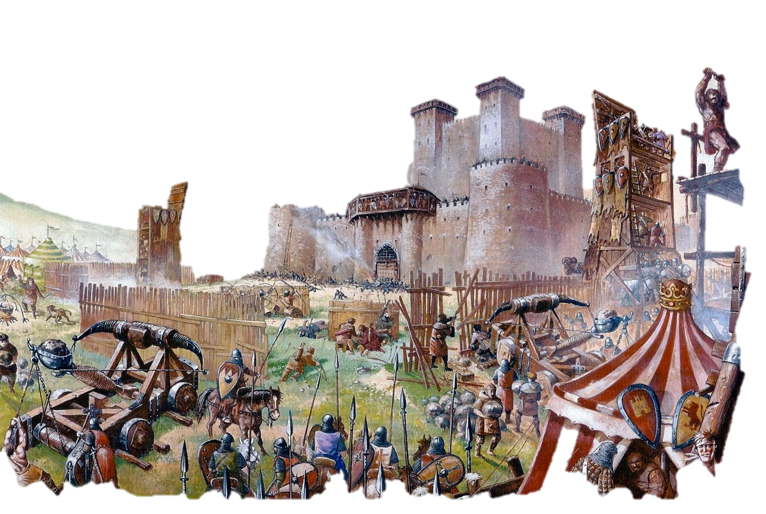
Toy Design: Self-Assembly Catapult
Industrial Design I
Prof. Nakamura
Runtao You

Slide 2
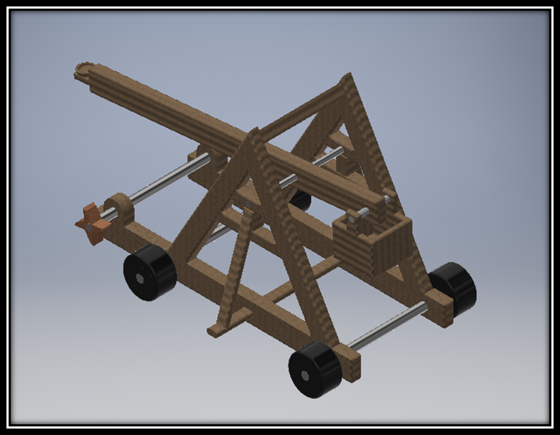
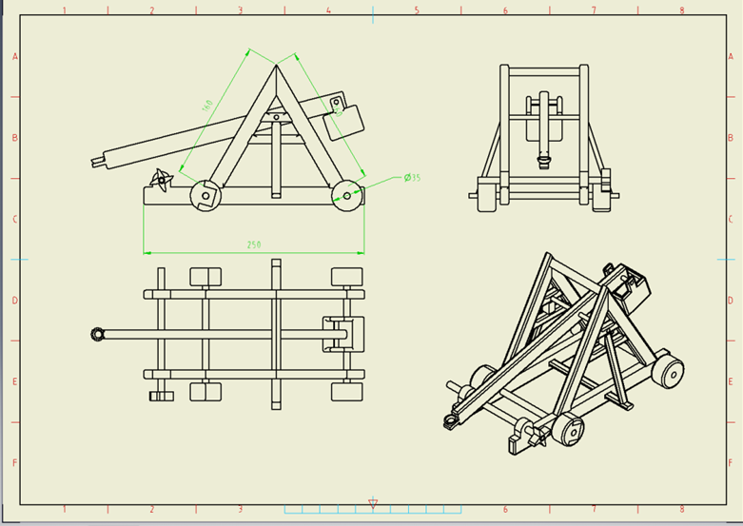
3D Model and Drawing
Notes:
https://en.wikipedia.org/wiki/Torsion_siege_engine
https://en.wikipedia.org/wiki/Trebuchet

Slide 3
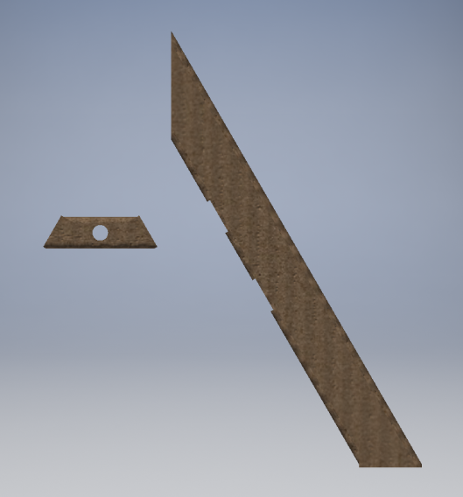
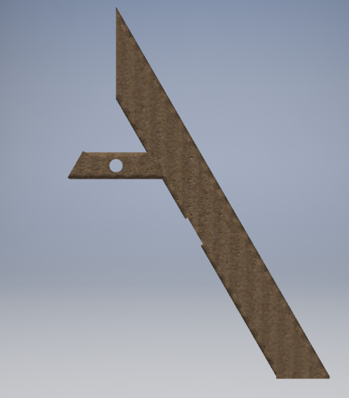
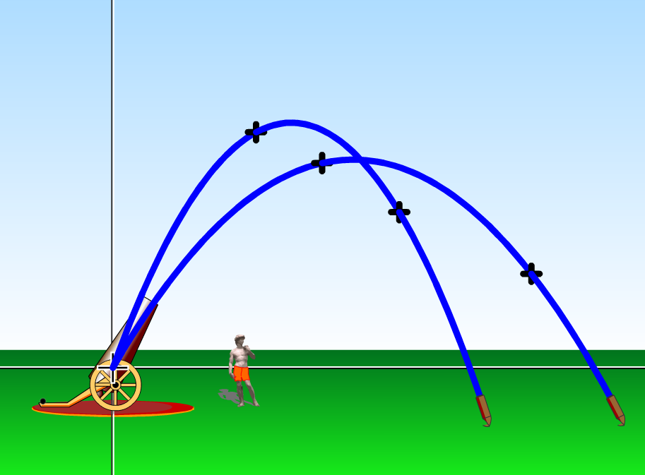
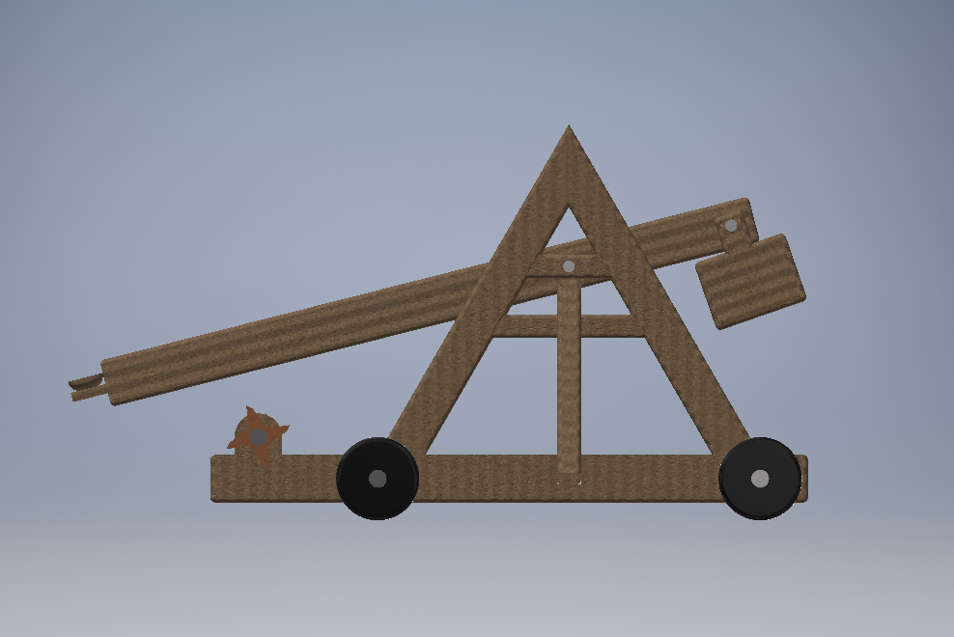
Functions of the Toy
User age: 6-12 years old children
Present educational purposes to convince the buyer- parents
Assembly of Toy
Counter Wight
Introduce Projectile Motion
Energy Transformation

