Slide 1
Reflection on OG STEM Application
NYCCT/CNY
Fall 2016-Spring 2017
Lucie Mingla

Slide 2
My Preparation for Flipped classroom
STEM Application Project in
Complex Numbers and Circuits
  My Videos
    Class Discussion
      Handout Practice
        Assessing Students
        Group Project
        Exam related questions
        Feedback and grading
        Student’s Reflection towards other groups and each-other within their groups
        MY reflection

Slide 3
Links to my videos and students projects in open lab
(To be able to watch the videos please copy the links and paste in the browser)
http://screencast-o-matic.com/watch/cbVvoaQPZ4
http://screencast-o-matic.com/watch/cbnVYfQRK8
http://screencast-o-matic.com/watch/cbnQf06h1i
http://screencast-o-matic.com/watch/cbhjo3XT5l
This is the link of this video that you are watching.
https://openlab.citytech.cuny.edu/groups/mat-1275-spring-2017/files/

Slide 4
The application in the classroom went really good. Students felt that it was really challenging in terms of physics concepts about circuits, but they enjoyed the fact that they were learning complex numbers, because they were used almost everywhere in our everyday life. They enjoyed my three videos.
Part one was about solving quadratic equations by completing the square and introducing complex numbers.
They referred to that video for solving quadratic equations, deriving quadratic formula, wring the quadratic functions (parabola) in vertex form etc.
The second video had pure operations with complex numbers. They referred to it to learn operations with
complex numbers
The third one was with the STEM applications in circuits. They referred to that video for their research and
group presentation.
So my application in the classroom was as it follows below:
I introduced my videos to my students after they took the test on session 9. I showed the first video to them pausing and explaining solving equations by completing the square.
Gave them the links. (The slides and the flier were posted in open lab)
Discussed in class the following session.
Gave them handout to practice and discuss.
Asses them by giving questions related to stem applications in circuits.
Project based research presentation in STEM applications for opening up the ideas and give them the chance to expend the knowledge and explore some STEM applications. (This was complete outside the classroom collaborations in groups. Only the presentation was in class in a concise manner).

Slide 5
My observations
*The students were recommended to chose an application of complex numbers, however they could chose from any of the topics that they had learned during the course.
* STEM applications in general were really good selections and well presented, even though none of the groups choose Complex numbers as topic.
* The two major topics chosen were Pythagorean theorem and parabolas.
(Recently they had learned distance formula, and the parabola using these two concepts as major ones).

Slide 6
Overall observation and reflection
Choosing the STEM applications in terms of extra curriculum and Real life. applications.
Research and enrichment of the material presented.
Mathematical calculations and physics interpretations.
Students are passionate about exploring the real world
Students resist in working together in the beginning, but once they start doing it, it becomes an excellent excel of knowledge and experience
They are great evaluators for each other and provide valuable feedback
In terms of collaboration and effort in their group work they are honest and generous. They say who gave the contribution and who didn’t really show any great efforts.
It seems challenging to them to pick any engineering or physics related topic to the math concepts, but they are capable of doing it well and they enjoy what they did afterward
Mathematical-wise the concept is much more alive, they see why they learn these concepts and it shows better scores in the test results. I think that if done more often it would show a better result. I think that if it was in only one topic (Ex. Complex numbers) The results may have been more distinguished.
Overall it is challenging, but fun and learning to do these types of activities. We all enjoyed them.

Slide 7
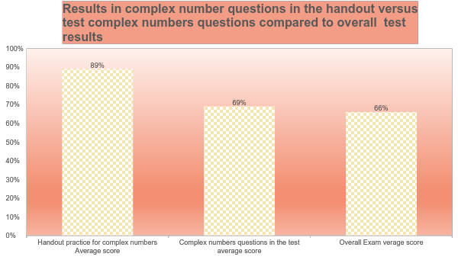
*

Slide 8
Groups Performance
 | Topic Chosen E(Excellent) VG(Very good) S(Satisfactory) U(Unsatisfactory) | Quality of performance and research in %
Group 1 | Interesting topic in Architecture using Pythagorean theorem | Well organized, interesting examples. No much math calculations shown. Well presented 90%
Group 2 | Interesting applications of Pythagorean Theorem in sports, construction, building Missiles or rockets, fishing boat etc | Well organized, illustrated with videos, diagrams and mathematical calculations. Excellent presentation. 100%
Group 3 | Interesting applications of Pythagorean Theorem in construction and architecture. Vey similar to the two first presentations, but with their own examples. | More illustrations with calculations were needed. 90%

Slide 9
Groups Performance
 | Topic Chosen E(Excellent) VG(Very good) S(Satisfactory) U(Unsatisfactory) | Quality of performance and research in %
Group 4 | Interesting application of parabola (Mcdonald's logo) | This groups’focus was in only one application of parabola, but the work on it was more detailed and including graphs(using desmos), writing the equation of parabolas, line of symmetry, vertex etc. I would have preferred to see the limitation of the length of the branches of parabolas. (restricting y-values 90 %
Group 5 | Interesting applications of parabola in real world: Satellite dishes, RollerCoaster, Bridges, THE BOTTOM OF THE EIFFEL TOWER etc | Excellent interpretation of physics concepts illustrated with mathematical calculations. 100%
Group 6+7 | The applications were chosen in using trigonometry in construction. Right tringles etc | A nice connection between geometry, trig, algebra and the real world applications was performed. 90%

Slide 10
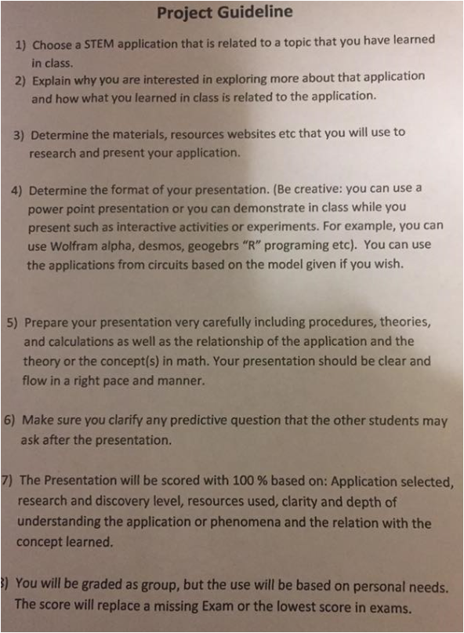
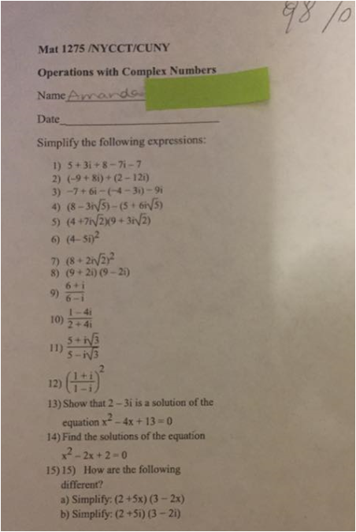
*Project Guideline and Student’s work sample

Slide 11
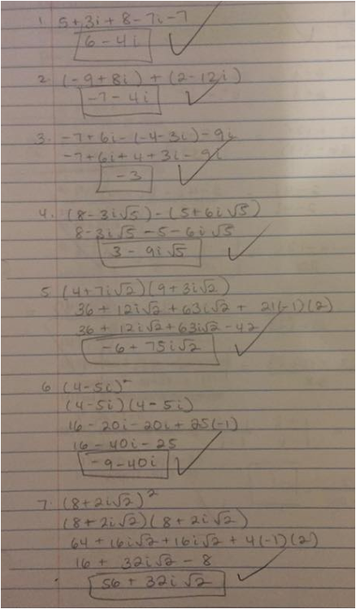
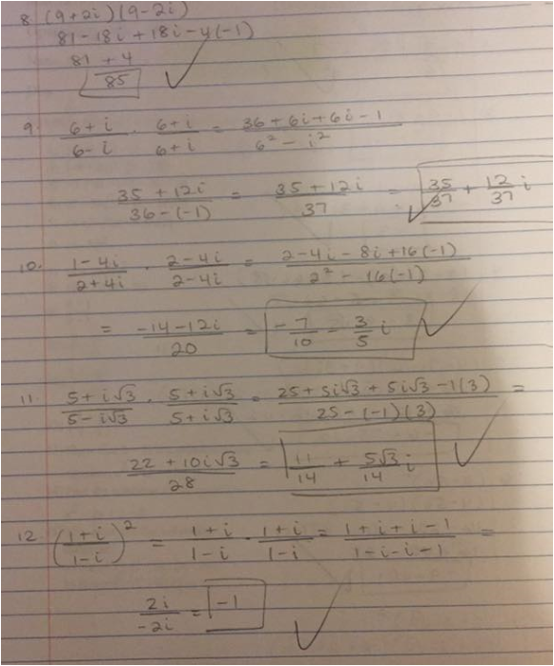
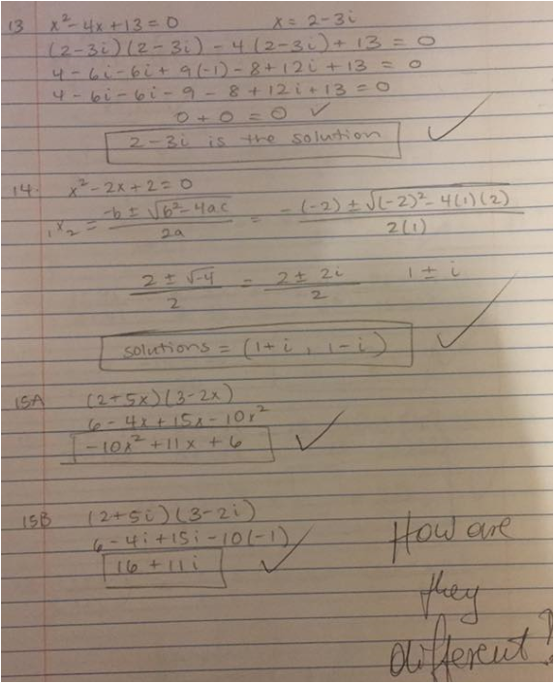

Slide 12
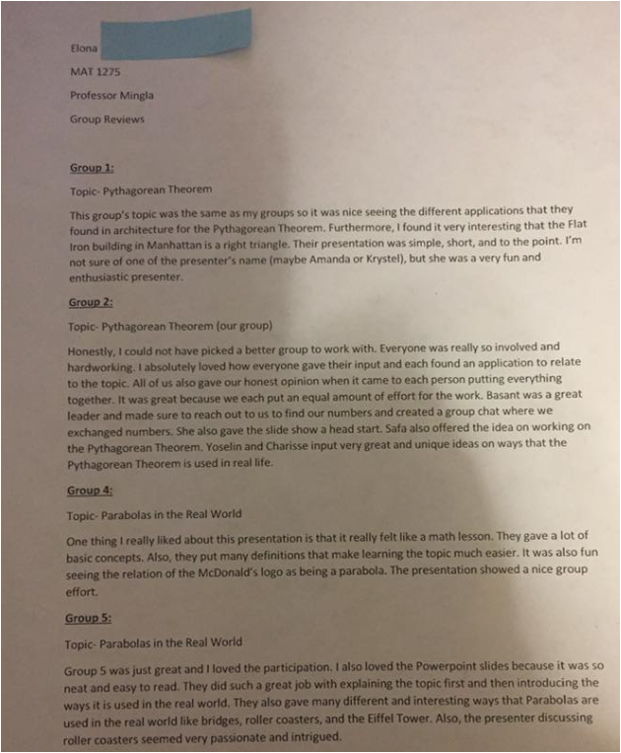
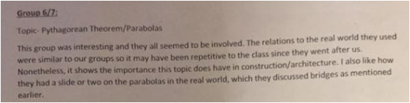

Slide 13
