Slide 1

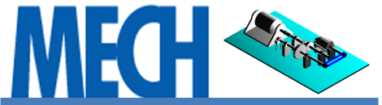
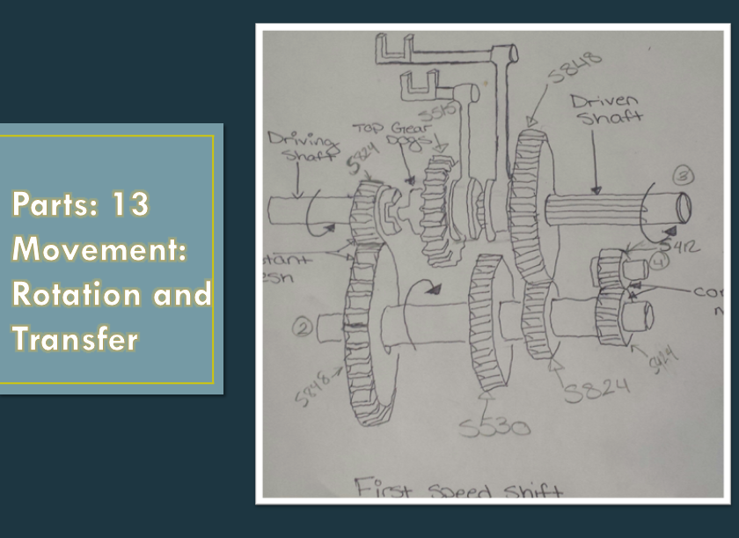
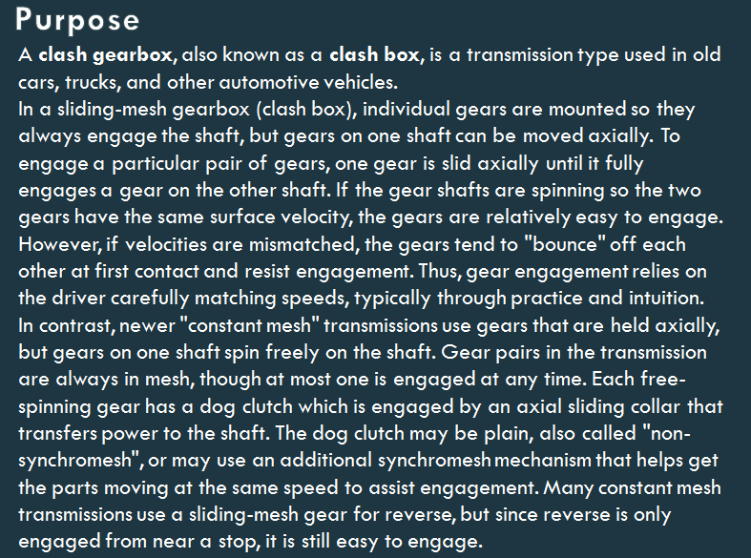
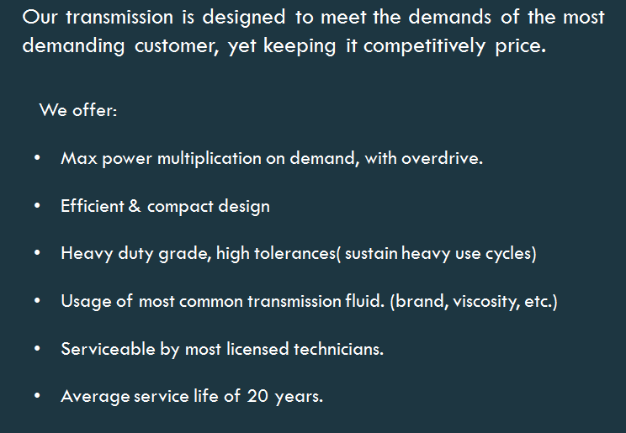
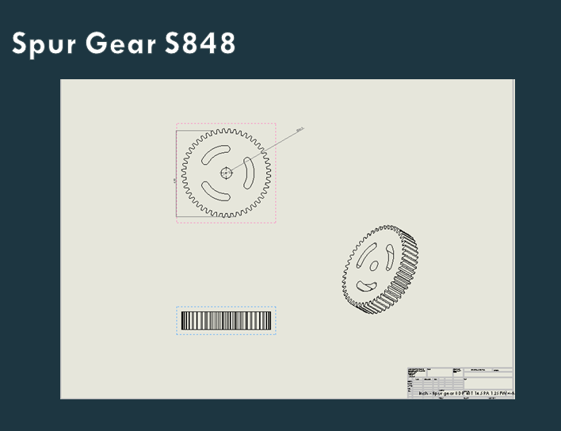
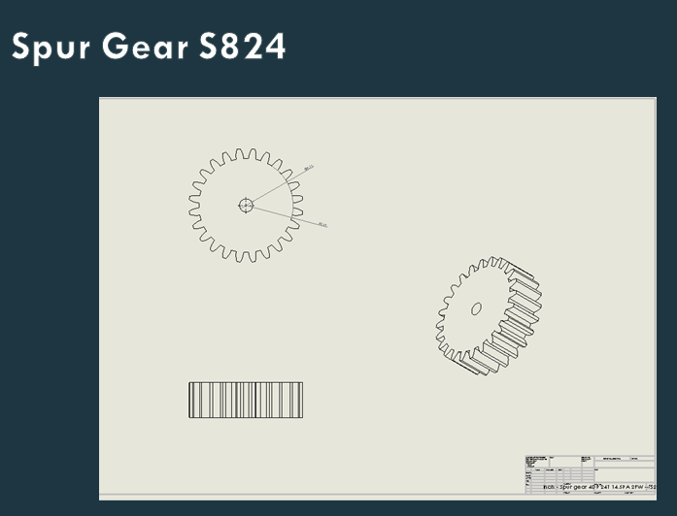
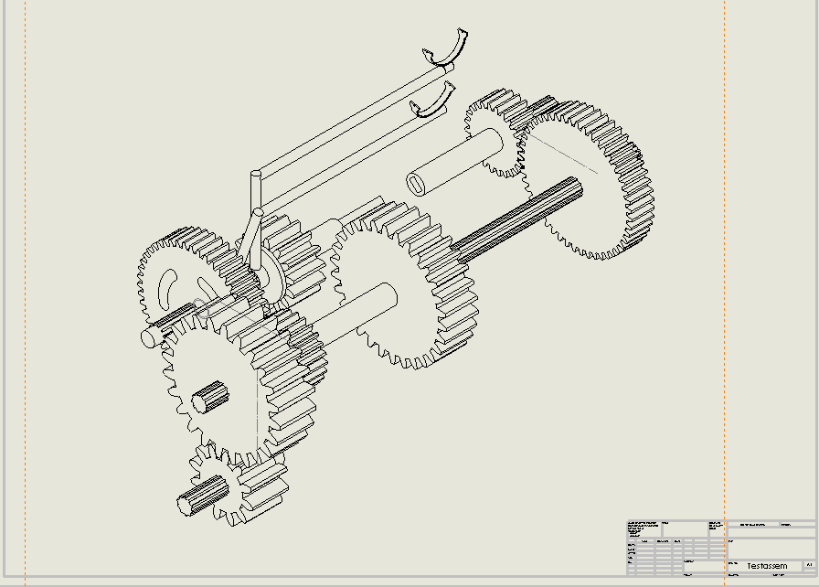
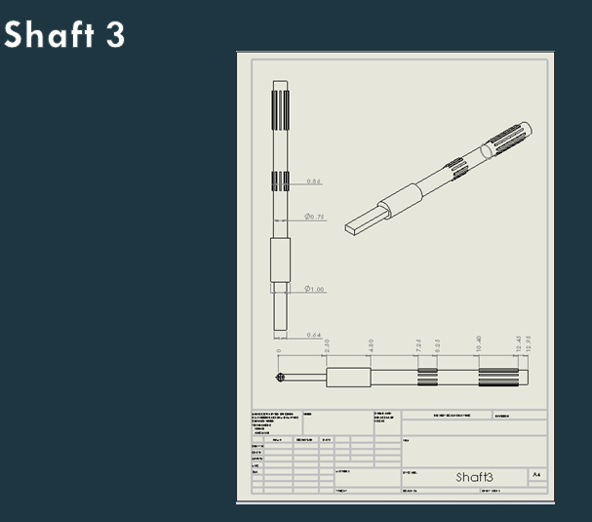
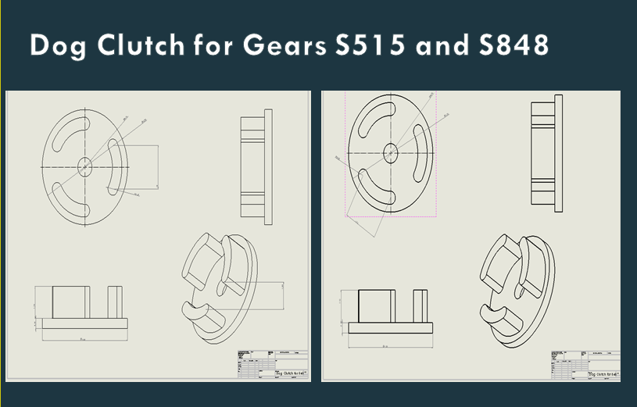
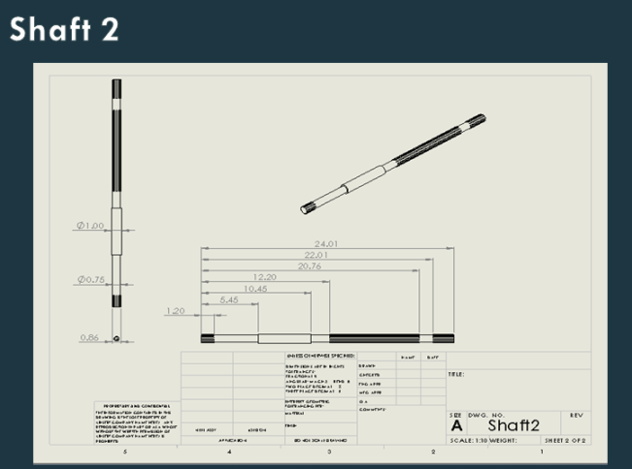
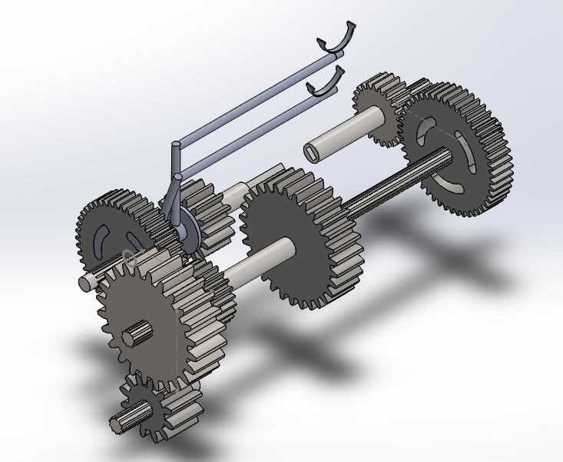
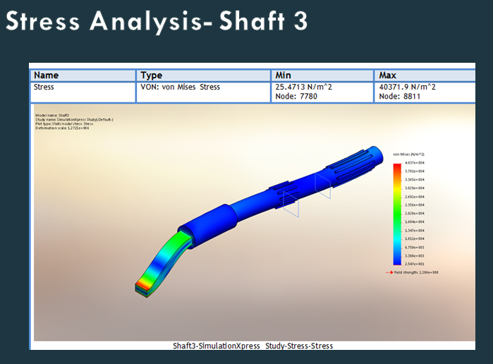
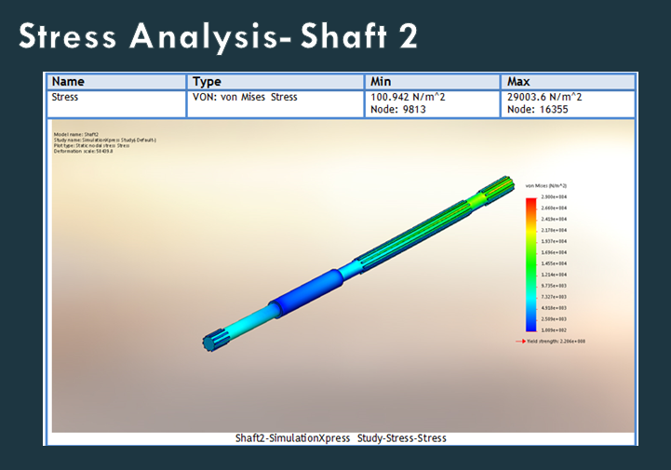
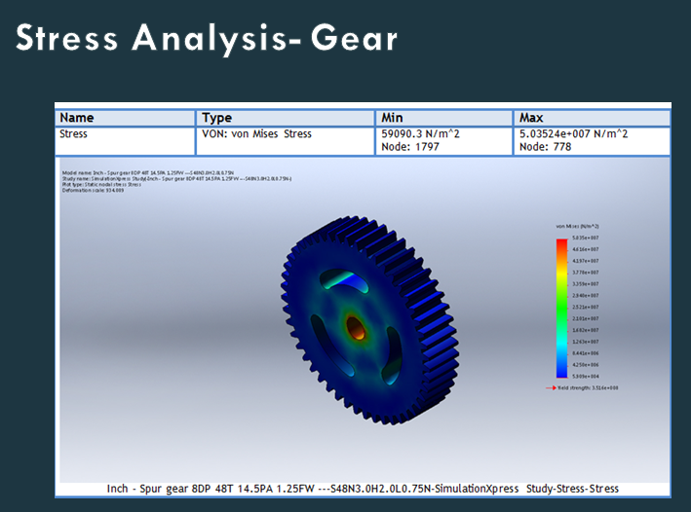
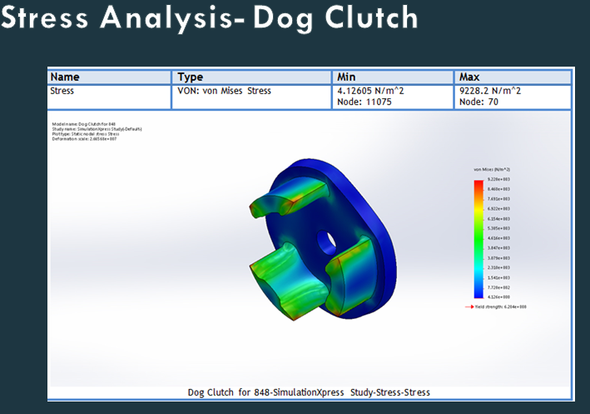
MECH2410 Machine Design
Final Project
Instructor: Prof. Masato R. Nakamura
Course Coordinator: Prof. Andy Zhang
Departments of Mechanical Engineering Technology
New York City College of Technology (City Tech), City University of New York (CUNY), Brooklyn, NY
Group Name: Machine Design Group A
Group Member Names: Mark Mendez, Eraj Khan. Omar ElRaey, Jesus Castellanos
Final Project Title: Three Speed Clash Gear Box
I. Introduction:
II. Background:
III. Objectives:
IV. Part Drawings:
V. Assembly Drawings:
VI. 3D Modeling:
VII. Stress analysis:
VIII. Summary:
The 3 Speed Clash Gear Box works properly. In order to make everything turn at the same time we need to add key ways to the shaft

