Slide 1


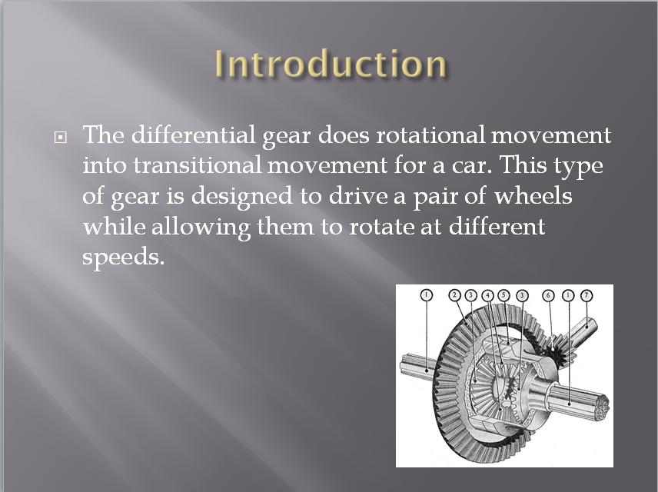
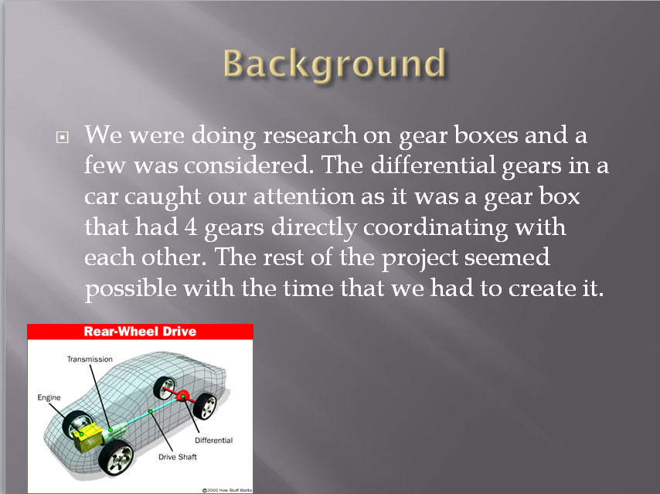
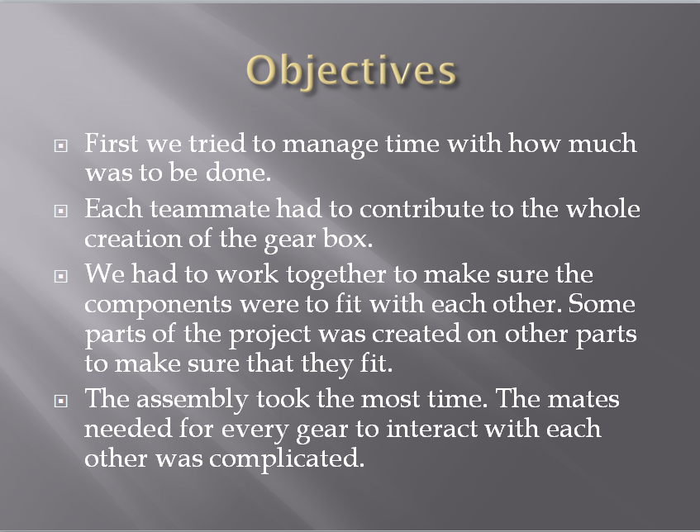
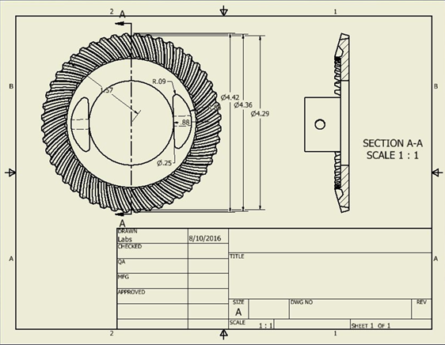
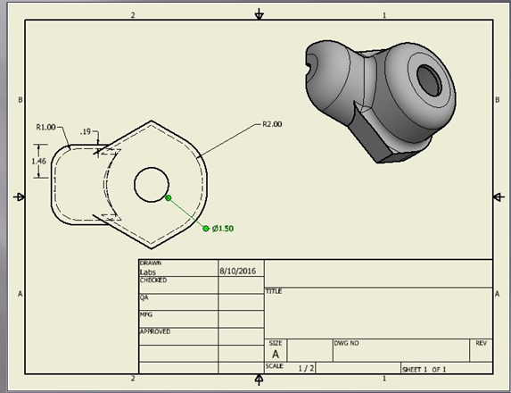
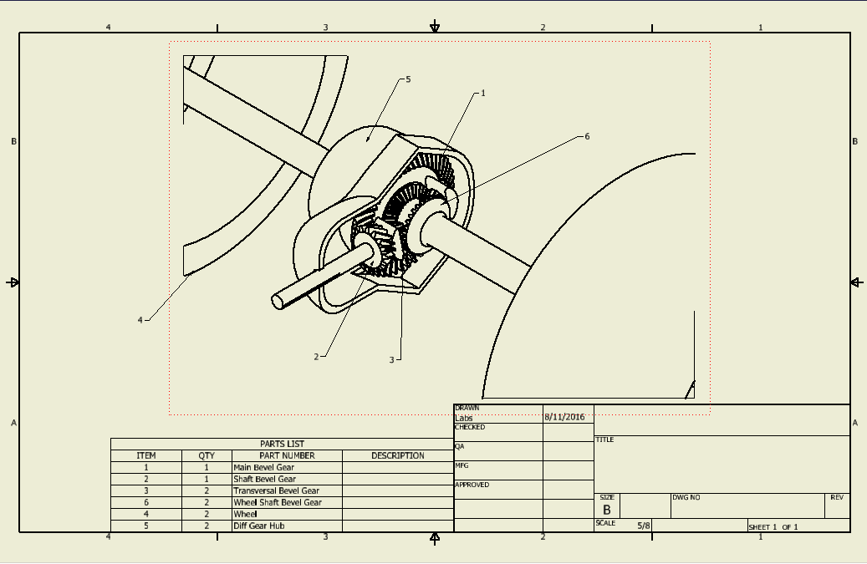
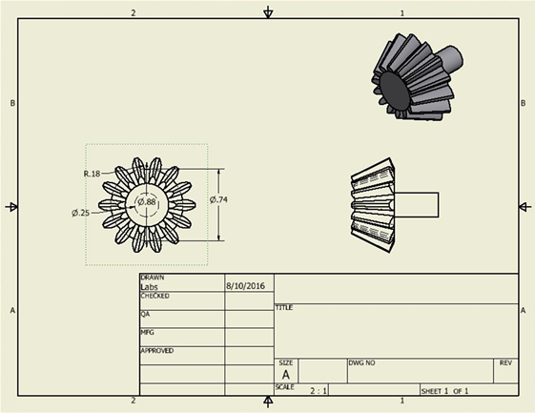
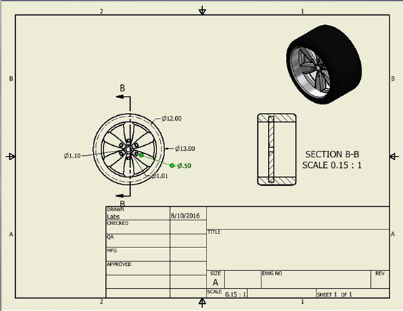
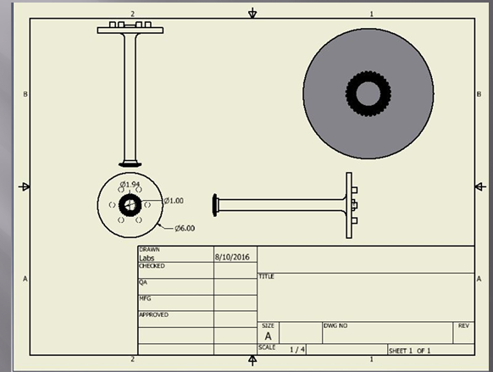
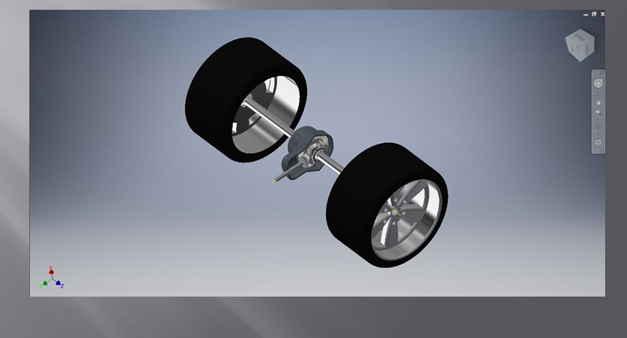
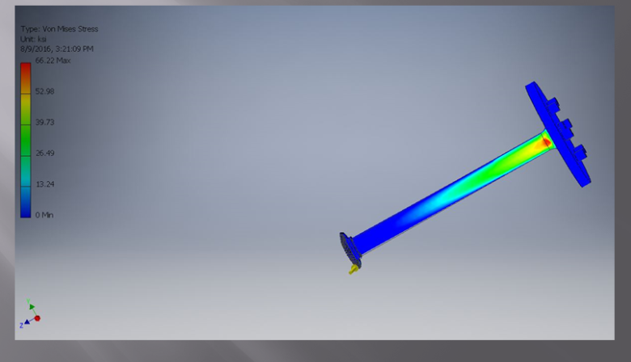
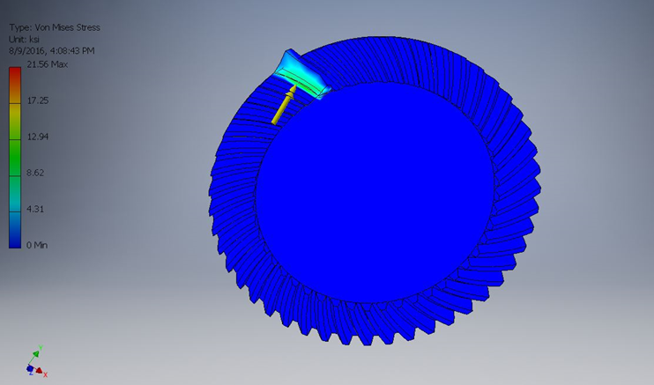
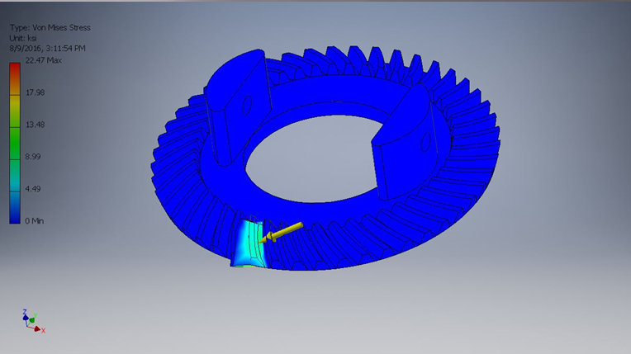
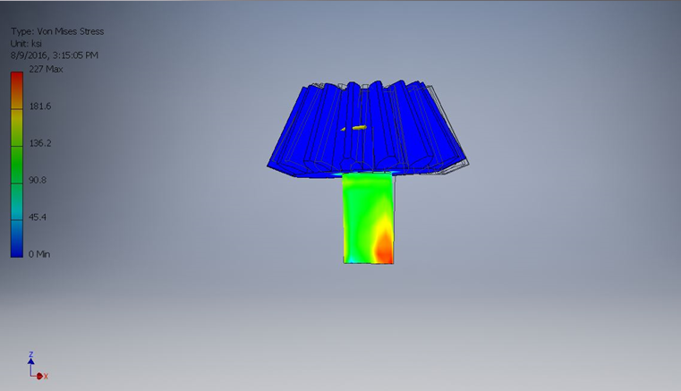
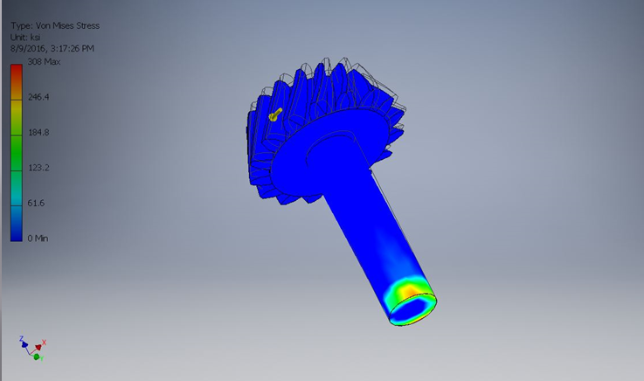
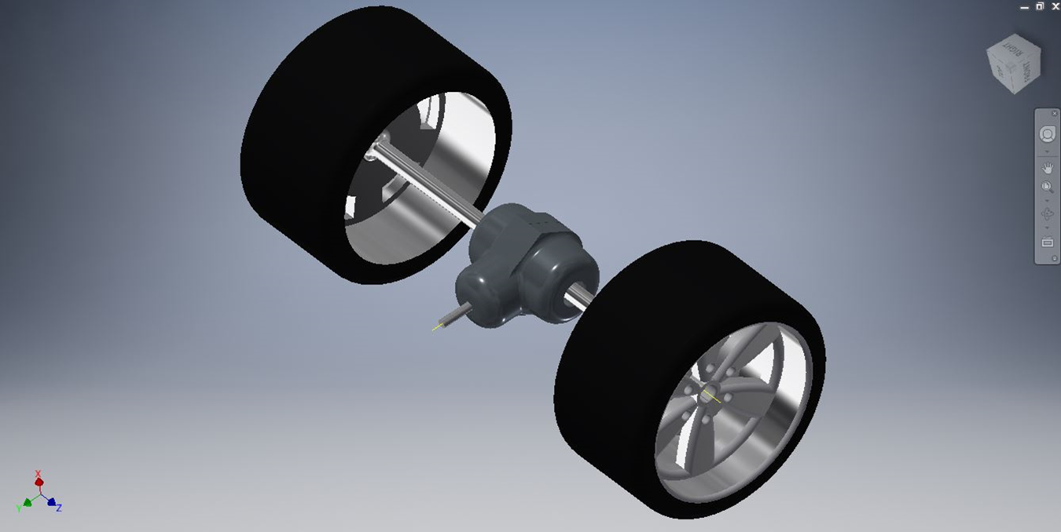
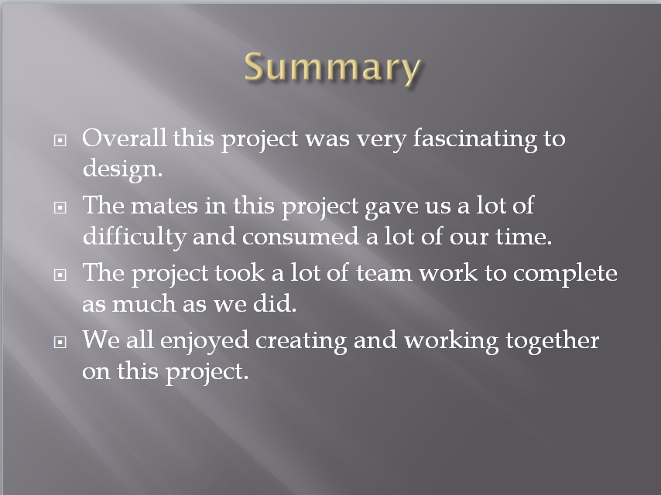
MECH2410 Machine Design
Final Project
Instructor: Prof. Masato R. Nakamura
Course Coordinator: Prof. Andy Zhang
Departments of Mechanical Engineering Technology
New York City College of Technology (City Tech), City University of New York (CUNY), Brooklyn, NY
Group Name:B
Group Member Names: Muhammad Adnan, Erick Vasquez, Pasram Dipchand, Kevon Charles.
Final Project Title: Differential Gear
I. Introduction:
II. Background:
III. Objectives:
IV. Part Drawings:
V. Assembly Drawings:
VI. 3D Modeling:
VII. Stress analysis:
VIII. Summary:

