Slide 1
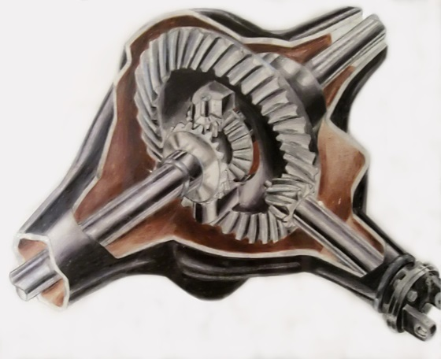
Differential Gear
Group B: Erick Vasquez, Pasram Dipchand, Kevon Charles, Muhammad Adnan.

Slide 2
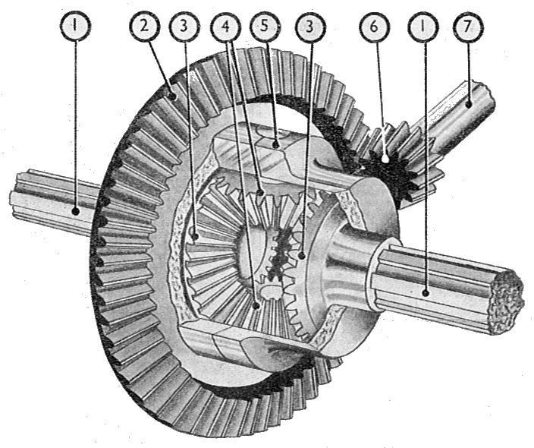
Introduction
The differential gear does rotational movement into transitional movement for a car. This type of gear is designed to drive a pair of wheels while allowing them to rotate at different speeds.

Slide 3
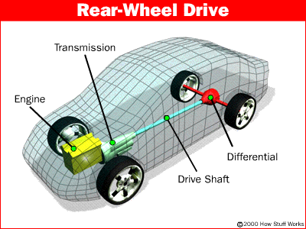
Background
We were doing research on gear boxes and a few was considered. The differential gears in a car caught our attention as it was a gear box that had 4 gears directly coordinating with each other. The rest of the project seemed possible with the time that we had to create it.

Slide 4
Objectives
First we tried to manage time with how much was to be done.
Each teammate had to contribute to the whole creation of the gear box.
We had to work together to make sure the components were to fit with each other. Some parts of the project was created on other parts to make sure that they fit.
The assembly took the most time. The mates needed for every gear to interact with each other was complicated.

Slide 5
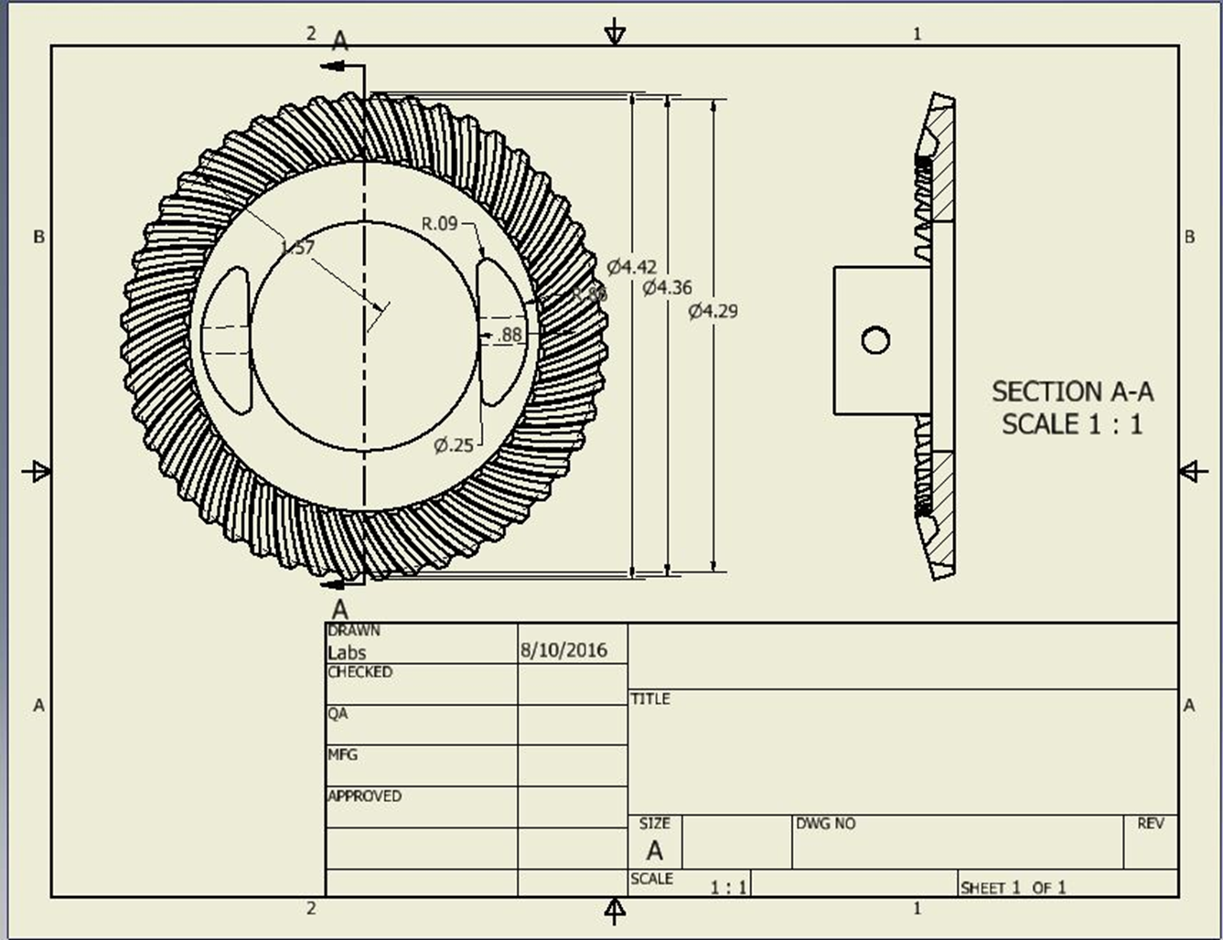
Part Drawings

Slide 6
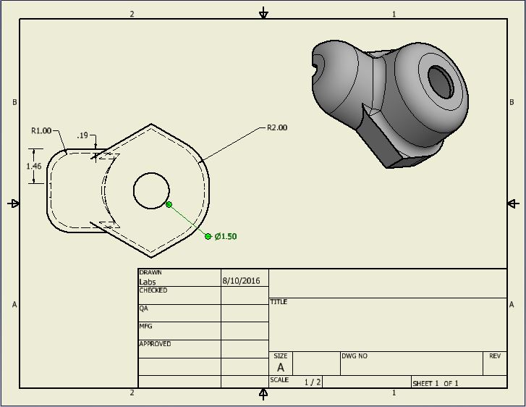

Slide 7
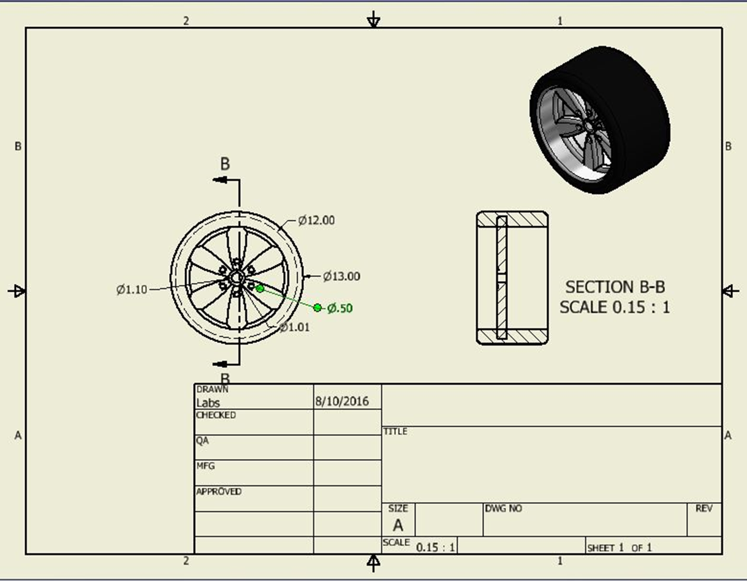

Slide 8
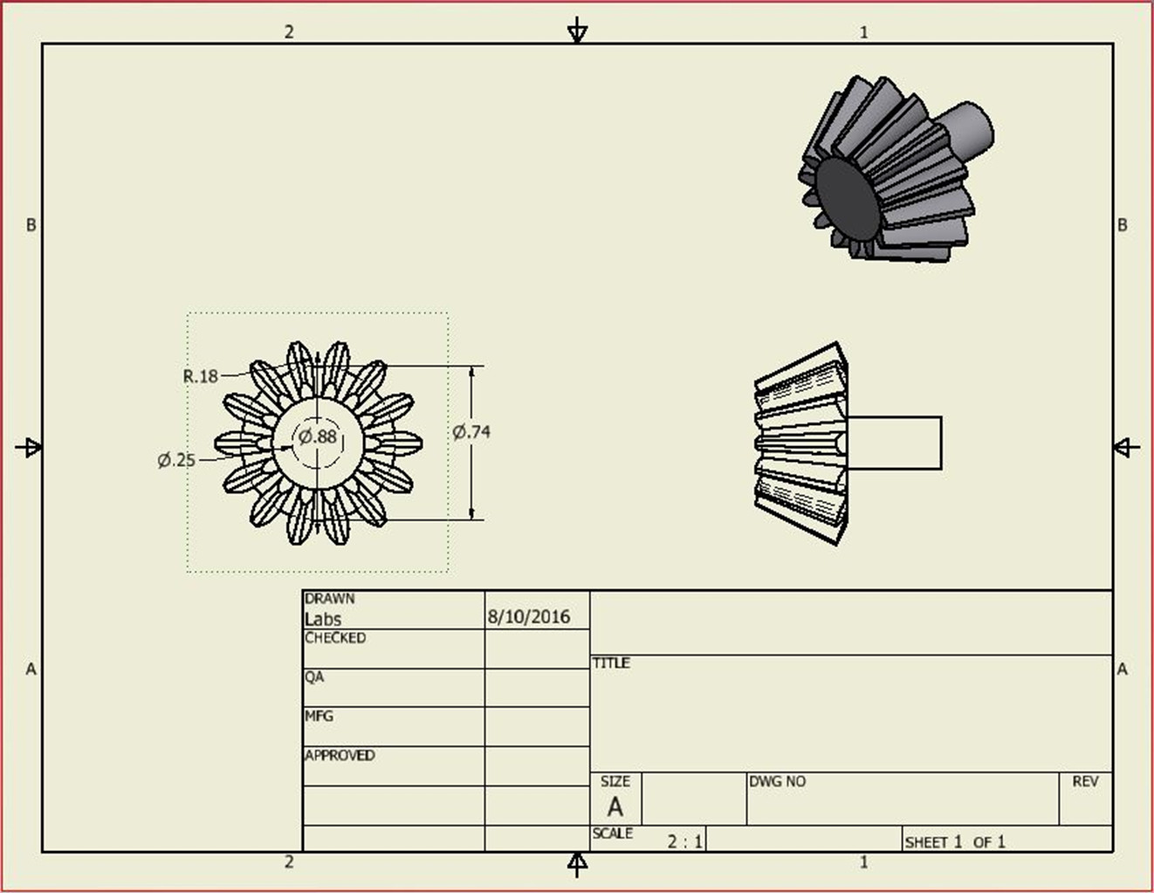

Slide 9
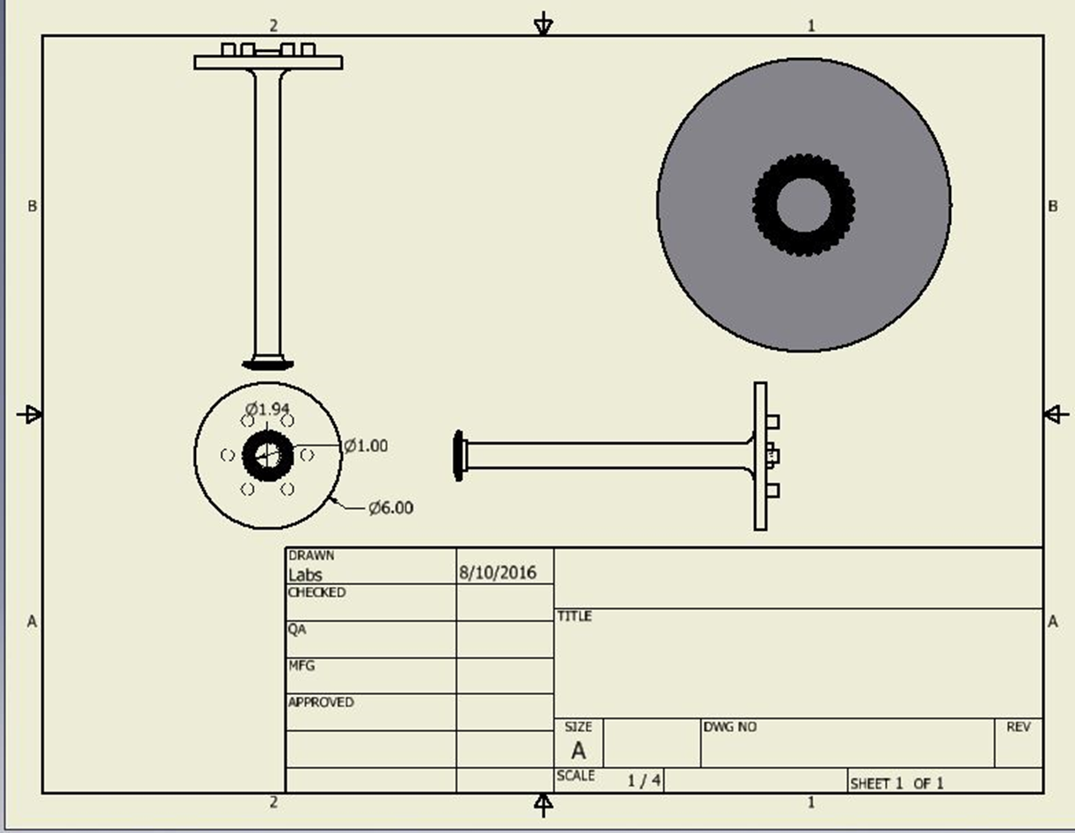

Slide 10
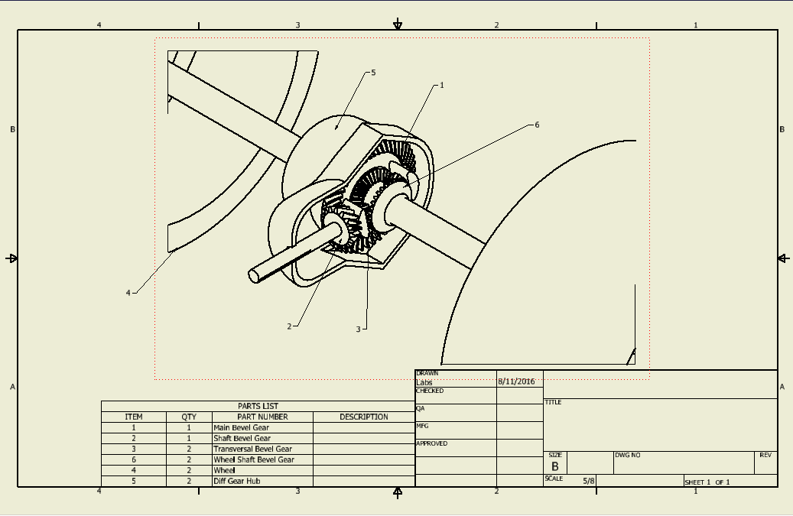
Assembly Drawings

Slide 11
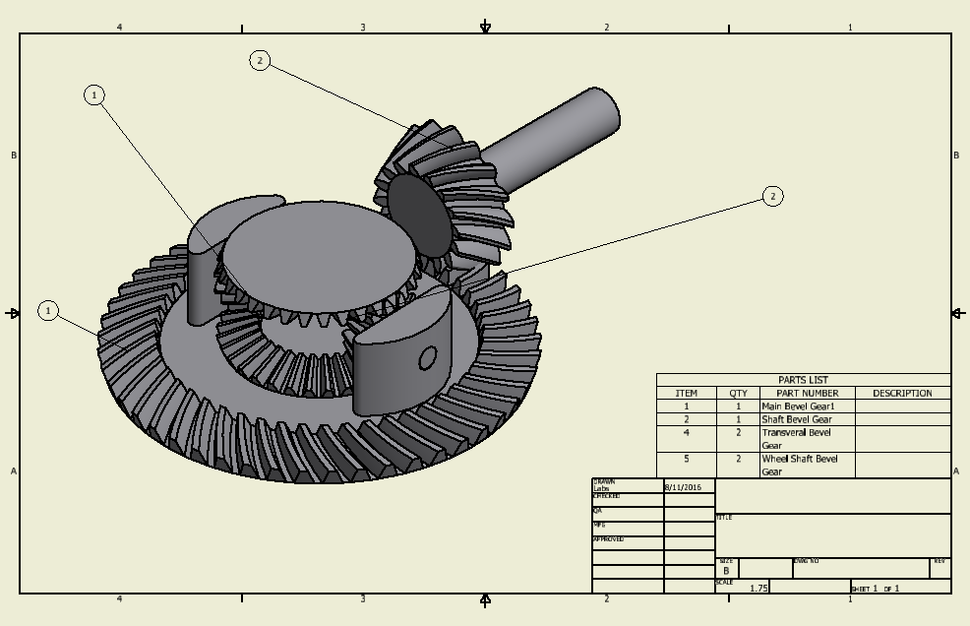

Slide 12
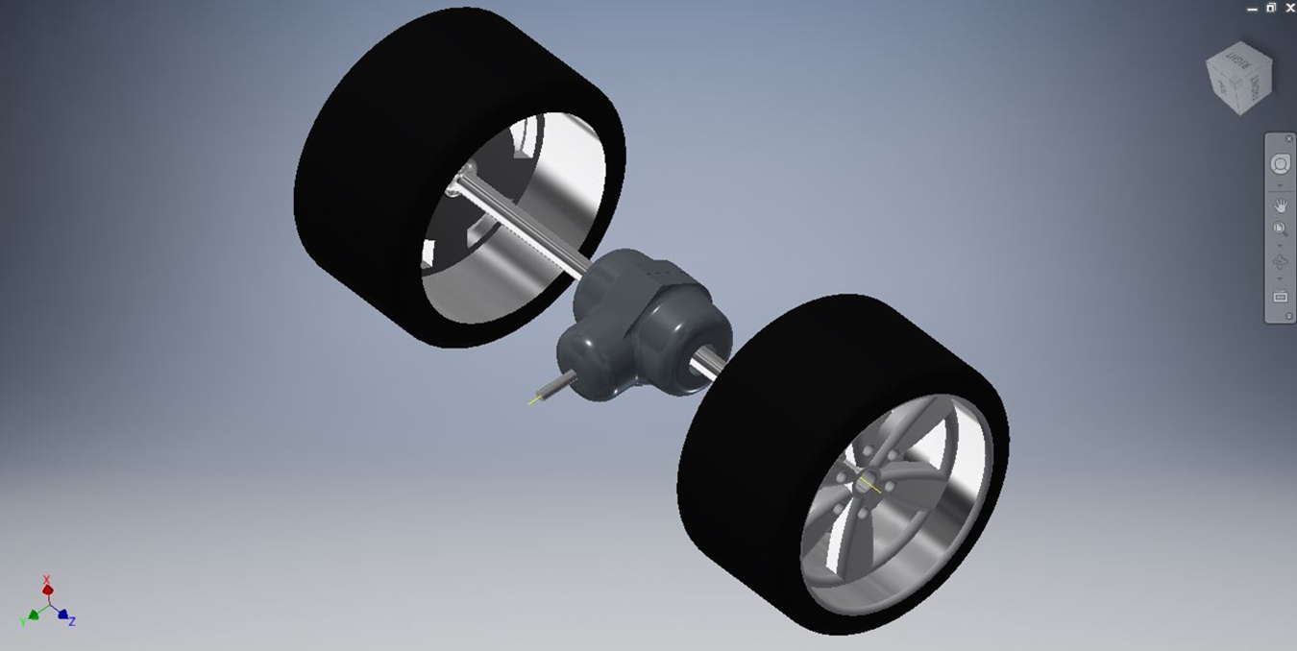
3D Modeling

Slide 13
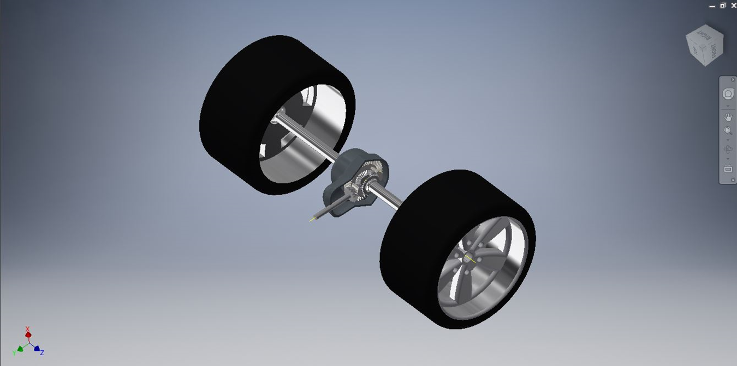

Slide 14
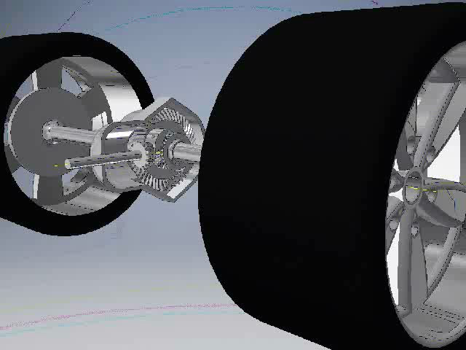
Animation

Slide 15
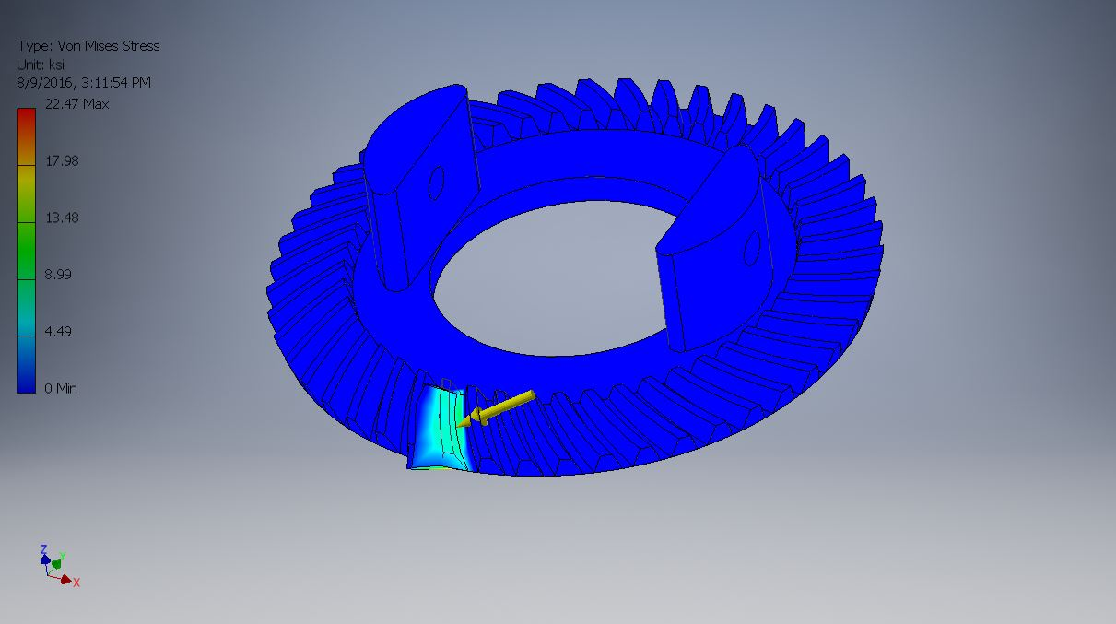
Stress analysis

Slide 16
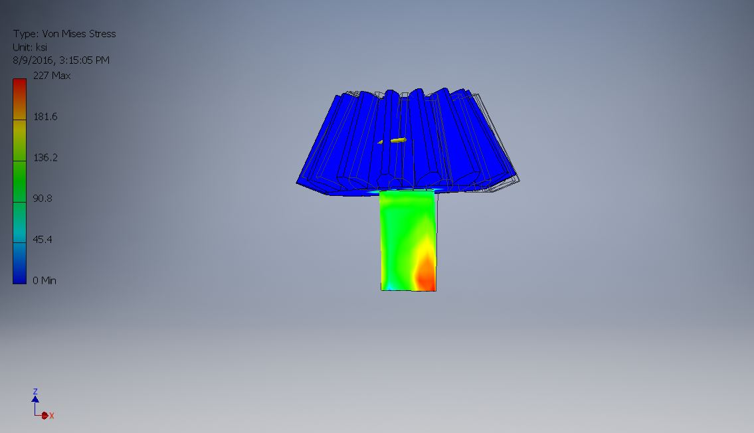

Slide 17
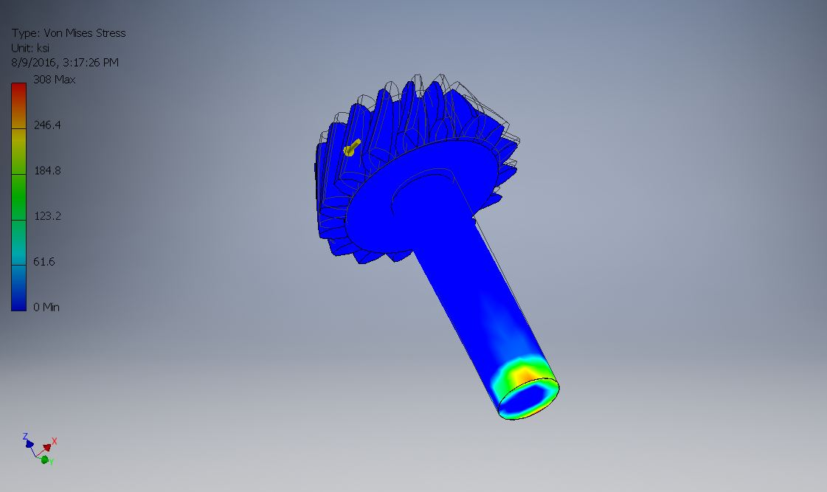

Slide 18
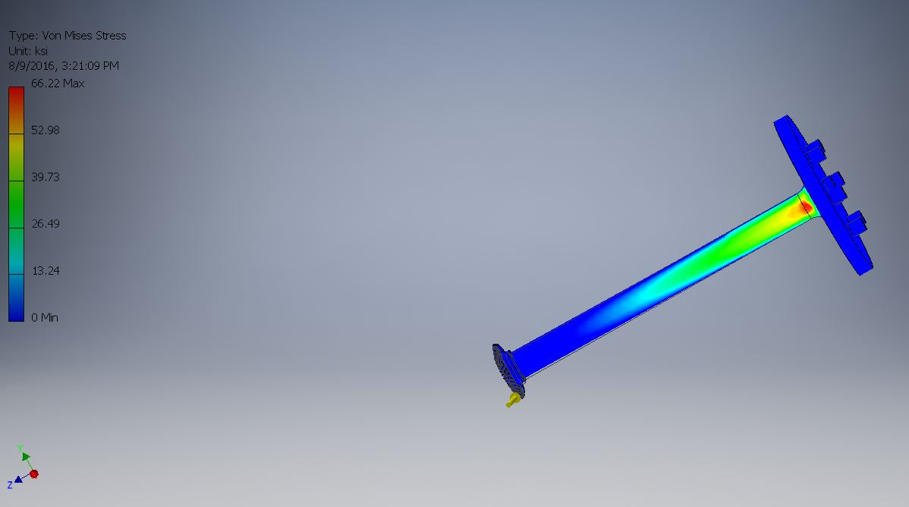

Slide 19
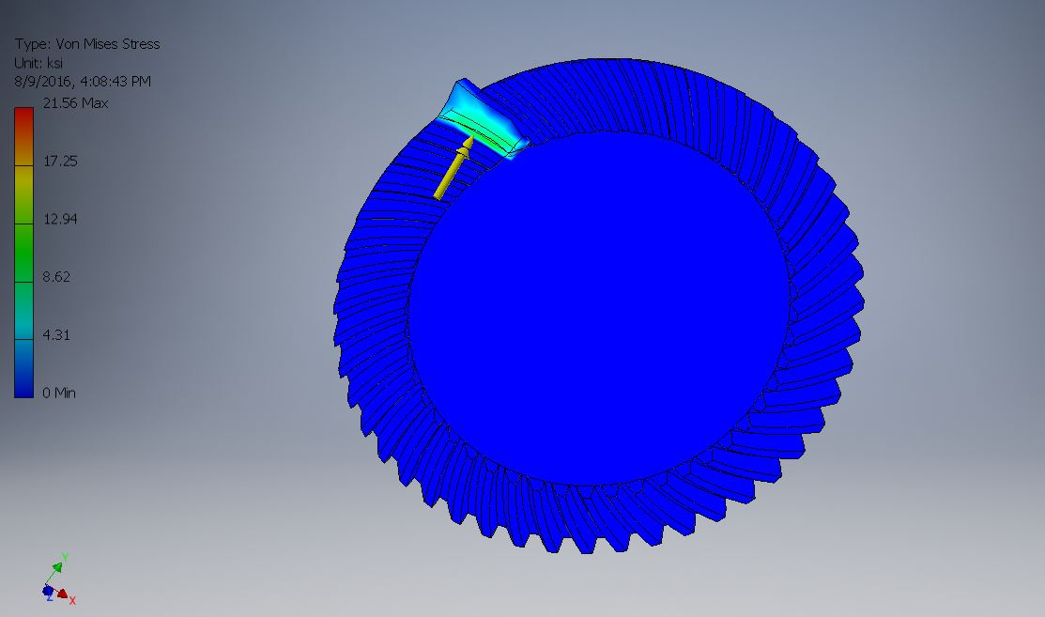

Slide 20
Summary
Overall this project was very fascinating to design.
The mates in this project gave us a lot of difficulty and consumed a lot of our time.
The project took a lot of team work to complete as much as we did.
We all enjoyed creating and working together on this project.

Slide 21
THE END

