Slide 2
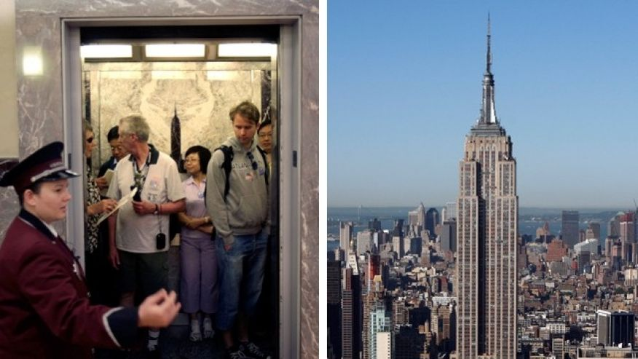
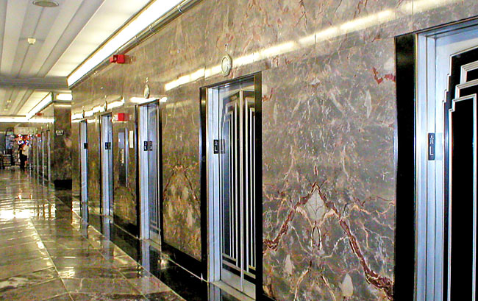
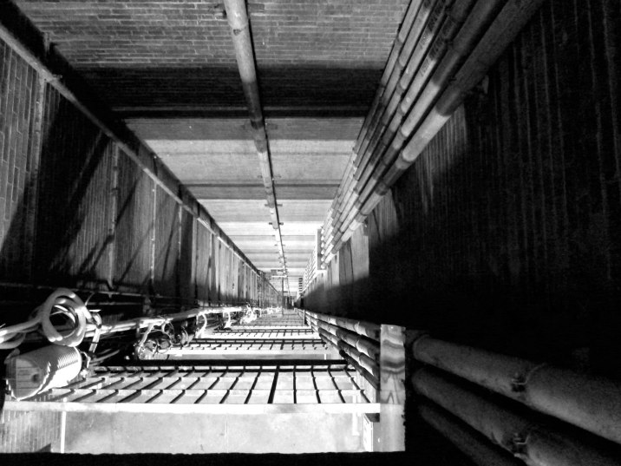
Day02 EX02 Design Process
Name:
Email:
You are an engineer at Research and Development (R&D) Department in an elevator company and your manager, head of R&D department asks you to develop a new elevator for empire state building. You have no experience of designing an elevator but you want to complete this challenging project. Research all information of current elevators that can be applied to this and create a plan for designing an elevator (i.e. design process).
We need to gather all the information as much as possible . (Building and the old Elevators)
Dimension of the building
How many floors
How many old elevators are there
The specification of the old Elevators (Speed, Capacity, Dimension)
How many people can the old elevator hold.
2. Now we need information from the Empire State Building company.
The Budget
Date
Any instructions
3. Proposal of the new elevator
Safety Features
New Design, Better, Lower the Maintenance fee, more Capacity.
Design Factor
Reliability
I have a Proposal for the Empire State Building.
A new elevator should be better in specs but also to keep the vintage interior that can be suitable for the empire state building.
Also, a proposal to install elevators outside of the building so, people can see the view of the NYC with all glass design elevator.

