Slide 2
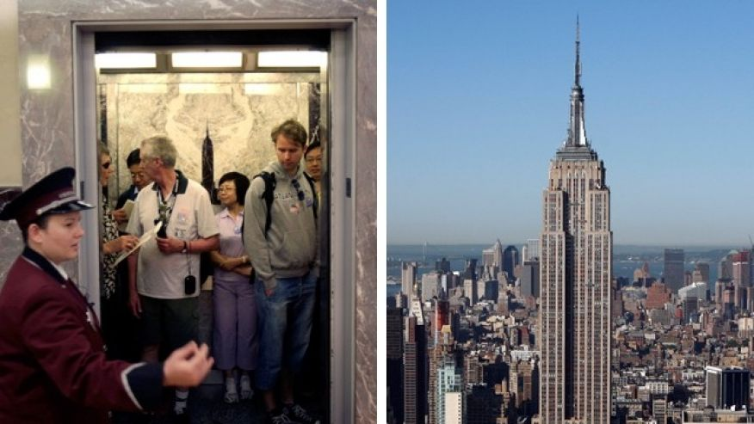
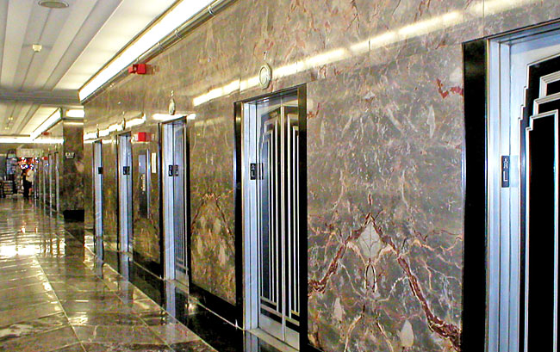
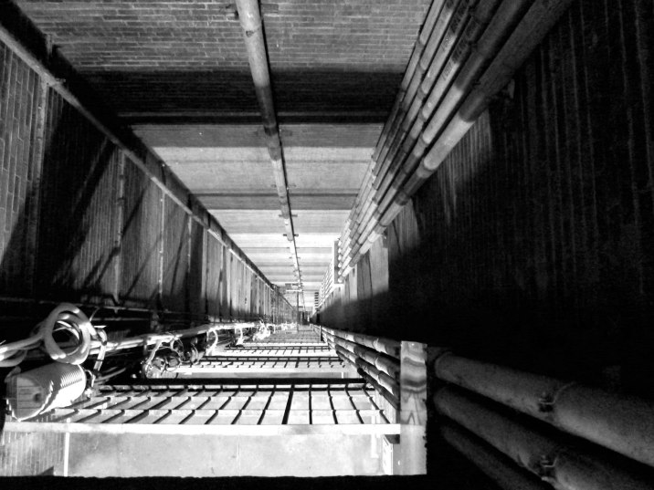
Day02 EX02 Design Process
Name: Warren Simpson, Pasram Dipchand
Email:
You are an engineer at Research and Development (R&D) Department in an elevator company and your manager, head of R&D department asks you to develop a new elevator for empire state building. You have no experience of designing an elevator but you want to complete this challenging project. Research all information of current elevators that can be applied to this and create a plan for designing an elevator (i.e. design process).
Describe here
. In order to make the elevator move faster there should be no cables and wire that would cause friction.
Instead, it would be better to use maglev technology which would make it love even faster.
At each floor there would be a set of locks to hold the elevator in place when someone person a button a signal would sent to the lock upon the elevator arrival. It would also be a little more convenient for the elevator doors to close 10% faster than usual. In addition to increase the speed, it would be better to use light weight metals that are strong for the frame of the elevator.

