Slide 2
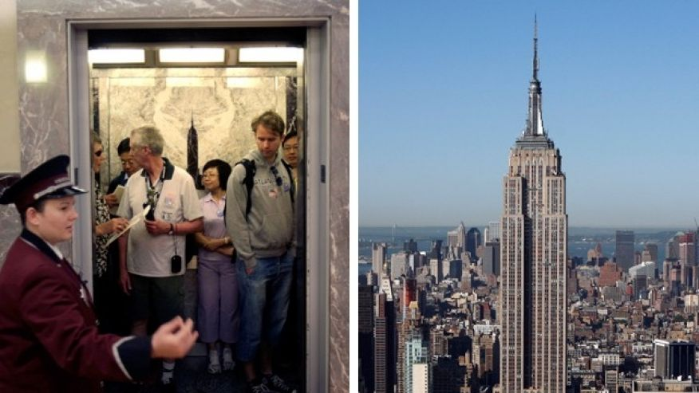
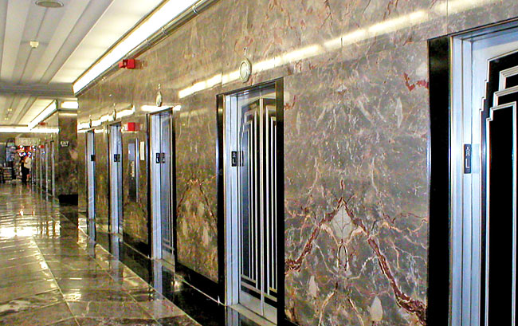
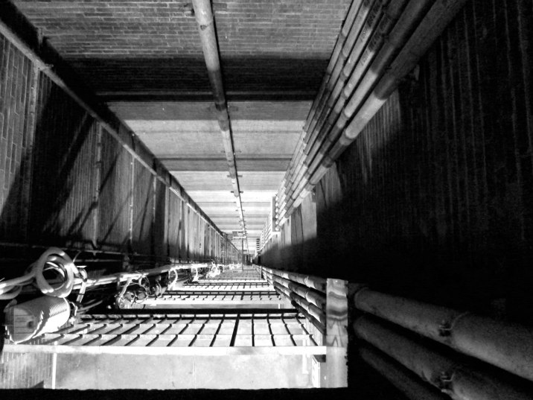
Day02 EX02 Design Process
Name: Mohamed Beshir and Kevon Chhaeles
Email: mohamed.beshir.96@gmail.com , kevoncharles123@gmail.com
You are an engineer at Research and Development (R&D) Department in an elevator company and your manager, head of R&D department asks you to develop a new elevator for empire state building. You have no experience of designing an elevator but you want to complete this challenging project. Research all information of current elevators that can be applied to this and create a plan for designing an elevator (i.e. design process).
Describe here.
1) Design, dimensions and materials needed
Type of elevator
- Gear-less Traction Elevators
- Capacity
- Speeds of the elevator with different amounts of people on it
(Try to make the new one faster than the old one)
Safety of the elevator (Must be safer than the old elevator)
- Safety in dangerous situations like a fire
- Alarms and help buttons
- Safety of died and live loads simultaneously
Amount of Energy/Electricity need for the elevator
Cost and Time to build and remove the old elevator
Maintenance

