Slide 1
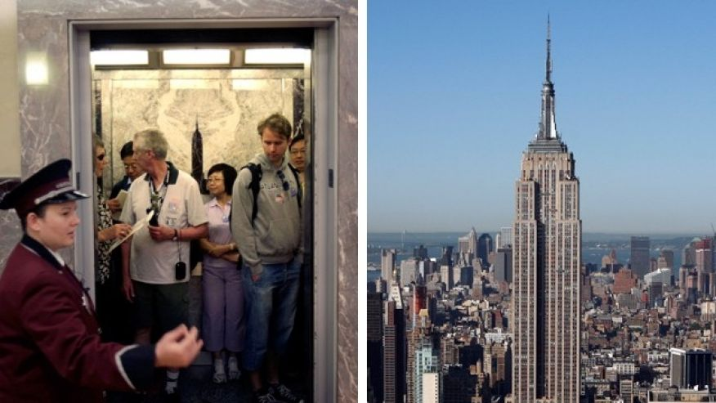
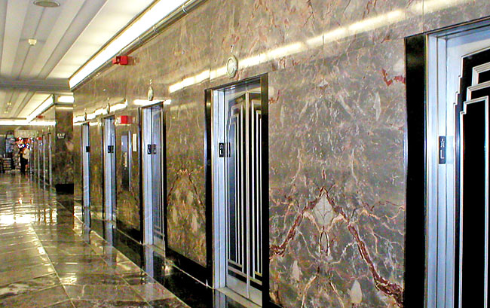
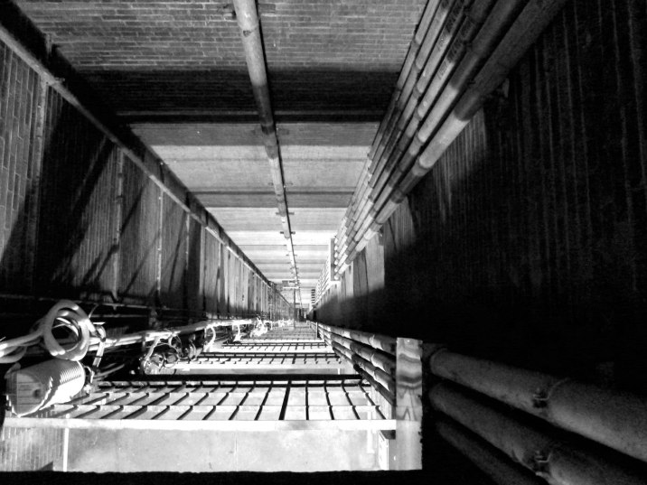
Day02 EX02 Design Process
Name: Erick Vasquez
Omar ELRaey
Email: evasquez0324@yahoo.com
elraeyomar@gmail.com
You are an engineer at Research and Development (R&D) Department in an elevator company and your manager, head of R&D department asks you to develop a new elevator for empire state building. You have no experience of designing an elevator but you want to complete this challenging project. Research all information of current elevators that can be applied to this and create a plan for designing an elevator (i.e. design process).
Describe here.
Design Process:
First gather all the information of the previous elevators.
Learn of the new specifications that are needed for the upgrade.
Learn how an elevator works.
(specifically in a high-rise structure)
Learn the average traffic flow of people in the elevators .
(The maximum capacity should be a decent amount higher than the average.)
Learn the speed needed for the elevator to make it to several floors in a high building in time.
(Do not leave people waiting too long.)
Learn of the best materials needed to best fit all specifications.
Start measuring all the dimensions needed to fit the new elevator.
Make blueprints of new elevators.
Make sure that everything is safe as possible.
Costs

Slide 2
The type of elevator we will be using is the gearless traction elevator. They are the only kind of elevators that can be used for high-rise buildings, since 1454 feet is the height of the empire state, an elevator of speed that can reach 500 feet per minute and can go as high as 2000 feet will be perfect. In the long term when it’s required to install a new electronic elevator system, it’s rarely necessary to change the elevator. The counterweight (which descends when the car elevates) is designed to match the weight of the car and half of the load, so the motor is designed to take care of the other half of the car’s load. That reduces the energy consumption of the motor.

