Slide 2
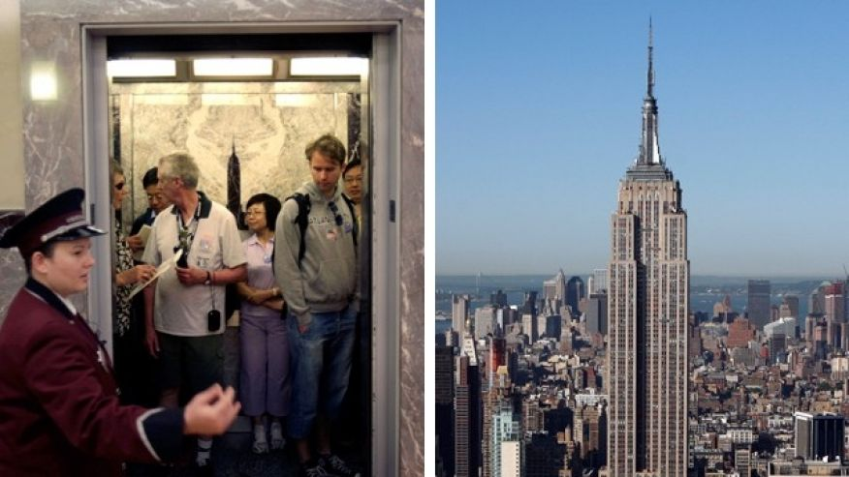
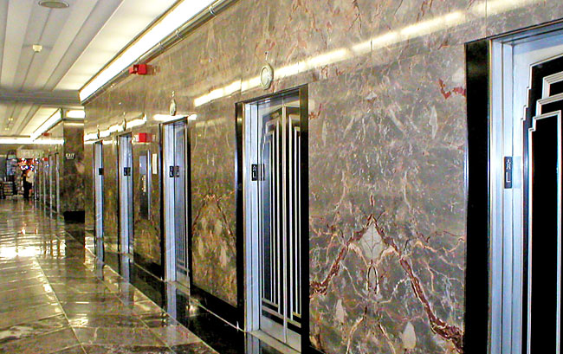
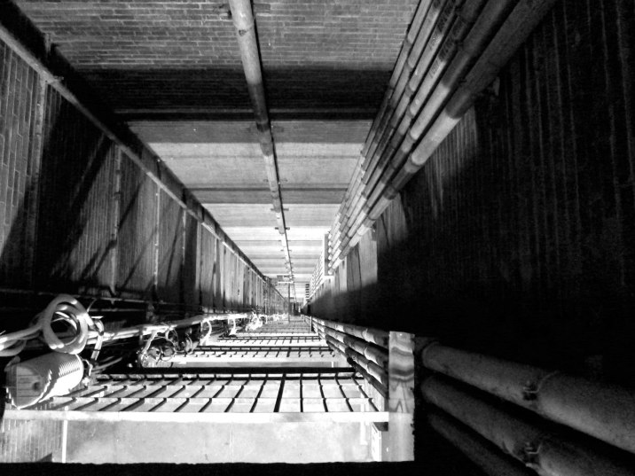
Day02 EX02 Design Process
Name:
Email:
You are an engineer at Research and Development (R&D) Department in an elevator company and your manager, head of R&D department asks you to develop a new elevator for empire state building. You have no experience of designing an elevator but you want to complete this challenging project. Research all information of current elevators that can be applied to this and create a plan for designing an elevator (i.e. design process).
Describe here:
What are clients looking for?
  Faster?
  Larger Capacity?
How does the old elevator work?
  Original Capacity
  Speed
Find improvements areas
  What are the pros and cons of the old elevator
  What can we do to improve the cons
4. Research improvements and provide multiple solutions
  Dimensions of elevators
  Research the facility we are working on
  Determine the failures of elevator, such as maximum load, design factors, probability of failure
5. Calculate improvement percentages
  How much faster is the new elevator?
  How many more people can fit?
6. Calculate cost of project and time
  Cost of materials
  Time for constructions
7. Presenting alternatives/solutions to clients
8. Deciding which improvements to make

