Slide 2
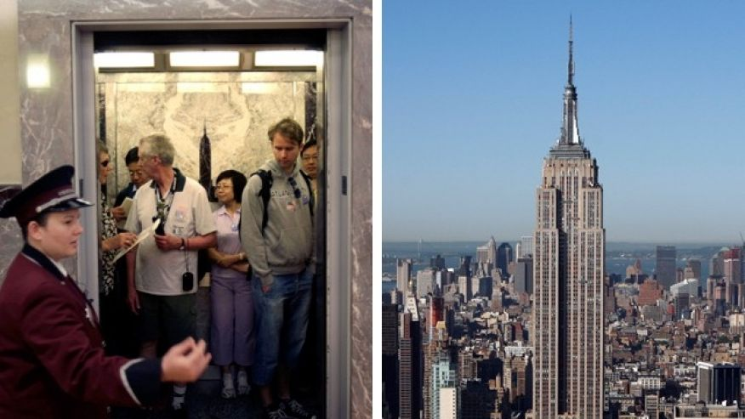
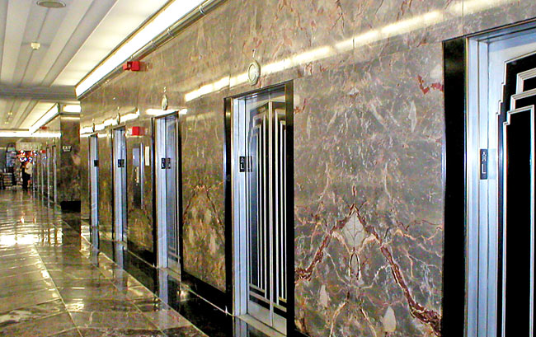
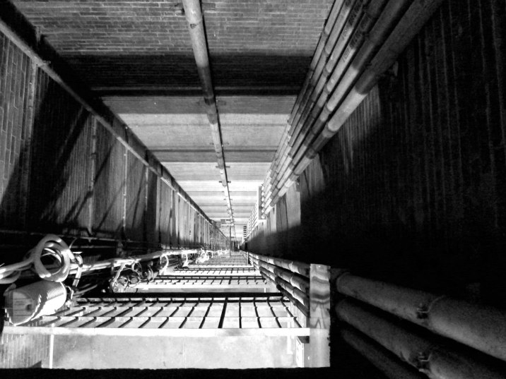
Day02 EX02 Design Process
Name:
Email:
You are an engineer at Research and Development (R&D) Department in an elevator company and your manager, head of R&D department asks you to develop a new elevator for empire state building. You have no experience of designing an elevator but you want to complete this challenging project. Research all information of current elevators that can be applied to this and create a plan for designing an elevator (i.e. design process).
Describe here.

