Slide 1
Air Quality
Content | Earth | Mars
Oxygen | 21% | .13%
Carbon Dioxide | .038% | 95.3%
Nitrogen | 78% | 2.7%
Water | 1% | .25%

Slide 2
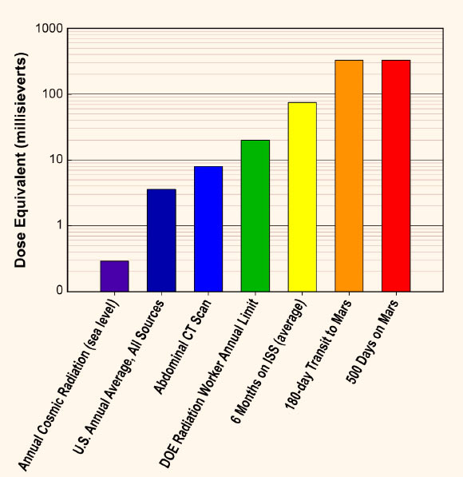
Radiation
Mars does not have a magnetosphere
Galactic cosmic rays (small)
Sun produces solar energetic particles (large)
Prolonged exposure can cause cancer or radiation poisoning
Adequate shelter and UV blocking windows

Slide 3
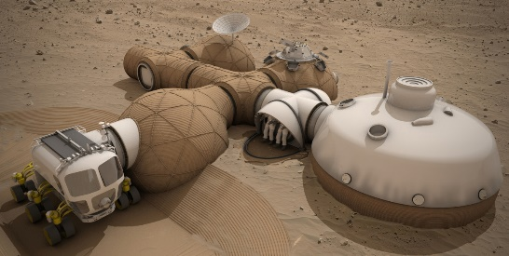
Above Ground Shelter
Similarities to Earth shelters
Easy to transport
Consists of a frame and inflatable structures.
Upgradable

Slide 4
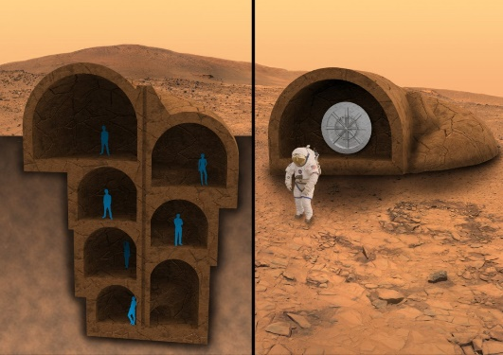
Below ground Shelter
Require a tunnel digging machine
Higher cost
Protection against Mars Environment
Require greenhouse

Slide 5
Society and community foundations
Programs to deal with isolation
Fulfil persons basic needs(self-actualization, esteems, love, safety)
System of Law
Jobs and rewards
Important to make decisions with thought to future generations.

