Slide 1
Wines of the Southern Hemisphere:
Australia, New Zealand & South Africa
New York City College of Technology, CUNY
Spring 2016
Prof. Karen Goodlad, CSW

Slide 3
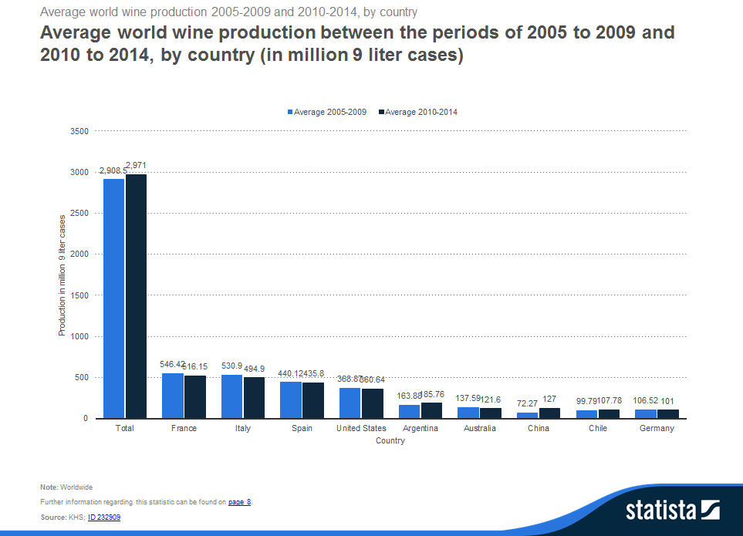
Total
2,908.5 vs. 2971.0
Million Liters
Australia
137.59 vs 121.6
Million liters
4.1% of production

Slide 4
Wines of Australia: An Overview
Harvest is March/April
Chaptalization is illegal/acids can be added
Use of technology in both the vineyard and the winery are common
Corporate Giants: Southcorp, BRL Hardy, Orland Wyndham, Beringer Blass, McGuigan Simeon

Slide 5
Australia: Wine Laws
Geographic indication
“Super-Area” Southeastern Australia
85% of grape varietal on label, region specific
85% of blend, list in order
Generic labels are not permitted
95% vintage
Show Reserve, must win an award from a competition
“Wood-Matured” aged in new or young casks
Notes:
Similar to AVA
Geographic indication controversy regarding defined areas
The importance eow wine shows is that wines show a particular style

Slide 6
Australia: Labeling Laws
Wine must come from place name (geographical indication)
Can not use other geographical information
  Ex: Bordeaux, Champagne, Napa

Slide 7
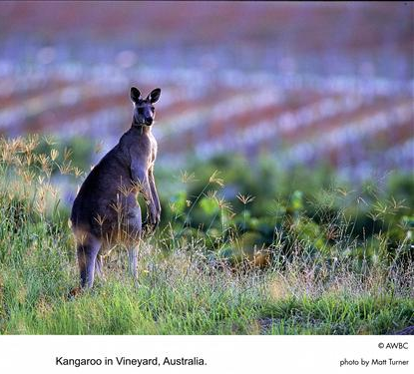
Australia: Dominant Grape Varieties
Shiraz (Syrah of Rhone Valley)
Chardonnay
Cabernet Sauvignon
Notes:
Varietal First mindset
Chard 15%
Shiraz 18% really the syrah grape
Cab. Sauv 15%

Slide 8
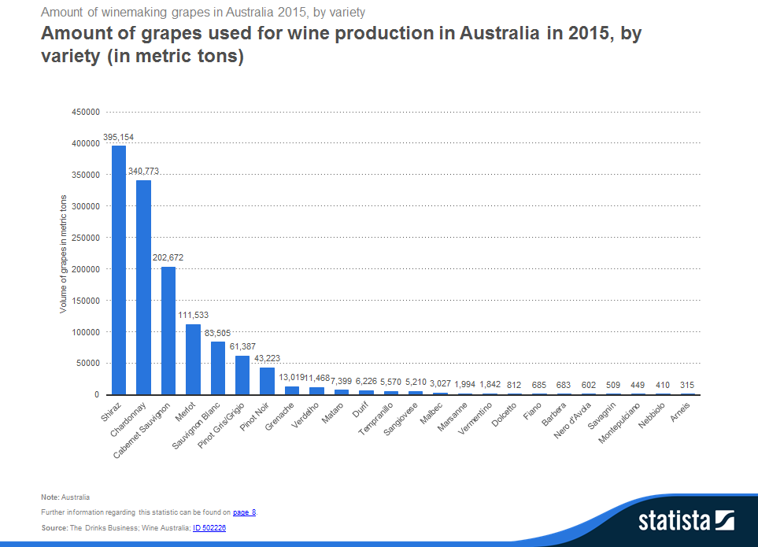
Shiraz, 395,154
Chardonnay 340,779
Cab Sauv, 202,672

Slide 9
Winegrape Production by State, 2010
Source: Wines of Australia
Notes:
Source: http://www.wineaustralia.com/australia/LinkClick.aspx?fileticket=0xGfZTMjDjA%3d&tabid=5419
Murray River and Murrumbidgee provide irrigation for Victoria and New South Wales
South Australia, No phylloxera
Victoria gets water from melting snow of The Great Dividing Range

Slide 10
Trends in the Australian Wine Industry
2005
2010
Price per bottle
  66% = $2.50-$4.99
  3% = >$10.00
Export
  700 million Lt.
  UK 17%
  USA 7%
  China, not noted
  AU 41%
Excellent Production
Price per bottle
  72% = $2.50-$4.99
  4% = >$10
Exports
  ~800 million Lt.
  UK 15%
  USA 12%
  China 3%
  AU 26%
Concerns of Draught

Slide 11
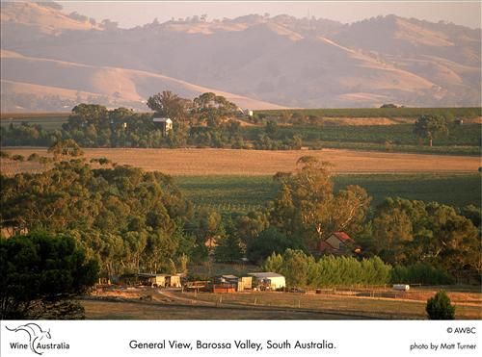
South Australia: Barossa Valley
50% of the wine in South Australia comes from Barossa Valley

Slide 12
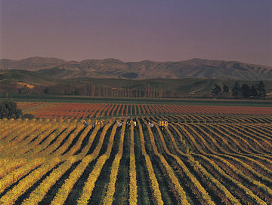
Wines of New Zealand
Two Islands Separated by Cook Strait
Maritime Climate in all Regions
Historically:
  Little Wine Consumption
  Early 1900’s Prohibition + Phylloxera
  Until the Late ’70s Restaurants Could Not Sell Wine
Today:
  High Quality Wine/Intense Competition
  33rd Largest Wine Producer/Export 20%
  Labels are Regulated to Represent 85% of Regions, Varietal and Vintage
Learn more about NZ Sauvignon Blanc: https://www.youtube.com/watch?v=SeH97pApyaw
Notes:
Videos http://www.nzwine.com/media-centre/video/

Slide 13
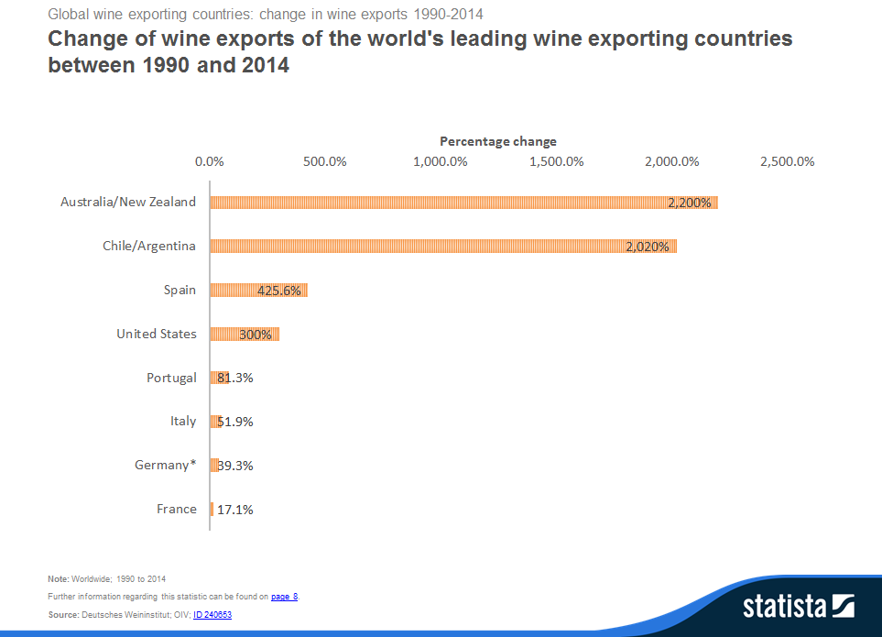
2,200%
Change between 1990 & 2014

Slide 14
Number of wineries by amount sold, April 2012

Slide 15
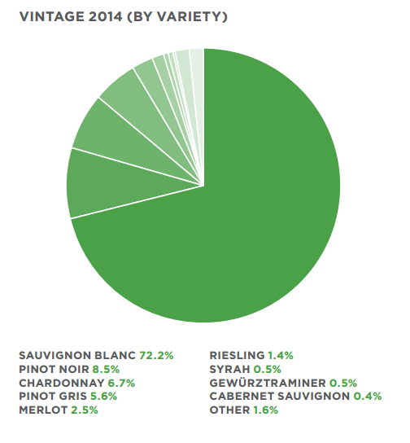

Slide 16
New Zealand Grape Varieties 2000-2009
Source: Wine of NZ Annual Report 2012

Slide 17
New Zealand:
Wine Regions and the Number of Wineries by region as of April 2012
North Island
  Auckland, 117
  Waikato, 15
  Bay of Plenty
  Hawke’s Bay, 85
  Gisborne, 25
  Wairarapa, 61
South Island
  Marlborough,150
  Canterberury, 69
  Nelson, 37
  Central Otago, 118
Dominant Grape Varieties: Chardonnay, Sauvignon Blanc, Cabernet Sauvignon, Merlot, Muscat, Chenin Blanc, Riesling, Gewurztraminer, Pinot Noir
Notes:
1990 farmers were paid to plant better varietals
Auckland: 3% of grape production, capital has become very urban
Montana, Corbans, Villa Maria: Largest prodrcers = 70% of production
Waikato and Bay of Plenty: most production of from Grapes from the south
Hawke’s Bay merlot/cab blends, cab, chard, sauv blanc less rain/more sun/better drainage than other regions most consistent and up and coming region
Gisborne 12% of total wine production chardonnay ½ total
Wairarapa stoney/silt soil, good drainage pinot noir and chardonnay
Marlborough prized sauvignon blanc 40-44% of New Zealand Production is here 40-50% is S.B.
Canterbury
Nelson

Slide 18
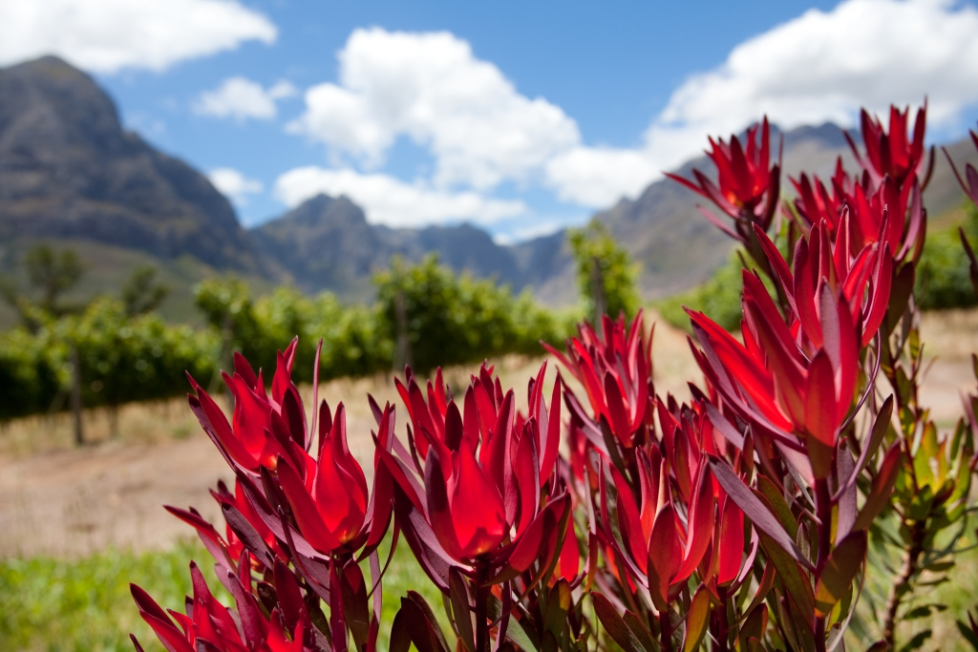
Wines of South Africa
VIP-Vine Integrity Program
replaced KWV (cooperative program)
Wine Laws
  85% Varietal on Label (as of 2005)
  100% Place of Origin (WO)
  85% From Vintage on Label
  80 Government Recognized Estate Wines
    100% Sourced From Estate and Produced on the Estate
National Flower of SA, King Protea
Notes:
1990 market opened wine started to flourish, is expected to continue to grow.
1918, KWZ- Kooperatiewe Wijnbuwers Vereniging to controlled production levels and promoted wine

Slide 19
BB-BEE/BEE Objectives
Black ownership
Black representation at managerial levels
Employment equity
Skills development preferential procurement for black-owned enterprises
Enterprise development and social/community development

Slide 20
South Africa: Label Regulation
WO = Wyn van Oorsprong (Wine of Origin)
Gebottel in
Gekweek, Gemaak en Gebottel Op
Landgoedwyn
To learn more visit Wines of South Africa
Notes:
Wyn van Oorsprong (WO) - Wine of Origin, appellation system, must be 100% form WO
Wine of Origin
Gebottel in = bottled in
Gekweek, Gemaak en Gebottel Op = Estate Bottled
Landgoedwyn - Estate wine

Slide 21
Grape Varieties, as percentage of total hectare retrieved from http://www.wosa.co.za/sa/stats_sa_industry.php
 | 1990 | 2000 | 2007
Steen/Chenin | 32 | 24 | 19
Chardonnay | 2 | 6 | 9
Sauvignon Blanc | 4 | 6 | 8
Viognier |  |  | 0,7
TOTAL WHITE | 84 | 64 | 56
Cabernet | 4 | 9 | 13
Merlot | 1 | 5 | 7
Pinotage | 2 | 7 | 6
Shiraz | 1 | 6 | 10
TOTAL RED | 16 | 36 | 44
Notes:
Steen = Chenin Blanc
Pinotage = Cinsault + Pinot Nior
Stellenbosch and Paarl- the two best wine regions for quality SA wine
Stellenbosch
Greatest # of Estates
Quality is Important
Micro Climates Vary

Slide 22
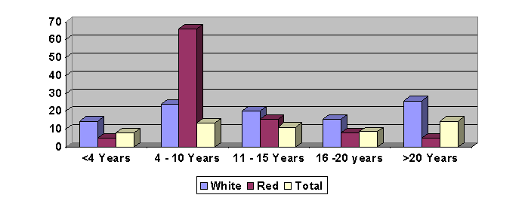
Age of SA Vines in 2007

Slide 23
Black Participation in the
Wine Industry and in Tourism
Wine industry employs 275,600 (directly and indirectly), including in wine tourism
160,000 employed from historically disadvantaged groups
30 Black-owned wine brands
Data as of June 2012
Notes:
30 Black-owned wine brands
Who are they
Who offers tourism opportunities
Participation level (land ownership, bottling, tourism_)\Supply chain

Slide 24
BEE Challenges
Legacies of Apartheid
Land ownership and disputes
Skills development
Education
Coordinating tourism
Enforcement

Slide 25
Wine Tourism and the Wine Industry in South Africa
Marketing
Bottling
Production
Agriculture
Wine Industry
Tourism Industry
Nature & wildlife
Culture & heritage
Leisure, food & wine
Service & Sales
Wine Tourism

Slide 26
Why Wine?
As of 2008, wine industry supports 2.2% of total labor force
  Employment in The Western Cape represents 8.8%
  275,606 people in 2008, up from 159, 952 in 2000
Labor costs exceed all other production costs at 40%
  58% unskilled, 29% semi-skilled and 13% skilled
Corporate structure
  Two large corporations numerous small and growing companies
20 Wine Routes
Source: South African Wine Industry Information and Systems

Slide 27
Wine Production & Sales 1996-2011
Source: South African Wine Industry Information and Systems
Notes:
Exports rose from 21% to 54% of production between 1999 and 2008
Source: Macro-economic Impact of the Wine Industry on the South African Economy
SAWIS
Average per capita consumption in SA in 2010 was 2.1 gallons http://web.up.ac.za/sitefiles/file/48/2052/Wine%20for%20Black%20Diamonds_Agrekon.pdf

Slide 28
Increase in
Red Varietal Plantings
1990-2010
16% 1990
36% 2000
44% 2007
44% 2010
Source: Wines of South Africa
Notes:
Plateau of red grape plantings, domestic and international market have reached their demand for SA wine and prices for grapes began to decrease
For the largest part of the 20th Century the industry was subject to a system of statutory
control and cooperative structure, while it was largely isolated from the international market
due to political sanctions. During this period, the South African wine industry’s main concern
became getting rid of surpluses, instead of developing market-oriented export strategies. The
market remained an abstract concept, removed from the primary producer on the farm. As a
result, the South African wine industry developed into an industry with an inward productionoriented
focus (Meissenheimer, Karaan & Vink, 2004:7).

Slide 29
Wine Exports by Country
Source: South African Wine Industry Information and Systems

Slide 30
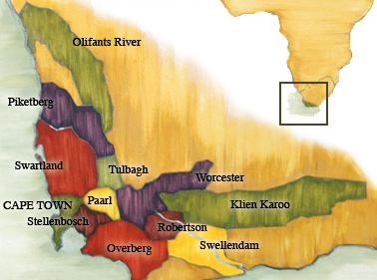
Little Karoo 3%
Orange River 5%
Worcester 9%
Olifants River10%
Breedekloof 13%
Robertson 14%
Paarl 16%
Stellenbosch17%
South African Wine Regions by Percent of Harvest 2011
Photo: South African Wine Industry Information and Systems

Slide 31
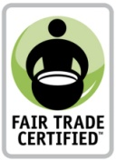

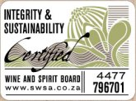
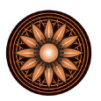
BEE Wine Industry Programs
Fair Trade Wine
Wine Industry Ethical Trade Association (WIETA)
Sustainable Wine South Africa (SWSA)
Nedbank Cape Winemakers Guild Development Trust and Protégé Programme
FUNDI
Notes:
FairTrade Wine: Fair Trade certification verifies and acknowledges the commitment of these producers to meet internationally recognized Fair Trade standards. Fair Trade Certified™
wine is grown by small farmers organized into associations or cooperatives and hired laborers employed on plantations.
Certification standards include:
• Environmental stewardship of water and soil resources
• Contracts with buyers and importers to establish long-term relationships and stability
WIETA’s mission is to improve the working conditions of employees in agriculture by:
formulating and adopting a code of good practice governing employment standards for those involved in primary growing and secondary production operations;
promoting the adoption of and adherence to the code of good practice among all producers and growers;\
educating producers and workers on the provisions of the code;
appointing independent social auditors to ensure that members of the association observe and implement the code of good practice; and
determining ways of encouraging implementation of and compliance with the code and determining measures to be taken in the case of non-compliance with the code
--79 cellars are certified, launching a campaign to look at the entire supply chain (small number
Goal is 60% my 2014
SWAS: Mostly focused on the environment but adds “Health and safety of workers”
60% in 2010, 85% in 2011 goal is 100%
Cape WineMakers: Developed in 1999, focused on education and development of winemakers form previously disadvmantaged communities
FUNDI an effort to identify and educate service professionals of previously under represented communities.
Find that Distell, KWV follow these standards and also support their own initiatives
Su Birch, CEO of Wines of South Africa and Lynne Sherriff MW, who chairs the Institute of Masters of Wine, based in London have been shortlisted by UK-based Wine Intelligence for its line-up of the world's most influential figures in wine over the past decade.

