Slide 1
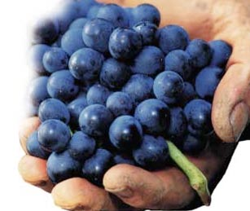

Prof. Karen Goodlad, CSW
Wine & Beverage Management
HMGT 2402
Spring 2016
Viticulture & Vinification

Slide 2
Overview
Attendance
Questions about Syllabus
Questions about OpenLab
Review of Assignments
Lecture Topci
  Viticulture and Vinification
Notes:
Syllabus Speed Dating – Karen Eifler, an education professor at the University of Portland, designed this activity. Two rows of chairs face each other (multiple rows of two can be used in larger classes).
Students sit across from each other, each with a copy of the syllabus that they’ve briefly reviewed. Eifler asks two questions: one about something in the syllabus and one of a more personal nature. The pair has a short period of time to answer both questions. Eifler checks to make sure the syllabus question has been answered correctly.
Then students in one of the rows move down one seat and Eifler asks the new pair two different questions. Not only does this activity get students acquainted with each other, it’s a great way to get them reading the syllabus and finding out for themselves what they need to know about the course. - See more at: http://www.facultyfocus.com/articles/teaching-professor-blog/first-day-of-class-activities-that-create-a-climate-for-learning/#sthash.R0MHLnQw.dpuf

Slide 3
Factors Affecting the Taste of Wine
Grape Variety
Soil
Physical Location
Climate
Viticulture
Vinification
Luck of the Year

Slide 4
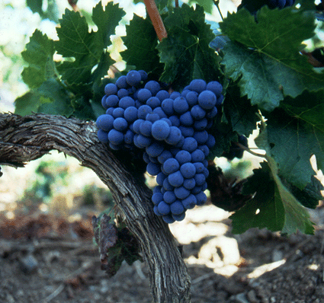
The Grape
The most important factor
influencing the taste of wine.
Genus
Species
Variety
Notes:
Genus: Vitis (a class of things that have common characteristics and that can be divided into subordinate kinds.)
Species: Scientific grouping (vines) genetically similar and can reproduce (about 60 including Vinifera and labrusca)
Variety: subspecies of grape
Clone: Vines descended from a single plant (asexual) exact replica
Cross: two different subspecies reproducing

Slide 5
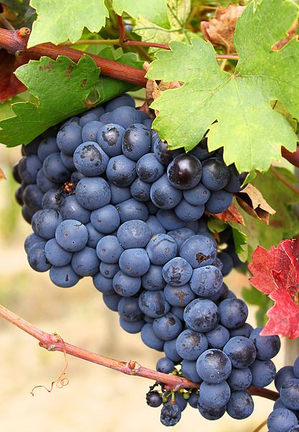
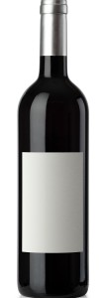
The Grape
Grape
Skin
(Pigment, Tannin, Yeast)
Water
Sugar
Acids and minerals
Seed
Water 80-85%
Alcohol 9-17%
Acids 0.4-1%
Sugar 0.1-1%
Wine

Slide 6
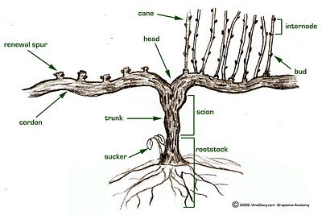
The Grape Vine
Grape bunch
Leaves
Cane
Cordon
Trunk
Root

Slide 7
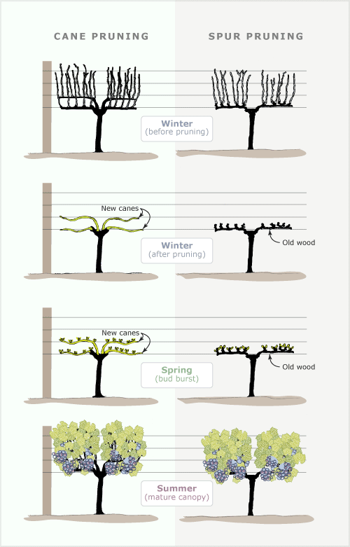

Slide 8
The Annual Life Cycle of a Vine
Dormant
Bud-break → Leaf and Shoot Growth
Flowering → Veraison/Ripening
Maturity
Harvest
Dormancy

Slide 9
The Soil
Examples:
  Chalk, Sandy, Gavel, Flint, Limestone, Sandstone
General size (small to large):
  Clay
  Silt
  Sand
  Rock and stone
General Characteristics
  Heat retention, Fertility, minerality, drainage
Notes:
Heat retention, Fertility, minerality, drainage

Slide 10
Physical Location
Latitude
Elevation
Aspect
Proximity to water

Slide 11
The Climate & The Weather
Continental vs. Maritime
Average temperature over a year
Likeliness of Fog During a Season
Average % of Sunlight
Actual Temperature
Actual Rain Fall
Actual Fog/Cloud Cover/Sunlight

Slide 12
Viticulture
The science of growing grapes
Vineyard Management
  Pruning, Trellising, Canopy, Irrigation, Harvest…
  Life Cycle of The Vine
  Decisions of Environmental Stewardship
    Conventional, Sustainable, Organic, Biodynamic
      Mike Benziger of Benziger Winery Discusses Organic and Biodynamic Viticulture

Slide 13
Oenology:
The scientific study of wine & winemaking
Vinification: the process of making wine
  Harvest
  Sorting
  Fermentation
    Yeast stains, oak vs. stainless steal, arrest fermentation
  Blending
    Mixing of various grape varieties of different lots
  Fining & Filtering
  Aging
    On wood, in bottle, how long
Notes:
What type of oak, American (more aromatic) (kiln dried) vs. French (more tannic) (air-dried)
Size of oak barrel

Slide 14
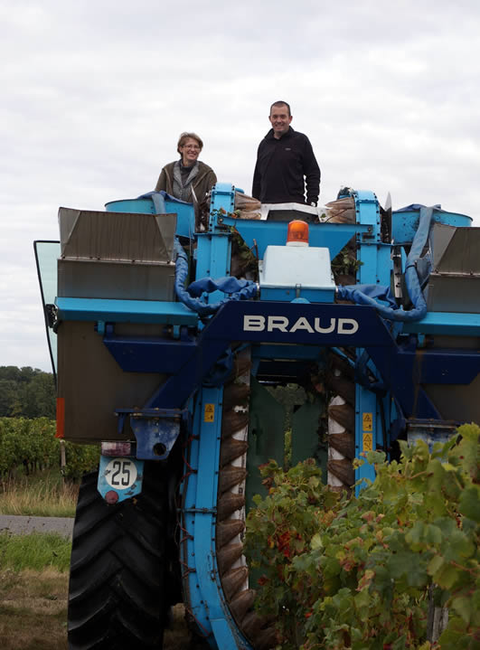
Mechanical Grape Harvest

Slide 15
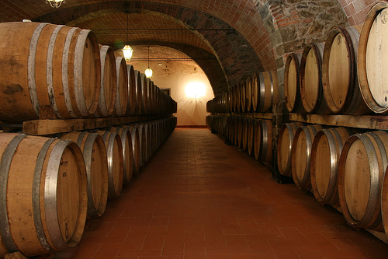
Wine Casks

Slide 16
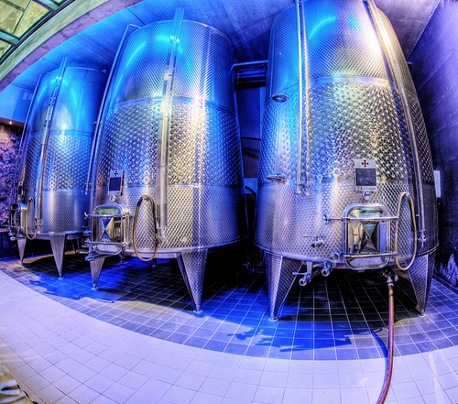
Wine Casks

Slide 17
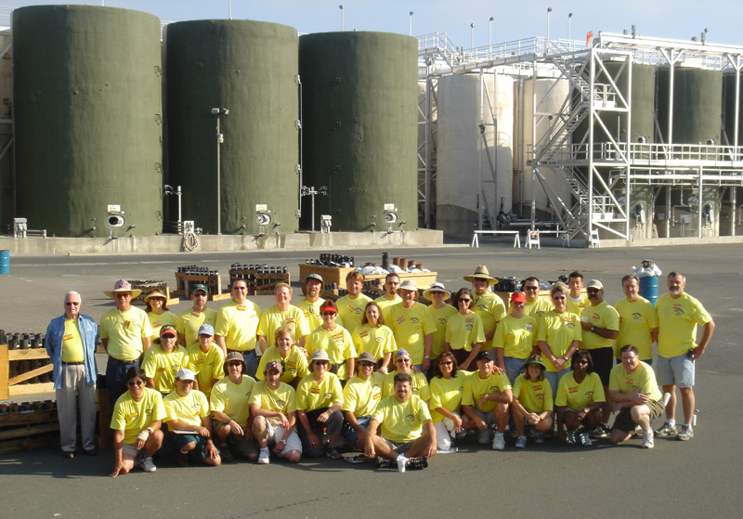
Gallo Wine Production Facility

Slide 18
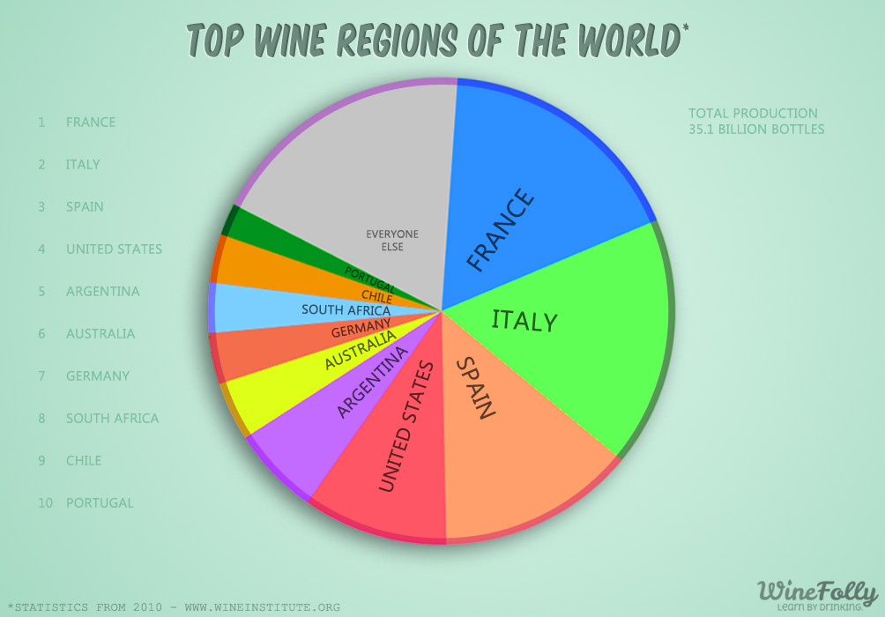
Image credit: http://winefolly.com/update/top-wine-regions-of-the-world/

Slide 19
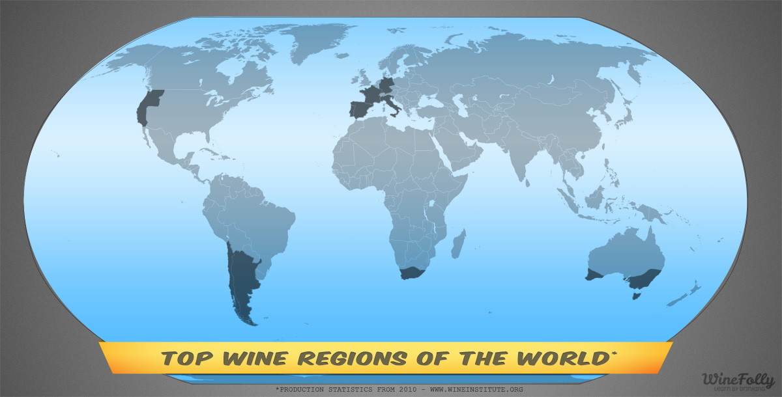
Image credit: http://winefolly.com/update/top-wine-regions-of-the-world/
Notes:
Temperate Zones
(both maritime and continental)
OLD WORLD:
France, Italy, Spain, Germany, Portugal, Switzerland, Austria, Hungary, Greece
NEW WORLD:
US, California, Chile, Argentina, Uruguay, South Africa, Australia, New Zealand

Slide 20
Common Regulations & Laws
Appellations
Grape Variety
Minimum Alcohol
Maximum Yield
Methods of Viticulture
Methods of Vinification
Notes:
Appellations: regions: zones: states:

Slide 21
Short List of Problems
Grape Vines Face
Phylloxera
Glassy Winged Sharpshooter

Slide 22
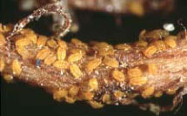
What is Phylloxera?
Grape Louse that feeds on the roots of vitis vinifera and injects its waste into the roots
Thought to be Resistant to Rootstock AxR1
Did it Destroyed Wine Industry????
  70% of French Vineyards in 1860’s-1870’s
  New Zealand in 1970’s
  Napa Valley in 1983
  West Coast of US by 1995
Various vitis labrusca root stocks now used

Slide 23

Terms to Know
Viticulture
Oenology (alt. spelling Enology)
Wine Maker, Vitner, Vineyard Manager, Grape Grower
Botrytis Cinerea (Noble Rot)
Must
Chaptalization
Acidification
Brix and Beaume
Carbonic Maceration
Fining and Filtration
Racking
Malolactic Fermentation
Vintage
Phylloxera
Appellation
Yield
Formula for fermentation
Cap, punching down the cap
Barrique
Vitis vinifera/labrusca
Grafting
Root stock/bud wood
Notes:
Botrytis Cinerea: Noble rot, mold growth that punctures the skin, water drains out
Must: the juice and liquidy pulp produced by crushing or pressing grapes before fermentation
Chaptalization: adding cane or beet sugar to wine must before or during fermentation in the effort to increase the sugar and hence alc.
Brix: a way to measure sugar
Carbonic Maceration: uncrushed grapes placed in a closed tank weight crushes grapes, heat from Fermentation creates fermentation in uncrushed grapes, light “juicy” wine
Barrique = 60 Gallons, 9 liters just over 6 cases

Slide 24
Until we meet again
Read in order to prepare for an exam on White Wines of France
Join the OpenLab and our course site.

