Slide 1
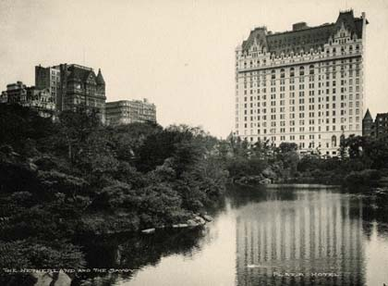
Chapter 2 & 3: The Hotel Business
Prof. Karen Goodlad
Fall 2014

Slide 2
Advisement
College Catalog & Student Handbook
Advisement Worksheet
Student
Faculty
Degree Audit

Slide 3
Class Objectives
Identify the scope of the hospitality and tourism industry.
Explore the roles and responsibilities of key executives and department heads in the hospitality industry.
Differentiate hotel classifications.

Slide 4
NY Times, 36 Hours in…
36 Hours on the Brooklyn Water Front

Slide 5
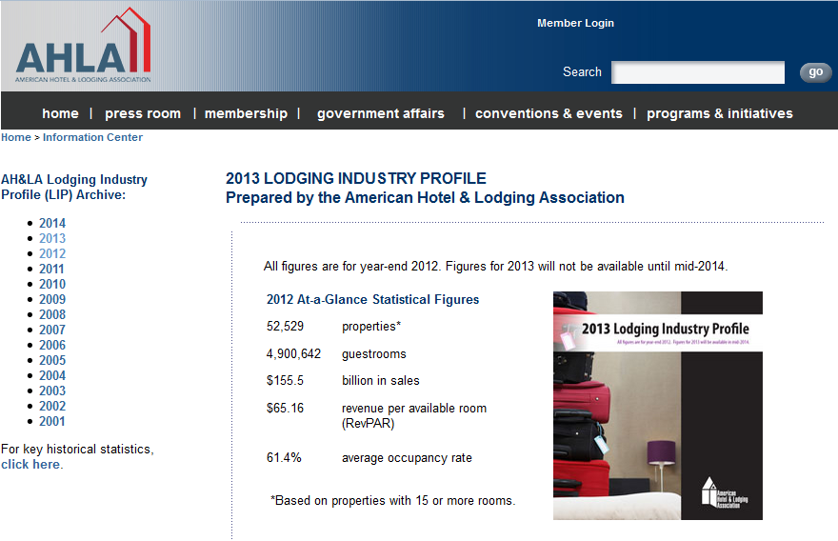
Source: American Hotel and Lodging Association http://www.ahla.com/content.aspx?id=35603
Notes:
What does this information mean to you?

Slide 6
Hotel Development & Ownership
Franchising
Pay to use the brand/name/logo/management practices/amenities of a proven organization
Owned and operated indipendantly
Referral
Associations
Management Contracts
Independent hotels Refer their clients to each other and share a central reservation system (CRS)Example: Leading Hotels of the World
Independent hoteliers or bankers will utilize the management team of a hotel brand to manage the hotel site.

Slide 7
Classification of Hotels
AAA Diamond Award:
  Inspecting and rating the nation’s hotels since 1977
  Less than 2% are 5 Diamond
  AAA uses descriptive criteria to evaluate the hotels that it rates annually in the United States, Canada, Mexico, and the Caribbean

Slide 8
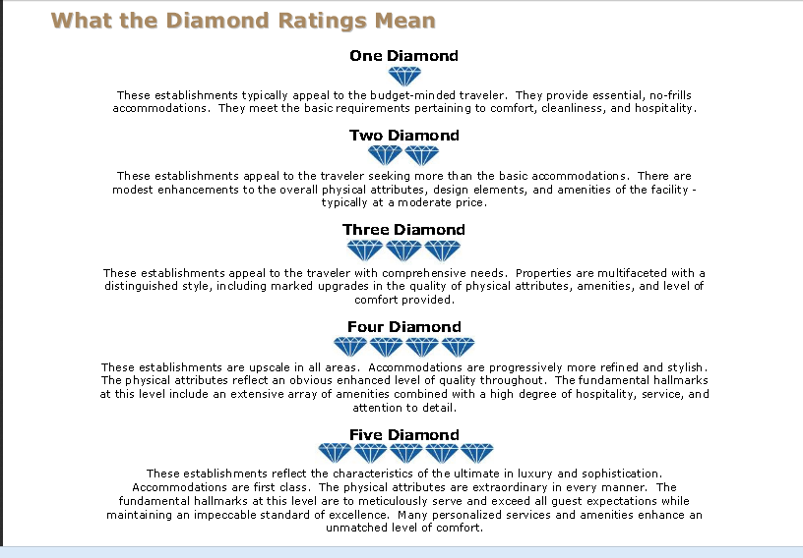

Slide 9
Types and Locations of Hotels
City center: Meets the needs of the traveling public for business or leisure reasons
Resort: Inclusive and diversified in accommodations
Airport: Guest mix consists of business, group, and leisure travelers; generally in the 200- to 600-room size and are full-service
Freeway hotel and motel: A convenient place to stay, reasonably priced, and with few frills
Casino: Coming into the financial mainstream; casinos make more money from the gaming than from the rooms
Convention: Provides facilities and meets the needs of groups attending and holding conventions

Slide 10
Types and Locations of Hotels
Full-Service: Offers a wide range of facilities, services, and amenities
Economy/Budget: Reasonably sized and furnished rooms without the frills
Boutique: Unique architecture, style, decor, and smaller in size
Extended-Stay: Majority of guests are long term
All-Suite Extended-Stay: Additional space in the form of a lounge and possibly kitchenette
Condotels: Combination of hotel and condominium
Mixed-Use: Hotel that may also have residences
Bed & Breakfast: Accommodations with the owner, who lives on the premises or nearby, providing a clean, attractive accommodation and breakfast

Slide 11
Hotels By Price Segment
Economy ($49-$69), ~15% of total rooms in US
  No frills, limited F&B and meeting space
Mid-Price ($69-$125)
  Limited F&B, introduction to technology in room
Upscale ($125-$225)
  Offer range of services, various F&B options available
Luxury ($150-$450)
  Focus on service & amenities, spacious accommodations, latest technology available, spas, in room dining…
All-Suites ($109-225)
  Kitchenette, long term stay, business traveler

Slide 12
Executive Committee Members
General Manager
Dir. of HR
Dir. of F&B
Dir. of Rooms Division
Director of Marketing & Sales
Dir. of Engineering
Dir. of Accounting

Slide 13
Expand Your Knowledge
Lodging trends for 2013: http://www.hospitalitynet.org/news/4058659.html
Sustainable Lodging trends for 2013 http://www.hotelnewsnow.com/Article/7958/5-trends-to-green-your-hotel
“Little Rooms, Big Profit” NYTimes
American Hotel and Lodging Association
HSMAI
The Plaza Hotel
  Company Website

Slide 14
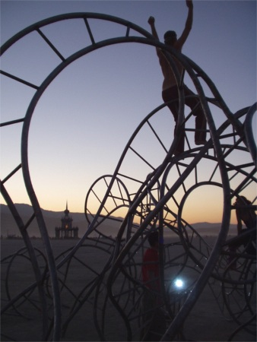
What do you think…
The path to career success is a jungle gym, not a ladder.

Slide 15
In Class Activity:
Thinking Environmental Sustainability
Read the handout
In groups identified by their executive committee membership, select titles for each group member and record their names/title
Discuss ways that your department can contribute to a more environmentally sustainable workplace
Determine your contribution
Report out to the class
Discuss outcomes as a class

Slide 16
Until We Meet Again
Lecture topic: Front Office Operations and Rooms Division, Class will meet at the Downtown Marriott http://www.marriott.com/hotels/hotel-information/travel/nycws-new-york-marriott-downtown/
Dress: Business suit, conservative hair and jewelry, welcoming smile
Homework: Review OpenLab

