Slide 1
Perspectives in
Hospitality Management
Prof. Karen Goodlad
Fall 2015
Introduction

Slide 2
Introduction
Prof. Bio
Student Introductions
Syllabus Review
Tour of Department
Lecture
OpenLab

Slide 3

So What is Hospitality?

Slide 4
“It's how you make your customers feel while using your products that distinguishes you.” Danny Meyer
At The Ritz-Carlton, hospitality is about providing legendary service to our guests, members and residents while embracing the culture that is The Ritz-Carlton.
"Food is our common ground, a universal experience." James Beard

Slide 5
Specific Areas we will Explore
Tourism
Hotels and Lodging
Food and Beverage
  Restaurants, Food Service (Food Trucks), Various Beverage Options
Accounting
Human Resources
Marketing
Event & Conference Planning
Recreation and Theme Parks

Slide 6
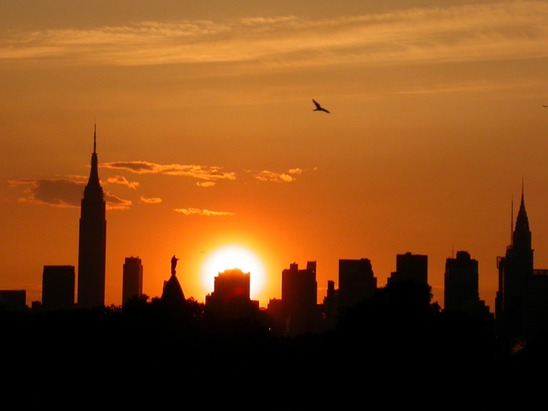
Exploring Your World:
A Moment of Truth

Slide 7
OpenLab
Our electronic classroom
Review and submit assignments
Ask questions
Start blogs
Find club information
Learn about other courses at City Tech
Chat with classmates and others on OpenLab

Slide 8
OpenLab
Create OpenLab Account and ePorfolio
  Due Before Class on Thursday, September 4
Upload Electronic Profile assignment
  Profile Due Before Class on Thursday, September 4
  Comments on Peer Profiles Due Before Class on Tuesday, September 9
  Update Profile to ePortfolio upon approval
Explore site
  Blogging, commenting, assignment submissions, editing, connecting with classmates

Slide 9
Before We Meet Again…
Read NYTimes Travel Section
Read Chapter 1in Introduction to Hospitality , 6th edition
Complete OpenLab Assignment for eProfile
Read Various BIO’s of industry leaders introduced in Introduction to Hospitality , 6th edition
Explore City Tech’s Library Website

