Slide 1
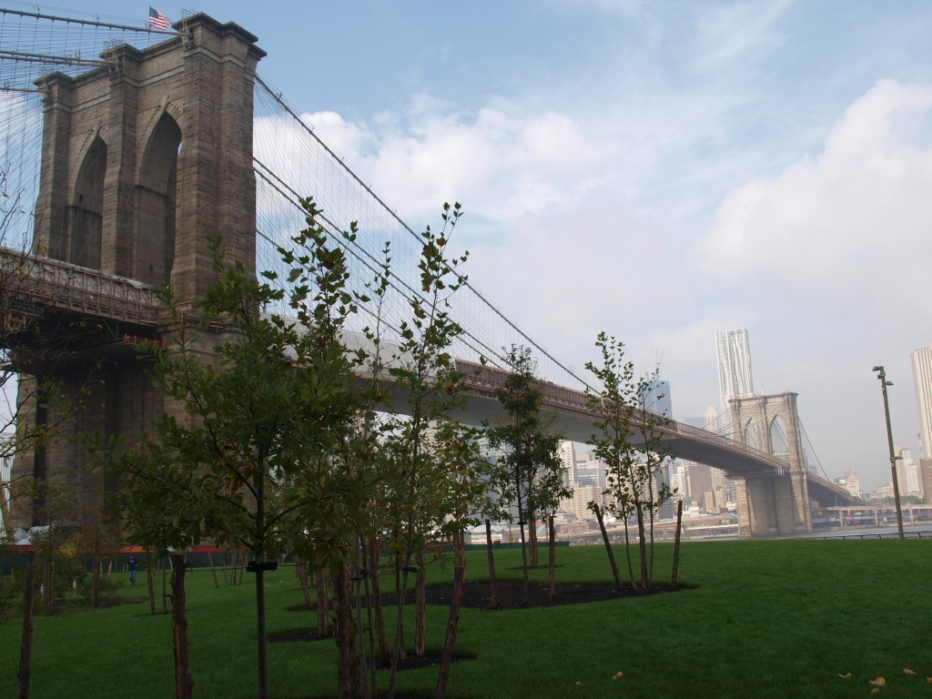
Living Lab General Education Seminar
Karen Goodlad,
Director, Living Lab General Education Seminar
Assistant Professor, Hospitality Management
February 10, 2017
Notes:
NOTE:
To change the image on this slide, select the picture and delete it. Then click the Pictures icon in the placeholder to insert your own image.

Slide 2
What is General Education?

Slide 3
Overview
Discussion of General Education (in general)
The Living Lab
  High Impact Educational Practices
  The OpenLab
  Assessment
  Place-based Learning
Ethical Reasoning
L4

Slide 4
Revitalizing General Education at a 21st Century College of Technology

Slide 5
Revitalizing General Education at a 21st Century College of Technology
High Impact Educational Practices
March 10
OpenLab
March 17
February 10
Build a Culture of Assessment
Place-based Learning on the Brooklyn Waterfront
March 31

Slide 6
High-impact educational practices:
What they are, who has access to them, and why they matter.

Slide 7
Which one of Kuh’s HIEP Would You use to support the General Education Learning Outcome of ethical reasoning?

Slide 8
Teaching for ethical reasoning in liberal education.
Sternberg, R. J.

Slide 9
Ethical Reasoning Activity

Slide 10
Living Lab Learning Library (L4)
Anna Matthews, Assistant Professor, Dental Hygiene
Laura Westengard, Assistant Professor, English
Directors of the L4

Slide 11
Next Steps and Reflection

